Slide 1
terraform
INFRASTRUCTURE AS CODE.

Slide 2
What is terraform ?
Terraform is an open-source IaC software tool that provides a consistent command line interface (CLI) workflow to manage hundreds of cloud services

Slide 3
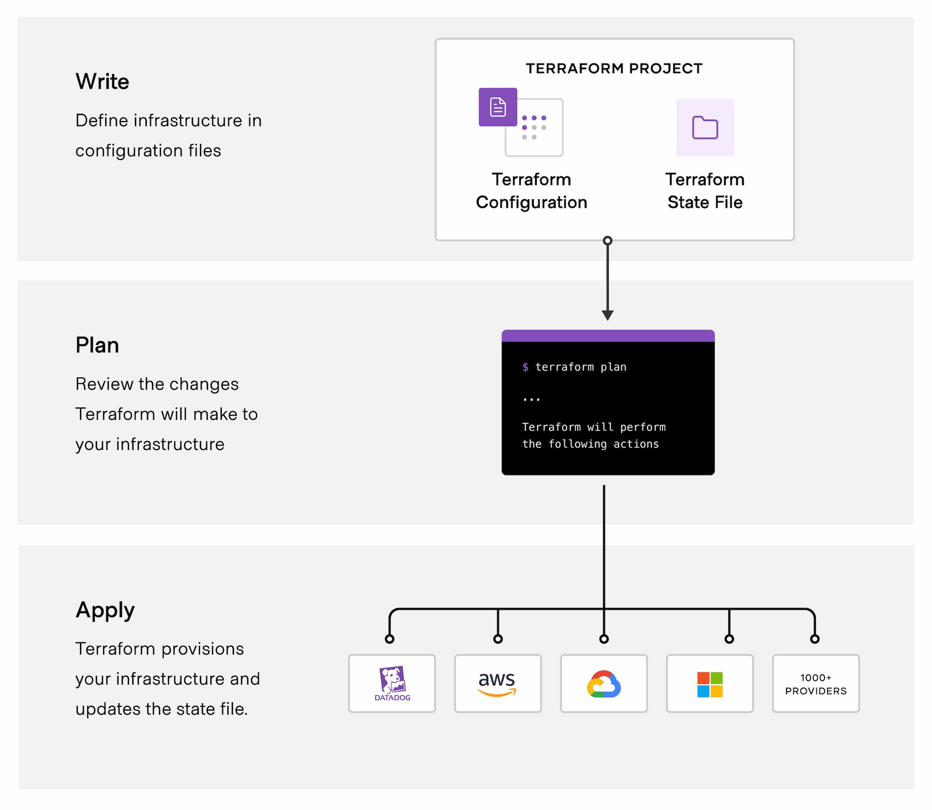
Terraform Workflow

Slide 4
Terraform Advantages :
Multi-cloud support: Terraform is cloud-agnostic and can be used to provision infrastructure on a variety of cloud providers including AWS Azure Google Cloud and more.
Version control: Terraform allows infrastructure to be managed in the same way as code. This means you can store your infrastructure code in version control and track changes over time just like you would with application code.
Scalability: With Terraform infrastructure can be easily scaled up or down to meet changing demands.
Cost savings: By automating infrastructure provisioning Terraform can help teams avoid costly manual processes and potential errors that can lead to downtime lost revenue and other expenses.

Slide 5
What is three-tier architecture ?
Three-tier architecture is a well-established software application architecture that organizes applications into three logical and physical computing tiers: the presentation tier, or user interface; the application tier, where data is processed; and the data tier, where the data associated with the application is stored and managed.

Slide 6
TERRAFORM IMPORTANT COMMANDS :
Terraform init: It starts the working directory consisting of Terraform configuration files, that can be checked from source control.
Terraform version: It tells which Terraform version is currently installed on your system.
Terraform fmt: It rewrites the terraform configuration files into canonical style and format
Terraform destroy: It allows you to destroy all of the remote objects managed by a particular configuration of terraforming.
Terraform validate: With this command, you can check whether a configuration is internally consistent and syntactically valid.
Terraform apply: Apply all the actions proposed under Terraform plan.

Slide 7
Terraform language
The main purpose of the terraform language is declaring resource which present infrastructure object
Syntax :
#creating a VPC for project
resource “aws_vpc” “MY_VPC”
cidr_block=“10.0.0.0/16”
}

Slide 8
BLOCKS
<BLOCK TYPE> "<BLOCK LABEL1>" "<BLOCK LABEL2>" {
# Block body
<IDENTIFIER> = <EXPRESSION> # Argument
}
BLOCK TYPE = RESOURCES
BLOCK LABEL1 = AWS VPC
BLOCK LABEL 2 = USER IDENTIFICATION
IDENTIFIER = AMI, CIDR BLOCK

Slide 9
TASKS
Create a vpc
Create Subnets
Create an Internet Gateway and NAT gateway
Create Route table
Configure Security Group
Create EC2 instances
Create Load Balance and RDS

Slide 10
EC2 – Instance Creation :
First of all we have create a file with .tf extension. For example ec2.tf
resource "aws_instance" "pub_instance" {
ami = "ami-012b9156f755804f5"
instance_type = "t2.micro"
count = 1
key_name = "testkey"
vpc_security_group_ids =["${aws_security_group.web_sg.id}"]
subnet_id = "${aws_subnet.pub-subnet1.id}"
associate_public_ip_address = true
user_data = “${file("data.sh")}”
tags = {
Name = “pub-instance“
}
}

Slide 11
Thank you .
One and all

