Slide 1
Understanding Deep Learning on stock data
DKE| Fakultät für Informatik
Mathematics and Numeric of Deep Neural Networks for Physical Simulations
Otto-von-Guericke-Universität Magdeburg
Presented by:
Saiyudh Mannan - 225982
Gracy Joseph - 225968

Slide 2
Recent Works & Study
Recent works:
Combining the desirable aspects of RNN and CNN architectures
Convolutional LSTM¹, Quasi-RNN model⁶, dilated RNN⁷
Multiple thorough evaluations of RNN architectures on representative sequence modeling tasks⁸
Current paper:
Focussed on a comparison of generic convolutional (TCN)² and recurrent architectures (LSTM and GRU)²

Slide 3
Time series Sequential model
Deep learning models that input or output sequences of data
Time series observation from the sequence of discrete-time of successive intervals
Seq models have to deal with input and output sequences of different lengths
Applications of Sequence Models
1. Stock Data Analysis
2. Trajectories of physical systems
3. Forecasting

Slide 4
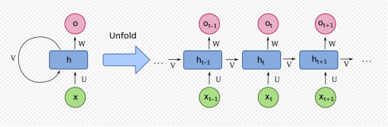
Recurrent Neural Network
- variant of the conventional feedforward artificial neural networks
- work for time series data or data that involves sequences
- has theoretical ability to retain information through sequences of unlimited length
- RNNs have feedback in the hidden layer
- during the next iteration, the data from the previous layer is also included in the computation
Source: https://commons.wikimedia.org/wiki/File:Recurrent_neural_network_unfold.svg

Slide 5
Recurrent Neural Network on sequential data²
specialized for sequential data
used in the field of Natural Language Processing
used in time series predictions
takes historical information for computation
backpropagation is done at each point in time
LSTM (Long Short-Term Memory)⁹
to overcome vanishing gradient problem
can capture long-range dependencies
gating mechanism allowed the network to learn the conditions
e.g.: Apple’s Siri and Google’s voice search
How does LSTM work:
a cell state is passed to the next time step
- the data from the previous layer is also included in the omputation

Slide 6
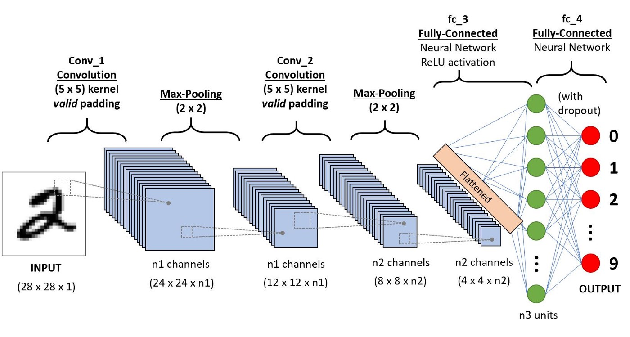
Convolutional Neural Network
- formed by a stack of distinct layers that transform the input volume into an output volume
- applied to analyze visual imagery
- connectivity pattern between neurons resembles the organization of the animal visual cortex
- use convolution in place of general matrix multiplication in at least one of their layers
Source: https://www.analyticsvidhya.com/blog/2020/10/what-is-the-convolutional-neural-network-architecture/

Slide 7
Convolutional Network on sequential data²
- can reach state-of-the-art accuracy
- has a backpropagation path different from the temporal direction of the sequence
TCN
- memory characteristics: Longer memory than LSTM
- more accuracy
- comparatively easier to train
- the TCN is causal (no information leakage from the future to the past)
- can map any sequence to an output sequence of the same length

Slide 8
Background
Paper:
An Empirical Evaluation of Generic Convolutional and Recurrent Networks for Sequence Modeling²
(Authors: Shaojie Bai, J. Zico Kolter, Vladlen Koltun)
- Sequence modeling focusses on recurrent networks
- Conducted a systematic evaluation of generic convolutional and recurrent architectures for sequence modeling
- Architecture temporal convolutional network (TCN) was compared to LSTMs and GRUs
- Model evaluation across a broad range of standard tasks

Slide 9
Background
Paper:
An Empirical Evaluation of Generic Convolutional and Recurrent Networks for Sequence Modeling
CONVOLUTIONAL ARCHITECTURES
Outperforms
In Sequence Modelling
RECURRENT
NETWORKS
- gating mechanisms or skip connections were not added to either TCNs or RNNs.
- standard regularizations used

Slide 10
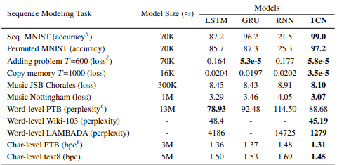
Synopsis
TCN architecture with minimal tuning outperforms canonical recurrent architectures

Slide 11
Which architecture should one use?
 | RNNs LSTM and GRU | CNNs TCN
Parallelism | sequentially | long input sequence can be processed as a whole
Flexible receptive field size | not as easier as TCN to adapt to different domains | better control of the model’s memory size
Stable gradients | major issue of vanishing gradients | avoids the problem of exploding/vanishing gradients
Low memory requirement for training | can use up a lot of memory to store the partial results for their multiple cell gates | less memory usage
Variable length inputs | sequential data of arbitrary length | take in inputs of arbitrary lengths

Slide 12
Dataset
CNNpred: CNN-based stock market prediction using a diverse set of variables Data Set[⁵]
Features:
S&P 500, NASDAQ Composite, Dow Jones Industrial Average, RUSSELL 2000, and NYSE
Data Set Characteristics: | Sequential, Time-Series
Number of Instances: | 8915
Number of Attributes: | 82

Slide 13
Preprocessing and Design choices
Missing values:
37.5% of instances in dataset had missing values
forward fill
zero fill
Feature Scaling:
Normalized 82 features
Standardized the features following Hoseinzade and Haratizadeh ³,⁴
Feature Set:
We considered three different feature sets: a full feature set with 82 total features
a reduced PCA feature set comprising 30 principal components explaining 90.7% variance of the original dataset

Slide 14
Preprocessing and Design choices [continued]
Data Split:
Cross Validation 80:10:10 [Train: Test: Validation]
[1395: 173 : 156 instances]
For 2D ,3D CNN we did not shuffle but aggregated the whole date to avoid cheating(using future data or same data from different markets to estimate predictions in another dataset or market.)
Evaluation metrics:
Accuracy
macro-average F1

Slide 15
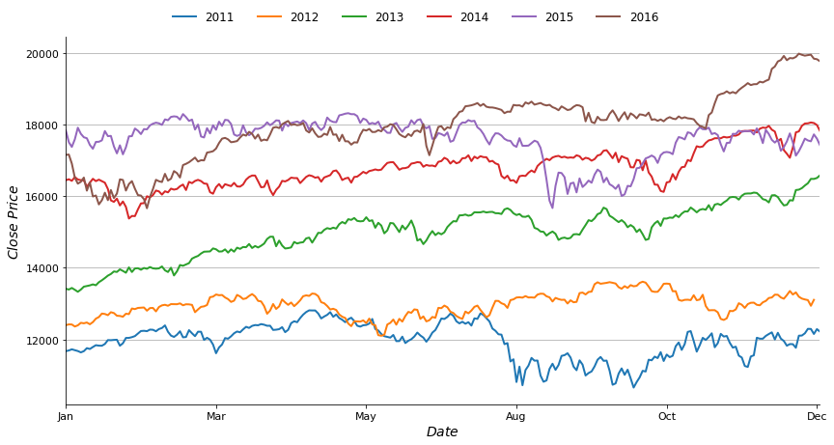
Time series data exploration based on close price vs year[DJI]

Slide 16
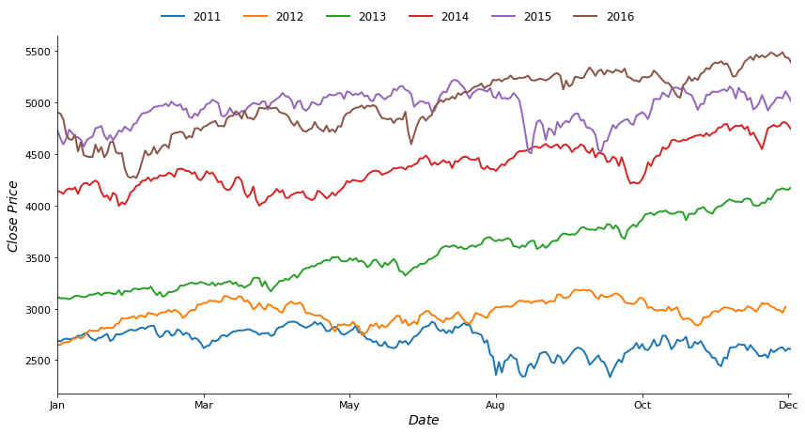
Time series data exploration based on close price vs year[NASDAQ]

Slide 17
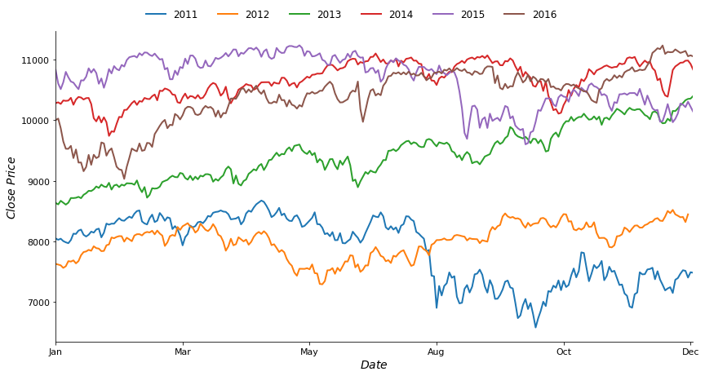
Time series data exploration based on close price vs year[NYSE]

Slide 18
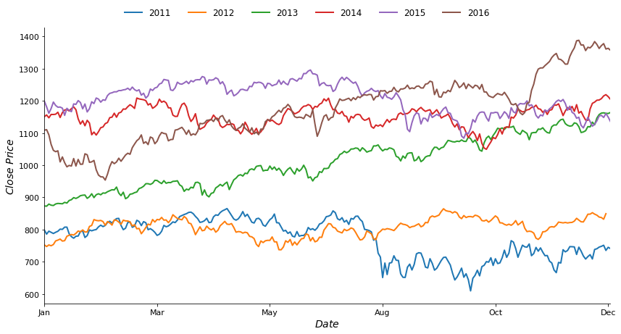
Time series data exploration based on close price vs year[Russel]

Slide 19
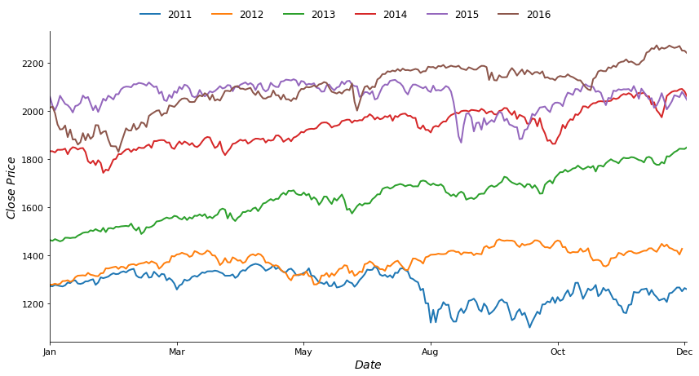
Time series data exploration based on close price vs year[S&P 500]

Slide 20
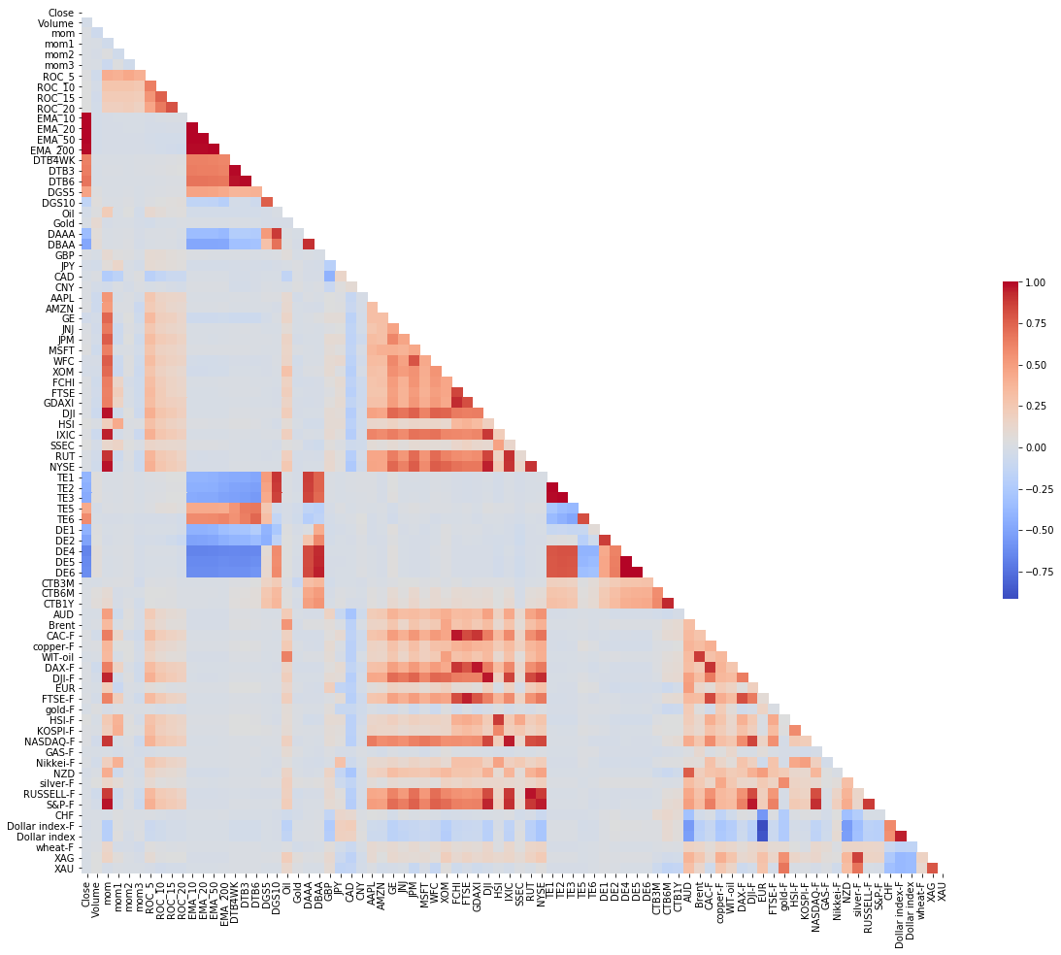
Correlation matrix of features
DJI,
NASDAQ
RUSSEL
S&P 500
NYSE

Slide 21
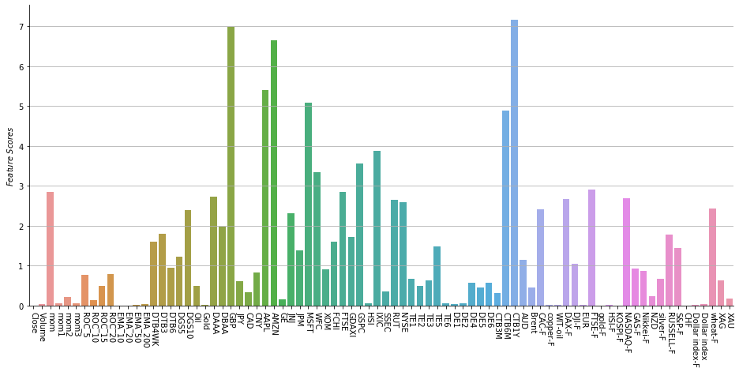
Feature Selection w.r.t to labels[DJI]

Slide 22
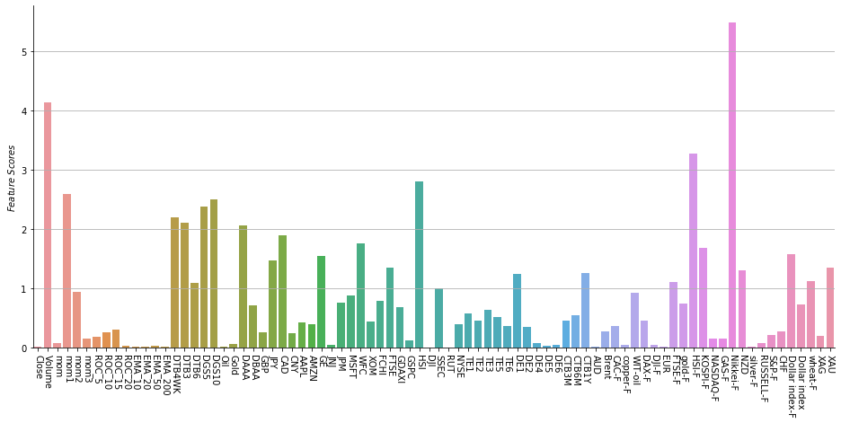
Feature Selection w.r.t to labels[NASDAQ]

Slide 23
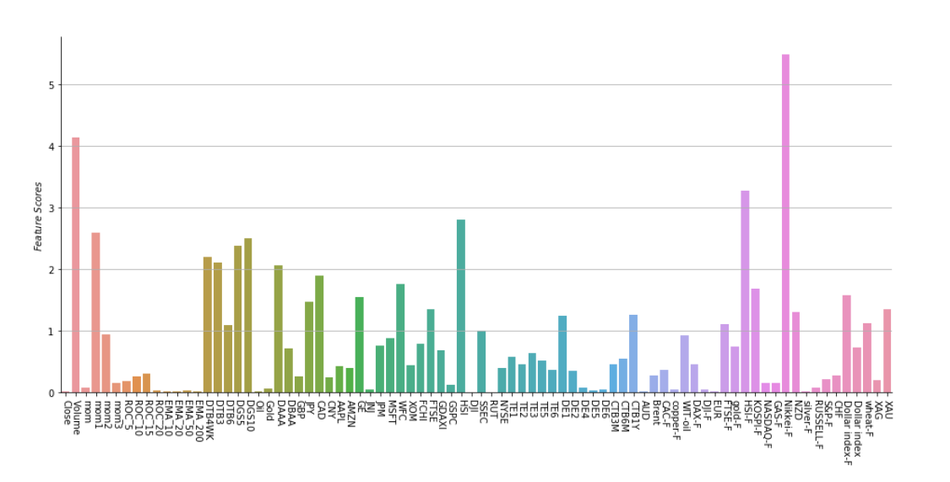
Feature Selection w.r.t to labels[NYSE]

Slide 24
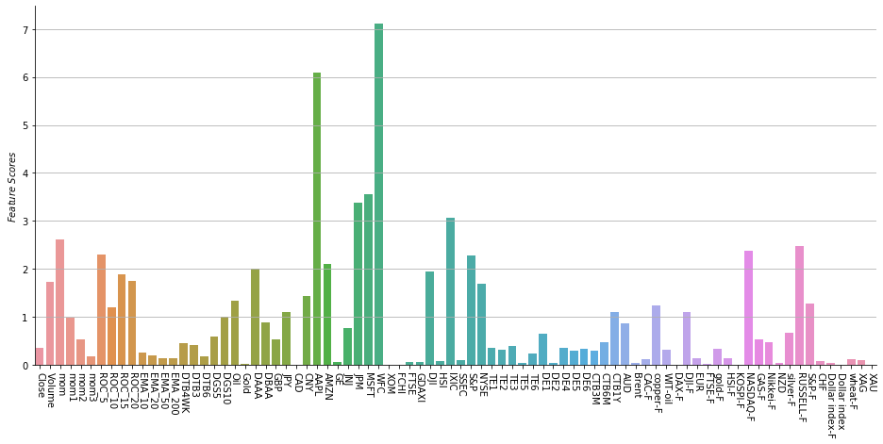
Feature Selection w.r.t to labels[Russel]

Slide 25
Feature Selection w.r.t to labels[S&P 500]

Slide 26
NN Descriptions in brief
Feedforward NN
two hidden layers 64 and 32 respectively with RELU
ending with sigmoid layer for prediction
2) 2D- CNN
Conv Layer with filter size x number of features and RELU
2 Conv Layer with RELU
max pooling of 3x1 and 2x1 used respectively
ending with sigmoid layer for prediction
3) 3D- CNN
Conv Layer with 1x1 filter and RELU
Conv Layer x number of markets and RELU
max pool 2x1 Conv Layer with filter 3x1, max pool 2x1
ending with a sigmoid layer for prediction

Slide 27
NN Descriptions in brief [continued]
4) LSTM
two LSTM layers with 128 and 64 neurons with leaky RELU
ending with sigmoid for prediction
5) TCN
Input followed by custom TCN from TCN library
ending with sigmoid for prediction

Slide 28
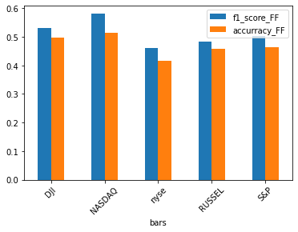
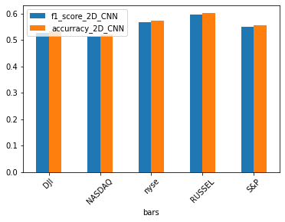
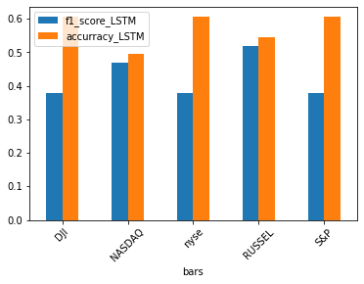
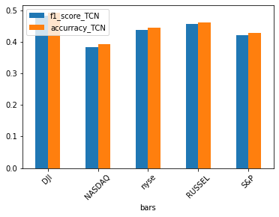
F1 Measure and Accuracy [Feedforward NN,2D CNN,LSTM,TCN]
Feedforward NN
2D CNN
LSTM
TCN

Slide 29
Evaluation over F1 measure and Accuracy
We observe that TCN performed better than Feedforward and LSTM but got outperformed by 2D_CNN.
some possible reasons could be,
lack of randomization
low number of epochs
model not complex enough as we are using the most basic of models

Slide 30
Conclusion
The experimental results indicated that TCN models substantially was outperformed by 2D_CNN but performed better than Feedforward and LSTM.
A simple convolutional architecture is more effective across sequence modeling on stock data than recurrent architectures.

Slide 31
References
Shi, Xingjian, Chen, Zhourong, Wang, Hao, Yeung, Dit-Yan, Wong, Wai-Kin, and Woo, Wang-chun. Convolutional LSTM network: A machine learning approach for precipitation nowcasting. In NIPS, 2015
S. Bai, J. Z. Kolter, and V. Koltun. An empirical evaluation of generic convolutional and recurrent networks for sequence modeling. arXiv preprint arXiv:1803.01271, 2018
Ehsan Hoseinzade and Saman Haratizadeh. Cnnpred: Cnn-based stock market prediction using several data sources. arXiv preprint arXiv:1810.08923, 2018.
Ehsan Hoseinzade and Saman Haratizadeh. Cnnpred: Cnn-based stock market prediction using a diverse set of variables. Expert Systems with Applications, 129:273–285, 2019.
https://archive.ics.uci.edu/ml/datasets/CNNpred%3A+CNN-based+stock+market+prediction+using+a+diverse+set+of+variables

Slide 32
References
6. Bradbury, James, Merity, Stephen, Xiong, Caiming, and Socher, Richard. Quasi-recurrent neural networks. In ICLR, 2017.
7. Chang, Shiyu, Zhang, Yang, Han, Wei, Yu, Mo, Guo, Xiaoxiao, Tan, Wei, Cui, Xiaodong, Witbrock, Michael J., HasegawaJohnson, Mark A., and Huang, Thomas S. Dilated recurrent neural networks. In NIPS, 2017.
8. Yin, Wenpeng, Kann, Katharina, Yu, Mo, and Schutze, Hinrich. ¨ Comparative study of CNN and RNN for natural language processing. arXiv:1702.01923, 2017.
9. LSTM: https://towardsdatascience.com/sequence-models-and-recurrent-neural-networks-rnns-62cadeb4f1e1

