Slide 1


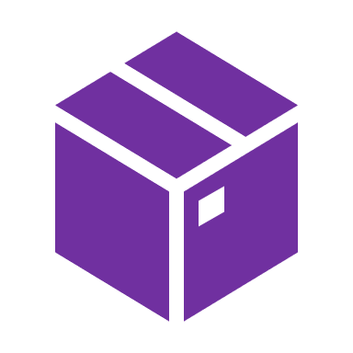

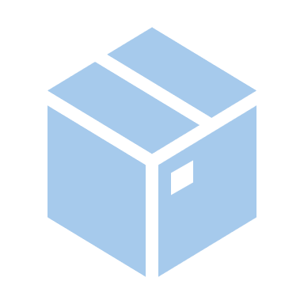
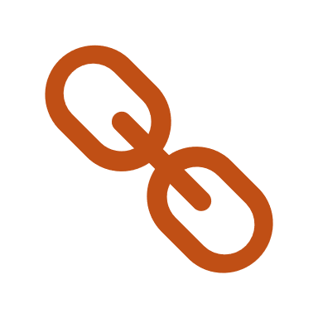
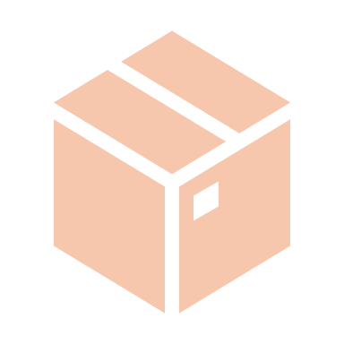

WellFund
Decentralized Crowdfunding Platform
Project Work Phase II
(EAI852)
MAY - 2023
Project Guide:
Dr Saurabh Pathak
Assistant Professor
Submitted By:
Saiyam Jain
TCA1959024

Slide 2
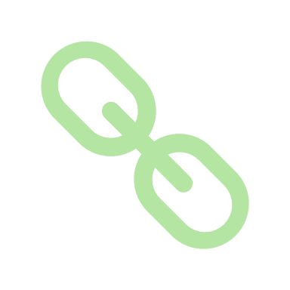
Problem Statement
Crowdfunding is one of the most popular ways to raise funds for any project, cause or for helping any individual in need. Crowdfunding is basically a process of raising money from a large number of people. It can be done to fund a project, a company or any social or personal cause. Even in some cases, the funders get some rewards or equity for the fund they donate. Crowdfunding platforms, particularly those primarily focused on donation-based crowdfunding have played an important role in making individuals and organizations capable to raise funds for charitable causes, medical causes, disaster relief causes and more. The current system of centralized platforms faces some challenges that any decentralized platform can handle more effectively. Some of the main problems in the current system are:
Lack of Transparency
High Platform Fees
Trust and Accountability Issues
Limited Access to certain Regions
Transparency and Immutability
Lower Fee

Slide 3
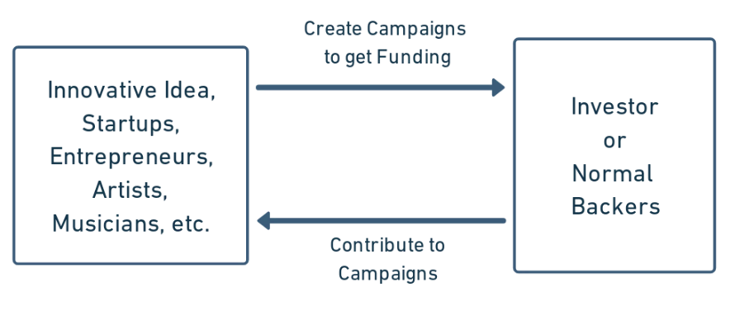
Introduction
WellFund is an innovative decentralized, donation-focused crowdfunding application built on the top of the Ethereum blockchain platform, which offers an intuitive and transformative approach to crowdfunding. In WellFund, users or donors have the opportunity to invest or donate to campaigns that align with their interests.
Fig. 1 Simple flow of WellFund
By utilizing the power of blockchain, WellFund comes with a bundle of advantages over traditional crowdfunding platforms. One of the notable benefits of WellFund is the provision of low-risk support for new ventures. Due to the implementation of blockchain, WellFund ensures that crowdfunding activities take place with reduced risk. The immutable nature of the blockchain ensures the transparency and accountability of the platform and allows the donors to track the investment.

Slide 4
Project Modules
Modules are independent parts of a system or a program that carry out specific tasks or responsibilities. They facilitate modular design, code reuse, and simpler maintenance since they encapsulate related functionality, data, and activities. Modularity and code management are enhanced via modules, which help organize and separate various components of a system.
The following modules are recognized based on the smart contract code for the WellFund project, and an explanation of how they function within the smart contract is listed below:
Project Creation and Management Module:
Contribution Processing Module:
Withdrawal Module:
Campaign Discovery Module:
Project and Backer Data Storage Module:
Project Status Management Module:
Tax Management Module:

Slide 5
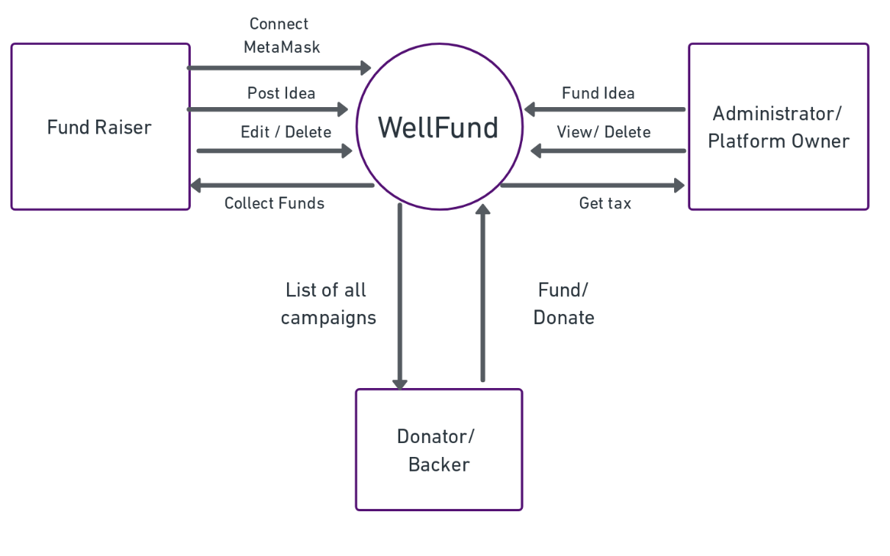
Context Diagram
Fig. 2 Context Level Diagram

Slide 6
User Classes and Characteristics
1. Admin/ Administrators: The group of users that has the highest level of permission.
- Update System and Fund Campaigns
- Approve/ Reject Projects or campaigns
2. Fund Seeker: The entity/organization/user that is in need of the funds
- Create Campaign
- Edit or delete the campaign if needed
- Withdraw Funds
3. Donor/ Contributor: The entity/organization/user that contributes to funds
- View Campaign
- Contribute to any campaign

Slide 7
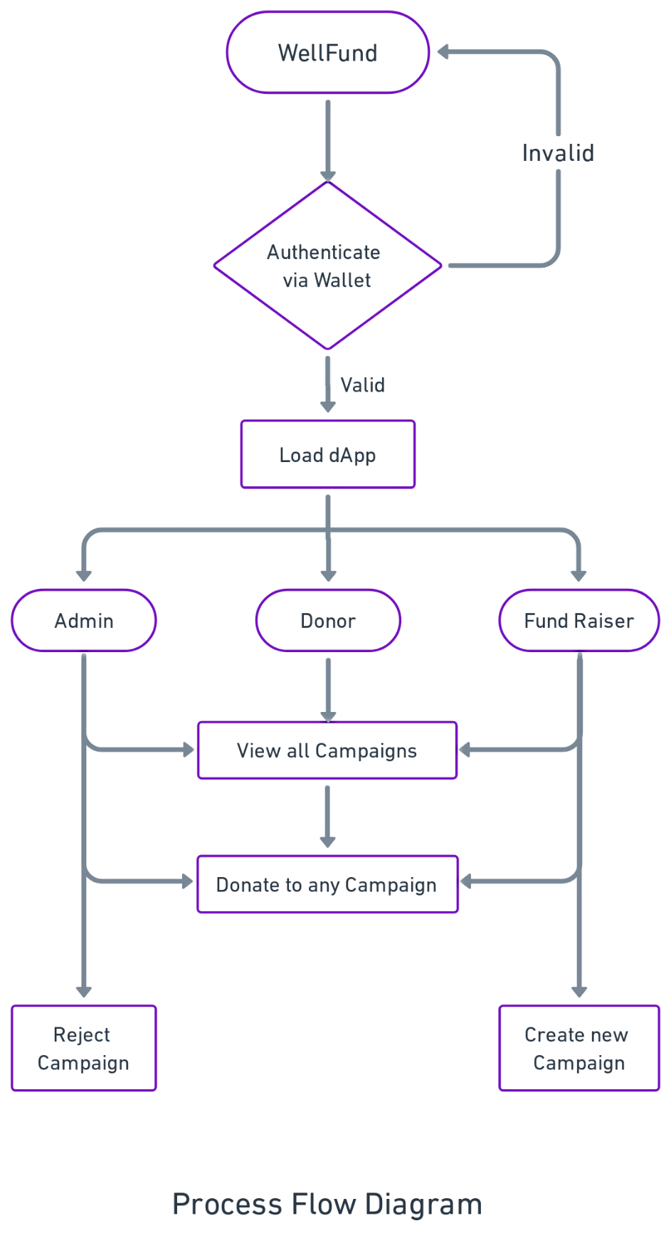
Process Diagram
Fig. 3 Process Flow Diagram

Slide 8
Technologies Used
The WellFund project's front-end and back-end components, which are responsible for implementing the necessary features and providing a user-friendly interface, are all a part of the software platform.
Front-end:
HTML5, CSS3, JavaScript
ReactJS
Web3.js
Tailwind CSS
Back-end
Solidity
Tools
MetaMask
Remix IDE
Git
Hardhat
VS Code

Slide 9
Advantages
Some of the major advantages of the project are:
Empowering Fundraisers
Efficient Fund Allocation
Great Donor Confidence
Global Accessibility
Enhanced Transparency
Reduced Costs
Scalability and Flexibility

Slide 10
Future Scope and Advancements
Increased User Adoption
Global Expansion
Partnerships and Collaborations
Integration with Decentralized Finance (DeFi)
NFT Crowdfunding
Mobile Application
Integration with Web3 (cross-chain)
Continuous Innovation and Improvement

Slide 11
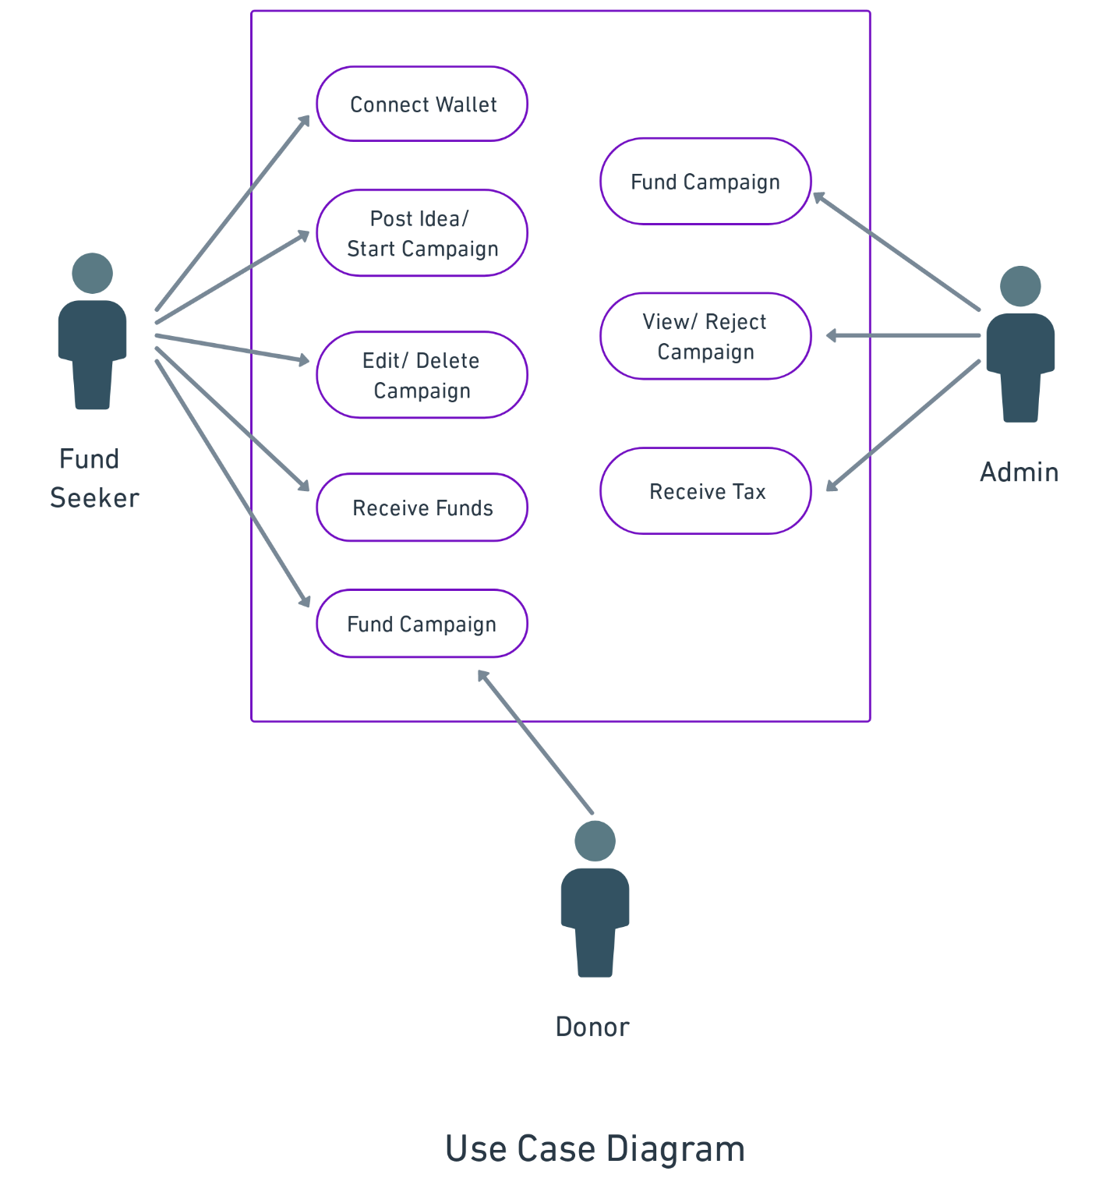
Use Case Diagram
Fig. 3 Use Case Diagram

Slide 12
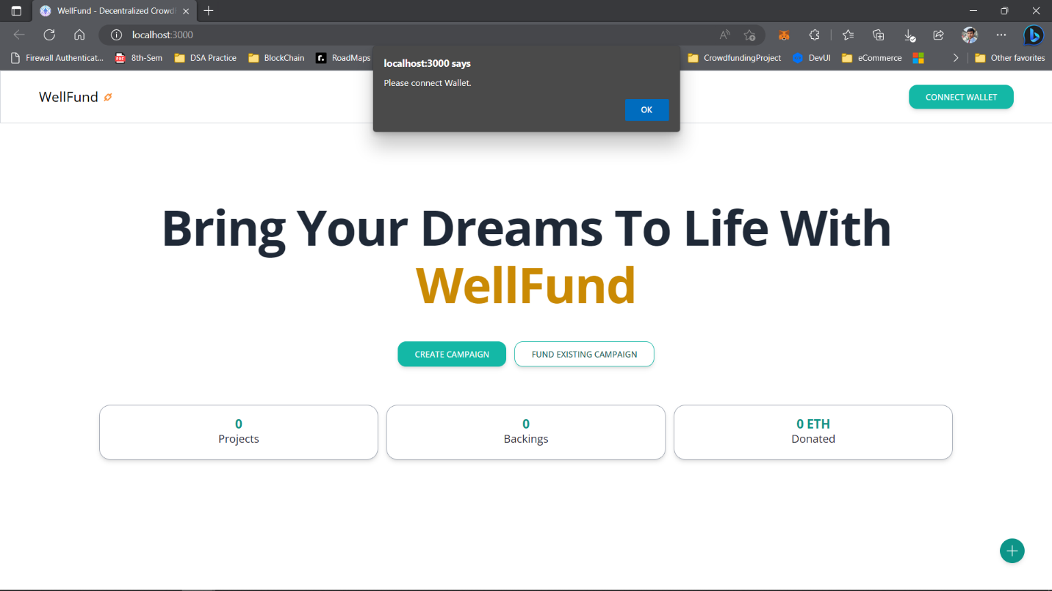
Screenshots
Homepage – Before Connecting Wallet

Slide 13
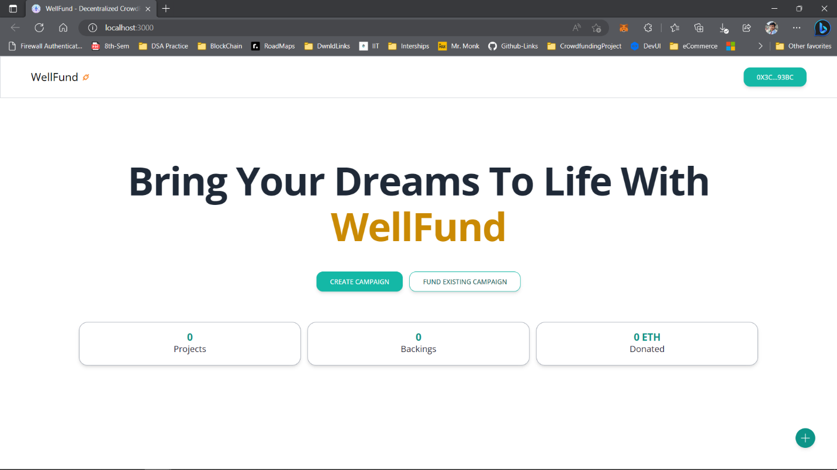
Screenshots
Homepage – After Connecting Wallet

