Slide 1

Practical Semantic Test Simplification
Sai Zhang
University of Washington
Notes:
A technique to simplify tests

Slide 2





A typical testing workflow
Test
Software
Test
Result
This paper
How to help programmers understand a failed test?

Slide 3
Test simplification
Isolate only the failure-relevant code
State of the art:
Delta debugging [Zeller’02]
Slicing [Weiser’84]
Fundamental limitations
Carve a subset of the existing test code
Simplify the test at the syntax level
Test
Test
Notes:
Less helpful for an already syntactically-minimized test. Which can also be difficult to understand

Slide 4
An example failed test (automatically generated by Randoop [Pacheco’07])
public void testTreeSet() {
Object obj = new Object();
Integer int1 = 0;
Integer int2 = 1;
Object[] objs = new Object[] {obj, int1, int2};
List list1 = Arrays.asList(objs);
List list2 = list1.sublist(int1, int2);
TreeSet ts = new TreeSet();
ts.add(list2);
Set set = Collections.synchronizedSet(ts);
assertTrue(set.equals(set));
}
Syntactically-minimized
- Both Delta debugging and slicing can no longer simplify it

Slide 5

The SimpleTest algorithm
An algorithm simplifying tests at the semantic level
Preserve the testing oracle’s behavior
Key steps:
Replace a referred variable with other alternatives
(greedy: use the earliest-defined type-compatible variable)
Simplify the test code by removing redundant code
Validate the oracle’s behavior
Object a = null;
Object b = a;
Object c = b;
c.hashCode();
Object a = null;
Object b = a;
Object c = b;
a.hashCode();
Object a = null;
Object b = a;
Object c = b;
a.hashCode();
replacement
simplification
validation
by execution
Object a = null;
a.hashCode();
Simplified!
Notes:
Look for the same exception

Slide 6
Simplifying the example test
public void testTreeSet() {
Object obj = new Object();
Integer int1 = 0;
Integer int2 = 1;
Object[] objs = new Object[] {obj, int1, int2};
List list1 = Arrays.asList(objs);
List list2 = list1.sublist(int1, int2);
TreeSet ts = new TreeSet();
ts.add(list2);
Set set = Collections.synchronizedSet(ts);
assertTrue(set.equals(set));
}

Slide 7
Simplifying the example test
public void testTreeSet() {
Object obj = new Object();
Integer int1 = 0;
Integer int2 = 1;
Object[] objs = new Object[] {obj, int1, int2};
List list1 = Arrays.asList(objs);
List list2 = list1.sublist(int1, int2);
TreeSet ts = new TreeSet();
ts.add(obj);
Set set = Collections.synchronizedSet(ts);
assertTrue(set.equals(set));
}

Slide 8
Simplifying the example test
public void testTreeSet() {
Object obj = new Object();
Integer int1 = 0;
Integer int2 = 1;
Object[] objs = new Object[] {obj, int1, int2};
List list1 = Arrays.asList(objs);
List list2 = list1.sublist(int1, int2);
TreeSet ts = new TreeSet();
ts.add(obj);
Set set = Collections.synchronizedSet(ts);
assertTrue(set.equals(set));
}

Slide 9
A semantically-simplified test
public void testTreeSet() {
Object obj = new Object();
TreeSet ts = new TreeSet();
ts.add(obj);
Set set = Collections.synchronizedSet(ts);
assertTrue(set.equals(set));
}

Slide 10
More in the paper
The semantic test simplification problem
Formal definition
NP-Completeness proof
SimpleTest algorithm
Complexity analysis
Optimizations to avoid trivial test like:
assert(null != null);

Slide 11
Preliminary experiments
Subject Program | LOC | #Failed Tests | Failed Test LOC
Time And Money | 2,372 | 23 | 1337
jdom | 8,513 | 3 | 194
Apache Commons Primitives | 9,368 | 5 | 377
Apache Commons Beanutils | 11,382 | 10 | 317
Apache Commons Math | 12,469 | 18 | 747
Apache Commons Collections | 55,400 | 8 | 399
java.util package | 48,026 | 6 | 178
Total | 149, 557 | 73 | 3549
All tests are automatically generated by Randoop [Pacheco’07]

Slide 12
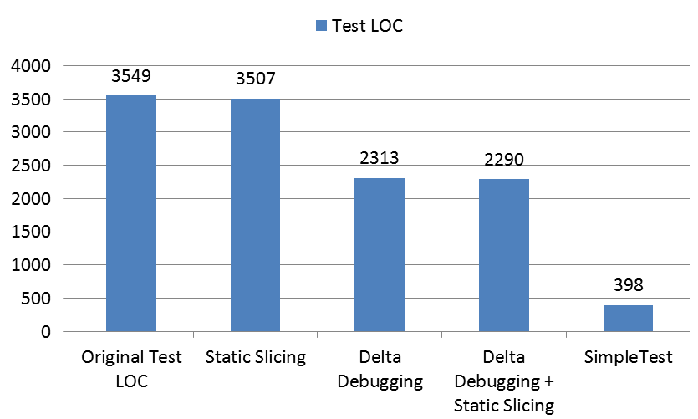
Results in simplifying failed tests

Slide 13
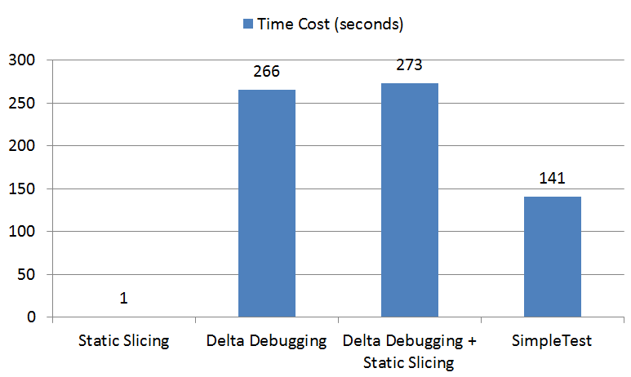
Time cost in simplifying failed tests

Slide 14
Related work
Syntax-level test simplification
Delta debugging [Zeller’02]
Program slicing [Weiser’84]
Combined approach [Leitner’07]
Will not be useful if a test is already syntactically-minimized
Semantic-level input value reduction
Hierarchical delta debugging [Misherghi’06]
C-Reducer [Regehr’12]
Does not preserve the semantics of the original test code
Notes:
Also relevant to human written tests

Slide 15
Contributions
Test
SimpleTest
Test
The semantic test simplification problem
Formal definition
Proof of its NP-Completeness
A technique to semantically simplify tests
Uses a greedy algorithm
Fully automated
Preserves the behavior of a given oracle
Experiments that demonstrate its usefulness
Outperforms existing syntax-level test simplification techniques

Slide 16
[Backup slides]

Slide 17
Future work
Extending SimpleTest to handle more Java features
If-else conditions
Loops
Exceptions
Comparing SimpleTest with other techniques
Dynamic slicing [Agrawal’91]
C-Reducer [Regehr’12]
Exploring downstream applications of SimpleTest
Fault localization with the simplified tests
Explanatory document inference

