Slide 1

Automated Diagnosis of Software Configuration Errors
Sai Zhang, Michael D. Ernst
University of Washington
Notes:
An automated technique to diagnose software configuration errors

Slide 2
A typical software workflow
Outputs
Inputs
Software

Slide 3

Modern software is often configurable
…
Configuration options
Configurable
Software
Outputs
Inputs

Slide 4




Possible root causes of wrong output
Configuration errors
This paper!
…
Configuration options
Configurable
Software
Outputs
Inputs
Bugs
Wrong inputs
Studied by many existing automated
debugging techniques

Slide 5
Why configuration errors?
Fixable by changing configuration options
Actionable by system administrators or end-users
17% of the total technical support cost [Kapoor ’03, Yin ’11]
Configuration options vs. Inputs
Options: customize program behaviors by altering the control flow
Input values: produce output for a specific task

Slide 6
Outline
Example
The ConfDiagnoser Technique
Evaluation
Related Work
Contributions

Slide 7
An example configuration error
A “bug report” against the Randoop test generation tool
… Randoop fails to generate tests for NanoXML using the
following command: java randoop.main.Main NanoXML ...
...,but Randoop works perfectly well on its own examples, such as
BinaryTree, TreeMap, etc.

Slide 8
Difficulty in diagnosing the Randoop error
A silent failure
No crashing points
No stacktrace
No error message
Inputs are already minimized
Inapplicable
Delta debugging [Zeller’02], dynamic slicing [Zhang’06], capture/replay [Whitaker’04], stack trace analysis [Rakbin’11], tainting [Attariyan’12] …

Slide 9
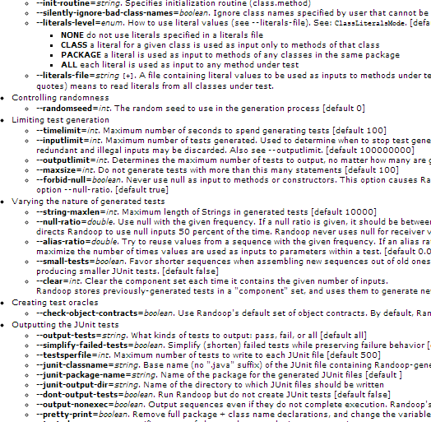
Root cause of the Randoop configuration error
57 Randoop options in total
…
maxsize = 100
…
Randoop code:
...
Sequence seq = createNewSeq();
if (seq.size() > maxsize) {
return null;
}
...
Resolve the reported ``bug’’:
java randoop.main.Main –-maxsize=1000 NanoXML

Slide 10
ConfDiagnoser’s diagnosis report
A ranked list of suspicious configuration options
The top-ranked option for the Randoop error:
Option name
Suspicious configuration option: maxsize
It affects the behavior of predicate:
“newSequence.size() > GenInputsAbstract.maxsize”
(line 312, class: randoop.ForwardGenerator)
This predicate evaluates to true:
3.3% of the time in normal runs
32.5% of the time in the undesired run
Explanation

Slide 11
Outline
Example
The ConfDiagnoser Technique
Evaluation
Related Work
Contributions

Slide 12
Outline
Example
The ConfDiagnoser Technique
Evaluation
Related Work
Contributions

Slide 13
ConfDiagnoser’s assumptions
Correct
Execution
Traces
Configuration errors
…
Configuration options
Configurable
Software
Outputs
Inputs
Bugs
Wrong inputs

Slide 14
ConfDiagnoser’s assumptions
Correct
Execution
Traces
Configuration errors
ConfDiagnoser
Report
1.
2.
3. …
…
Configuration options
Configurable
Software
Outputs
Inputs

Slide 15
ConfDiagnoser’s advantages
Fully-automatically diagnoses configuration errors
Diagnoses both crashing and non-crashing errors
Requires no OS-level support

Slide 16
ConfDiagnoser’s insight
Control flow propagates most configuration options’ effects
Correct execution traces serve as approximate oracles
The control flow difference provides debugging clues
//a configuration option
int maxsize = readFromCommandLine();
...
Sequence seq = createNewSeq();
if (seq.size() > maxsize) {
return null;
}
This predicate evaluates to true:
3.3% of the time in correct runs
32.5% of the time in the bad runs

Slide 17
The ConfDiagnoser technique
-----
--- ---------
-----
------------
Configuration Propagation
Analysis
affected predicates
-----
------------
Program
Configuration options
Compute a forward thin slice [Sridharan’07]
//a configuration option
int maxsize = readFromCommandLine();
Sequence seq = createNewSequence();
...
if (seq.size() > maxsize) {
return null;
}
...
affected predicate

Slide 18
The ConfDiagnoser technique
-----
--- ---------
-----
------------
Configuration Propagation
Analysis
affected predicates
-----
------------
-----
--- ---------
-----
------------
instrument
Program
Configuration options
How often an affected predicate is evaluated
How often an affected predicate evaluates to true

Slide 19

The ConfDiagnoser technique
-----
--- ---------
-----
------------
Configuration Propagation
Analysis
affected predicates
-----
------------
-----
--- ---------
-----
------------
instrument
Program
Configuration options
reproduce
the error
A bad execution trace
…
Compare
&
Select
Correct
Execution
Traces
a set of correct and similar execution traces
1. Convert a trace into a vector
2. Compute the cosine similarity between 2 vectors

Slide 20
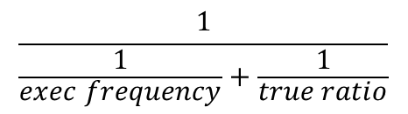
The ConfDiagnoser technique
-----
--- ---------
-----
------------
Configuration Propagation
Analysis
affected predicates
-----
------------
-----
--- ---------
-----
------------
instrument
Program
Configuration options
reproduce
the error
a bad execution trace
A bad execution trace
…
Compare
&
Select
…
Differencing
Correct
Execution
Traces
correct and similar trace
a set of correct and similar execution traces
Compare each predicate’s behavior between the bad and correct traces .
2. A metric for predicate’s behavior :
$$\frac{1}{\frac{1}{exec frequency}+\frac{1}{true ratio}}$$

Slide 21
The ConfDiagnoser technique
-----
--- ---------
-----
------------
Configuration Propagation
Analysis
affected predicates
-----
------------
-----
--- ---------
-----
------------
instrument
Program
Configuration options
reproduce
the error
a bad execution trace
A bad execution trace
…
Compare
&
Select
…
Differencing
Correct
Execution
Traces
correct and similar trace
a set of correct and similar execution traces
Report
identify affecting configuration options
1.
2.
3. …
behaviorally-deviated predicates

Slide 22
Outline
Example
The ConfDiagnoser Technique
Evaluation
Related Work
Contributions

Slide 23
Research questions
How effective is ConfDiagnoser in diagnosing errors?
Diagnosis accuracy
Time cost
Comparison with three existing techniques
One configuration error diagnosis technique
Two general automated debugging techniques

Slide 24
14 configuration errors from 5 subjects
Subject | LOC | #Options | #Non-crashing Errors | #Crashing Errors
Randoop | 18587 | 57 | 1
Weka | 3810 | 14 | 1
Synoptic | 19153 | 37 | 1
Soot | 159271 | 49 | 1
JChord | 23391 | 79 | 1 | 9
Collected from FAQ, forum posts, mailing list questions …
Collected from [Rabkin ASE’11]
Correct executions for each program
6 – 16 examples from its user manual

Slide 25
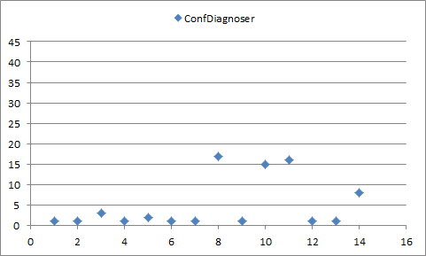

ConfDiagnoser’s accuracy and efficiency
Measure accuracy by the absolute root cause ranking
Time cost: 4 mins / error (on average)
1.
2.
3. …
Root Cause
Rank
Average rank: 5th
8 errors ranks first
10 errors ranks in the top 3
Better for non-crashing errors
Error ID
non-crashing errors
crashing errors

Slide 26
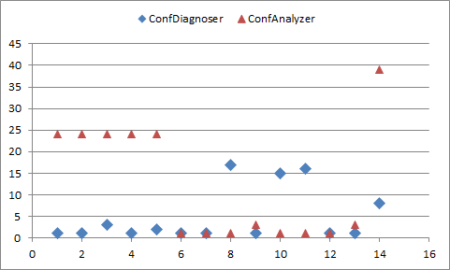
Comparison with ConfAnalyzer [Rabkin ’11]
The most recent configuration error diagnosis technique
Use dynamic tainting
Only supports crashing errors
Average rank
- ConfDiagnoser: 5th
- ConfAnalyzer: 12th
ConfDiagnoser produces:
- Better results on 8 errors
- Same results on 3 errors
- Worse results on 3 errors
non-crashing errors
crashing errors

Slide 27
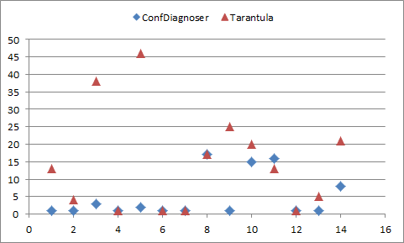
Comparison with Tarantula [Jones ’03]
Tarantula-based configuration debugging
Use statement coverage to localize suspicious statements
Use thin slicing to identify the affecting configuration options
Average rank
- ConfDiagnoser: 5th
- Tarantula: 15th
Tarantula’s statement-level granularity is too fine-grained
Many statements get the same suspiciousness value
Statement coverage does not indicate predicate evaluation results

Slide 28
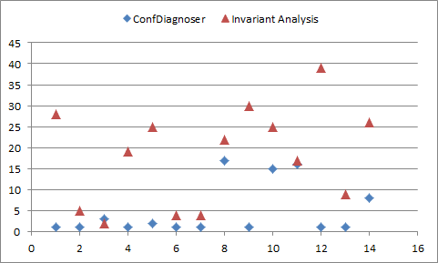
Comparison with Invariant Analysis [McCamant ’04]
Invariant Analysis-based configuration debugging
Use method invariant difference to localize suspicious methods
Use thin slicing to identify the affecting configuration options
Average rank
- ConfDiagnoser: 5th
- Invariant Analysis: 18th
Invariant analysis’ method-level granularity is too coarse-grained
Some control flow changes inside a method are not be reflected by invariants

Slide 29
Experimental conclusion
ConfDiagnoser is accurate and efficient
ConfDiagnoser outperforms existing techniques
One configuration error diagnosis technique
Two general automated debugging techniques

Slide 30
Outline
Assumption, Goal, and Insight
The ConfDiagnoser Technique
Evaluation
Related Work
Contributions

Slide 31
Related work on configuration error diagnosis
Tainting-based techniques
Dynamic tainting [Attariyan’08]
Static tainting [Rabkin’11]
Focuses exclusively on crashing errors
Search-based techniques
Delta debugging [Zeller’02], Chronus [Whitaker’04]
Requires a correct state for comparison, or OS-level support
Domain-specific techniques
PeerPressure [Wang’04]
RangeFixer [Xiong’12]
Targets a specific kind of configuration errors, and does not support a general language like Java

Slide 32
Outline
Assumption, Goal, and Insight
The ConfDiagnoser Technique
Evaluation
Related Work
Contributions

Slide 33
Contributions
Report
ConfDiagnoser
1.
2.
3. …
Configuration errors
A technique to diagnose configuration errors
Compare relevant predicate behaviors between executions
Fully automated
Can diagnose both crashing and non-crashing errors
Requires no OS-level support
Experiments that demonstrate its usefulness
Accurate and fast
Outperforms three existing techniques
The ConfDiagnoser tool implementation
http://config-errors.googlecode.com

Slide 34
[Backup Slides]

Slide 35
Representation of configuration options inside ConfDiagnoser
A configuration option is represented as a class field
An example configuration option in Randoop:
randoop.main.GenInputsAbsract.maxsize
Made a 24-LOC syntactic change to 5 subject programs
Transform configuration option into class field
Class name
Field name

