Slide 1

Software Bug Localization with Markov Logic
Sai Zhang, Congle Zhang
University of Washington
Presented by Todd Schiller

Slide 2




Software bug localization: finding the likely buggy code fragments
A software system
(source code)
Some observations
(test results, code coverage,
bug history, code dependencies,
etc.)
A ranked list of likely
buggy code fragments

Slide 3



An example bug localization technique (Tarantula [Jones’03])
Input: a program + passing tests + failing tests
Output: a list of buggy statements
Example:
if (a >= b) {
return b;
1. a = arg1
2. b = arg2
} else {
6. return a;
Tests
arg1 = 1
arg2 = 2
arg1 = 2
arg2 = 1
arg1 = 2
arg2 = 2
max(arg1, arg2) {
1. a = arg1
2. b = arg2
3. if (a b) {
4. return b;
5. } else {
6. return a;
7. }
}
>=
<

Slide 4
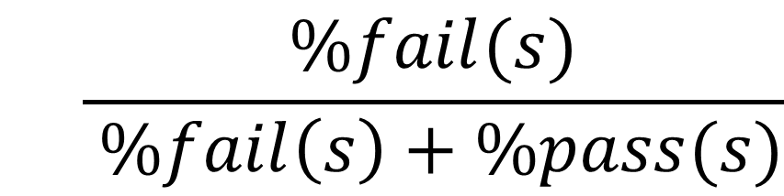
Tarantula’s ranking heuristic
For a statement: s
$$\frac{\%fail(s)}{ \%fail\left(s\right)+\%pass(s)}$$
Suspiciousness(s) =
Percentage of failing tests
covering statement s
Percentage of passing tests
covering statement s
This heuristic is effective in practice [Jones’05]

Slide 5
Problem: existing techniques lack an interface layer
Heuristics are hand crafted
Techniques are often defined in an ad-hoc way
A persistent problem in the research community
Techniques
Tarantula
Jones ICSE’03
xDebug
Wong, Compsac’07
CBI
Liblit PLDI’05
Raul ICSE’09
Wang
ICSE’09
…
…
Observations
Static
Code Info
Line coverage
Predicate
Branch coverage
Def-use
relations
…

Slide 6
Adding an interface layer
Tarantula
Jones ICSE’03
Why an interface layer?
Focus on key design insights
Avoid “magic numbers “ in heuristics
Fair basis for comparison
Fast prototyping
xDebug
Wong, Compsac’07
CBI
Liblit PLDI’05
Raul ICSE’09
Wang
ICSE’09
…
Interface layer
Static
Code Info
Line coverage
Predicate
Branch coverage
Def-use
relations
…

Slide 7

Who should be the interface layer?
Tarantula
Jones ICSE’03
xDebug
Wong, Compsac’07
CBI
Liblit PLDI’05
Raul ICSE’09
Wang
ICSE’09
…
Static
Code Info
Line coverage
Predicate
Branch coverage
Def-use
relations
…

Slide 8
Markov logic network as an interface layer
Tarantula
Jones ICSE’03
xDebug
Wong, Compsac’07
CBI
Liblit PLDI’05
Raul ICSE’09
Wang
ICSE’09
…
Markov Logic Network
Static
Code Info
Line coverage
Predicate
Branch coverage
Def-use
relations
…

Slide 9
Why Markov Logic Network [Richardson’05]?
Use first order logic to express key insights
E.g., estimate the likelihood of cancer(x) for people x
Example rules:
smoke(x) => cancer(x)
smoke(x) ∧ friend(x,y) => smoke(y)
friends(x, y) ∧ friends(y, z) => friends(x, z)
smoke causes cancer
you will smoke if your friend smokes
friends of friends are friends

Slide 10
Why Markov Logic Network [Richardson’05]?
Use first order logic to express key insights
E.g., estimate the likelihood of cancer(x) for people x
Example rules:
smoke(x) => cancer(x)
smoke(x) ∧ friend(x,y) => smoke(y)
friends(x, y) ∧ friends(y, z) => friends(x, z)
Efficient weight learning and inference
Learning rule weights from training data
Estimate cancer(x) for a new data point
w1
w2
w3
(details omitted here)

Slide 11

Markov logic for bug localization
Training data
First-order logic rules
(capture insights)
Alchemy
(learning)
Researchers
A markov logic network engine
Rule weights
Likelihood of s
being buggy
Alchemy
(inference)
A statement: s

Slide 12
Markov logic for bug localization
Different rules for
different bug localization algorithms
Training data
First-order logic rules
Alchemy
(learning)
Researchers
A markov logic network engine
Rule weights
Likelihood of s
being buggy
Alchemy
(inference)
A statement: s

Slide 13
Our prototype: MLNDebugger
First-order rules
cover(test, s) ∧ fail(test) => buggy(s)
cover(test, s) ∧ pass(test) => ¬ buggy(s)
control_dep(s1, s2) ∧ buggy(s1) => ¬ buggy(s2)
data_dep(s1, s2) ∧ buggy(s1) => ¬ buggy(s2)
5. wasBuggy(s) => buggy(s)
A statement covered by a failing test is buggy
A statement covered by a passing test is not buggy
If a statement has control dependence on a buggy statement, then it is not buggy
If a statement has data flow dependence on a buggy statement, then it is not buggy
Learning and inference
v = foo()
bar(v)
A statement that was buggy before is buggy
Buggy!
A statement:
stmt
Rules + Weights
Correct!
if(foo(x)) {
bar();
}
Buggy!
Buggy!
Correct!
Correct!
How likely stmt is buggy

Slide 14
Evaluating MLNDebugger on 4 Siemens benchmarks
80+ seeded bugs
2/3 as training set
1/3 as testing set
Measurement on the testing set
Return top k suspicious statements, check the percentage of buggy ones they can cover.
Baseline: Tarantula [Jones’ ICSE 2003]

Slide 15
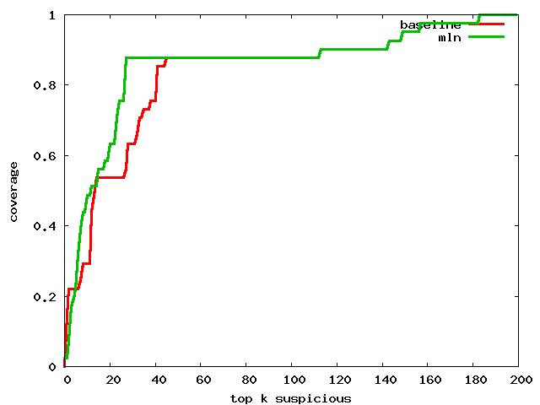
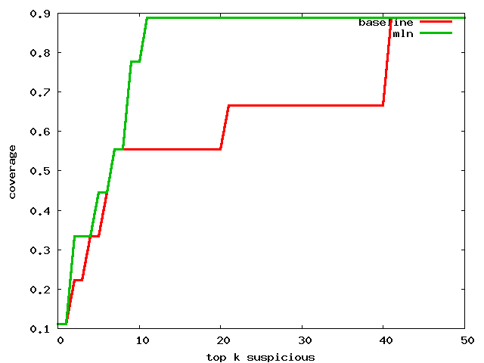
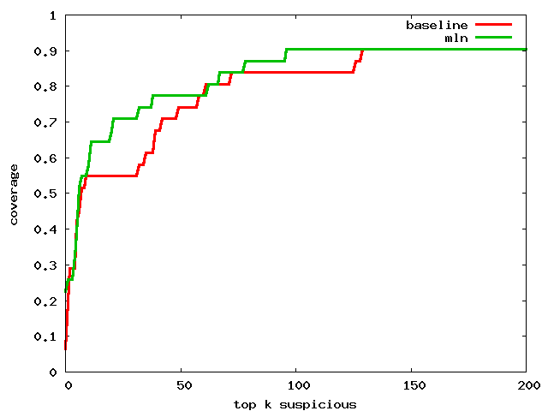
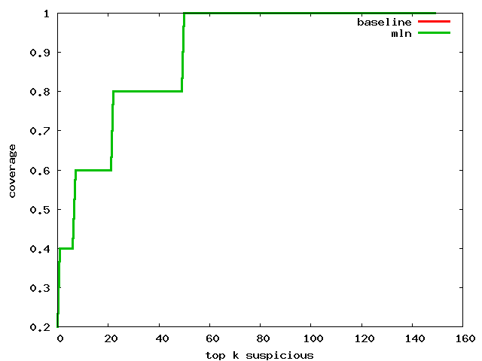
Experimental results
MLNDebugger
Tarantula

Slide 16
More in the paper…
Formal definition
Inference algorithms
Implementation details
Implications to the bug localization research

Slide 17
Contributions
The first unified framework for automated debugging
Markov logic network as an interface layer: expressive, concise, and elegant
A proof-of-concept new debugging technique using the framework
An empirical study on 4 programs
80+ versions, 8000+ tests
Outperform a well-known technique

