Slide 1

Which Configuration Option Should I Change?
Sai Zhang, Michael D. Ernst
University of Washington
Presented by: Kıvanç Muşlu
Notes:
Today, I am going to introduce a new technique to diagnose software configuration errors in evolving software

Slide 2



I have released a new software version …
I cannot get used to the UI
Developers
I do not know how to configure it
…
Users
Notes:
I release a new software version …. There are a number of problems users deal with the old versions
Let’s consider a typical scenario. Developers add some cool features to a new software version,
(click)
but users may not like these features. For example, users may not get used to the new UI, and users may not know how to configure the new version. In this scenario, the key problem is …. (go to next slide)

Slide 3
Diagnosis of User-Fixable Software Errors
Goal:
enable users to fix software errors
Challenges:
Errors can be crashing or non-crashing
Users much less understand source code
Developer tools are of little use
Notes:
There is a gap between software developers and users. For developers, ensuring software functional correctness does not necessarily mean meeting users’ expectation. A new software version may even cause software usage errors.
In this work, we aim to develop techniques to enable ordinary users to fix software errors
However, diagnosing errors for users are very challenging. software errors can be crashing or non-crashing, non-crashing here means the software terminated normally but outputs a wrong results. Further, user much less understand the source code, and they can not user developer tools like a debugger to track down the problem.

Slide 4
Our previous work [ISSTA’13]
Help users adapt to the new UI
A new software version
I cannot get used to the UI
Users
Notes:
In our previous, we have developed a technique to help users adapt to the new UI

Slide 5
A new software version
I do not know how to configure it
This paper:
How to help users configure
the new software version
(i.e., diagnosis of configuration errors)
Users
Notes:
In this talk, I am going to show you how to help users configuration the new software version.
(click)
That is, how to diagnose configuration errors in the new software version.
People may ask “why should we care about configuration errors”, (go to the next slide)

Slide 6


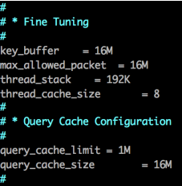
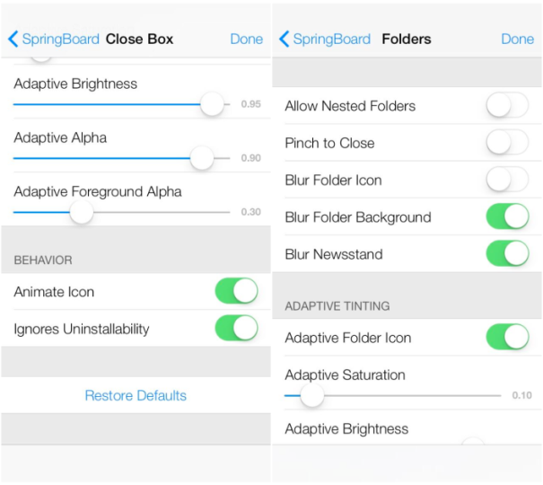
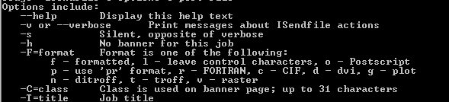
Software system often requires configuration
Configuration errors:
- Users use wrong values for options
- The software exhibits unintended behaviors
…
Configuration options
Example:
--port_num = 100.0
Should be a valid integer
Notes:
This is because most modern software systems are configurable by exposing a wide range of run-time configuration options.
(click)
These configuration options are often specified in a configuration file,
(click)
or provided in command line,
(click)
or can be specified in a graphical user interface.
(click)
A configuration error happens when users use wrong values for certain configuration options, and the software exhibits unintended behaviors.
(do not dig into the details of the example shown on the slide)

Slide 7
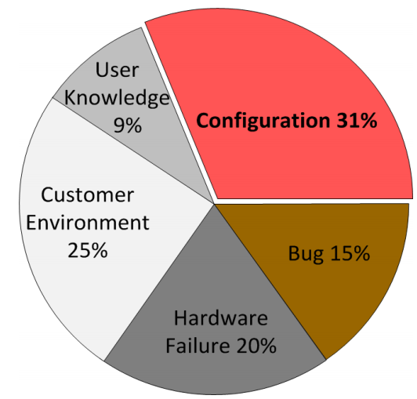
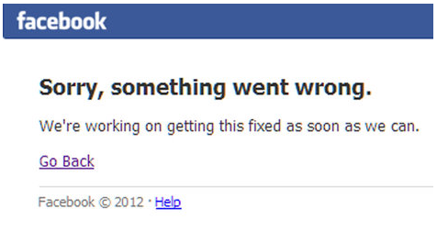


Configuration errors are common and severe
Root causes of high-severity issues in
a major storage company [Yin et al, SOSP’11]
Configuration errors can have
disastrous impacts
(downtime costs 3.6% of revenue)
Notes:
Such configuration errors are really common and severe in practice.
(click)
For example, according to a recent study, software configuration errors are the most common root causes for severe problems in a major storage company.
(click)
Even worse, configuration errors can cause disastrous impacts. They can bring down important service like facebook, DNS service, and Microsoft Cloud Platform. Such downtime can cost over 3% of a company’s revenue

Slide 8

Configuration errors are difficult to diagnose
Error messages are absent or ambiguous
e.g.,
Infeasible to automatically search for a good configuration
Need to know the spec of a valid configuration option value
(e.g., regex, date time, integer value range)
Huge search space
Need to specify a testing oracle for automation
Cannot directly use existing debugging techniques
[Zhang et al., ICSE’13]
(after setting --port_num = 100.0 in webs server)
Notes:
Unfortunately, configuration errors are difficult to diagnose in practice
(click)
First, error messages produced by configuration errors are often ambiguous or even absent. For example, given such error messages, even experienced developers may not know which part of the software goes wrong
(click)
People may wonder why not use the following simple approach: let’s try every possible values for every configuration options and then check the software behavior.
(click)
In practice, this simple approach may not work, since it is difficult to know the specification of a valid configuration option value. This is a particular problem for configuration options with regex, data time types.
(click)
Second, even when we know the spec of a valid configuration option, the search space can be huge even for a simple software with tens of configuration options
Further, the users need to write a testing oracle to check the software behaivor in order to achieve automation.
(click)
Lastly, as indicated in our previous work, existing automated debugging techniques cannot be directly used to diagnose software configuration errors.

Slide 9





Goal: diagnosing configuration errors for evolving software
a different output
Old version
New version
Requires configuration!
To maintain the desired behavior on the new version
Which configuration option should I change?
Notes:
The goal of this paper is to provide a practical technique to diagnose configuration errors for evolving sofware
(click)
Suppose we have an old software version. (click) It outputs an output for certain task
(click)
When the software evolves to a new version.
(click)
For the same task, it outputs a different output, and the software needs configuration.
(click)
So, the key question this paper wants to ask is that: if we want to maintain the desired behavior on the new software version, which configuration option should a user change?

Slide 10
Diagnosing configuration errors with ConfSuggester
a different output
Old version
New version
Key idea:
The execution trace
on the old version as
the “intended behavior”
Our technique: ConfSuggester
…
Suspicious configuration options
Notes:
Our technique, called ConfSuggester, can be used to help users diagnose such configuration errors. ConfSuggester outputs a ranked list of suspicious configuration options, whose values, if changed, will lead the software reveal intended behaivor.
(click)
The key idea of ConfSuggester is that we use the execution trace on the old version as the intended software behavior and compare the execution on the new version with it.

Slide 11
Design constraints for ConfSuggester
Accessible: no assumption about user background
(e.g., users cannot read or write code annotations)
Easy-to-use: fully automated
Portable: no changes to OS or runtime environment
Accurate: few false positives
Notes:
However, designing a technique like ConfSuggester for users is difficult, because of several design constraints.
(click and say, read each bullet points almost suffices)

Slide 12
Outline
Example
A Study of Configuration Evolution
The ConfSuggester Technique
Evaluation
Related Work
Contributions
Notes:
In the rest of the talk, I will show an example, describe an empirical study, introduce the ConfSuggester technique, present our evaluation, discuss the related work, and then conclude the talk.

Slide 13
Outline
Example
A Study of Configuration Evolution
The ConfSuggester Technique
Evaluation
Related Work
Contributions
Notes:
Let’s first start with a real-world example

Slide 14

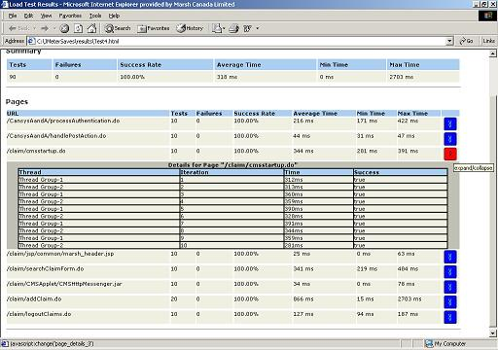

A popular performance testing tool
Managers
Use Jmeter to monitor a website’s performance
Notes:
Jmeter is a popular performance testing tool
(click)
It can be integrated into existing infrastructures to monitor a website’s performance and provide nice report for managers to inspect

Slide 15

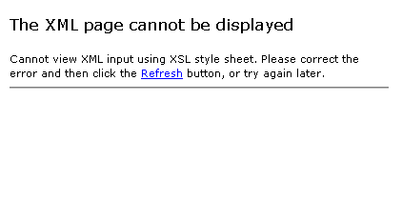
All regression tests passed
Version 2.8
Version 2.9
Managers
Use Jmeter to monitor a website’s performance
Notes:
When Jmeter evolves into a new version,
(click)
however, the monitoring website just crashes
(click)
During its evolution, all regression tests pass, and the website crash is unlikely to be caused by a bug
(click)
So why does it happen?

Slide 16


All regression tests passed
Version 2.8
Version 2.9
Causes XML parsing error
No regression bugs.
The new version behaves as designed,
but differently from a user expects.
Notes:
De-emphasize the connection between bugs and
Apparently ,
The new version behaves differently from a user expects
(click)
In fact, there are no regression bugs introduced between these 2 versions.
(click)
The new Jmeter version just behaves as designed but differently from a user’s expectation
(click)
In the old version, Jmeters saves its output as an XML file
(click)
But in the new version, Jmeter saves its output as a CSV file which causes the XML parsing error

Slide 17
All regression tests passed
Version 2.8
Version 2.9
ConfSuggester
Suspicious configuration options
…
output_format
Resolve the problem: set output_format = XML
Notes:
(click)
To fix this problem, we can use our technique, called ConfSuggester.
(click)
ConfSuggester outputs a ranked list of suspicious configuration options.
(click)
At the top is the output_format configuration option
(click)
To resolve the problem, users only need to change the output_format’s value to “XML”
(click)
So that Jmeter will save the results as an XML file again.

Slide 18
All regression tests passed
Version 2.8
Version 2.9
Notes:
This will bring back the original reporting interface

Slide 19
Outline
Example
A Study of Configuration Evolution
The ConfSuggester Technique
Evaluation
Related Work
Contributions
Notes:
Now, I am going to present an empirical study to show configuration changes do occur frequently in practice.

Slide 20







Do configuration changes arise in software evolution?
8 open-source programs
40 versions released in the past 6 years
Searched for “configuration changes”-related messages in 7022 commits
and 28 change logs
Count the number of changes made to configuration options
Notes:
We want to investigate the question: do configuration changes arise in practice?
(click)
We select 8 open-source programs, some of them are written in C and some of them are written in Java
(click)
We selected 40 versions released in the past 6 years
(click)
Read the text
(click)
Read the text

Slide 21
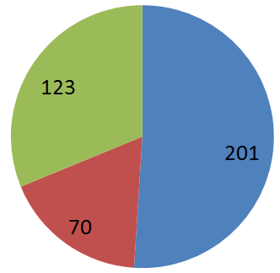
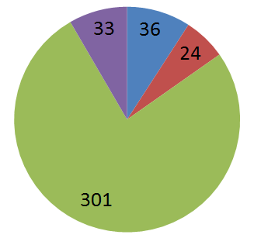
Results
Configuration changes arise in every version of all software systems
(394 configuration changes in total)
Reliability
Fix bugs
Renaming
Modified
Options
Added
Options
Deleted
Options
Enhance features
Configuration change can lead to unexpected behaviors (details later)
Notes:
As a result, we found configuration changes arise in every version of all software systems
(click)
There are around 400 configuration changes in total
(click)
Around half of them are used to add new options, and the rest are used to modify or delete existing options.
(click)
If we look at the data in a different angle, the vast majority of config changes are used to enhance software features, while a small number of them are used to improve software reliability, fix bugs, or simply do renmaing.
(click)
As I will show later, those configuration changes can lead to unexpected software behaviors across versions.

Slide 22
Outline
Example
A Study of Configuration Evolution
The ConfSuggester Technique
Evaluation
Related Work
Contributions
Notes:
Next I am going to detail the confSuggester technique

Slide 23
Key insights of ConfSuggester
Control flow propagates most configuration options’ effects
The execution traces on the old version can serve as the “intended behavior”
The control flow difference and their impacts provides diagnosis clues
/* a configuration option in JMeter */
String output_format = readFromCommandLine();
...
if (output_format == “XML”) {
saveAsXML();
} else {
saveAsCSV();
}
The evaluation result of this predicate affects the
next 1000+ instructions
Notes:
There are two key insights in the design of ConfSuggester. First, for most configuration options, control flow propagates their effects.
(click)
in the Jmeter example, when the output_format configuration option is read from command line, it affects the control flow of whether saving the result as an xml file or as an csv file.
(click)
We can often use the execution trace on the old version to serve as the intended behavior, and then compare it with the execution trace on the new version.
The difference often indicate which parts of a program might be wrong and why
(click)
For this predicate affected by the output_format option, it affects the next 1000’s instruction execution.

Slide 24



Workflow of ConfSuggester
Old version
An old trace
Trace
Comparison
New version
A new trace
Report
Root Cause
Analyzer
1.
2.
3. …
Deviated execution parts
(at the predicate-level)
Notes:
ConfSuggester uses the following workflow.
(click)
It takes two program versions as input
(click)
Then, it asks the users to demonstrate the software behaviors on both versions. Each user demonstration produces an execution trace
(click)
Then, confsuggeser compares two execution traces
(click)
And identify a set of deviated predicates
(click)
Then, ConfSuggester analyzes the root causes to find a list of suspicious configuration options
The workflow of ConfSuggester is fairly complex. Essentially, it contains 3 steps, first
(click and go to the next slide)

Slide 25
Workflow of ConfSuggester
User demonstration:
show the error
Old version
An old trace
Dynamic analysis:
understand the
behavior
Trace
Comparison
New version
A new trace
Static analysis:
compute the solution
Report
Root Cause
Analyzer
1.
2.
3. …
Deviated execution parts
(at the predicate-level)
Notes:
It uses user demonstration to show the error
(click)
Then, it uses dynamic analysis to understand the software behavior
(click)
Then, it uses static analysi to compute the solution

Slide 26
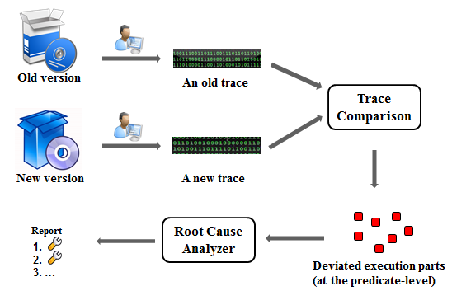
Workflow of ConfSuggester
Notes:
Let’s look at the first step
(click after the animation is done)

Slide 27
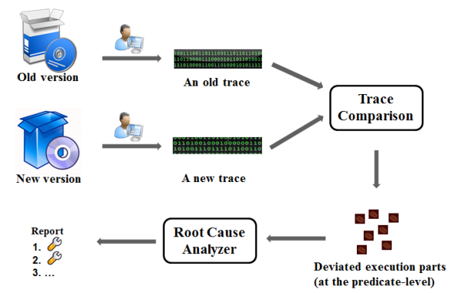
User demonstration
Old version
An old trace
New version
A new trace
Code instrumentation, monitoring:
predicate execution frequency and result
execution of each other instruction
Notes:
(click)
ConfSuggesters instruments two program versions by monitoring the predicate execution frequency and its execution results. It also monitors the execution of each other instructions.
(click)
Then it asks the user to demonstrate the behavior on two instrumented versions
(click)
Each user demonstration produces an execution trace

Slide 28


Execution trace comparison
An old trace
A new trace
: a predicate
: a deviated predicate
Matching
predicates
Identifying
deviated
predicates
Ranking
deviated
predicates
Notes:
The second step of execution trace comparison contains 3 steps
(click)
First, confsuggester uses a static statement matchiing algorithm to find the matched predicate on the new execution trace
(click)
Of course, some predicates may not have matched ones
(click)
In the second step, confsuggester identifies the behaviorally-deviated predicates across execution traces
(click)
Then, confsuggester ranks the identified deviated predicates by their impacts

Slide 29
Matching predicate across traces
JDiff algorithm [Apiwattanapong’07]
Tolerate small changes between versions
...
if (output_format == “XML”) {
saveAsXML();
} else {
saveAsCSV();
}
...
...
if (isValidFormat(output_format) {
//check validity
}
if (output_format == “XML”) {
checkXMLParser();
saveAsXML();
} else {
saveAsCSV();
}
...
Old version
New version
Notes:
In the first step, confsuggester uses a Jdiff algorithm to match statement across versions. The Jdiff algorithm can tolerate small changes.
(click)
For example, we have an old program version and its new version. The blue part represents the changed code part
(click)
In this code example, there are 3 predicates.
(click)
The Jdiff algorithm can correct identify the two red predicates are matched across execution traces

Slide 30
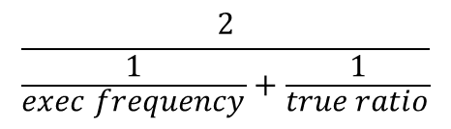
Identifying deviated predicates
Goal:
An old trace
…
A new trace
: a predicate
: a deviated predicate
a predicate p’s behavior in an execution trace t:
ϕ (p, t) =
a predicate p’s behavior difference across executions:
deviation(p, t_{old}, t_{new}) = | ϕ (p, t_{old}) - ϕ (p, t_{new}) |
p is a deviated predicate, if deviation(p, t_{old}, t_{new}) > δ
$$\frac{2}{\frac{1}{exec frequency}+\frac{1}{true ratio}}$$
Notes:
Next, confsuggesters identifies behaviorally-deviated predicates between 2 execution traces.
(click)
We define a metric to capture a predicate p’s behavior in an execution t.
This predicate combines the predicate execution frequency and the predicate evaluation result, which is the true ratio.
(click)
We also defiine a metric called deviation to capture a predicate p’s behavior change across 2 executions. This deviation metric is the absolute difference between p’s behavior in the old trace and p’s behavior in the new trace.
(click)
Finally, we selected p as a deviated predicate is the deviation value is greater than a threshold, which is 0.1 in our experiment

Slide 31
Ranking deviated predicates
Rank predicates by their impacts
A predicate p’s deviation impact
= deviation(p, t_{old}, t_{new})
× (controlled_instructions(p, t_{old}) + controlled_instructions(p, t_{new}) )
Defined in the previous slide
predicate p:
Old trace
# of instructions
executed
Old trace
...
if (output_format == “XML”) {
saveAsXML();
} else {
saveAsCSV();
}
...
if(..)
saveAsXML()
saveAsCSV()
Notes:
controlled_instructions
In the third step, confsuggester ranks deviated predicates by the number of controlled instructions.
(click)
We define a metric to capture a predicate p’s deviation impact.
The metric multiples the deviation metric, which is defined in step 2, with the number of controlled instructions.
(click)
(click)
Next, I will focus on illustrating the number of controlled instructions by examples
(click)
For the codes snippet in Jmeter,
(click)
Here is the corresponding control flow graph
(click)
Suppose the old execution trace takes the true branch of the predicate, the number of controlled instruction on the old version is the number of instructions in the saveAsXML() method

Slide 32
Ranking deviated predicates
Rank predicates by their impacts
A predicate p’s deviation impact
= deviation(p, t_{old}, t_{new})
× (controlled_instructions(p, t_{old}) + controlled_instructions(p, t_{new}) )
predicate p:
New trace
New trace
# of instructions
executed
...
if (output_format == “XML”) {
saveAsXML();
} else {
saveAsCSV();
}
...
if(..)
saveAsXML()
saveAsCSV()
Notes:
(click)
Similarly, if the new exectuion trace takes the false branch, the # of controlled instruction is the instruction executed in the saveAsCSV() method

Slide 33
Ranking deviated predicates
Rank predicates by their impacts
A predicate p’s deviation impact
= deviation(p, t_{old}, t_{new})
× (controlled_instructions(p, t_{old}) + controlled_instructions(p, t_{new}) )
Approximate the impact of a predicate’s behavior change to the subsequent program execution.
predicate p:
New trace
New trace
# of instructions
executed
...
if (output_format == “XML”) {
saveAsXML();
} else {
saveAsCSV();
}
...
if(..)
saveAsXML()
saveAsCSV()
Notes:
Using this metric, confsuggester approximates the impact of predicate’s behavior change to the subsequent program execution

Slide 34
Root Cause Analyzer
Find configuration options affecting the deviated predicate
Using static thin slicing [Sridharan ’07]
//a configuration option in JMeter
String output_format = ...;
...
if (output_format == “XML”) {
saveAsXML();
} else {
saveAsCSV();
}
Find the affecting predicate
Compute a backward thin slice
from here
The behavior of this predicate deviates
Report
1.
2.
3. …
output_format
Notes:
In the last step, confsuggester finds configuration options affecting each deviated predicate by using static thin slicing
(click)
For example, in Jmeter
(click)
This predicate is deviated
(click)
Confsuggester computes a backward thin slice from the predicate and identify the configuration options whose initialization statements are in the slice
(click)
Confsuggester outputs the identified affecting predicate as the suspicious configuration options. For the Jmeter example, at the top is the output_format option

Slide 35
Outline
Example
A Study of Configuration Evolution
The ConfSuggester Technique
Evaluation
Related Work
Contributions
Notes:
Now, I am going to present the evaluation of ConfSuggester

Slide 36
8 configuration errors from 6 subjects
Subject | LOC | #Options | ∆LOC | #Config errors
Randoop | 18587 | 57 | 1893 | 1
Weka | 275035 | 14 | 1458 | 1
Synoptic | 19153 | 37 | 1658 | 2
JChord | 26617 | 79 | 3085 | 2
JMeter | 91797 | 55 | 3264 | 1
Javalanche | 25144 | 35 | 9261 | 1
Non-trivial code changes
Reproduced from change logs and user reports.
Notes:
We evaluated confsuggester on 8 configuration errors from 6 subject programs.
For each subject programs, based on the change logs and user reports, we collected 2 software versions and reproduced the error introduced in the software evolution.

Slide 37
ConfSuggester’s accuracy
Measure accuracy by the rank of the actual root cause in ConfSuggester’s output
1.
2.
3. …
Notes:
We measure the accuracy of ConfSuggester by the rank of the actual root cause in its output
Before we present the results of confsuggester, let me first show you the results of base line and previous work
(click)
We use “arbitrary selection” as a baseline for comparison. That is, if there is no tool support, users may select the suspicious option in an arbitrary order. For this base, the average rank is the half of the available cofniguration option number.
(click)
Our ConfSuggester technique produces significantly better results than the base line
(click)
For 6 errors, the root cause ranks 1st
(read the text on the slide)

Slide 38
ConfSuggester’s accuracy
Measure accuracy by the rank of the actual root cause in ConfSuggester’s output
1.
2.
3. …
Technique | Average Root Cause Rank
Baseline | 23.3
ConfAnalyzer [Rabkin’11] | 22
ConfDiagnoser [Zhang’13] | 15.3
ConfSuggester | 1.9
Baseline:
Users select options in an arbitrary order
Half of the total number of available options

Slide 39
ConfSuggester’s accuracy
Measure accuracy by the rank of the actual root cause in ConfSuggester’s output
1.
2.
3. …
Technique | Average Root Cause Rank
Baseline | 23.3
ConfAnalyzer [Rabkin’11] | 22
ConfDiagnoser [Zhang’13] | 15.3
ConfSuggester | 1.9
ConfAnalyzer:
Use program slicing for error diagnosis

Slide 40
ConfSuggester’s accuracy
Measure accuracy by the rank of the actual root cause in ConfSuggester’s output
1.
2.
3. …
Technique | Average Root Cause Rank
Baseline | 23.3
ConfAnalyzer [Rabkin’11] | 22
ConfDiagnoser [Zhang’13] | 15.3
ConfSuggester | 1.9
ConfDiagnoser:
Use trace comparison (on the same version) for error diagnosis

Slide 41
ConfSuggester’s accuracy
Measure accuracy by the rank of the actual root cause in ConfSuggester’s output
1.
2.
3. …
Technique | Average Root Cause Rank
Baseline | 23.3
ConfAnalyzer [Rabkin’11] | 22
ConfDiagnoser [Zhang’13] | 15.3
ConfSuggester (this paper) | 1.9
ConfSuggester:
6 errors: root cause ranks 1st
1 error: root cause ranks 3rd
1 error: root cause ranks 6th
Notes:
Change the slides
We measure the accuracy of ConfSuggester by the rank of the actual root cause in its output
(click)
We use “arbitrary selection” as a baseline for comparison. That is, if there is no tool support, users may select the suspicious option in an arbitrary order. For this base, the average rank is the half of the available cofniguration option number.
(click)
Our ConfSuggester technique produces significantly better results than the base line
(click)
For 6 errors, the root cause ranks 1st
(read the text on the slide)

Slide 42

ConfSuggester’s efficiency
User demonstration
6 minutes per error, on average
Error diagnosis
4 minutes per error, on average
Notes:
Does our technique take too much time? No, ConfSuggester just runs in a practice amount of time.
The user demonstration costs less than 6 minutes per error, on average
And the error diagnosis costs less than 4 minutes per error, on average.

Slide 43
Outline
Example
A Study of Configuration Evolution
The ConfSuggester Technique
Evaluation
Related Work
Contributions
Notes:
Now, I am going to discuss some related work

Slide 44
Related work on configuration error diagnosis
Tainting-based techniques
Dynamic tainting [Attariyan’08], static tainting [Rabkin’11]
Focuses exclusively on crashing errors
Search-based techniques
Delta debugging [Zeller’02], Chronus [Whitaker’04]
Requires a correct state for comparison, or OS-level support
Domain-specific techniques
PeerPressure [Wang’04], RangeFixer [Xiong’12]
Targets a specific kind of configuration errors, and does not support a general language like Java
A common limitation: do not support configuration error diagnosis in software evolution.
Notes:
Several configuration error diagnosis techniques are developed in the literature
(click)
First, tainting-based techniques exclusively focus on crashing errors, while our technique can also handle non-crashing errors.
(click)
Search-based technique like delta debugging and Chronus often require a correct state for comparison or OS-level support, while our techniques eliminate these assumptions
(click)
There are also domain-specific techniques developed for a specific kind of configuration errors. However, these techniques do not support a general language like Java.
(click)
Furthermore, all previous techniques do not support configuration errors in software evolution.

Slide 45
Outline
Example
A Study of Configuration Evolution
The ConfSuggester Technique
Evaluation
Related Work
Contributions
Notes:
(say nothing, go to the next slide)

Slide 46



Contributions
Report
ConfSuggester
1.
2.
3. …
Configuration errors
A technique to diagnose configuration errors for evolving software
Compare relevant predicate behaviors between executions from two versions
The ConfSuggester tool implementation
http://config-errors.googlecode.com
Accessible: no assumption about user background
Easy-to-use: fully automated
Portable: no changes to OS or runtime environment
Accurate: few false positives
Notes:
To sum up, Today, I have presented a technique to diagnose configuration errors for evolving software. The key takeway message is that we can compare relevant predicate behaviors between executions from 2 software versions to reason about the solutions.
(click)
We have achieved our design goals, making our technique accessible, easy-to-use, protable, and accurate.
(click)
The tool implementation can be downloaded from the following URL
(click)
Now I would like to take some questions
Thank you, Kivanc!

