Slide 1
Change Impact Analysis for AspectJ Programs
Sai Zhang, Zhongxian Gu, Yu Lin and Jianjun Zhao
Shanghai Jiao Tong University

Slide 2
Change Impact Analysis for AspectJ Programs
AspectJ’s specific constructs requires adapting the existing analysis techniques
  Requires to handle the unique aspectual features
Can we develop techniques/tools automatically determine the affected program fragments, affected tests and their responsible changes?
In this paper, we present an approach to address both questions with atomic change and AspectJ call graph representation

Slide 3
Outline
Background and Motivation
  Software Change impact analysis
  AspectJ semantics and analysis challenges
Contributions
  A catalog of atomic changes for AspectJ, to capture semantic change information
  A change impact analysis model for AspectJ programs
  Experimental Evaluation
Conclusion
  Change impact analysis applications
  Future work

Slide 4
Outline
Background and Motivation
  Software Change impact analysis
  AspectJ semantics and analysis challenges
Contributions
  A catalog of atomic changes for AspectJ, to capture semantic change information
  A change impact analysis model for AspectJ programs
  Experimental Evaluation
Conclusion
  Change impact analysis applications
  Future work

Slide 5
Software Change Impact Analysis
A useful technique for software evolution, it can be used to:
  Determine the effects of a source editing session, including:
  Predict the potential impact of changes before applied
  Estimate the side-effect of changes after they are addressed
Applications of change impact analysis
  Testing, debugging, change assessment, etc.

Slide 6
AspectJ Semantic
An AspectJ program can be divided into two parts:
  Base code, that is, language constructs as in Java
  Aspect code, includes aspectual constructs , like join point, pointcut, advice, intertype declarations.
A Simple Example:
aspect
aspect M {
pointcut callPoints():
execution(* C.n());
after(): callPoints() { …. }
}
class C {
void n(){...}
}
pointcut
Join point
advice

Slide 7
AspectJ Semantic
An AspectJ program can be divided into two parts:
  Base code, that is, language constructs as in Java
  Aspect code, includes aspectual constructs , like join point, pointcut, advice, intertype declarations.
A Simple Example:
aspect M {
pointcut callPoints():
execution(* C.n());
after(): callPoints() { …. }
}
class C {
void n(){...}
}
aspect M {
pointcut callPoints():
execution(* C.n());
after(): callPoints() { …. }
}
main() {
…
new C().n()
…
}
invoke

Slide 8
Analyses Challenges
Changes in both aspect/base code can change dramatically the program behavior
  Such as editing pointcut designator
Can we directly apply existing techniques to AspectJ programs?
  The discrepancy between source code and the woven bytecode can be significant
  Compiler-specific code
  Hard to estimate relationships for mapping analysis result to the source code [Xu et al. ICSE 07]
A more general question
  What is an appropriate static change representation for AspectJ software for impact analysis and other tasks?

Slide 9
Our approach
Perform source-code-level static analysis for AspectJ software
Use atomic changes to represent code modifications in AspectJ program (extend Ryder et al. OOPSLA 04’s catalog for Java)
Employ static aspect-aware call graph to safely identify impacted program fragments

Slide 10
Outline
Background and Motivation
  Software Change impact analysis
  AspectJ semantics and analysis challenges
Contributions
  A catalog of atomic changes for AspectJ, to capture semantic change information
  A change impact analysis model for AspectJ programs
  Experimental Evaluation
Conclusion
  Change impact analysis applications
  Future work

Slide 11
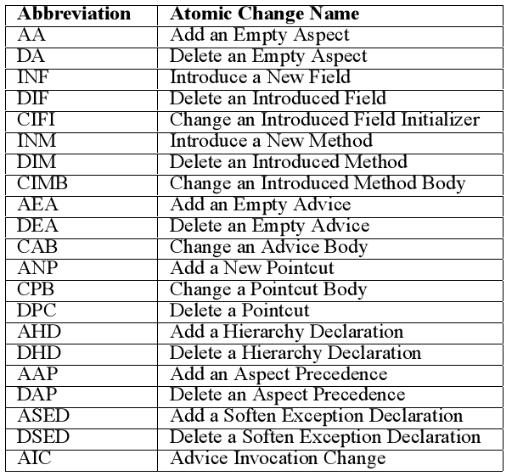
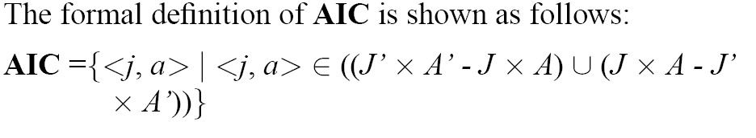
Atomic Change Representation
A catalog of atomic changes for AspectJ
  Abstracted change representations
  Proposed for capturing semantic change information, which is foundation of our analysis model
Reflects the semantic different between the original program Pand edited
program P’, in forms of <joinpoint, advice> matching tuples

Slide 12
Example
aspect M { class C {
pointcut callPoints(): void n(){...}
execution(* C.n()); }
after(): callPoints() { …. }
}
AA (M)
ANP( callPoints) , CPB(callPoints)
AEA( after:callPoints) , CAB(after:callPoints)
AIC(C.n(), after:callPoints)

Slide 13
Inter-dependences between atomic changes
Syntax dependence
  To ensure the syntactical correctness of program when applying one change
Interaction dependence
  Model the interactions between aspect code and base code
Why we need dependence?
  Capture semantic relationships between source code change
  Construct intermediate program versions for debugging
  Use for further analysis, such as incremental analysis

Slide 14
Example: Syntactic Dependence
aspect M { class C {
pointcut callPoints(): void n(){...}
execution(* C.n()); }
after(): callPoints() { …. }
}
AA (M)
ANP( callPoints) , CPB(callPoints)
AEA( after:callPoints) , CAB(after:callPoints)
AIC(C.n(), after:callPoints)
CAB depends on AEA => CAB AEA
AEA depends on ANP => AEA ANP

Slide 15

Example: Interaction Dependence
aspect M { class C {
pointcut callPoints(): void n(){...}
execution(* C.n()); }
after(): callPoints() { …. }
}
AA (M)
ANP( callPoints) , CPB(callPoints)
AEA( after:callPoints) , CAB(after:callPoints)
AIC(C.n(), after:callPoints)
AIC depends on AEA => AIC AEA

Slide 16
Change Impact Analysis Model
A change impact analysis model for AspectJ programs
  Used to identify affected program fragments, affected regression tests, and their corresponding changes
This analysis model is based on aspect-aware call graph
  Use RTA algorithm to build static call graph for the base code
  Treat advice as a method-like node
  Matching relationship of <advice, joinpont> as edges
  Finally connect base code and aspect code graph
    Conservative assumption for dynamic pointcut

Slide 17
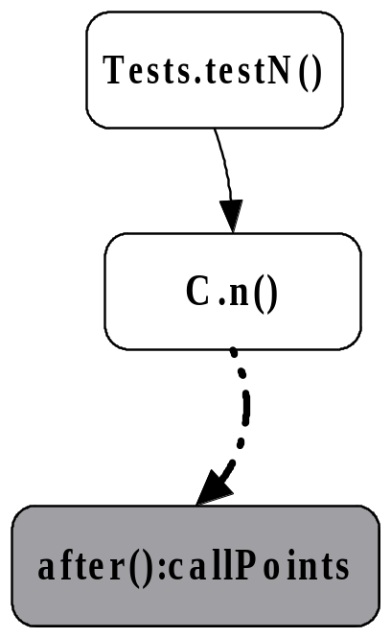
Example: call graph
aspect M { class C {
pointcut callPoints(): void n(){...}
execution(* C.n()); }
after(): callPoints() { …. } class Tests {
} void testN() {
new C().n();
}}

Slide 18
Impact Analysis Model
Detecting affected program fragments
  Traversing the call graph from the modified nodes
Detecting affected tests
  The call graph of test contains an affected node
Detecting responsible changes
  All the atomic changes appearing on the call graph nodes (edges), and all their prerequisites

Slide 19
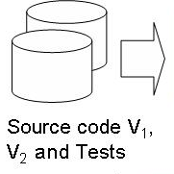
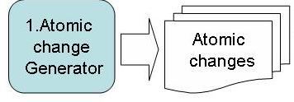
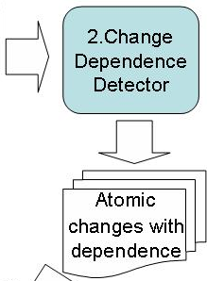
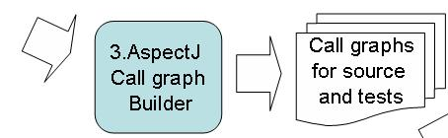
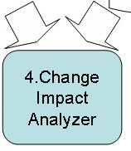
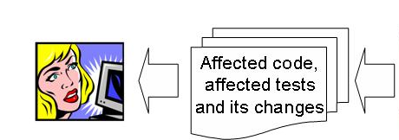
Tool Implementation
We implement our automatic analysis tool, Celadon, on top of ajc compiler [ICSE 08 demo, AOSD 08 demo]

Slide 20
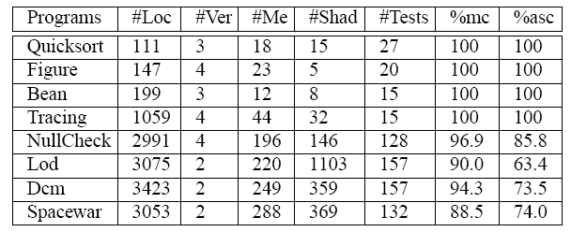
Evaluation
Evaluation and applications
  On 24 AspectJ benchmark versions
Subject programs

Slide 21
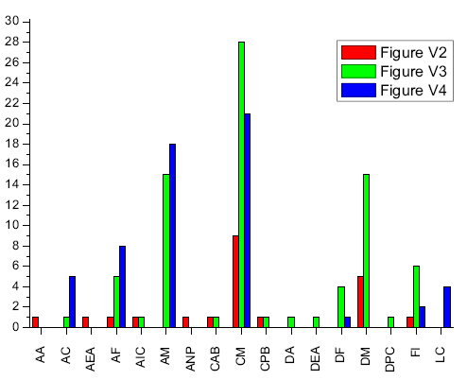
Experimental Result (1)
Atomic changes between version pairs
Celadon successfully handle aspectual features.

Slide 22
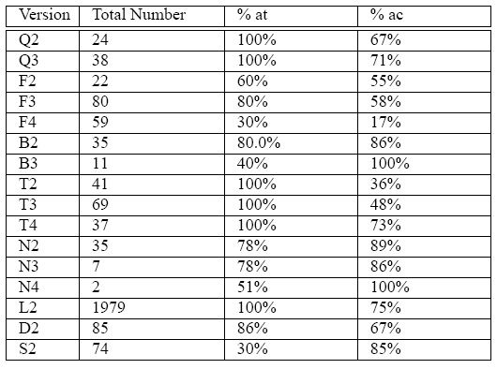
Experimental Result (2)
Affected tests and affecting changes
Faulty change isolation
For regression test selection

Slide 23
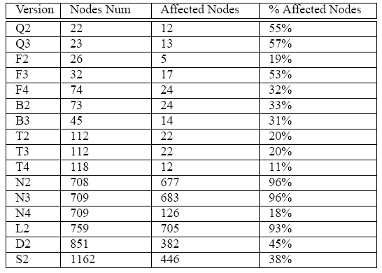
Experimental Result (3)
Affected program fragment (at method level)
For change assessment

Slide 24
Experiment Discussion
Discussion
  Promising experimental result for AspectJ programs
  Handle aspectual features
Threats to validity
  Scalability
  Human bias

Slide 25
Outline
Background and Motivation
  Software Change impact analysis
  AspectJ semantics and analysis challenges
Contributions
  A catalog of atomic changes for AspectJ, to capture semantic change information
  A change impact analysis model for AspectJ programs
  Experimental Evaluation
Related Work
Conclusion
  Change impact analysis applications
  Future work

Slide 26
Related Work
Atomic Changes in OO Programs [Ryder et al 01]
Change Impact Analysis for Java[Ren et al 04]
Change Impact Analysis for AspectJ [Zhao 02, Shinomi et al 05, Stoerzer 05]
Change Impact Analysis Applications [Chelsey 05, Ren 06, 07, Stoerzer 06]
Regression Tests Selection [Zhao 06, Xu 07]
Delta Debugging [Zeller et al, 99, 02, 05, Misherghi et al 06]

Slide 27
Outline
Background and Motivation
  Software Change impact analysis
  AspectJ semantics and analysis challenges
Contributions
  A catalog of atomic changes for AspectJ, to capture semantic change information
  A change impact analysis model for AspectJ programs
  Experimental Evaluation
Conclusion
  Change impact analysis applications
  Future work

Slide 28
Limitation and Future Work
Improve the visualization of output result
  Rich information instead of a textual tree-based representation
  More clearly for programmer’s to use
Improve the atomic change model for AO programs
  Modeling dynamic pointcut, like cflow
Investigate more applications
  Automated debugging support [PASTE 08]
  Maintainability assessment [TASE 08]
  Incremental analysis [Technical report]
  …

Slide 29
Summary
We extend the atomic changes in Java to AspectJ programming language.
We present a change impact analysis model for AspectJ programs.
We implement Celadon, a change impact analysis tool for AspectJ Programs.
We apply Celadon to other program analysis applications, such as automatic debugging.

