Slide 1
Combined Static and Dynamic Automated Test Generation
Sai Zhang
University of Washington
Joint work with:
David Saff, Yingyi Bu, Michael D. Ernst

Slide 2
Unit Testing for Object-oriented Programs
Unit test = sequence of method calls + testing oracle
Automated test generation is challenging:
Legal sequences for constrained interfaces
Behaviorally-diverse sequences for good coverage
Testing oracles (assertions) to detect errors

Slide 3
Unit Testing a Database Program
public void testConnection() {
Driver driver = new Driver();
Connection connection =
driver.connect("jdbc:tinysql");
Statement s = connection.createStmt();
s.execute("create table test (name char(25))");
....
s.close();
connection.close();
}
Constraint 1:
Method-call orders
1
2
3
Constraint 2:
Argument values
It is hard to create tests automatically!

Slide 4

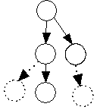
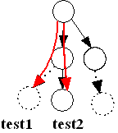
Palus: Combining Dynamic and Static Analyses
Dynamically infer an object behavior model from a sample (correct) execution trace
Capture method-call order and argument constraints
Statically identify related methods
Expand the (incomplete) dynamic model
Model-Guided random test generation
Fuzz along a specific legal path

Slide 5
Outline
Motivation
Approach
Dynamic model inference
Static model expansion
Model-guided test generation
Evaluation
Related Work
Conclusion and Future Work

Slide 6
Overview of the Palus approach
Inputs:
A Sample Trace
Dynamic
Model Inference
Dynamic Model
Guided Random
Test Generation
Program Under Test
Static Method Analysis
Method
Dependence
JUnit Theories
Testing Oracles
JUnit Tests
Outputs:
(Optional)

Slide 7
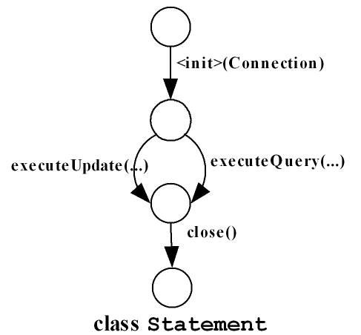
(1) Dynamic Model Inference
Infer a call sequence model for each tested class
Capture possible ways to create legal sequences
A call sequence model
A rooted, acyclic graph
Node: object state
Edge: method-call
One model per class

Slide 8
An Example Trace for Model Inference
Driver d = new Driver()
Connection con = driver.connection(“jdbc:dbname”);
Statement stmt1 = new Statement(con);
stmt1.executeQuery(“select * from table_name”);
stmt1.close();
Statement stmt2 = new Statement(con);
stmt2.executeUpdate(“drop table table_name”);
stmt2.close();
con.close();

Slide 9
Model Inference for class Driver
Driver d = new Driver();
Driver class
A
<init>()
B

Slide 10
Model Inference for class Connection
Connection con = driver.connect(“jdbc:dbname”);
Driver class
Connection class
A
C
<init>()
Driver.connect(“jdbc:dbname”)
B
D
Nested calls are omitted for brevity

Slide 11
Model Inference for class Connection
Connection con = driver.connect(“jdbc:dbname”);
con.close();
Driver class
Connection class
A
C
<init>()
Driver.connect(“jdbc:dbname”)
B
D
close()
E
Nested calls are omitted for brevity

Slide 12
Model Inference for class Statement
Statement stmt1 = new Statement(con);
stmt1.executeQuery(“select * from table_name”);
stmt1.close();
Driver class
Connection class
Statement stmt1
A
C
F
<init>(Connection)
<init>()
Driver.connect(“jdbc:dbname”)
G
B
D
executeQuery(“select * ..”);
H
close()
close()
E
G
Construct a call sequence model for each observed object

Slide 13
Model Inference for class Statement
Statement stmt2 = new Statement(con);
stmt2.executeUpdate(“drop table table_name”);
stmt2.close();
Driver class
Connection class
Statement stmt1
Statement stmt2
A
C
F
I
<init>(Connection)
<init>(Connection)
<init>()
Driver.connect(“jdbc:dbname”)
G
J
B
D
executeQuery(“select * ..”);
executeUpdate(“drop * ..”);
H
K
close()
close()
close()
E
G
L
Construct a call sequence model for each observed object

Slide 14
Merge Models of the Same class
Merge
Driver class
Connection class
Statement stmt1
Statement stmt2
A
C
F
I
<init>(Connection)
<init>(Connection)
<init>()
Driver.connect(“jdbc:dbname”)
G
J
B
D
executeQuery(“select * ..”);
executeUpdate(“drop * ..”);
H
K
close()
close()
close()
E
G
L
Merge models for all objects to form one model per class

Slide 15
Call Sequence Model after Merging
Driver class
Connection class
Statement class
A
F
C
<init>(Connection)
<init>()
Driver.connect(“jdbc:dbname”)
G
B
D
executeQuery(“select * ..”);
executeUpdate(“drop * ..”);
close()
H
E
close()
G

Slide 16
Enhance Call Sequence Models with Argument Constraints
F
Invoking the constructor requires a Connection object
<init>(Connection)
G
But, how to choose a desirable Connection object ?
executeQuery(“select * ..”);
executeUpdate (“drop * ..”);
H
close()
G
Statement class

Slide 17
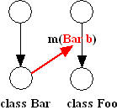
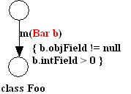
Argument Constraints
Argument dependence constraint
Record where the argument object values come from
Add dependence edges in the call sequence models
Abstract object profile constraint
Record what the argument value “is”
Map each object field into an abstract domain
as a coarse-grained measurement of “value similarity”

Slide 18
Argument Dependence Constraint
Represent by a directed edge ( below)
Means: transition F → G has data dependence on node D, it uses the result object at the node D
Guide a test generator to follow the edge to select argument
F
A
C
<init>(Connection)
<init>
Driver.connect(“jdbc:dbname”)
G
executeQuery(“select * ..”);
executeUpdate(“drop * ..”);
B
D
Driver class
H
close()
close()
E
G
Connection class
Statement class

Slide 19
Abstract Object Profile Constraint
For each field in an observed object
Map the concrete value → an abstract state
Numeric value → > 0, = 0, < 0
Object → = null, != null
Array → empty, null, not_empty
Bool /enum values → not abstracted
Annotate model edges with abstract object profiles of the observed argument values from dynamic analysis
Guide test generator to choose arguments similar to what was seen at runtime

Slide 20
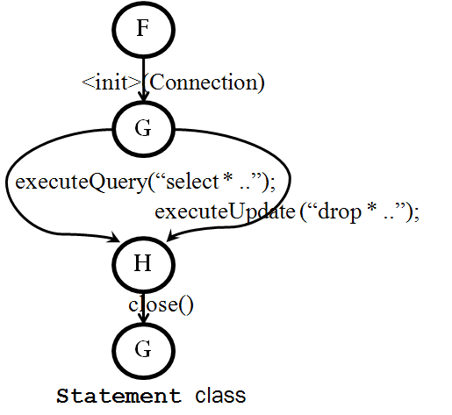
Annotate Model Edges with Abstract Object Profiles
Class Connection contains 3 fields
Driver driver; String url; String usr;
All observed valid Connection objects have a profile like: {driver != null, url != null, usr != null}
Annotate the method-call edge: <init>(Connection)
Argument Connection’s profile:
{driver != null, url != null, usr !=null}
Palus prefers to pick an argument with the same profile,
when invoking : <init>(Connection)

Slide 21
(2) Static Method Analysis
Dynamic analysis is accurate, but incomplete
May fail to cover some methods or method invocation orders
Palus uses static analysis to expand the dynamically-inferred model
Identify related methods, and test them together
Test methods not covered by the sample trace

Slide 22
Statically Identify Related Methods
Two methods that access the same fields may be related (conservative)
Two relations:
Write-read: method A reads a field that method B writes
Read-read: methods A and B reference the same field

Slide 23
Statically Recommends Related Methods for Testing
Reach more program states
Call setX() before calling getX()
Make the sequence more behaviorally-diverse
A correct execution observed by dynamic analysis will never contain:
Statement.close();
Statement.executeQuery(“…”)
But static analysis may suggest to call close() before executeQuery(“…”)

Slide 24

Weighting Pair-wise Method Dependence
tf-idf weighting scheme [Jones, 1972]
Palus uses it to measure the importance of a field to a method
Dependence weight between two methods:

Slide 25
(3) Model-Guided Random Test Generation: A 2-Phase algorithm
Phase1:
Loop:
1. Follow the dynamically-inferred model to select methods to invoke
2. For each selected method
2.1 Choose arguments using:
- Argument dependent edge
- Captured abstract object profiles
- Random selection
2.2 Use static method dependence information to
invoke related methods
Phase 2:
Randomly generate sequences for model-uncovered methods
- Use feedback-directed random test generation [ICSE’07]

Slide 26
Specify Testing Oracles in JUnit Theory
A project-specific testing oracle in JUnit theory
@Theory
public void checkIterNoException(Iterator it) {
assumeNotNull(it);
try {
it.hasNext();
} catch (Exception e) {
fail(“hasNext() should never throw exception!”);
}
}
Palus checks that, for every Iterator object, calling hasNext() should never throw exception!

Slide 27
Outline
Motivation
Approach
Dynamic model inference
Static model expansion
Model-guided test generation
Evaluation
Related Work
Conclusion and Future Work

Slide 28
Research Questions
Can tests generated by Palus achieve higher structural coverage
Can Palus find (more) real-world bugs?
Compare with three existing approaches:
Approaches | Dynamic | Static | Random
Randoop [ICSE’07] |  |  | ●
Palulu [M-TOOS’06] | ● |  | ●
RecGen [ASE’ 10] |  | ● | ●
Palus (Our approach) | ● | ● | ●

Slide 29
Subjects in Evaluating Test Coverage
6 open-source projects
Program | Lines of Code
tinySQL | 7,672
SAT4J | 9,565
JSAP | 4,890
Rhino | 43,584
BCEL | 24,465
Apache Commons | 55,400
Many
Constraints
Few
Constraints

Slide 30
Experimental Procedure
Obtain a sample execution trace by running a simple example from user manual, or its regression test suite
Run each tool for until test coverage becomes saturated, using the same trace
Compare the line/branch coverage of generated tests

Slide 31
Test Coverage Results
Approaches | Dynamic | Static | Random | Avg Coverage
Randoop [ICSE’07] |  |  | ● | 39%
Palulu [M-TOOS’06] | ● |  | ● | 41%
RecGen [ASE’ 10] |  | ● | ● | 30%
Palus (Our approach) | ● | ● | ● | 53%
Palus increases test coverage
Dynamic analysis helps to create legal tests
Static analysis / random testing helps to create behaviorally-diverse tests
Palus falls back to pure random approach for programs with few constraints (Apache Commons)

Slide 32
Evaluating Bug-finding Ability
Subjects:
The same 6 open-source projects
4 large-scale Google products
Procedure:
Check 5 default Java contracts for all subjects
Write 5 simple theories as additional testing oracles for Apache Commons, which has partial spec

Slide 33
Finding Bugs in 6 open-source Projects
Checking default Java language contracts:
E.g., for a non-null object o: o.equals(o) returns true
Finds the same number of bugs as Randoop
Writing additional theories as testing oracle
Palus finds one new bug in Apache Commons
FilterListIterator.hasNext() throws exception
Confirmed by Apache Commons developers
 | Dynamic | Static | Random | Bugs
Randoop [ICSE’07] |  |  | ● | 80
Palulu [M-TOOS’06] | ● |  | ● | 76
RecGen [ASE’ 10] |  | ● | ● | 42
Palus (Our approach) | ● | ● | ● | 80

Slide 34
Finding Bugs in 4 Google Products
4 large-scale Google products
Each has a regression test suite with 60%+ coverage
Go through a rigorous peer-review process
Google Product | Number of tested classes
Product A | 238
Product B | 600
Product C | 1,269
Product D | 1,455

Slide 35
Palus Finds More Bugs
Palus finds 22 real, previously-unknown bugs
3 more than existing approaches
Primary reasons:
Fuzz a long specific legal path
Create a legal test, diversify it, and reach program states that have not been reached before
 | Dynamic | Static | Random | Bugs
Randoop [ICSE’07] |  |  | ● | 19
Palulu [M-TOOS’06] | ● |  | ● | 18
RecGen [ASE’ 10] |  | ● | ● | --
Palus (Our approach) | ● | ● | ● | 22

Slide 36
Outline
Motivation
Approach
Dynamic model inference
Static model expansion
Model-guided test generation
Evaluation
Related Work
Conclusion and Future Work

Slide 37
Related Work
Automated Test Generation
Random approaches: Randoop [ICSE’07], Palulu [M-Toos’06], RecGen[ASE’10]
Challenge in creating legal / behaviorally-diverse tests
Systematic approaches: Korat [ISSTA’02], Symbolic-execution-based approaches (e.g., JPF, CUTE, DART, KLEE…)
Scalability issues; create test inputs, not object-oriented method sequences
Capture-replay -based approaches: OCAT [ISSTA’10], Test Factoring [ASE’05] and Carving [FSE’05]
Save object states in memory, not create method sequences
Software Behavior Model Inference
Daikon [ICSE’99], ADABU [WODA’06], GK-Tail [ICSE’08] …
For program understanding, not for test generation

Slide 38
Outline
Motivation
Approach
Dynamic model inference
Static model expansion
Model-guided test generation
Evaluation
Related Work
Conclusion and Future Work

Slide 39
Future Work
Investigate alternative ways to use program analysis techniques for test generation
How to better combine static/dynamic analysis?
What is a good abstraction for automated test generation tools?
We use an enhanced call sequence model in Palus, what about other models?
Explain why a test fails
Automated Documentation Inference [ASE’11 to appear]
Semantic test simplification

Slide 40
Contributions
A hybrid automated test generation technique
Dynamic analysis: infer model to create legal tests
Static analysis: expand dynamically-inferred model
Random testing: create behaviorally-diverse tests
A publicly-available tool
http://code.google.com/p/tpalus/
An empirical evaluation to show its effectiveness
Increases test coverage
Finds more bugs

Slide 41
Backup slides

Slide 42
Sensitivity to the Inputs
Investigate on two subjects: tinySQL and SAT4J
This approach is not very sensitive to the inputs
Not too many constraints in subjects?
Subject | Input Size | Coverage
tinySQL | 10 SQL Statements | 59%
 | ALL Statements from Manual | 61%
SAT4J | A 5-clause formula | 65%
 | A 188-clause formula | 66%
 | A 800-clause formula | 66%

Slide 43
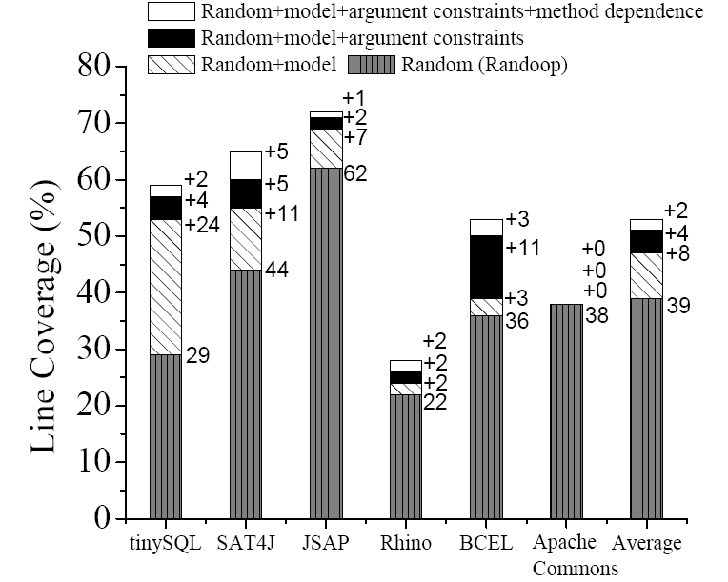
Breakdown of Contributions in Coverage Increase

