Slide 1
Finding Errors in Multithreaded GUI Applications
Sai Zhang
University of Washington
Joint work with: Hao Lu, Michael D. Ernst

Slide 2
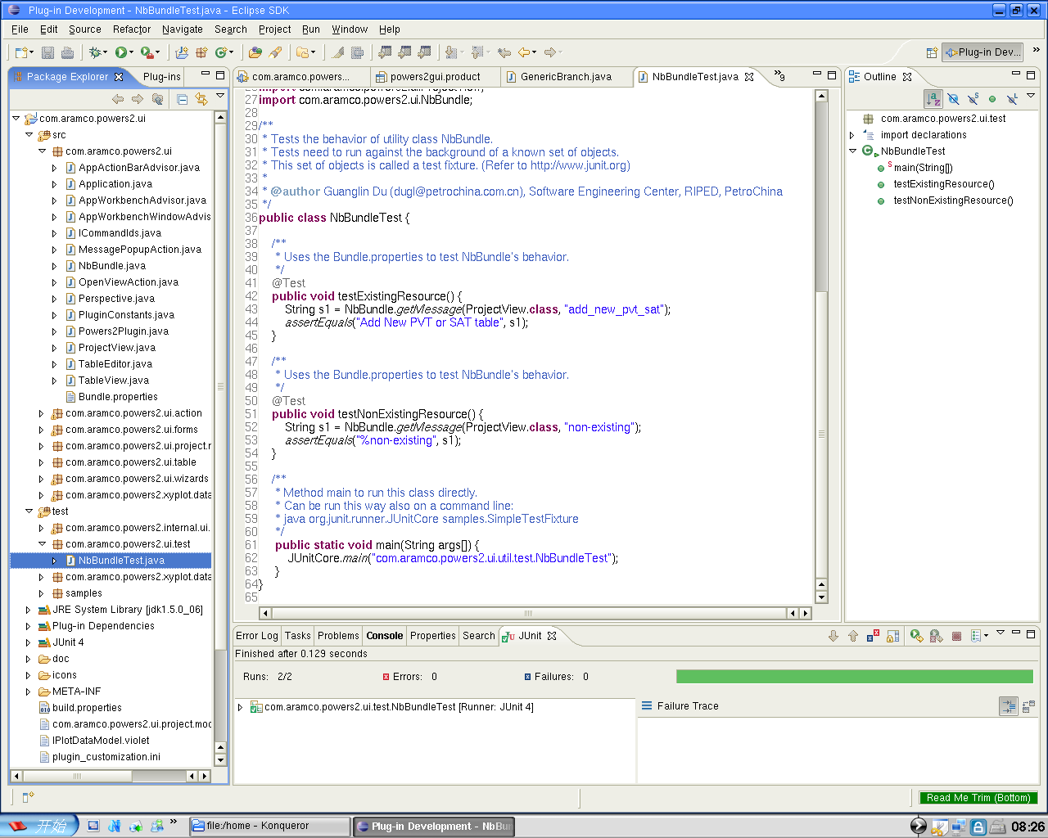
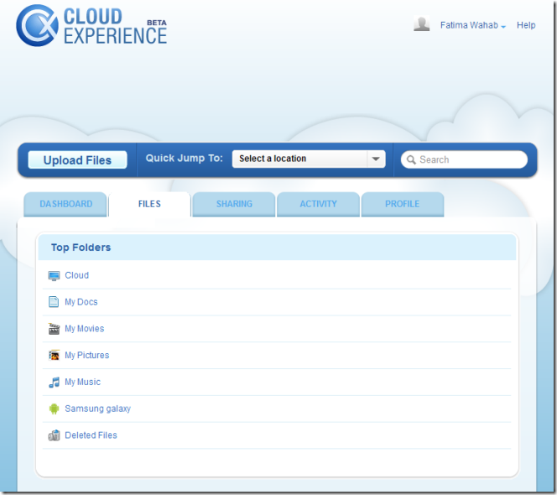
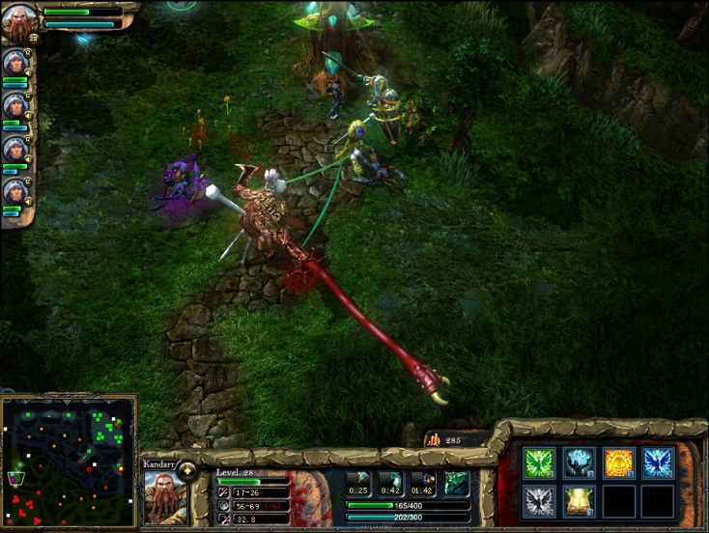
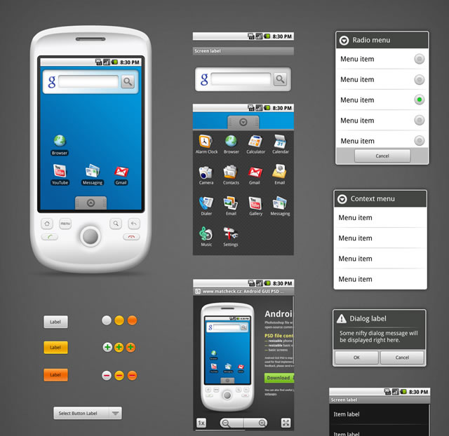
GUIs are everywhere in modern software

Slide 3



Multithreading in GUI applications
A GUI Application
UI thread
UI event 1
UI event 2

Slide 4







The Single-GUI-Thread Rule
All GUI objects must be exclusively accessed by the UI thread
Required by:
…
A GUI Application
UI thread
UI event 1
This non-UI thread must not access any GUI objects

Slide 5
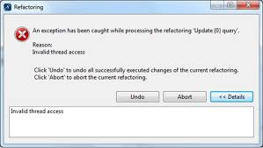
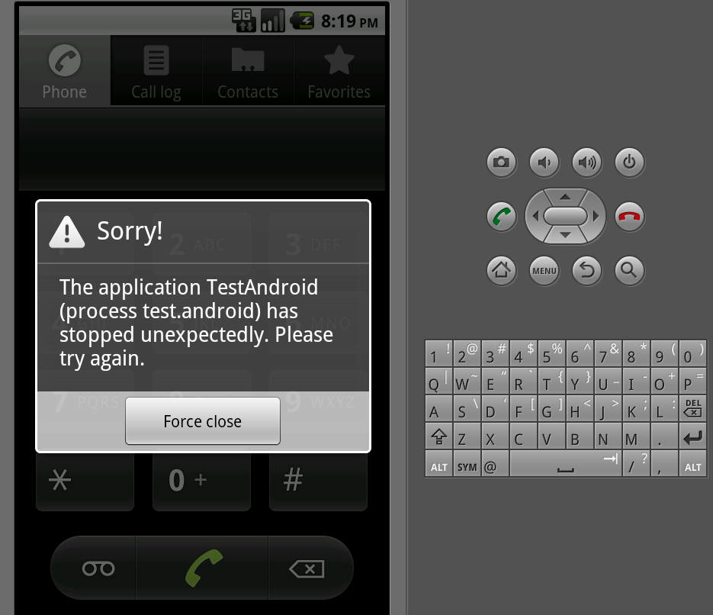
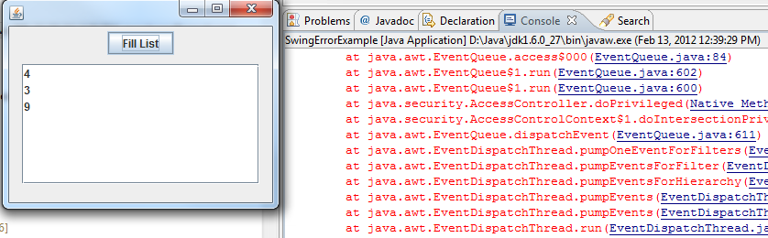
Violation of the Single-GUI-Thread rule
Triggers an “Invalid Thread Access Error”
May abort the whole application
SWT / Eclipse plugin
Android
Swing

Slide 6
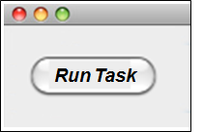
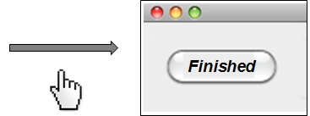

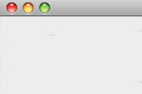


An Example Violation
UI thread
Do some computation,
and update the UI.
runTask()
a non-UI thread
button.setText(“.”)
button’s event handler:
checkThread()
public void runTask() {
Runnable r = new Runnable() {
public void run() {
… //do some lengthy computation
button.setText(“Finished”);
}
};
new thread(r).start();
}
Create a new, non-UI thread
Run Task
Finished
Access the button object to set text
//GUI framework code
public void setText(String) {
checkThread();
...
}
Trigger an invalid-thread-access-error

Slide 7
Invalid Thread Access Errors in practice
Pervasive
One of the top 3 bug categories in SWT [Shanmugam 2010]
A Google search returns 11800+ entries (bug reports, FAQs, etc.)
In Eclipse
2732 bug reports
156 confirmed bugs in 20+ projects, 40+ components
Severe
Often aborts the whole application
Hard to debug
Non-trivial effort to fix (e.g., 2 years to resolve one bug in Eclipse)

Slide 8
Why the Single-GUI-Thread Rule?
Simpler programming
No datarace nor deadlock on GUI objects
Less overhead
No locking when accessing GUI objects
A single event queue can dispatch UI events
Easy event processing, program comprehension, and testing

Slide 9

Our Error Detection Technique
Bugs
Static Analyses
10 bugs
1. Call graph construction
2. Error detection
3. Error filtering
A GUI Application
Warnings
5 hours human inspection
False
Positives
9 applications
from 4 supported
GUI frameworks
Less than 5 mins per application
20 warnings
10 false positives
-Automated: no need for a test harness
-General: instantiated it for 4 GUI frameworks:
-Scalable: evaluated on 9 applications, over 1.4 M LOC with lib code
-Practical: found 10 bugs with 10 false positives

Slide 10
Existing Solutions for this Problem
UI thread
runTask()
Testing
Misses many corner cases in practice
Stylized programming rules
a non-UI thread
asyncExec
setText(“…”)
public void runTask() {
Runnable r = new Runnable() {
public void run() {
… //do some lengthy computation
button.setText(“Finished”);
}
};
new thread(r).start();
}
Requiring Wrappers
Display.asyncExec(new Runnable(){
public void run() {
button.setText(“Finished”);
}
};
Results on 9 evaluation programs
Unnecessary: if already on the UI thread
Dangerous: may introduce new concurrency errors
 | #Warnings | #Bugs
Requiring Wrappers | 6393 | ?
Our technique | 20 | 10

Slide 11
Outline
Problem
Error detection technique
Implementation
Experiments
Related work
Conclusion and future work

Slide 12
Terminology
UI thread:
a single special thread to handle UI events
Non-UI thread: other threads
UI-accessing method:
a method whose execution may read or write a GUI object
Safe UI method:
message-passing methods to execute code on the UI thread
A GUI Application
UI-thread
asyncExec(..)
Non-UI thread
void runTask() {
...
button.setText(“..”);
}
Safe UI method
UI-accessing method

Slide 13
Assumptions
Single UI thread
Thread spawning:
Every non-UI thread is (transitively) spawned by the UI thread
A GUI Application
UI-thread
Non-UI thread

Slide 14

Problem formulation: call graph reachability
An invalid thread access error occurs when:
a non-UI thread invokes a UI-accessing method without going through a Safe UI method
A reachability problem
Source: non-UI thread spawning
Sink: UI-accessing method
button.setText(“”)
Non-UI thread spawning (source)
Display.asycExec(…)
UI-accessing method (sink)
Thread.start()
entry
Safe UI method
runTask()
Other method

Slide 15
Error detection algorithm
1. Construct a call graph for the tested program
2. Find paths from Thread.start() to UI-accessing methods without going through a safe UI method
Non-UI thread spawning
(i.e., Thread.start())
UI-accessing method
A method-call chain as error report
Safe UI method
entry
Other method

Slide 16
Reflection in Constructing Call Graphs
Android Application:
<LinearLayout>
<Button android:id="@+id/button_id" android:text="A Button" />
</LinearLayout>
...
Button button = (Button) findViewById(“button_id”);
button.setText(“This is a button”);
...
findViewById does not explicitly construct a button object
A call graph construction algorithm may:
- fail to conclude the variable button points to a concrete object
exclude a setText edge to the call graph (that should exist)
miss 1 bug in our experiments

Slide 17
Reflection-aware call graph construction
Android Application:
<LinearLayout>
<Button android:id="@+id/button_id" android:text="A Button" />
</LinearLayout>
Button button = (Button) findViewById(“button_id”);
button.setText(“This is a button”);
Before transformation:
After transformation:
Button button = new Button(null);
button.setText(“This is a button”);
Program transformation: replace reflection calls with explicit object creation expressions
Use an off-the-shelf call graph construction algorithm on the transformed program

Slide 18
Annotation support for native methods
Relationships between native methods and Java methods
@CalledByNativeMethods(callers = {“init”})
public void addTypeItem(int id, String label) { …}
- Manually specified
- addTypeItem(int, String) may be called by native method “init”
- Our technique will miss 1 bug without such annotations

Slide 19
Filtering the error reports
A static analysis may report:
false positives
redundant warnings with the same error root cause
A set of error filters to remove likely invalid reports
2 sound filters
3 heuristic filters

Slide 20
2 sound error report filters
Filter 1: remove syntactically subsumed reports
a() → b() → thread.start() → d()
b() → thread.start() → d()
Filter 2: remove reports containing user-annotated, project-specific methods
util.runOnUIMethod(Runnable r)
Checks whether the current thread is UI thread or not

Slide 21
3 heuristic error report filters
Filter 3: remove reports containing specific library calls
e.g., Runtime.shutDown
Filter 4: remove longer reports with the same “entry node → Thread.start()” head nodes
a() → b() → Thread.start() → c() → d() → e()
a() → b() → Thread.start() → c() → f()
Filter 5: remove longer reports with the same “thread.start() → ui-accessing node” tail nodes
a() → b() → Thread.start() → c() → d() → e()
f() → Thread.start() → c() → d() → e()

Slide 22
Outline
Problem
Error detection technique
Implementation
Experiments
Related work
Conclusion and future work

Slide 23
Instantiation for different frameworks
Need to customize
program entry points
UI-accessing methods
Safe UI methods
?
?
Non-UI thread spawning
(i.e., Thread.start()))
Thread.start()
?
UI-accessing method
?
entry
?
Safe UI method
?
Other method
Thread.start()
?

Slide 24
Instantiation details for 4 GUI frameworks
Frameworks | Entry node | UI-accessing methods | Safe UI method
SWT | main() | checkWidget / checkDevice | asyncExec / syncExec
Eclipse Plugin | all overridden SWT UI event handlers | checkWidget / checkDevice | asyncExec / syncExec
Swing | All overridden Swing UI event handlers | All methods in GUI class with 3 exceptions | invokeLater / invokeAndWait
Android | methods in class Activity + all overridden Android UI event handlers | checkThread | post / postDelay

Slide 25
Outline
Problem
Error detection technique
Implementation
Experiments
Related work
Conclusion and future work

Slide 26
Subject programs
Programs | Line of Code
SWT desktop applications
FileBunker | 14,237
ArecaBackup | 23,226
Eclipse plugins
EclipseRunner | 3,101
HundsonEclipse | 11,077
Swing applications
S3dropbox | 2,353
Sudoku Solver | 3,555
Android applications
SGTPuzzler | 2,220
Mozilla Firefox | 8,577
MyTracks | 20,297
Total: | 89, 273
Framework size: 1.4 MLOC

Slide 27
Experimental Procedural
Run the error detection algorithm on each application
3 call graph construction algorithms
2 configurations for Android applications
with / without call graph enhancement
(handle reflection + annotations for native methods)
RTA 0-CFA 1-CFA
precision
Tool performance
Less than 5 minutes per application
Manual result inspection
Spent 5 hours in total to check the output validity

Slide 28
Experimental Results
Output 20 warnings, in which 10 are bugs (5 are new)
Call graph algorithm | # Warnings | #Bugs
RTA with enhancement | 250 | 4
0-CFA with enhancement | 136 | 6
1-CFA with enhancement | 20 | 10
More precise call graph ⇒ more bugs found
1-CFA found the most
Call graph algorithm | # Warnings | #Bugs
1-CFA | 19 | 8
1-CFA with enhancement | 20 | 10
Call graph enhancement are useful (2 more bugs)

Slide 29
Comparing graph search strategies
Our technique uses BFS, compare it with alternatives
Strategies | #Warnings | #Bugs
BFS | 20 | 10
Multi-source BFS | 20 | 8
DFS | 19 | 9
Exhaustive search | 0 (explored 5,100,000,000+ non-cyclic paths in an hour) | 0
Observations from our subject programs
Multi-source BFS omits bugs
DFS searches deeper, and returns longer paths
(more likely to be invalid, due to the conservative call graph)
Exhaustive search is sound but infeasible in practice

Slide 30
Evaluating error filters
Sound Filters:
F1: remove lexically subsumed reports
F2: remove annotated reports
Heuristic Filters:
F3: remove specific library calls
F4: merge common heads
F5: merge common tails

Slide 31
Experimental conclusion
Our technique:
Finds real invalid-thread-access errors
Detects more errors as the call graph precision increases
Uses BFS to find more errors than other search strategies
Reduces likely invalid reports via 5 error filters

Slide 32
Outline
Problem
Error detection technique
Implementation
Experiments
Related work
Conclusion and future work

Slide 33
Related Work
Analyzing and testing GUI applications
Guitar [Memon ‘00], Stabilizer [Michail ‘05], Julia [Payet ‘11] …
Focus on test generation, error predication, and code verification; but
does not support finding invalid thread access errors
Finding bugs in multithreaded programs
Eraser [Savage ‘97], Chord [Naik ‘05], Goldilocks [Elmas ‘07],
FastTrack [Flanagan ‘09] …
Different goals (dataraces + deadlocks), algorithms, and, abstractions
Call graph construction algorithms
RTA [Bacon ‘97], k-CFA [Might ‘10], TamiFlex [Bodden ‘11] …
Does not support reflection, or need dynamic information

Slide 34
Outline
Problem
Error detection technique
Implementation
Experiments
Related work
Conclusion and future work

Slide 35
Future Work
Incorporate dynamic and symbolic analysis
Filter out infeasible paths
Identify more entry points
Automatically fix the invalid-thread-access errors
Counterexample-guided reasoning
Heuristic reasoning
Unit testing of multithreaded GUI applications
Test abstraction
Event simulation
Notes:
"

Slide 36

Contributions
A general technique to find invalid thread access errors
Formulate error detection as a call graph reachability problem
A tool implementation supporting 4 GUI frameworks
Available at:
https://guierrordetector.googlecode.com/
An evaluation on 9 subjects shows its usefulness

