Slide 1

Automatically Repairing Broken Workflows for Evolving GUI Applications
Sai Zhang
University of Washington
Joint work with: Hao Lü, Michael D. Ernst

Slide 2

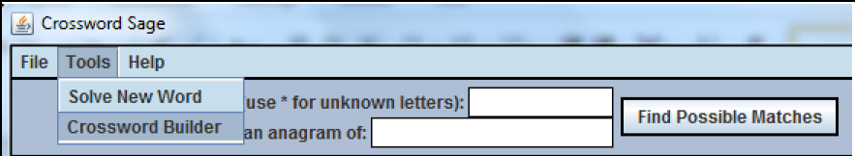
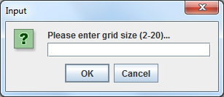
End-user’s workflow
A workflow = A sequence of UI actions for a specific task
2.Fill in textbox
Example:
A 3-action workflow of creating a crossword puzzle:
1. Click menu item
3. Click OK
12
1
2
3

Slide 3
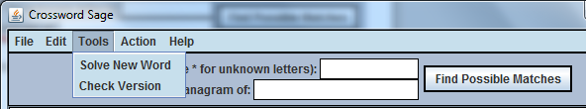

GUI evolution can break workflows
Version 0.3
(the first action in creating a puzzle)
?
Version 0.35
The workflow is broken!
Notes:
To complete the existing workflow – creating a new puzzle, a user must identify a functionally-equivalent one to complete the task
This is a simple example and we will talk it later, how about the workflow in practice.

Slide 4
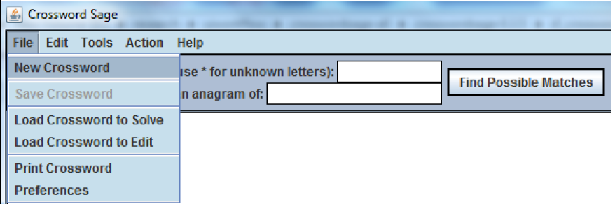
Goal: repair a broken workflow
Suggest a “replacement action” for a broken action
No change to the code
Help users perform the same task, but adapt to the new GUI
?
Version 0.35
the first action in creating a puzzle is broken.
Replacement action:
Click “New Crossword”
(Suggested by our technique: FlowFixer, since both invoke method “showCrosswordBuilder”)
Notes:
To continue the workflow…
The task can still be accomplished in the new version, but must be completed in a different way.
Change the task across versions.
The same task might be completed in a different way!
As a workflow becomes broken during its evolution,
Ppl may think this is toy example, users can simply find the action by ..

Slide 5
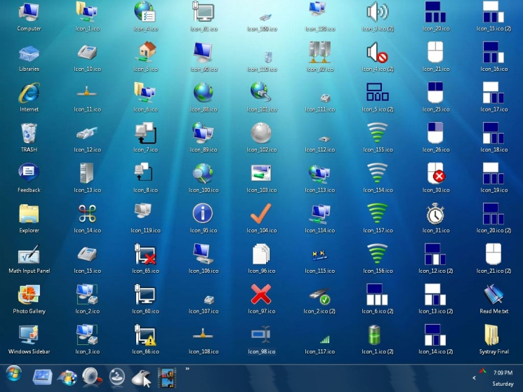
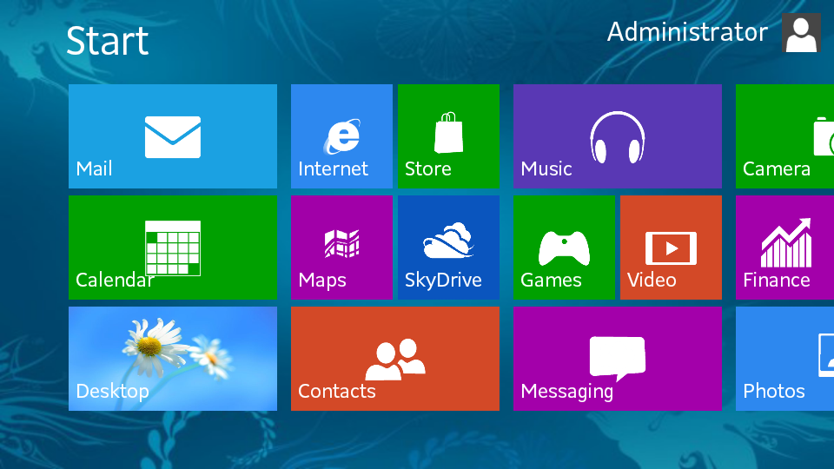
GUIs keep evolving all the time

Slide 6
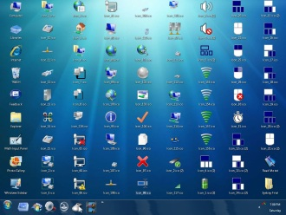

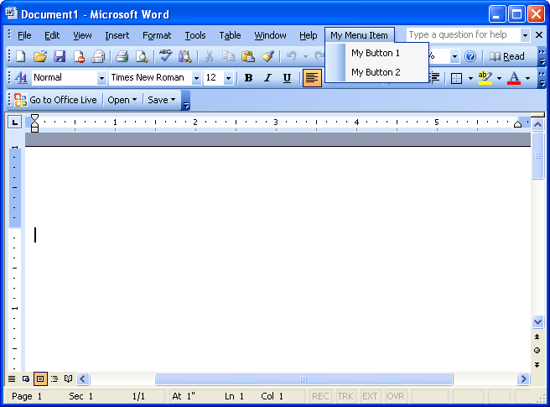
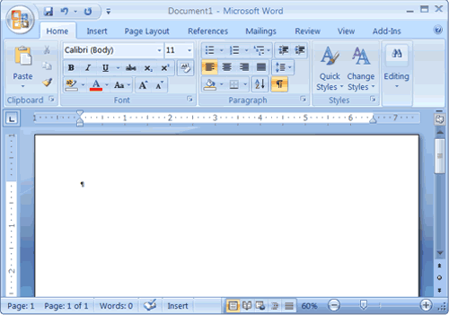
GUIs keep evolving all the time

Slide 7
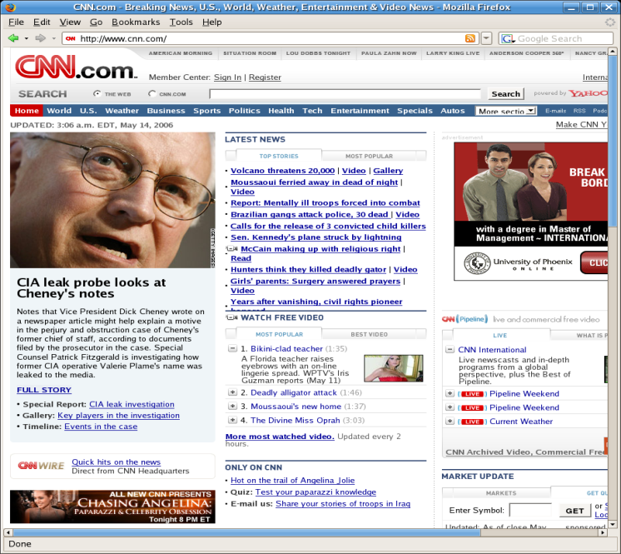
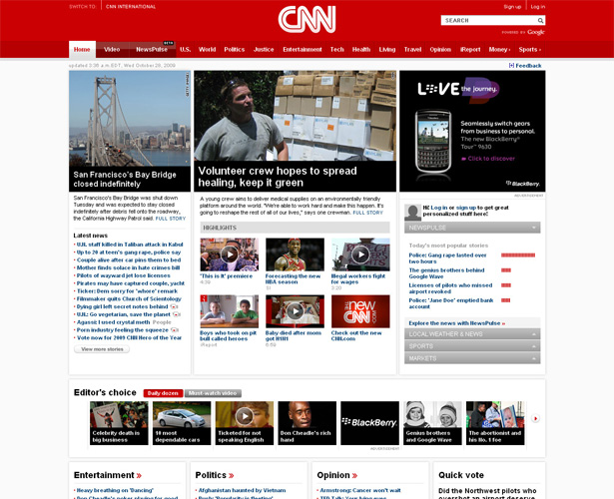
GUIs keep evolving all the time

Slide 8
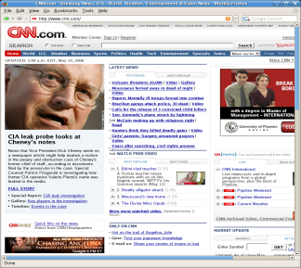

GUIs keep evolving all the time

Slide 9
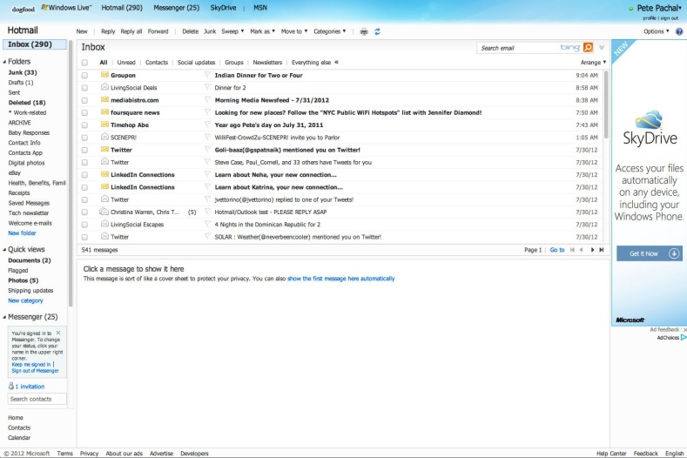
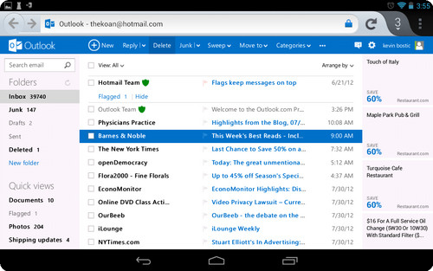
GUIs keep evolving all the time

Slide 10


GUIs keep evolving all the time
GUI evolution can break workflows!
Notes:
More specifically, the UI action on the original interface might be removed, or replaced by a different, but functionally-equivalent UI action.

Slide 11

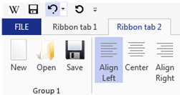

Broken workflows in practice
Affect user experience (focus of this talk)
Impact automated testing
100+ posts
Example: the ribbon UI in Office 2007
Tedious and challenging to resolve them manually
Notes:
This is also relevant to the automated testing, but my talk will focus on the first part.
For a large application such office, and a huge number of broken workflows. It is infeasible to

Slide 12




The “action semantics” challenge
A UI action’s effect cannot be observed statically
Repairing broken workflows needs to:
distinguish actions that look similar but have different results
identify different UI actions that may perform the same task
Requires knowing the “what the action does”
Notes:
The frequency of broken workflows motivates us to design new automated techniques to automatically repair it
However, designing automated techniques to suggest replacement actions is not easy

Slide 13
Outline
Problem
Technique
Evaluation
Related Work
Contributions

Slide 14
Key insights of FlowFixer
The underlying code implementing the same functionality stays relatively the same between versions
“action semantics” ≈ the invoked methods
UI Actions invoking similar methods are likely to perform similar tasks

Slide 15






An overview of the FlowFixer technique
Old version
New version
GUI change
User demonstration
Random testing
Weight
actionPerformed()
showCrosswordBuilder()
...
1/3
1
1. Click “New Crossword”
actionPerformed()
showCrosswordBuilder()
...
Method matching
1/3
2. Click “Save Crossword”
actionPerformed()
saveCrossword()
...
1/3
3. Click “Solve New Crossword”
actionPerformed()
crosswordSolverPanel<init>()
...
Replacement actions:
Click “New Crossword”
…
Notes:
Map to the corresponding, possibly updated method in the new version, and use such information to reason about the desired actions

Slide 16


The FlowFixer technique
Record all methods invoked by the broken action
A broken workflow
---
------
instrument
---
------
an execution trace
Old version
Instrumented version
--- -
- ---
User demonstrates the workflow up to the broken action
New version
(the first action is broken)
Notes:
Since the user has just demonstrate to the last action, the last invoked action corresponds to

Slide 17
The FlowFixer technique
A broken workflow
---
------
instrument
---
------
an execution trace
Old version
Instrumented version
--- -
- ---
Static Method Matching
New version
Match each method invoked by the broken action in the new version

Slide 18
The FlowFixer technique
A broken workflow
---
------
instrument
---
------
an execution trace
Old version
Instrumented version
--- -
- ---
Static Method Matching
Matched
Methods
New version
(in the new version)
Action → method mapping
instrument
---
------
→ f1(), f2(), f3()
→ f1(), f4()
Instrumented version
Random testing
…
Randomly execute each applicable UI action, and recursively explore UI actions on new screens
Notes:
Random generate UI actions, and perform
When performing random testing, to bound the large execution space.., we bound the execution of each UI action at most once.
Random testing, though by no means complete in achieving code coverage, we find it works well enough for this problem, since many important core methods have already been invoked

Slide 19
The FlowFixer technique
A broken workflow
---
------
instrument
---
------
an execution trace
Old version
Instrumented version
--- -
- ---
Static Method Matching
Matched
Methods
New version
Action → method mapping
instrument
---
------
→ f1(), f2(), f3()
Replacement
Action
Recommendation
→ f1(), f4()
Instrumented version
Random testing
…
For each invoked method, find all actions invoking it.
The weight of each action is inversely proportional to the number of all possible invoking actions.
Ranked list of
replacement actions
1.
2.
3. …

Slide 20
Outline
Problem
Technique
Evaluation
Related Work
Contributions

Slide 21
Research questions
How effective is FlowFixer in repairing broken workflows?
Accuracy
Efficiency
Comparison with a GUI-comparison-based technique [Grechanik’09]
Notes:
Evaluation of FlowFixer’s design choices, in the paper

Slide 22
Subject programs and broken workflows
Subject | Versions | LOC | ∆LOC | #Broken workflows
Crossword | 0.3 → 0.35 | 3,087 | 1,386 | 1
JEdit | 2.5 → 2.6 | 32,607 | 5,017 | 1
Gantt Project | 2.0.1 → 2.5.4 | 55,009 | 3,777 | 5
JabRef | 2.0 → 2.8.1 | 83,447 | 38,992 | 3
Freemind | 0.71 → 0.8 | 70,430 | 10,757 | 6
Popular software, being actively developed for 3—12 years
Non-trivial code changes
16 workflows with distinct root causes. Collected from user manual.
Selection of broken workflows
356 documented workflows, 70 are broken, 16 have distinct root causes
Exclude trivial UI changes, e.g.,
swapping two neighboring menu items
move a button to a different location on the same panel.

Slide 23
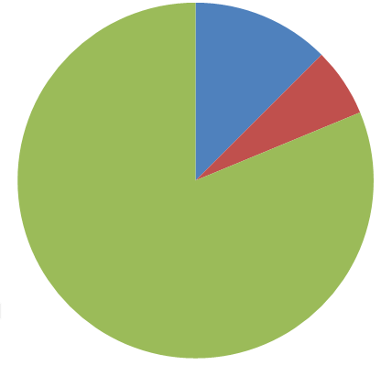

FlowFixer’s accuracy
Measured by the absolute rank of the correct actions
1.
2.
3. …
2 workflows
Correct action ranks second
13 workflows
Correct action
ranks first
1 workflow
FlowFixer outputs
wrong result
16 broken workflows
FlowFixer can repair 15 broken workflows

Slide 24


FlowFixer’s efficiency
Random testing
27 mins per application
(A one-time cost, shared by different workflows)
User demonstration
< 1 min per workflow
(assuming the old version is installed)
Action recommendation
4 mins per workflow
Notes:
27 mins is amortized

Slide 25
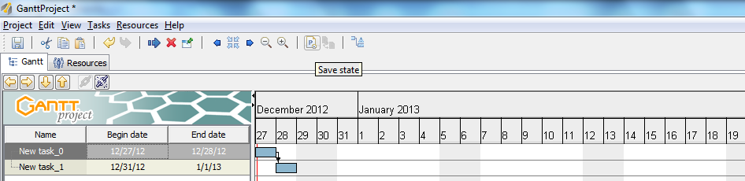
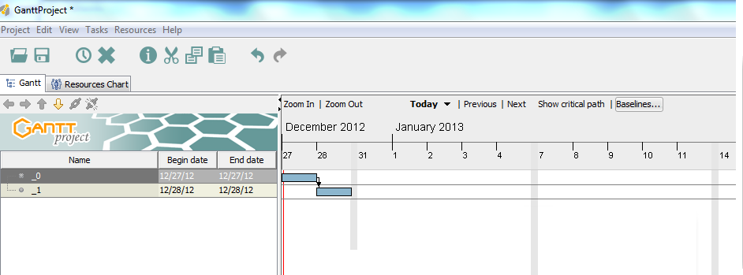
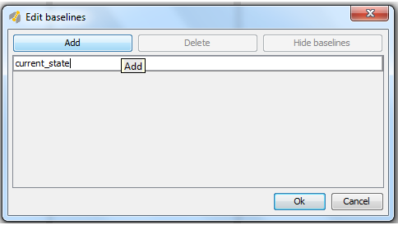
An example repair
Save current state
Gantt Project version 2.0
Fill the textbox to save
the current state
?
Gantt Project version 2.5

Slide 26
An example repair
Save current state
UndoableEditImpl.createTemporaryFile
Gantt Project version 2.0
Fill the textbox to save
the current state
?
Gantt Project version 2.5

Slide 27
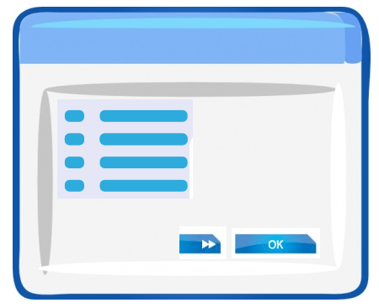
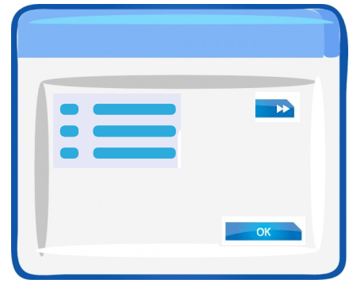
Comparison with an existing technique
REST: a GUI-comparison-based technique [Grechanik’09]
A black-box approach
Compare GUIs of two versions to identify modified UI elements
Identifies affected actions, but gives no repair suggestion
Old version
New version

Slide 28
Comparison with an existing technique
REST: a GUI-comparison-based technique [Grechanik’09]
A black-box approach
Compare GUIs of two versions to identify modified UI elements
Identifies affected actions, but gives no repair suggestion
Extend REST for workflow repair
Recommend actions on the matched UI element of the new version
Old version
New version

Slide 29

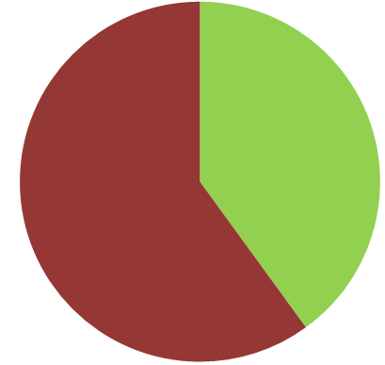
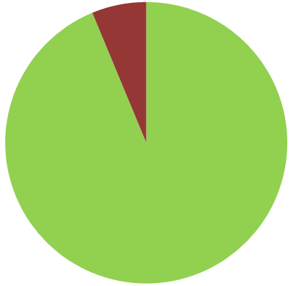
REST vs. FlowFixer
Fail to fix 10 workflows
Fail to fix 1 workflow
6 workflows
fixed
16 broken workflows
16 broken workflows
15 workflows fixed
REST
FlowFixer

Slide 30

Why REST did not work well?
REST only repairs 6 workflows where a UI element is
moved to a different location
FlowFixer repairs 15 broken workflows
Execute UI actions and observe their consequences
- Ineffective for non-trivial UI changes
UI label change
UI element change
UI action change
REST’s black-box approach is not aware of the “action semantics”

Slide 31
Experimental conclusions
FlowFixer is accurate and efficient in repairing broken workflows
FlowFixer achieves better results than a GUI-comparison-based technique

Slide 32
Outline
Problem
Technique
Evaluation
Related Work
Contributions

Slide 33
Related work
Test repair
ReAssert [Daniel’09], REST [Grechanik’09], Guitar [Memon’04],
Genetic approach [Huang’10], WATER [Choudhary’11] …
Make obsoleted tests compilable without preserving its original semantics.
Not applicable to repairing broken workflows.
Program repair
GenProg [Weimer’09], ClearView [Perkins’09], PAR [Kim’13]…
Search patches for bugs.
Not applicable to broken workflows caused by UI changes.
Change analysis
Chianti [Ren’05], SemDiff [Dagenais’08], RefactoringCrawler [Dig’05],
Hybrid approach [Wang’12] …
Identify code-level changes and compute the effects. Not applicable for repairing UI-level workflows.

Slide 34
Outline
Problem
Technique
Evaluation
Related Work
Contributions

Slide 35
Future directions
User study
Extend FlowFixer to repair UI test scripts
Lift syntax-correcting repair to semantics-preserving repair
Integrate FlowFixer into software evolution
Proactively finding broken workflows
Summarize UI-level changes
Automatically update user manual
Help users learn new GUI features
Notes:
There are plenty of todos for the future work

Slide 36
Contributions
Fix suggestions
FlowFixer
1.
2.
3. …
A broken workflow
A technique to repair broken workflows
analyze method invocations and evolution to reason about fix actions
fully automated
handles non-trivial code changes
Experiments that demonstrate its usefulness
Accurate and efficient
Fixed 15 out of 16 broken workflows
Outperforms alternative techniques
The FlowFixer tool implementation:
http://workflow-repairer.googlecode.com

Slide 37
[Backup Slides]

Slide 38



What if multiple actions are broken?
Use FlowFixer in an interactive way
FlowFixer
Fix action
1.
2.
3. …
Might be a different broken action!
FlowFixer
Fix action
1.
2.
3. …
Fixed!

Slide 39

FlowFixer’s recommendation limitation
Recommends one replacement action for a broken action
Does not support recommending:
A sequence of actions for one action
One action for a sequence of actions
A sequence of actions for a sequence of actions
FlowFixer
Fix action
1.
2.
3. …
Fix action
…
FlowFixer
1.
2.
3. …
…
Fix action
FlowFixer
1.
2.
3. …
…
Fix action
FlowFixer
1.
2.
3. …
…
…
…

Slide 40
Why does this simple random testing work?
Goal:
Identify “signature” method for each UI action
NOT achieve good coverage
The “signature” method is often easy to reach:
Symbolic, model-based techniques might achieve better results, but are more expensive to use
Event handler, shared by many actions
actionPerformed()
showCrosswordBuilder()
...
A “signature” method, only invoked by “Clicking New Crossword”
Other methods. Requires certain states

