Slide 1


Empirically Revisiting the Test Independence Assumption
Sai Zhang, Darioush Jalali, Jochen Wuttke, Kıvanç Muşlu, Wing Lam, Michael D. Ernst, David Notkin
University of Washington

Slide 2




Order dependence
Two tests:
Dependent
test
createFile(“foo”)
...
readFile(“foo”)
...
Executing them in default order:
(the intended test results)
Executing them in a different order:

Slide 3


Use the default execution
order as baseline
Visible test result rather than internal program state
Dependent
test
A test that yields
a different test result than
the default result
in a reordered subsequence
of the original test suite.
createFile(“foo”)
...
readFile(“foo”)
...
Executing them in default order:
(test results by design)
Executing them in different orders:
Execute real tests rather than contrived ones
Notes:
Execute real tests rather than contrived ones.

Slide 4
Why should we care about test dependence?
Makes test behaviors inconsistent
Affects downstream testing techniques
Test prioritization
Test parallelization
Test selection
CPU 1
CPU 2

Slide 5

Conventional wisdom: test dependence is not a significant issue
Test independence is assumed by:
Test selection
Test prioritization
Test parallel execution
Test factoring
Test generation
…
31 papers in
ICSE, FSE, ISSTA, ASE,
ICST, TSE, and TOSEM
(2000 – 2013)

Slide 6
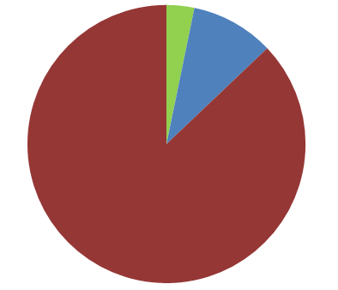
Conventional wisdom: test dependence is not a significant issue
Consider test
dependence
Test independence is assumed by:
Test selection
Test prioritization
Test parallel execution
Test factoring
Test generation
…
As a threat
to validity
1
3
31 papers in
ICSE, FSE, ISSTA, ASE,
ICST, TSE, and TOSEM
(2000 – 2013)
27
Assume test independence
without justification
Notes:
Add an outline to 27.

Slide 7
Is the test independence assumption valid?
No!
Does test dependence arise in practice?
What repercussions does test dependence have?
How to detect test dependence?
Yes, in both human-written and automatically-generated suites
Inconsistent results: missed alarms and false alarms
Affecting downstream testing techniques
Proof: the general problem is NP-complete
Approximate algorithms based on heuristics work well
Notes:
Say “is test independence assumption valid” in the second time.
This is the key contributions of this paper: we revisit this assumption by comprehensive empirical study, theoretical analysis, and designing new testing techniques

Slide 8
Is the test independence assumption valid?
Implications:
Test independence should no longer be assumed
New challenges in designing testing techniques
No!
Does test dependence arise in practice?
What repercussions does test dependence have?
How to detect test dependence?
Yes, in both human-written and automatically-generated suites
Inconsistent results: missed alarms and false alarms
Affecting downstream testing techniques
Proof: the general problem is NP-complete
Approximate algorithms based on heuristics work well
Notes:
Say “is test independence assumption valid” in the second time.
This is the key contributions of this paper: we revisit this assumption by comprehensive empirical study, theoretical analysis, and designing new testing techniques

Slide 9
Is the test independence assumption valid?
Does test dependence arise in practice?
What repercussion does test dependence have ?
How to detect test dependence?
Yes, in both human-written and automatically-generated suites
Inconsistent results: missed alarms and false alarms
Affecting downstream testing techniques
The general problem is NP-complete
Approximate algorithms based on heuristics work well

Slide 10









Methodology
Reported dependent tests
New dependent tests
5 issue tracking systems
4 real-world projects

Slide 11
Methodology
Reported dependent tests
Search for 4 key phrases:
(“dependent test”, “test dependence”,
“test execution order”, “diﬀerent test outcome”)
Manually inspect 450 matched bug reports
Identify 96 distinct dependent tests
5 issue tracking systems
Characteristics:
Manifestation
Root cause
Developers’ action

Slide 12
Manifestation
Number of tests involved to yield a different result
…
…
(default order)
(run in isolation)
#Tests = 1
(run after another)
#Tests = 2
Notes:
In general the longer, the more complex (

Slide 13

Manifestation
Number of tests involved to yield a different result
96 dependent tests

Slide 14
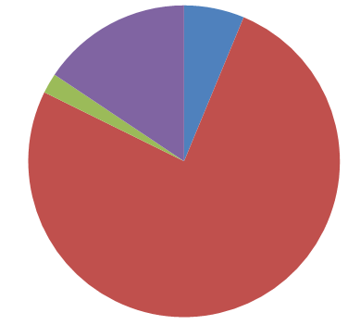
Manifestation
Number of tests involved to yield a different result
#Tests = 1
Unknown
6
82% can be revealed by
no more than 2 tests
15
#Tests = 3
2
73
#Tests = 2

Slide 15
Root cause
96 dependent tests

Slide 16
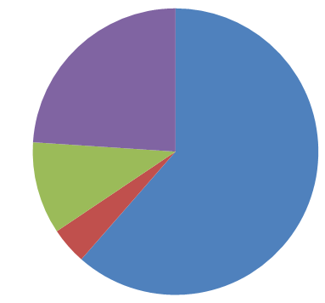
Root cause
Unknown
23
at least 61% are due to
side-eﬀecting access to
static variables.
59
10
database
4
static variable
file system

Slide 17
Developers’ action
98% of the reported tests are marked as major or minor issues
91% of the dependence has been fixed
Improving documents
Fixing test code or source code

Slide 18
Methodology
New dependent tests
Human-written test suites
4176 tests
Automatically-generated test suites
use Randoop [Pacheco’07]
6330 tests
Ran dependent test detection
algorithms (details later)
29 dependent tests
354 dependent tests
4 real-world projects

Slide 19
Characteristics
Manifestation: number of tests to yield a different result
29 manual
dependent tests
Notes:
8:00 minutes here

Slide 20
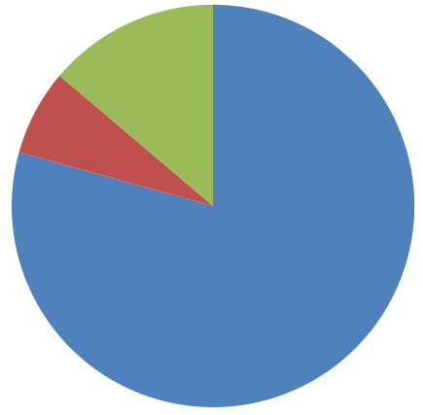
Characteristics
Manifestation: number of tests to yield a different result
#Tests = 3
#Tests = 2
4
2
29 manual
dependent tests
354 auto-generated
dependent tests
23
#Tests= 1
Notes:
Use the same title. Move the pie chart.

Slide 21
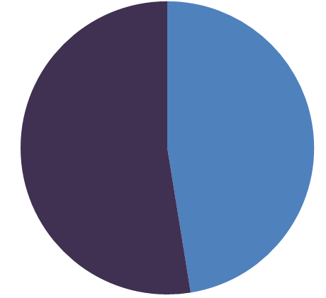
Characteristics
Manifestation: number of tests to yield a different result
#Tests = 3
#Tests ≥ 2
#Tests = 2
4
2
29 manual
dependent tests
186
168
23
#Tests= 1
#Tests = 1

Slide 22
Characteristics
Manifestation: number of tests to yield a different result
Root cause
All because of side-effecting access of static variables
#Tests = 3
#Tests ≥ 2
#Tests = 2
4
2
29 manual
dependent tests
186
168
23
#Tests= 1
#Tests = 1

Slide 23
Developers’ actions
Confirm all manual dependent tests
tests should always “stand alone”, that is “test engineering 101”
Merged two tests to remove the dependence
Opened a bug report to fix the dependent test
Wont fix the dependence, since it is due to the library design
Notes:
10:00

Slide 24
Is the test independence assumption valid?
Does test dependence arise in practice?
What repercussion does test dependence have ?
How to detect test dependence?
Yes, in both human-written and automatically-generated suites
Inconsistent results: missed alarms and false alarms
Affecting downstream testing techniques
The general problem is NP-complete
Approximate algorithms based on heuristics work well

Slide 25
Reported dependent tests
96 dependent tests
5 issue tracking systems

Slide 26
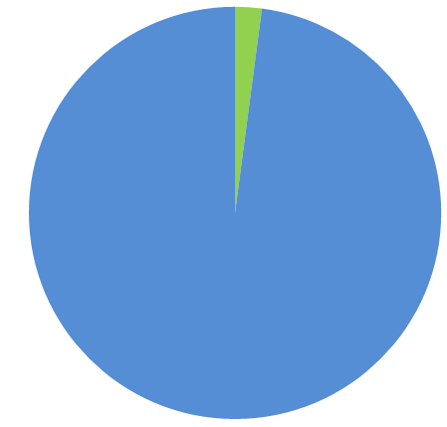
Reported dependent tests
Missed alarms
2
96 dependent tests
94
5 issue tracking systems
False alarms

Slide 27
Example false alarm
void testDisplay() {
//create a Display object
…
//dispose the Display object
}
void testShell() {
//create a Display object
…
}
In Eclipse, only one Display object is allowed.
In default order: testDisplay testShell
In a non-default order: testShell testDisplay
Led to a false bug report that took developers 3 months to resolve.

Slide 28


Example missed alarm
Need to be set to “arg” before a client calls any method in the class.
public final class OptionBuilder {
static String argName = null;
static void reset() {
…
argName = “arg”;
}
}
BugTest.test13666 validates correct behavior.
This test should fail,
but passes when running in the default order
Another test calls reset() before this test
Hid a bug for 3 years.

Slide 29
Example missed alarm
Need to be set to “arg” before a client calls any method in the class.
public final class OptionBuilder {
static String argName = null;
static void reset() {
…
argName = “arg”;
}
}
BugTest.test13666 validates correct behavior.
This test should fail,
but passes when running in the default order
Another test calls reset() before this test
Hid a bug for 3 years.

Slide 30
Example missed alarm
Need to be set to “arg” before a client calls any method in the class.
public final class OptionBuilder {
static String argName = null;
static void reset() {
……
}
static {
argName = “arg”;
}
}
Bug fix
BugTest.test13666 validates correct behavior.
This test should fail,
but passes when running in the default order
Another test calls reset() before this test
Hid a bug for 3 years.

Slide 31

Test prioritization
…
…
A test execution order
A new test execution order
Achieve coverage faster
Improve fault detection rate
…
Each test should yield the same result.

Slide 32
Five test prioritization techniques [Elbaum et al. ISSTA 2000]
Test prioritization technique
Randomized ordering
Prioritize on coverage of statements
Prioritize on coverage of statements not yet covered
Prioritize on coverage of methods
Prioritize on coverage of methods not yet covered
4 real-world projects
Total: 4176 manual tests
Record the number of tests yielding different results
Notes:
13:00

Slide 33
Evaluating test prioritization techniques
Test prioritization technique | Number of tests that yield different results
Randomized ordering | 12
Prioritize on coverage of statements | 11
Prioritize on coverage of statements not yet covered | 17
Prioritize on coverage of methods | 11
Prioritize on coverage of methods not yet covered | 12
Total: 4176 manual tests
Implication:
Existing techniques are not aware of test dependence
Notes:
Over 10 tests

Slide 34
Is the test independence assumption valid?
Does test dependence arise in practice?
What repercussion does test dependence have ?
How to detect test dependence?
Yes, in both human-written and automatically-generated suites
Inconsistent results: missed alarms and false alarms
Affecting downstream testing techniques
The general problem is NP-complete
Approximate algorithms based on heuristics work well

Slide 35
General problem of test dependence detection
…
…
A test suite
All dependent tests
NP-Complete
Proof: reducing the Exact Cover problem to
the dependent test detection problem
Notes:
Intuition: need to execute all test permutations
Complexity: O(n!), n is the suite size

Slide 36
Detecting dependent tests in a test suite
…
…
A test suite
All dependent tests
Approximate algorithms
Reversal algorithm
Randomized execution
Exhaustive bounded algorithm
Dependence-aware bounded algorithm
All algorithms are sound but incomplete

Slide 37
Approximate algorithms by heuristics
Reversal algorithm
Randomized execution
Exhaustive bounded algorithm
Dependence-aware bounded algorithm
Intuition: changing order of each pair may expose dependences
Notes:
Change order of every pair may expose dependence

Slide 38
Approximate algorithms by heuristics
Reversal algorithm
Randomized execution
Exhaustive bounded algorithm
Dependence-aware bounded algorithm
Shuffle the execution order multiple times
…

Slide 39
Approximate algorithms by heuristics
Reversal algorithm
Randomized execution
Exhaustive bounded algorithm
Dependence-aware bounded algorithm
Executes all k-permutations
for a bounding parameter k
k= 2
Most dependent tests can be found by running
short test subsequences
(82% of the dependent tests are revealed by
no more than 2 tests)

Slide 40
Approximate algorithms by heuristics
Reversal algorithm
Randomized execution
Exhaustive bounded algorithm
Dependence-aware bounded algorithm
x
y
read
write
write
k= 2
Record read/write info for each test
Filter away unnecessary permutations

Slide 41
Evaluating approximate algorithms
Finding New dependent tests
Human-written test suites
4176 tests
Automatically-generated test suites
use Randoop [Pacheco’07]
6330 tests
29 dependent tests
354 dependent tests
4 real-world projects
Notes:
As I mentioned before, we have found xxx dependent tests

Slide 42


Evaluating approximate algorithms
Estimated
cost
Actual cost
Shuffle 1000 times
k = 2
(did not finish for some programs)
Notes:
Change to 2-bounded

Slide 43
Evaluating approximate algorithms
Cheap and detects half of the dependent tests!
Find all dependences within a bound, but computationally infeasible.
Detects the most dependent tests.
Notes:
Change to 2-bounded

Slide 44
Related work
Existing definitions of test dependence
Based on program state change [Kapfhammer’03]
Informal definitions [Bergelson’06]
Our definition focuses on the concrete test execution result.
Program state change may not affect test execution result.
Flaky tests [Luo et al’14, Google testing blog]
Tests revealing inconsistent results
Dependent test is a special type of flaky test.
Tools supporting to execute tests in different orders
JUnit 4.1: executing tests in alphabetical order by name
DepUnit, TestNg: supporting specifying test execution order
Do not support detecting test dependence.

Slide 45



Contributions
Revisiting the test independence assumption
Test dependence arises in practice
Test dependence has non-trivial repercussions
Test dependence detection is NP-complete
Heuristic algorithms are effective in practice
Our tool implementation
http://testisolation.googlecode.com
Test independence should no longer be assumed!

Slide 46
[Backup slides]

Slide 47
Why not run each test in a separate process?
Implemented in JCrasher
Supported in Ant + JUnit
Unacceptably high overhead
10 – 138 X slowdown
Recent work merges tests running in separate processes into a single one [Bell & Kaiser, ICSE 2014]

Slide 48
Why more dependent tests in automatically-generated test suites?
Manual test suites:
Developer’s understanding of the code and their testing goals help build well-structured tests
Developers often try to initialize and destroy the shared objects each unit test may use
Auto test suites:
Most tools are not “state-aware”
The generated tests often “misuse” APIs, e.g., setting up the environment incorrectly
Most tools can not generate environment setup / destroy code

Slide 49
What is the default test execution order?
The intended execution order as designed
Specified by developers
Such as, in make file, ant file, or TestAll.java
Lead to the intended results as developers want to see

Slide 50
Dependent tests vs. Nondeterministic tests
Nondeterminism does not imply dependence
A program may execute non-deterministically, but its tests may deterministically succeed.
Test dependence does not imply nondeterminism
A program may have no sources of nondeterminism, but its tests can still be dependent on each other

Slide 51
Controlled Regression Testing Assumption (CRTA) [Rothermel et al., TSE 1996]
A stronger assumption than determinism, forbidding:
Porting to another system
Nondeterminism
Time-dependencies
Interaction with the external environment
(implicitly) test dependence
The authors commented “CRTA is not necessarily impossible” to employ.
Our paper has a more practical focus on the overlooked issue of test dependence

