Slide 1
Effective Identification of Failure-Inducing Changes:
A Hybrid Approach
Sai Zhang, Yu Lin, Zhongxian Gu, Jianjun Zhao
PASTE 2008

Slide 2
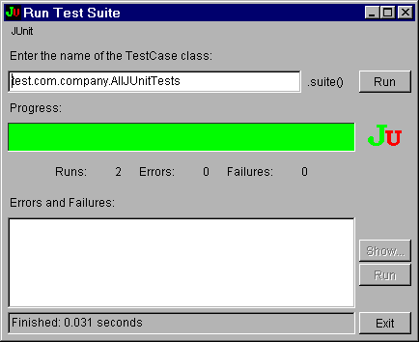
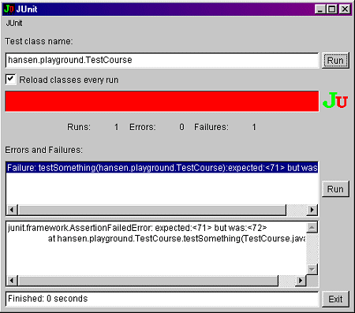
My program fails, why?
Code changes
Which part of code change is responsible for the regression test failure?
  Examine each code edits manually might be tedious and laborious
  Failures may result from a combination of several changes

Slide 3
Identify failure-inducing changes
Delta debugging [Zeller ESEC/FSE’99]
  A promising approach to isolate faulty changes
  It constructs intermediate program versions repeatedly to narrow down the change set
Can we develop more effective techniques?
  Integrate the strength of both static analyses and dynamic testing, to fast narrow down the change set
  Goal: A complementary general approach to original debugging algorithm (not restricted to one specific programming language)

Slide 4
Outline
Background
  Delta debugging
  Improvement room
Our hybrid approach
  Prune out irrelevant changes
  Rank suspicious change
  Construct valid intermediate version
  Explore changes hierarchically
Experiment evaluation
Related work
Conclusion

Slide 5
Outline
Background
  Delta debugging
  Improvement room
Our hybrid approach
  Prune out irrelevant changes
  Rank suspicious change
  Construct valid intermediate version
  Explore changes hierarchically
Experiment evaluation
Related work
Conclusion

Slide 6
Background
Delta debugging
  Originally proposed by Zeller in ESEC/FSE’99
  Aim to isolate failure-inducing changes and simplify failed test input
Basic idea
  Divide source changes into a set of configurations
  Apply each subset of configurations to the original program
  Correlate the testing result to find out the minimum faulty change set

Slide 7
Delta debugging: an example
Suppose there are eight changes: C₁, C₂, C₃, …. C₈
; and C₇ is the only failure-inducing change
Delta debugging works as follows:
Step | Configurations | Result
1 | C₁, C₂, C₃, C₄ | PASS
2 | C₅, C₆, C₇, C₈ | FAIL
3 | C₅, C₆ | PASS
4 | C₇, C₈ | FAIL
5 | C₈ | PASS
6 | C₇ | FAIL
Result | C₇ is the only faulty change! | FOUND!!!

Slide 8
A more complex example
Suppose there are eight changes: C₁, C₂, C₃, …. C₈
; and a combination C₃ and C₆ changes is the failure cause
Step | Configurations | Result
1 | C₁, C₂, C₃, C₄ | PASS
2 | C₅, C₆, C₇, C₈ | PASS
3 | C₁, C₂, C₅, C₆, C₇, C₈ | PASS
4 | C₃, C_{4,} C₅, C₆, C₇, C₈ | FAIL
5 | C₃, C₅, C₆, C₇, C₈ | FAIL
6 | C₁, C₂, C₃, C_{4,} C₇, C₈ | PASS
7 | C₁, C₂, C₃, C_{4,} C₅, C₆ | FAIL
8 | C₁, C₂, C₃, C_{4,} C₅, | PASS
Result | C₃ and C₆ are the faulty changes | FOUND!!!
C₃ is found!
C₆ is found!
Original Delta debugging can also handle configuration inconsistent problem.

Slide 9
Can we make it faster?
Key insights:
  Searching space
    Delta debugging (DD) searches the whole configuration set.
    Is it necessary?
  Configuration selection
    DD selects configurations in an arbitrary order.
    Can we improve the selection strategy?
  Intermediate version construction
    DD constructs intermediate program version by syntax difference, which might result in inconsistence.
    Can we introduce semantic dependence information?
  Configuration exploration strategy
    DD treats all changes as a flat list.
    Can we explore changes hierarchically, and prune out irrelevant ones earlier?

Slide 10
Outline
Background
  Delta debugging
  Improvement room
Our hybrid approach
  Prune out irrelevant changes
  Rank suspicious change
  Construct valid intermediate version
  Explore changes hierarchically
Experiment evaluation
Related work
Conclusion

Slide 11
Our hybrid approach: an overview
Reduce searching space
  Use static change impact analysis
  Then, focus on the relevant (suspicious ) changes
Rank suspicious changes
  Utilize dynamic testing result of both passing and failing tests
  Apply changes with higher likelihood first
Construct valid intermediate version
  Use atomic change representation
  Guarantee the intermediate version constructed is compliable.
Explore changes hierarchically
  From method-level to statement-level
  Prune a large number of changes earlier

Slide 12
Step 1: reduce searching space
Generally, when regression test fails, only a portion of changes are responsible
Approach
  We divide code edits into a consistent set of atomic change representations [Ren et al’ OOPSLA 04, Zhang et al ICSM’08].
  Then we construct the static call graph for the failed test
  Isolate a subset of responsible changes based on the atomic change and static call graph information
    A safe approximation

Slide 13
Example
class A {
int num = 10;
public int getNum() {
return num;
}
}
class A{
int num = 10;
int tax = 5;
public int getNum() {
if(tax > 5)
tax = 5;
num = num + tax;
return num;
}
public void setNum(int num) {
this.num = num;
}
}
Figure 1, original program
pubic void testGetNum(){
A a = new A();
assertTrue(
a.getNum() == 10);
}
Figure 3, a Junit test
Figure 2, program after editing

Slide 14
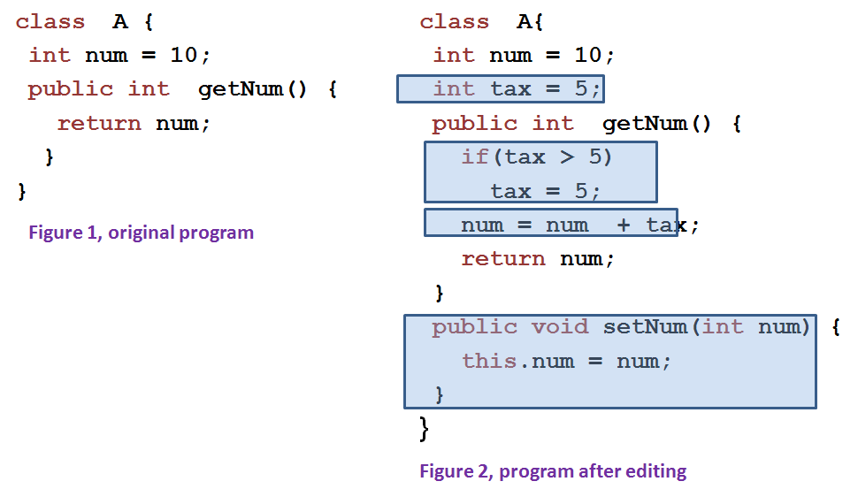
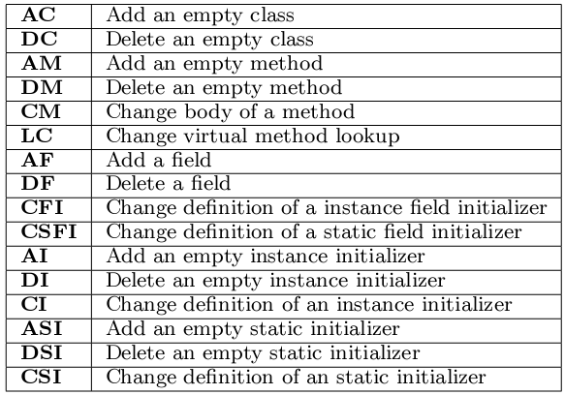
Example (cont )
Table 1, A catalog of atomic changes for Java (from Ren et al OOPSLA’04 paper)
Generate atomic changes
AF (tax), FI(tax), CM(getNum()), AM(setNum(int)), CM(setNum(int))
Add dependence relations
FI (tax) AF(tax), CM(getNum()) AF(tax)
CM(setNum(int)) AM(setNum(int))

Slide 15
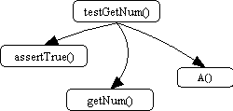
Example (cont )
pubic void testGetNum(){
A a = new A();
assertTrue(
a.getNum() == 10);
}
FI (tax) AF(tax),
CM(getNum()) AF(tax)
CM(setNum(int)) AM(setNum(int))
Construct static call graph,
and identify responsible changes
The responsible change set is:
Changes appearing on the call graph either as a node or an edge
All dependent changes of changes in ①
All responsible changes:
CM(getNum())
AF(tax), FI(tax)
CM(getNum())
Call graph of the failed test

Slide 16
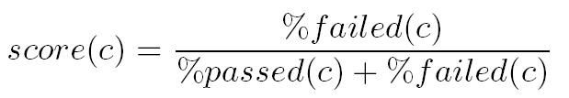
Step 2: rank suspicious changes
Ideally speaking, changes which are most likely to contribute to the failure should be ranked highest and tried first.
The heuristic we used for ranking is similar to the Tarantula approach [Jones et al ICSE’02]
We compute a value for each atomic change c
%failed(c) returns, as percentage, the ratio of the number of failed tests that cover c as a responsible change to the total failed test number.

Slide 17
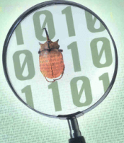
Step 3: explore faulty changes
The core module of our approach, an improved Three-Phase delta debugging algorithm
  Focus on the responsible change set
  Increase the change granularity from coarse method level to fine statement level in three steps
Three-Phase delta debugging working flow:
Result
Change set
Third Phase
First Phase
Generate
Atomic-Change-Chains
Faulty
Chains
Delta debugging
Delta debugging
Second Phase
Extract suspicious statements
Faulty
Changes
Extract faulty atomic changes
Delta debugging

Slide 18
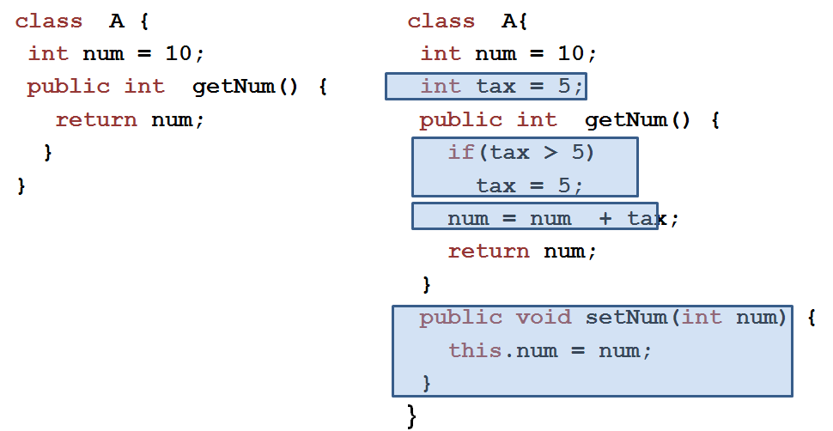
Back to the Example
Final output
Faulty statement:
num = num + tax;
Static change impact analysis
Delta debugging
Extract changed statements:
1. if(tax > 5) tax = 5;
2. num = num + tax;
All responsible changes:
CM(getNum())
AF(tax), FI(tax)
We prune out all def-change here
An atomic-change-chain starts from an atomic change
without any children, and includes all transitively
dependent changes
Phase 3
Faulty change
CM(getNum())
Three-Phase delta debugging: Phase 1
Delta debugging
Atomic-change-chains:
Only 1 chain, containing changes:
CM(getNum()), AF(tax), FI(tax)
Phase 2
Suspicious atomic changes:
CM(getNum()), FI(tax)
Notes:
, it is clear that the chain includes anything connected
to the starting change, even children of ancestors.

Slide 19
Other technical issue
The correctness of intermediate program version
  The dependence between atomic changes guarantee the correctness of intermediate version in phase 1 and 2 [Ren et al OOPSLA’04]
  However, in phase 3, the configurations could be inconsistent as the original delta debugging

Slide 20
Outline
Background
  Delta debugging
  Improvement room
Our hybrid approach
  Prune out irrelevant changes
  Rank suspicious change
  Construct valid intermediate version
  Explore changes hierarchically
Experiment evaluation
Related work
Conclusion

Slide 21
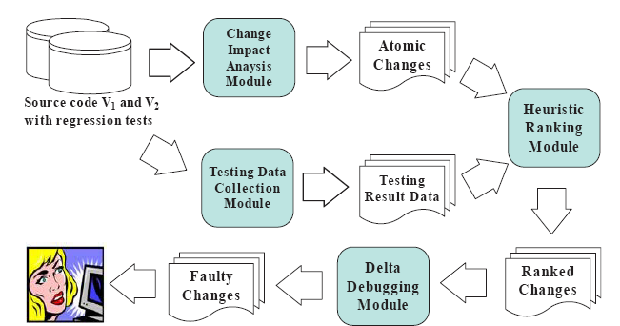
Prototype Implementation
We implement our prototype called AutoFlow for both Java and AspectJ programs
  Build on top of our Celadon [ICSM 08, ICSE’08 demo, ISSTA’08, student poster] framework
  Modify Java/AspectJ compiler source code
Figure 4, tool architecture

Slide 22
Subject programs
Two medium-sized Java/AspectJ programs, from UNL SIR and AspectJ distribution package
Subject | Type | LOC | #Ver | #Me | #Tests
XML-Security | Java | 16800 | 4 | 1221 | 112
Dcm | AspectJ | 3423 | 2 | 2 | 157

Slide 23
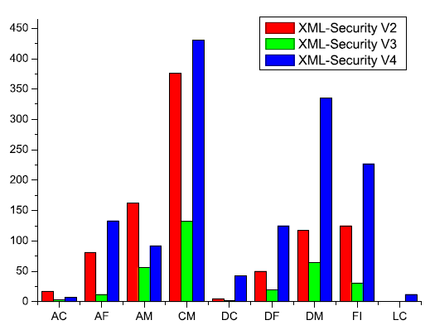
Case Study , XML-Security
We found one test testSecOctetStreamGetNodeSet1() passes in its 2nd version, but fails in its 3rd version
Changes between 2nd and 3rd version (total 312 atomic changes)

Slide 24
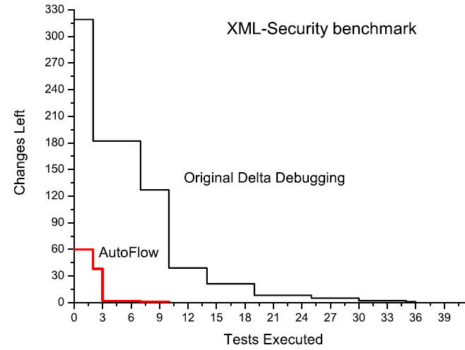
Exploring changes by AutoFlow
After impact analysis:
61 changes
Time saving is also considerable
Only needs 10 tests by AutoFlow vs 40 tests by Original delta debugging
Notes:
The execution time of the test

Slide 25
Outline
Background
  Delta debugging
  Improvement room
Our hybrid approach
  Prune out irrelevant changes
  Rank suspicious change
  Construct valid intermediate version
  Explore changes hierarchically
Experiment evaluation
Related work
Conclusion

Slide 26
Related Work
Delta debugging and its applications
  Zeller ESEC/FSE’99, FSE’02, ICSE’04, ISSTA’05
  Misherghi ICSE’06
Change impact analysis and its applications
  Ryder et al PASTE’01, Ren et al OOPSLA’04
  Ren et al TSE’06, Chesley et al ICSM’05, Max FSE’06
Fault localization techniques (closely related)
  Jones ICSE’02, Ren et al ISSTA’07, Jeffery et al ISSTA’08

Slide 27
Outline
Background
  Delta debugging
  Improvement room
Our hybrid approach
  Prune out irrelevant changes
  Rank suspicious change
  Construct valid intermediate version
  Explore changes hierarchically
Experiment evaluation
Related work
Conclusion

Slide 28
Conclusion
We present a hybrid approach to effectively identify failure-inducing changes (requires 4X less tests)
Implement the tool and present two case studies
We recommend our approach to be an integrated part of the delta debugging technique; when a regression test fails:
  Remove unrelated changes first
  Rank suspicious change, and
  Explore code edits from coarse-grained to fine-grained level

Slide 29
Future Directions
Eliminate searching space
  Using more precise impact analysis approaches, such as dynamic slicing, Execution-After information
Perform more experiment evaluations
Investigate the correlations between change impact analysis and heuristic ranking
Long term plan
  Explore how to incorporate static/statistical analysis techniques into debugging tasks
  Combine testing and verification for effective/scalable fault localization

