Slide 1


Beauty Care Cosmetics
E-commerce Website

Slide 2
Main Idea:
Beauty Care is an online website for selling cosmetics products that are made from organic ingredients, and shipping all over the world.

Slide 3
Technologies used to build the website:
HTML 5
CSS3
Bootstrap
GIT
PHP
MySQL

Slide 4
Beauty Care Team:
Sara Kteifan (Product Owner)
Ro’a Yaseen (Scrum Master)
Saja Alghalayini
Ghufran ALmomani
Bahaa Al-deen

Slide 5
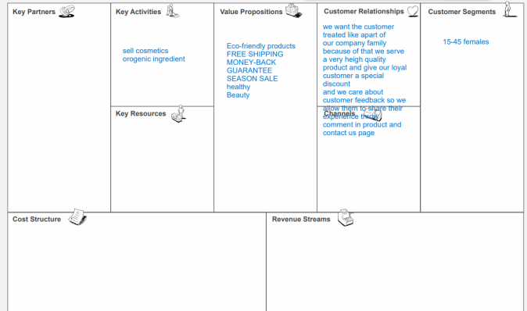
Cosmetics brands and stores
Natural and organic ingredients mainly
Costs of manufacturing products
Costs of IT system
Costs of shipping
Costs of storage
Revenue from selling products
Revenue from Advertising on the website

Slide 6
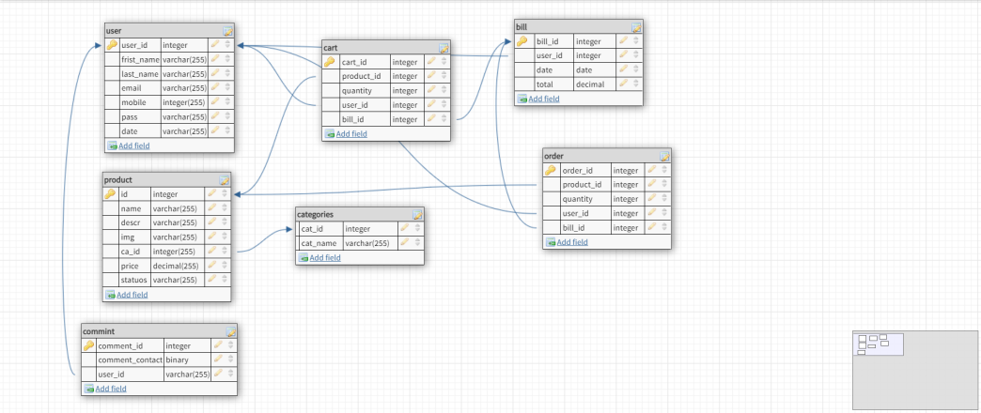
Database Schema

