Slide 1
OS Processes
Name : Laith ALferjani
SN : 2425

Slide 2
Objectives
Identify the separate component of a process.
Explain how component of a process are represented and scheduled in an OS.
Explain the mechanisms involved in creating and termination processes in an OS.
Identify the programs that use the appropriate system calls.
Describe and contrast inter-process communication using shared memory and message passing.
*Describe the kernel modules that interact with the Linux OS*.

Slide 3
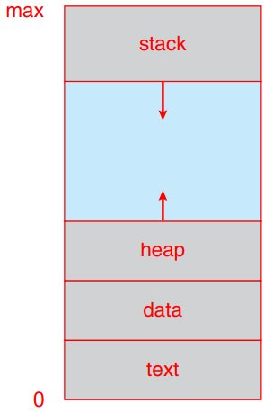
1. Identify the separate component of a process..
a process is a program in execution.
A process is more than the program code, which is sometimes known as the text section.
Memory layout:
Text section: the executable code.
Data section: global variables .
Heap section: memory that is dynamically allocated during program run time.
Stack section: temporary data storage when invoking functions.

Slide 4
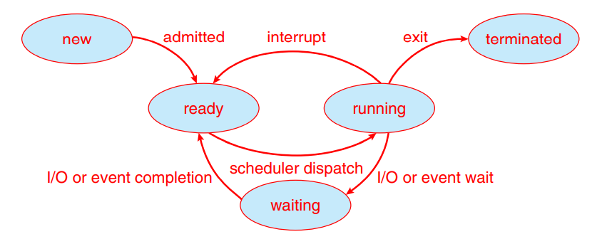
Process State
The state of a process is defined in part by the current activity of that process. A process may be in one of the following states:
New: The process is being created.
Running: Instructions are being executed.
Waiting: The process is waiting for some event to occur
Ready: The process is waiting to be assigned to a processor.
Terminated: The process has finished execution.

Slide 5
Process Control Block
Each process is represented in the operating system by a process control block (PCB)—also called a task control block.
PCB contains many pieces of information associated with a specific process, including these:
Process state: The state may be new, ready, running, waiting, halted, and so on.
Program counter: The counter indicates the address of the next instruction to be executed for this process.
CPU registers: The registers vary in number and type, depending on the computer architecture.
CPU-scheduling information: This information includes a process priority, pointers to scheduling queues, and any other scheduling parameters

Slide 6
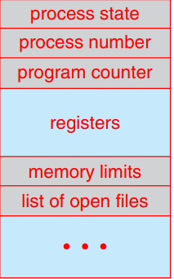
Process Control Block
Memory-management information: This information may include such items as the value of the base and limit registers and the page tables, or the segment tables, depending on the memory system used by the operating system.
Accounting information: This information includes the amount of CPU and real time used, time limits, account numbers, job or process numbers, and so on.
I/O status information: This information includes the list of I/O devices allocated to the process, a list of open files, and so on.

Slide 7
Threads
The process model discussed so far has implied that a process is a program that performs a single thread of execution.
when a process is running a word-processor program, a single thread of instructions is being executed.
Most modern operating systems have extended the process concept to allow a process to have multiple threads of execution and thus to perform more than one task at a time.

Slide 8
2.Explain how component of a process are represented and scheduled in an OS.
Maximize CPU use, quickly switch processes onto CPU for time sharing
Process scheduler selects among available processes for next execution on CPU
Maintains scheduling queues of processes
Job queue – set of all processes in the system
Ready queue – set of all processes residing in main memory, ready and waiting to execute
Device queues – set of processes waiting for an I/O device
Processes migrate among the various queues

Slide 9
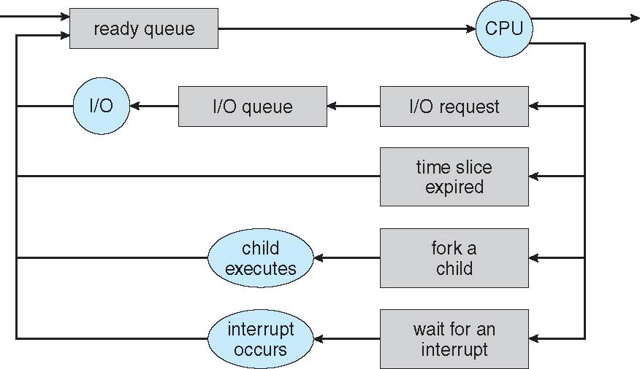
Representation of Process Scheduling

Slide 10
Schedulers
Short-term scheduler (or CPU scheduler) – selects which process should be executed next and allocates CPU
Sometimes the only scheduler in a system
Short-term scheduler is invoked frequently (milliseconds) --> (must be fast)
Long-term scheduler (or job scheduler) – selects which processes should be brought into the ready queue
Long-term scheduler is invoked infrequently (seconds, minutes)  (may be slow)
The long-term scheduler controls the degree of multiprogramming
Processes can be described as either:
I/O-bound process – spends more time doing I/O than computations, many short CPU bursts
CPU-bound process – spends more time doing computations; few very long CPU bursts
Long-term scheduler strives for good process mix

Slide 11
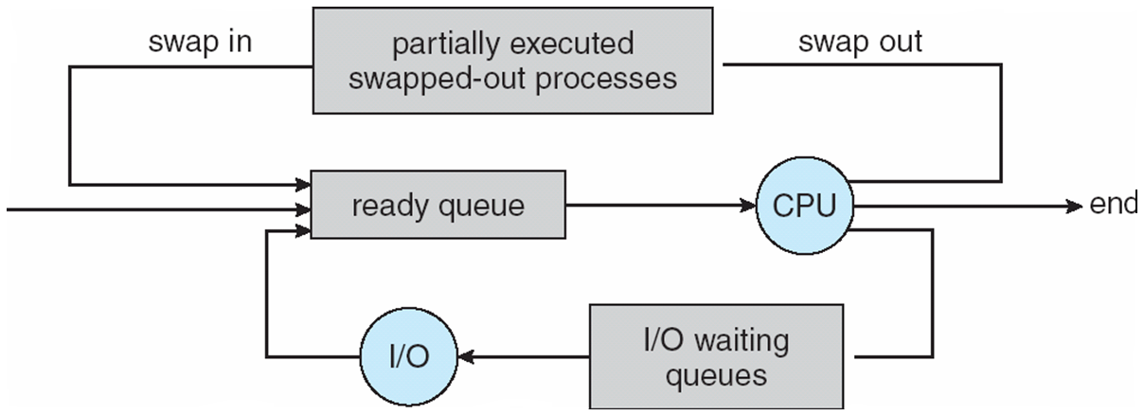
Schedulers
Medium-term scheduler can be added if degree of multiple programming needs to decrease
Remove process from memory, store on disk, bring back in from disk to continue execution: swapping

Slide 12
3.Explain the mechanisms involved in creating and termination processes in an OS.
Process Creation
Parent process create children processes, which, in turn create other processes, forming a tree of processes
Generally, process identified and managed via a process identifier (pid)
Resource sharing options
Execution options
Address space
Process Termination
Process executes last statement and then asks the operating system to delete it using the exit() system call.
Parent may terminate the execution of children processes using the abort() system call.

Slide 13
4.Identify the programs that use the appropriate system calls.
the POSIX API for shared memory :
POSIX shared memory is organized using memory-mapped files, which associate the region of shared memory with a file.

Slide 14
message passing in the Mach operating system :
Mach is part of the Mac OS X operating system.
The Mach kernel supports the creation and destruction of multiple tasks, which are similar to processes but have multiple threads of control and fewer associated resources.
Most communication in Mach is carried out by messages.
Messages are sent to and received from mailboxes, called ports in Mach.
Even system calls are made by messages.

Slide 15
Windows and the uses shared memory as a mechanism for providing certain types of message passing:
The Windows operating system is an example of modern design that employs modularity to increase functionality and decrease the time needed to implement new features.
Windows provides support for multiple operating environments, or subsystems.
Application programs communicate with these subsystems via a message-passing mechanism.
Thus, application programs can be considered clients of a subsystem server.
The message-passing facility in Windows is called the advanced local procedure call (ALPC) facility.

Slide 16
Describe and contrast inter-process communication using shared memory and message passing.
Shared Memory
An area of memory shared among the processes that wish to communicate
The communication is under the control of the users processes not the operating system.
Major issues is to provide mechanism that will allow the user processes to synchronize their actions when they access shared memory.

Slide 17
Message Passing
Message Passing
Mechanism for processes to communicate and to synchronize their actions
Message system – processes communicate with each other without resorting to shared variables
IPC facility provides two operations:
send(message)
receive(message)
The message size is either fixed or variable

Slide 18
Message Passing
If processes P and Q wish to communicate, they need to:
Establish a communication link between them
Exchange messages via send/receive
Implementation of communication link
Physical:
Shared memory
Hardware bus
Network
Logical:
Direct or indirect
Synchronous or asynchronous
Automatic or explicit buffering

Slide 19
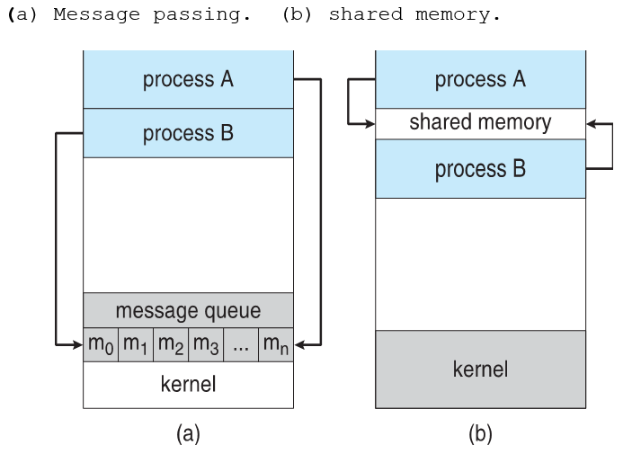

Slide 20
Reference :
Abraham-Silberschatz-Operating-System-Concepts---9th2012.12

