Slide 1


Athenak Profiling and performance
Sajad Azizi $⋅$ Salvatore Cielo

Slide 2
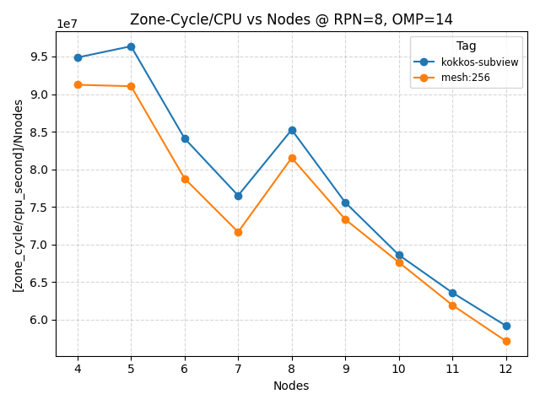
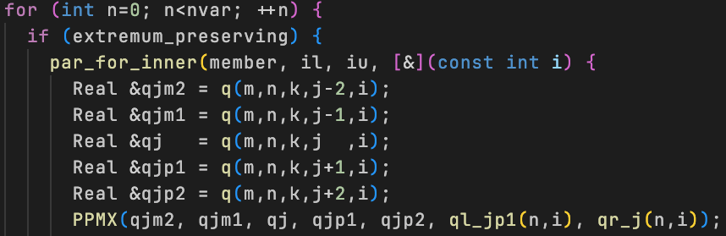
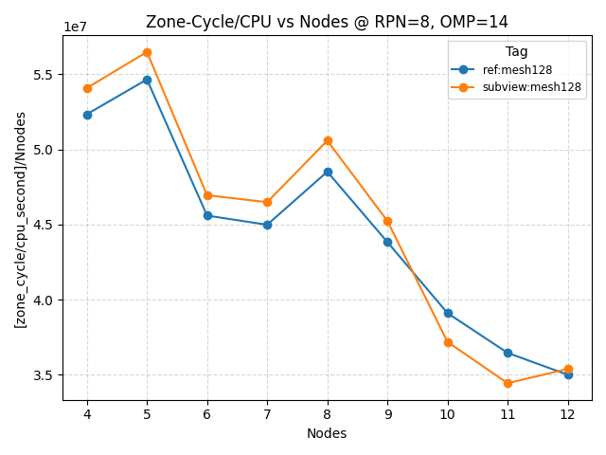
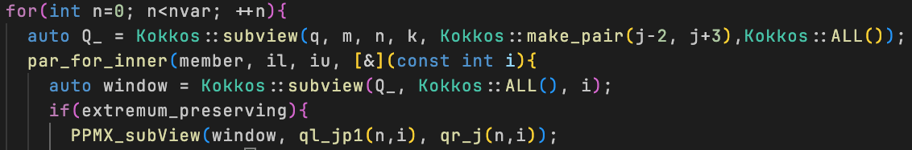
AthenaK Performance: Kokkos subview
Passing an slice of a view (Kokkos subview) to increase performance
subview
Sajad Azizi $⋅$ Salvatore Cielo, LRZ

Slide 3
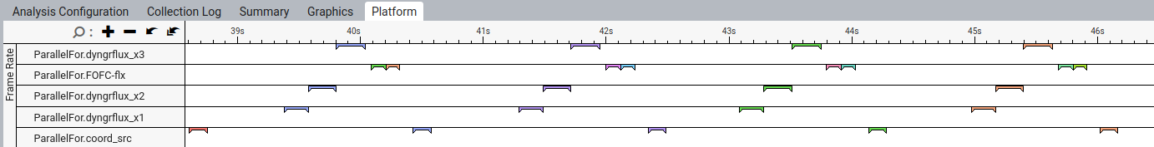
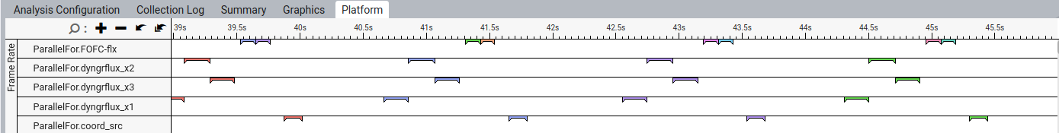
AthenaK profiling: Kokkos subview in Kokkos-tools
subview
Sajad Azizi $⋅$ Salvatore Cielo, LRZ

