Slide 1

Biden vs. Trump!
Who wins the sentiment?
Text and Media Analytics - Group Assignment

Slide 2


1. Intro
1.1 Literature Review
1.2 Research Gap
1.3 Research Question(s)

Slide 3
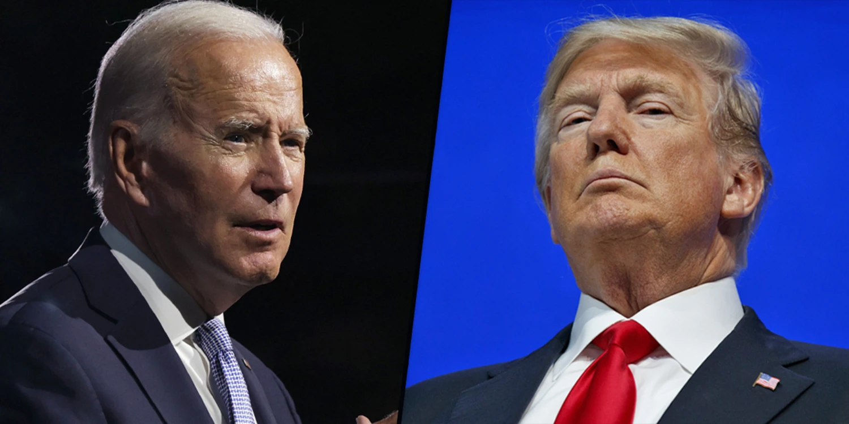
1.1 A review on literature
Sentiment Analysis(Opinion Mining): mining of behavior, and opinions using NLP methods(Neshan & Akbari, 2020)
Micro blogging services(Twitter, …) : provide free discussion area for people
Politicians refer facebook, twitter and blogs to collect reviews amongst the people (Dorle & Pise, 2018)
Ref: NBC News

Slide 4
1.1 A review on literature(Cont.)
Political Sentiment Analysis through Social Media(Dorle & Pis, 2018):
RNN with LSTM, Scraped Twitter and Facebook, Polarity of opinions
Optimizing sentiment analysis of Nigerian 2023 presidential election (Oyewola et al, 2023):
using two-stage residual long short term memory, Twitter data
What Tweets and YouTube comments have in common? US elections 2020 (Shevtesov et al., 2023)
Cross-Platform traffic analysis(Youtube and Twitter), Trump with higher positive sentiment

Slide 5
1.2 Research Gap
Most research focused on Twitter(the largest microblogging platform), and sentiment analysis
Few work on applying sentiment analysis based on topic modeling in US elections
Topic Modeling as a Tool to Gauge Political Sentiments from Twitter Feeds(Sarddar et al., 2020), in a different domain(India, 2017 election)
Analyzing Brexit’s impact using sentiment analysis and topic modeling on Twitter discussion(Ilyas, 2020)
Our Idea: finding sentiments within topic clusters for each candidate
A more detailed approach: look at each candidate’s opinions
Higher contribution to governments to to revise strategic policies

Slide 6
1.3 Research Question
How does viewer sentiment vary between political topics within YouTube’s platform?

Slide 7
2. Methodology
2.1 Data
2.2 Framework
2.3 Model and Tools

Slide 8
2.1 Data
All videos published in 2023 from Trump and Biden's official YouTube channels(YouTube API, two datasets)
41 videos for Trump
43 videos for Biden
maximum 500 comments (ranked by relevance) for each video
20,500 comments from Trump’s channel
15,731 comments from Biden’s channel
Additional data via the Youtube API (youtube-transcript-api, google-api-python-client)

Slide 9
2.2 Framework
Video comments
Pre-processing & Cleaning
Sentiment Analysis
Results
Video Transcripts
Pre-processing & Cleaning
Topic Modeling

Slide 10
2.3 Model and Tools
Cleaning and Pre-processing:
nltk
Emoji
Topic Modeling: LDA
Sentiment Analysis:
Lexicon-based Text-Blob

Slide 11
3. Results
3.1 Clusters
3.2 Polarity comparison
3.3 Positive sentiment per topic

Slide 12
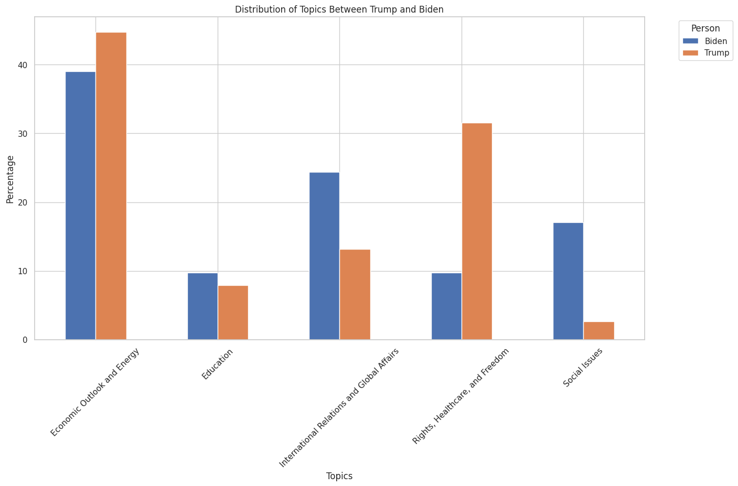
3.1 Clusters

Slide 13
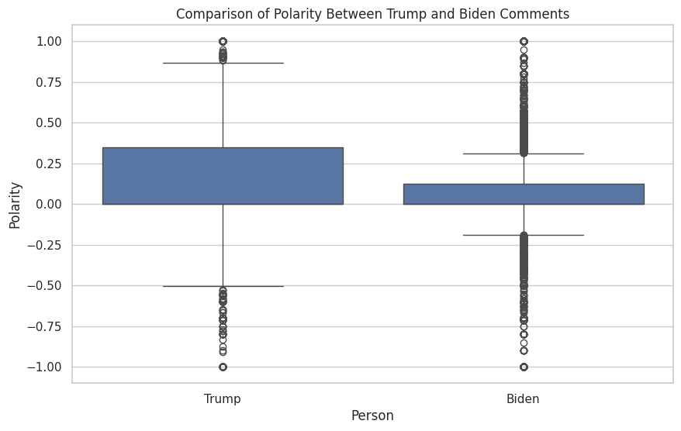
3.2 Polarity comparison

Slide 14
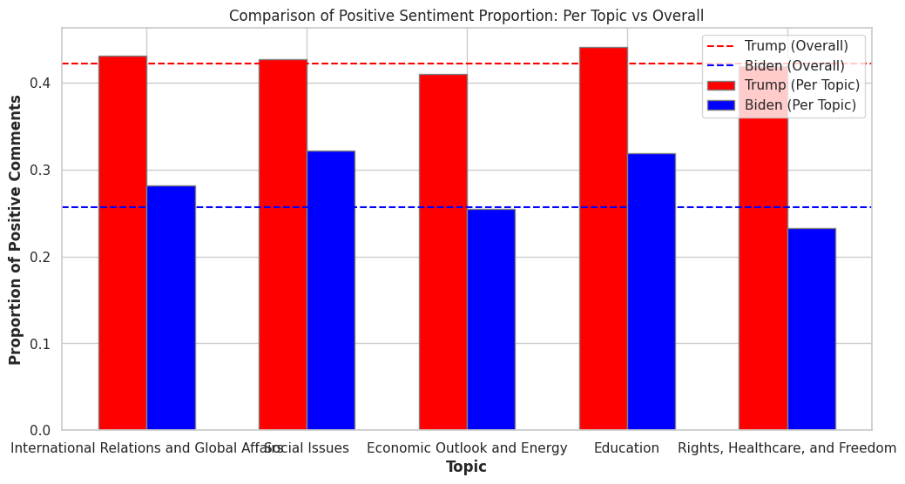
3.3 Positive sentiment per topic

Slide 15
Questions?

