Slide 1
Brain Trainer
Android app
by Sajad

Slide 2
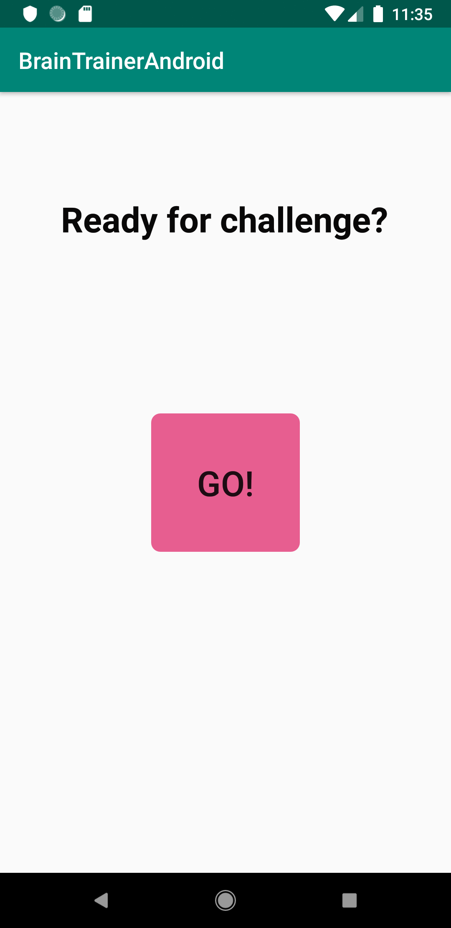
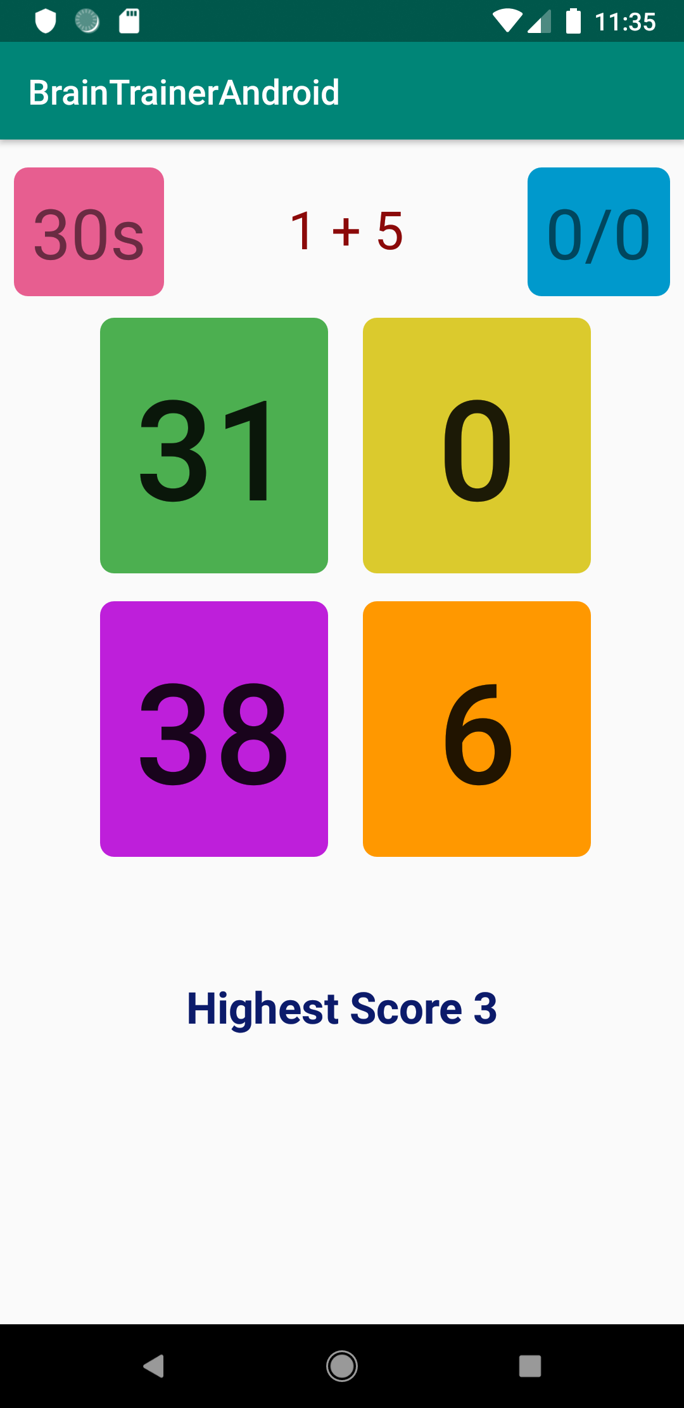
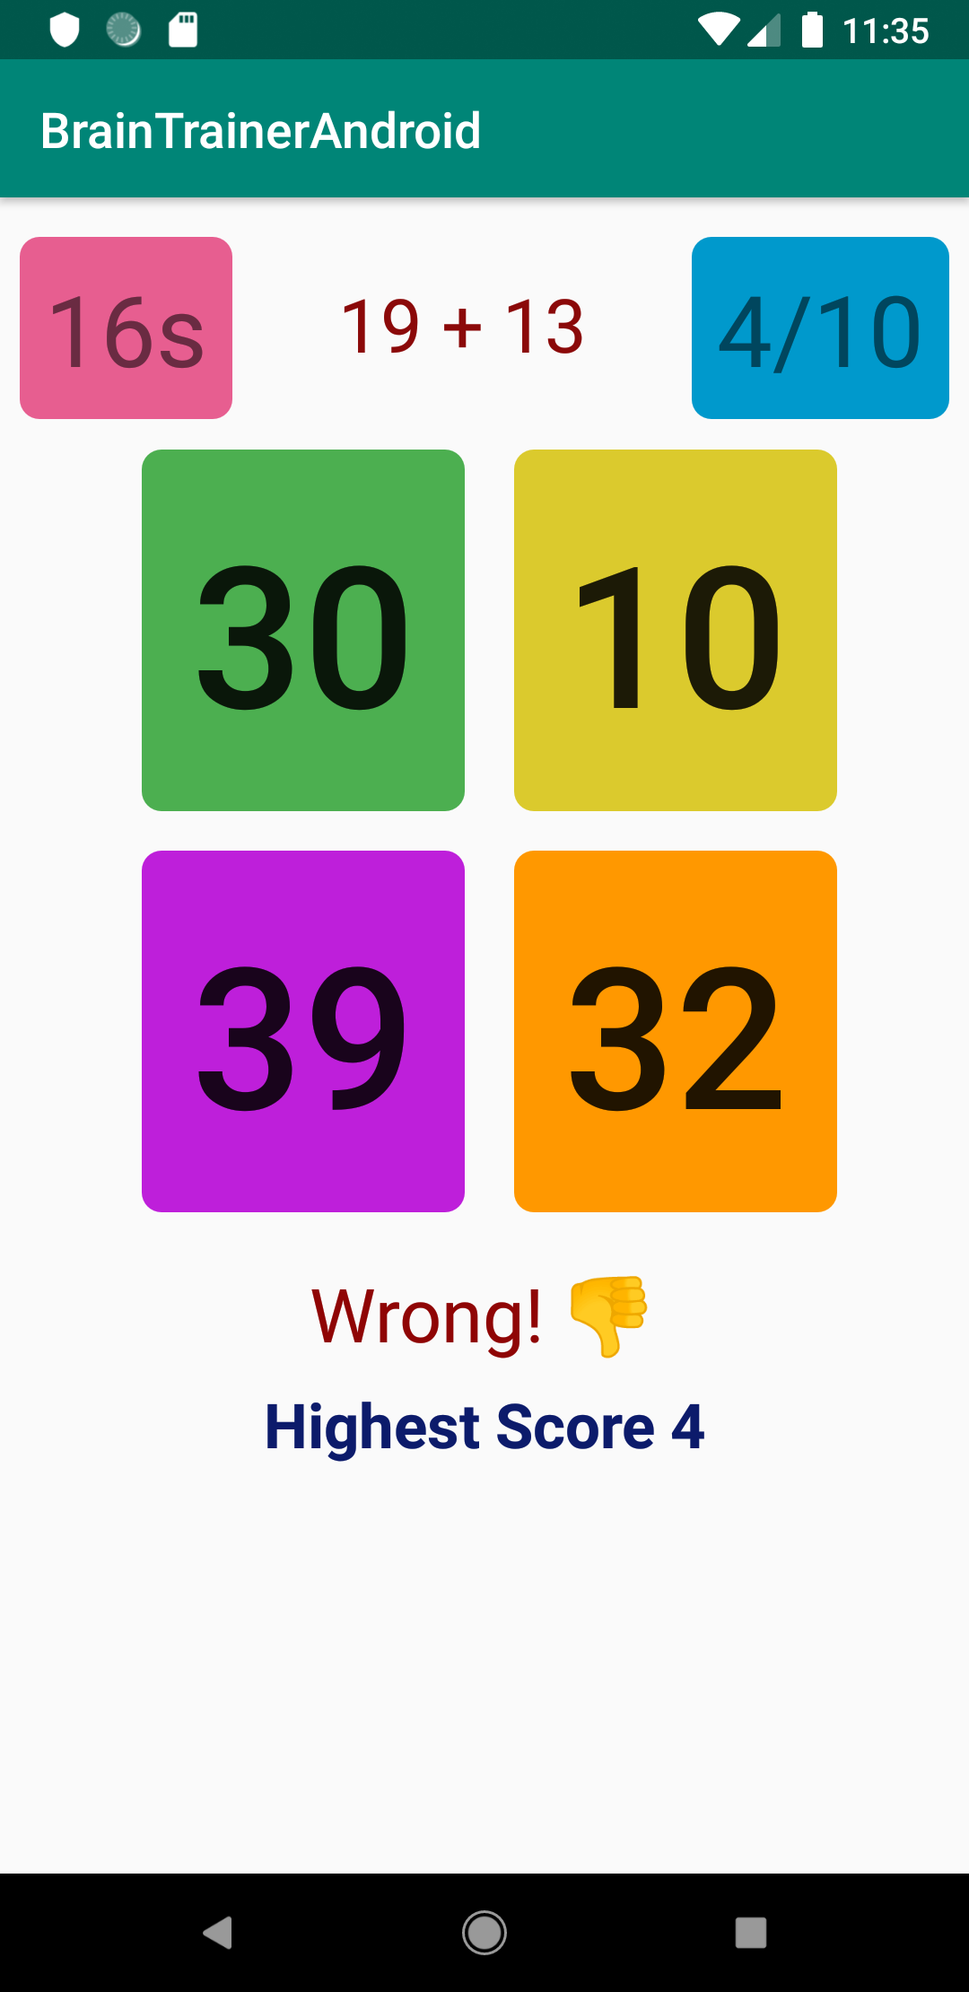
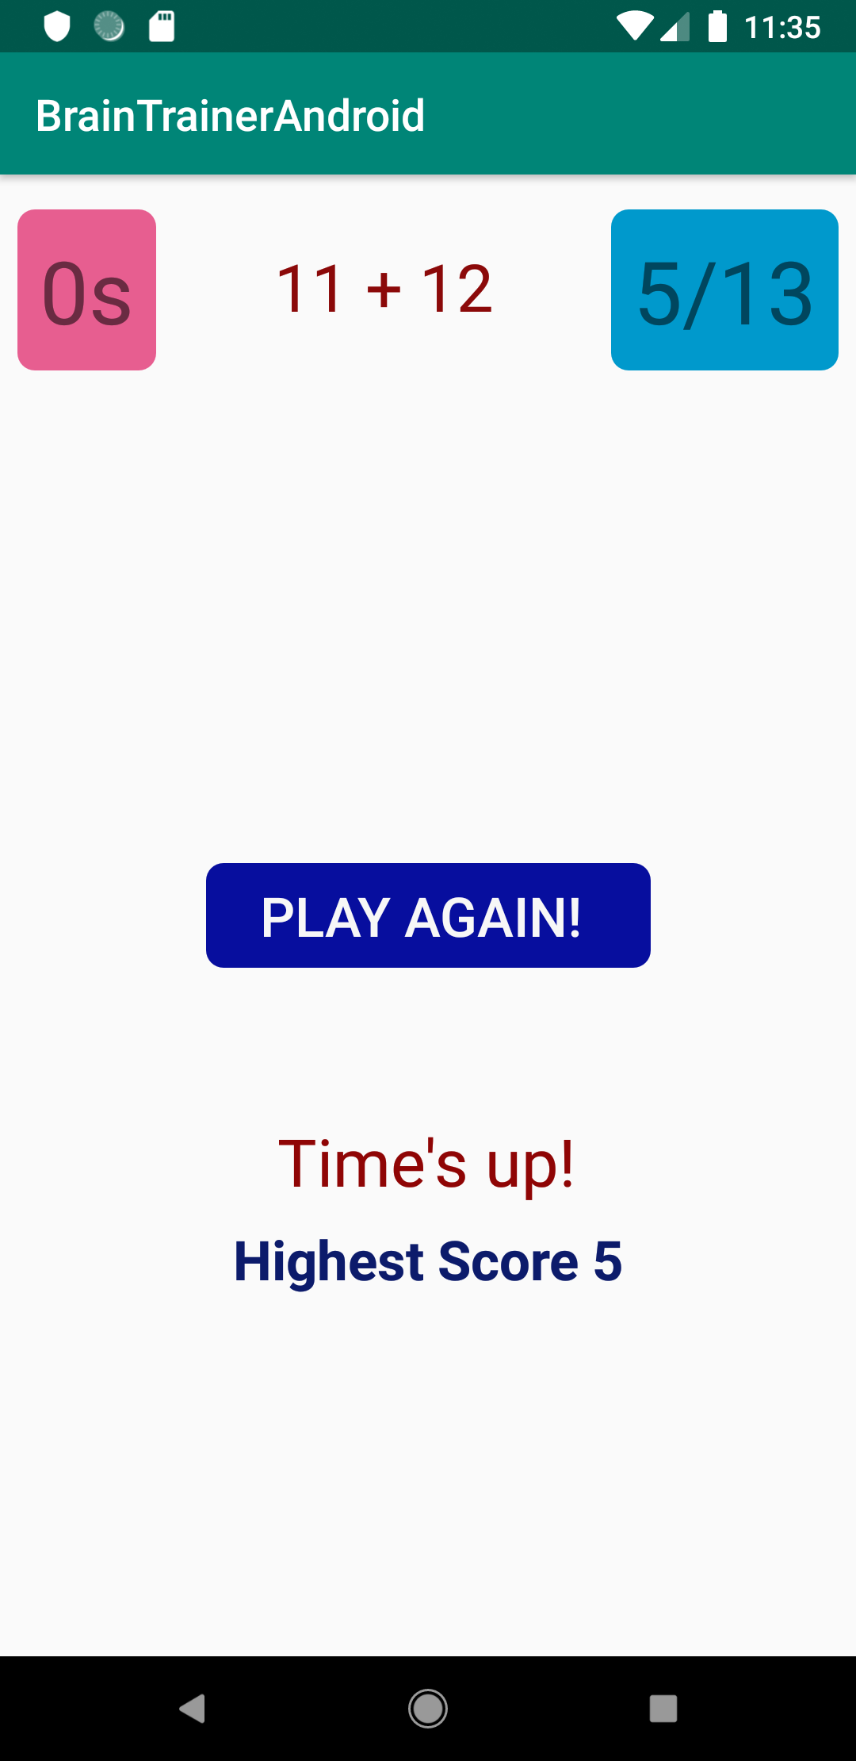
Demo

Slide 3
High Level Overview
An Android app that lets the user play Math games to gain higher scores within the time limit.
There will be random simple Math questions showing up on the screen with multiple choices to pick.
The user is supposed to pick the correct answer each time. There is a timer counting down every second.
Within the time limit, the user should answer as many correct answers as they can to gain a higher score.
The Highest Score is being updated as a higher record is hit, in real time being fetched from Firebase Database.
At the end of the timer, the user has the option to play again if they wish.

Slide 4
How is it implemented
First, we pick a random int from 0 to 3 save it as the ‘locationOfCorrectAnswer’, and 4 buttons with 0 to 3 tags.
We push the 3 random integers and one integer having the value of ‘correctAnswer’ into the answers list.
Show the ‘correctAnswer’ in the button with the same tag number.
If the user clicks on the button with the tag number equal to ‘locationOfCorrectAnswer’, score++, else wrong.
30 seconds counting down. Keeping track of scores, insert the most recent highest score fetched from database as the starting score element in ‘scoreLst’, on each round of user answer, new score added to ‘scoreLst’, max of ‘scoreLst’ is written to database as highest score, and show that if changed from database on screen.
On times up, show the highest score reached reached from real time database, and show the playAgain layout

Slide 5
Features
Using Firebase real time database to read and write the highest score from/to database, updating the highestScoreTextView every time a new highestScore record is hit
Using android.os.CountDownTimer library for the timer
Using ArrayList, Collections.max, java.util.Random in the implementation of the program.
Using ConstraintLayouts, TextView, Buttons, tableLayout in the UI.

Slide 6
Challenges
Saving/Retrieving the highest score from firebase database; solved by inserting the highestScore fetched from database into the scoreLst as a starting score, every time app is reset to keep the highestScore from being overwritten to zero or getting lost. If there is no database connected or established, the starting score will be zero.
Layout positioning after adding a new nested constraintlayout was added, it changed the positions of all components
So much to learn !

Slide 7
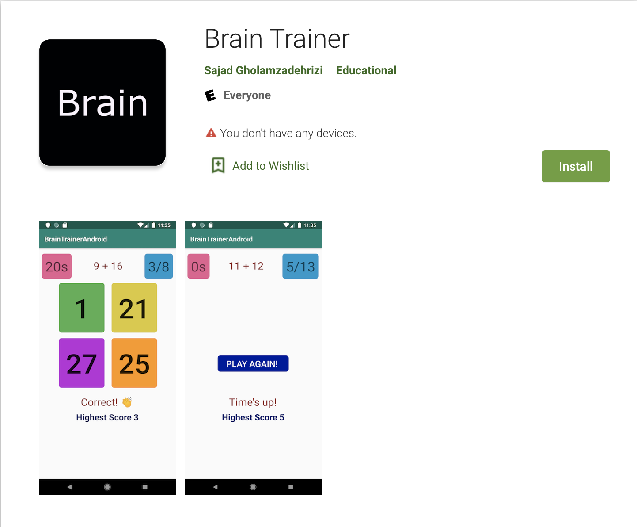
What did I learn
How to build an Android app for the first time
How to connect a database to a mobile app and retrieve/write to it
How the Andoid UI components work; how to add drawable shapes to style components e.g round buttons, or how to add emojis using unicode
How to just keep googling every time you can’t fix a bug, someone else probably has
How to publish your app on Google Play Store
https://play.google.com/store/apps/details?id=sajad.braintrainerandroid

Slide 8
If I had more time …
More types of questions, more functionalities such as a reward in the forms of more time for each correct answer
Save name/nickname of user with highest score
Improve the look of the app

Slide 9
Thank You

