Slide 1

IOT Enabled Traffic Diversion System for Emergency Services
Group No. 4
Vatsal Singh 19104006
Pushkar Telavane 19104011
Shubhangi Tripathi 19104067
GUIDES:
Prof. Apeksha Mohite
Prof. Sneha Dalvi

Slide 2
Contents
Abstract
Introduction
Objectives
Literature Survey
Problem Definition
Technological Stack
Proposed System Architecture/Prototype

Slide 3
1. Abstract
One of the most profound aftermaths of evolving technologies in this modern era is rapidly increasing vehicular counts, which has become grave in the wake of staggering rise in world population. As a result, traffic congestion has become a serious problem in most countries around the world. We are developing a system with the help of IOT to make emergency system like ambulance to reach destination to its earliest. We would be providing the driver of ambulance with the option to choose source and destination location. That selected lane will be displayed on digital screens present near signals. The message being displayed on screen will be seen by other drivers on highway and they will be able to sideline themselves before arrival of ambulance.

Slide 4
2. Introduction
Problem Identified :
    The evolving problem of traffic is an inevitable situation in wide and rising cities worldwide. Population growth has led to a growth in the number of cars leading to absolute congestion development. The reaction time required by the emergency responders plays a vital role in the face of disasters. To address this, an intelligent traffic system is needed using a pre-emptive equation that adapts rapidly to environmental conditions .
Solution Proposed :
    To facilitate the emergency services with dedicated lanes on highways for fast travel and reduced time to reach to the hospital and to manage the traffic on highways for providing fastest routes to emergency services.

Slide 5
3. Objectives
To make ambulances services faster and efficient by using Google API for finding the shortest route to destination.
To guide the traffic controller to manage traffic during peak hours as well as normal hours and make way for ambulance.
To help the traffic controller to move traffic in a systematic order by displaying the lane chosen by the ambulance driver.
To provide an efficient service to driver by opting for our user-friendly application using Flutter.
To get the feedback from the driver of the ambulance about assistance provided through system using grading scale, emoticons or stars.

Slide 6
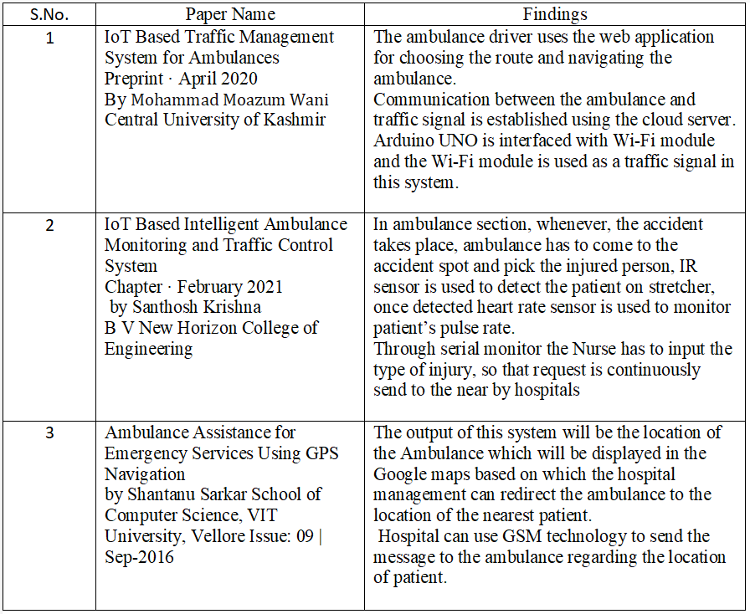
4. Literature Survey

Slide 7
5. Problem Definition
When the ambulance at emergency comes and the ambulance has to face traffic, this costs a whole life sometimes. Increased traffic in modern urban areas is increased to uncertain level. The road accidents in modern urban areas are increased to uncertain level. The loss of human life due to traffic is to be avoided. Traffic congestion and tidal flow are major facts that cause delay to ambulance The loss of human life due to mis- managed traffic and delay in ambulance reaching destination is terrifying and heart wrenching. Traffic congestion and tidal flow are major facts that cause delay to ambulance
Solution Proposed:
To develop a system with help of IOT to manage the routing of emergency services like ambulance for faster and systematic travelling.

Slide 8
6. Technology Stack
SOFTWARE REQUIREMENTS
Flutter 3.3.2
Python 3.9/3.10
MySql 8.0.16
Tinkercad
Arduino IDE
HARDWARE REQUIREMENTS
nodeMCU
LCD
10K Pot
Power Supply
Jumper wires

Slide 9
7. Proposed System Architecture/Prototype
Mobile Application which is user friendly for the driver of ambulance so that he can input source and destination location an also select a lane for his entire journey.
Display of message like, "Ambulance Incoming, vacate lane __” on Digital boards near traffic signal using microcontrollers.
Giving driver the option to submit his review on our services based on his ease and serviceability of the system.

Slide 10
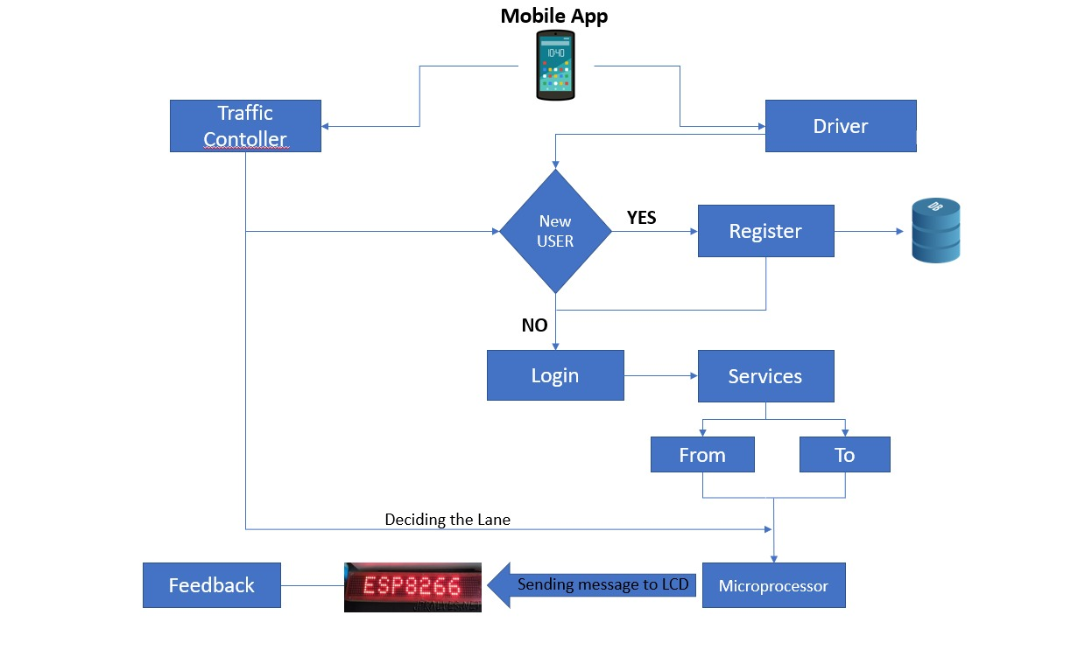
7. Proposed System Architecture/Prototype
Fig: Flowchart of System

Slide 11
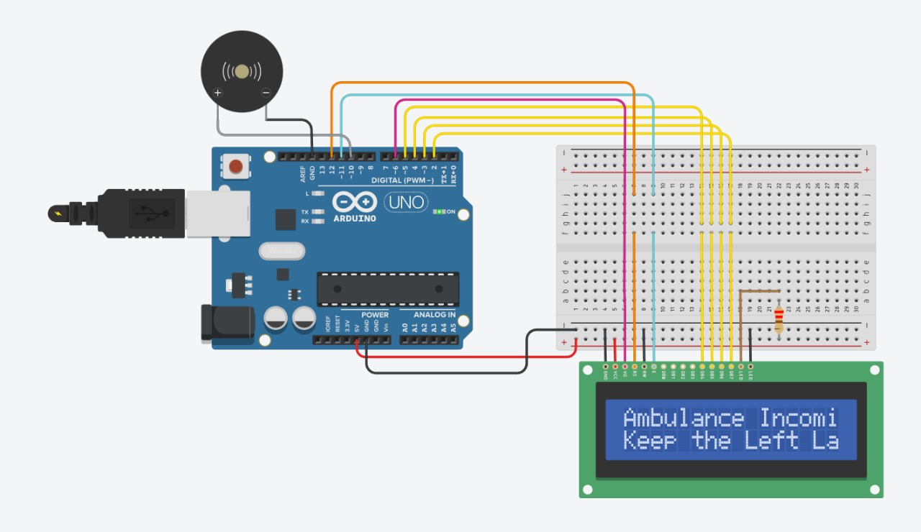
Fig: Tinkercad Simulation

Slide 12
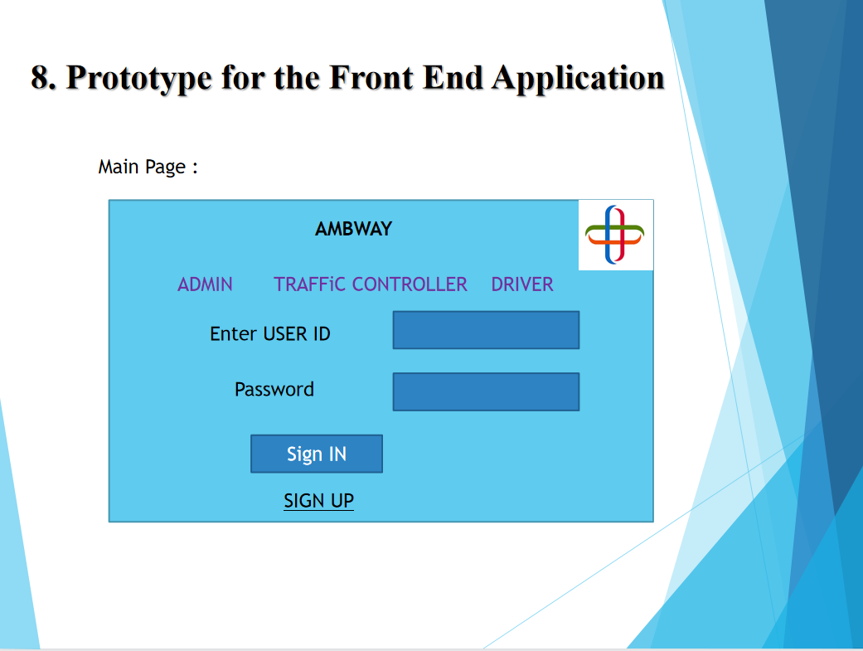

Slide 13
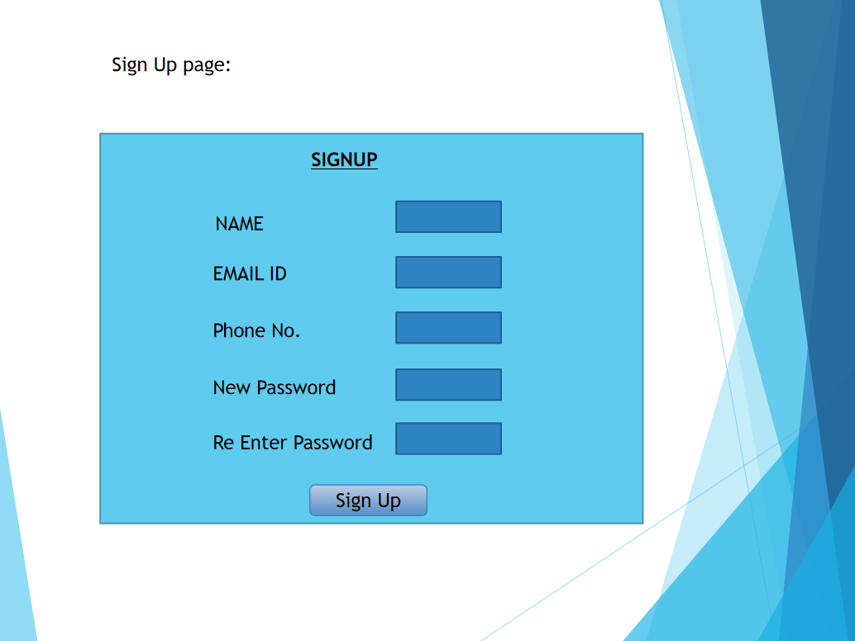

Slide 14
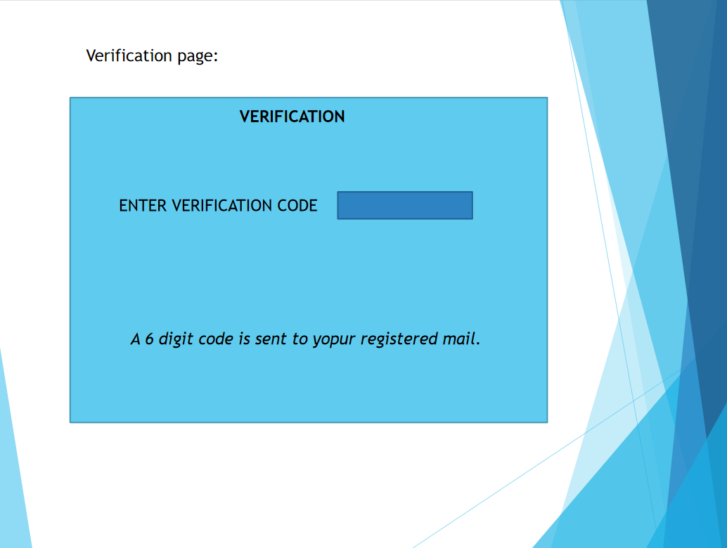

Slide 15
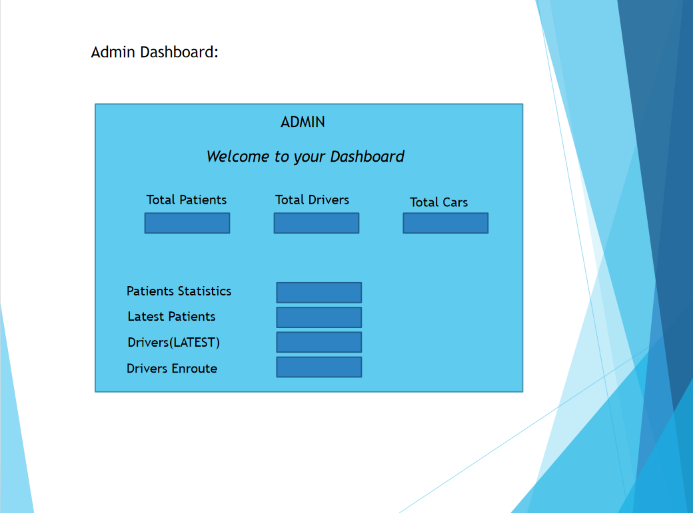

Slide 16
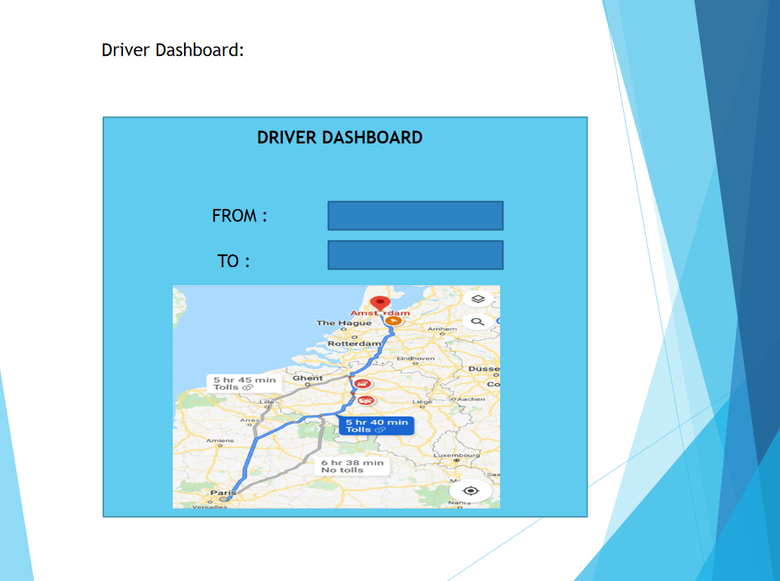

Slide 17
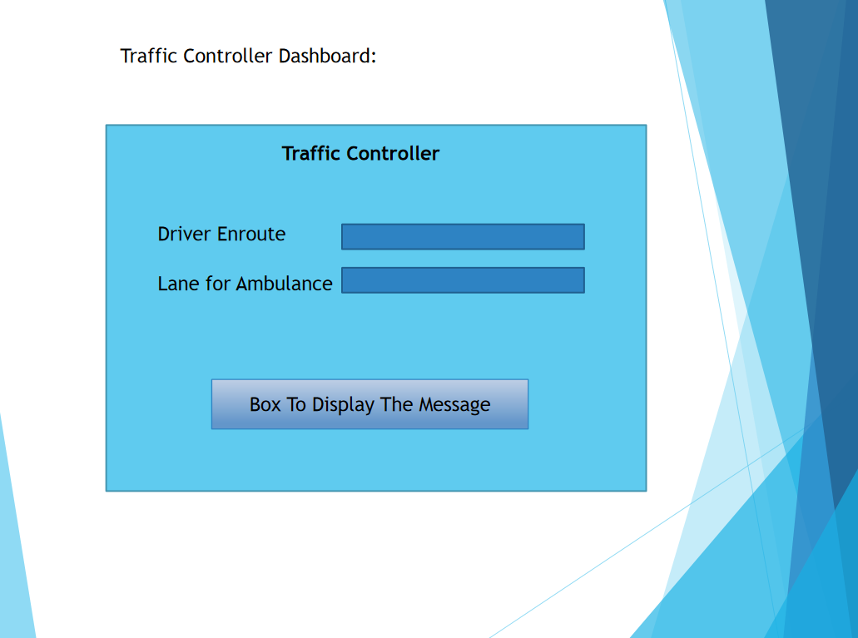

Slide 18

Feedback
Feedback Form
Rate Us

Slide 19
Thank You...!!

