Slide 1
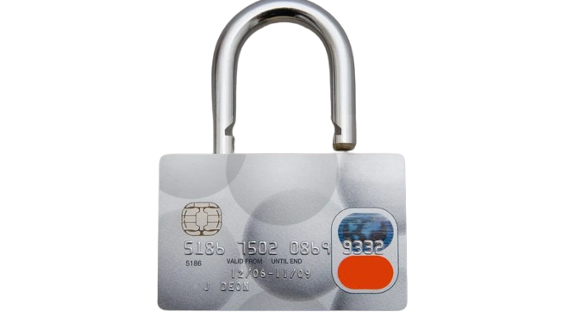

Feature Engineering for Credit Card Fraud Detection
Submitted By
Name: Sajal Samanta
Institution: Techno India University
Instructor: Naina Devi
Domain: Machine Learning

Slide 2

Overview:
Credit card fraud poses a serious threat to financial institutions and customers. Detecting fraudulent transactions in real-time is challenging due to highly imbalanced datasets and complex patterns.
Objective: To apply feature engineering techniques that enhance the performance of machine learning models for fraud detection, improving both accuracy and interpretability.
Key Idea: Transform raw transaction data into meaningful, informative features that enable ML algorithms to better distinguish between fraudulent and genuine transactions.

Slide 3


Technology Stack
Pandas, NumPy – Data manipulation
Scikit-learn – Feature selection & model building
Matplotlib, Seaborn – Data visualization
Python 3.10+
Random Forest, Logistic Regression, XGBoost – ML algorithms
Imbalanced-learn (SMOTE) – Handling class imbalance
Jupyter Notebook

Slide 4
Workflow
Data Preprocessing:
Missing value handling
Data normalization/scaling
Exploratory Data Analysis (EDA):
Fraud vs. Non-Fraud pattern visualization
Feature Engineering
Derived features: TransactionAmount_log, Time_Sin/Cos, TransactionFrequency
Correlation-based feature selection
Balancing Dataset
Used SMOTE to handle class imbalance
Model Training
Random Forest & Logistic Regression

Slide 5
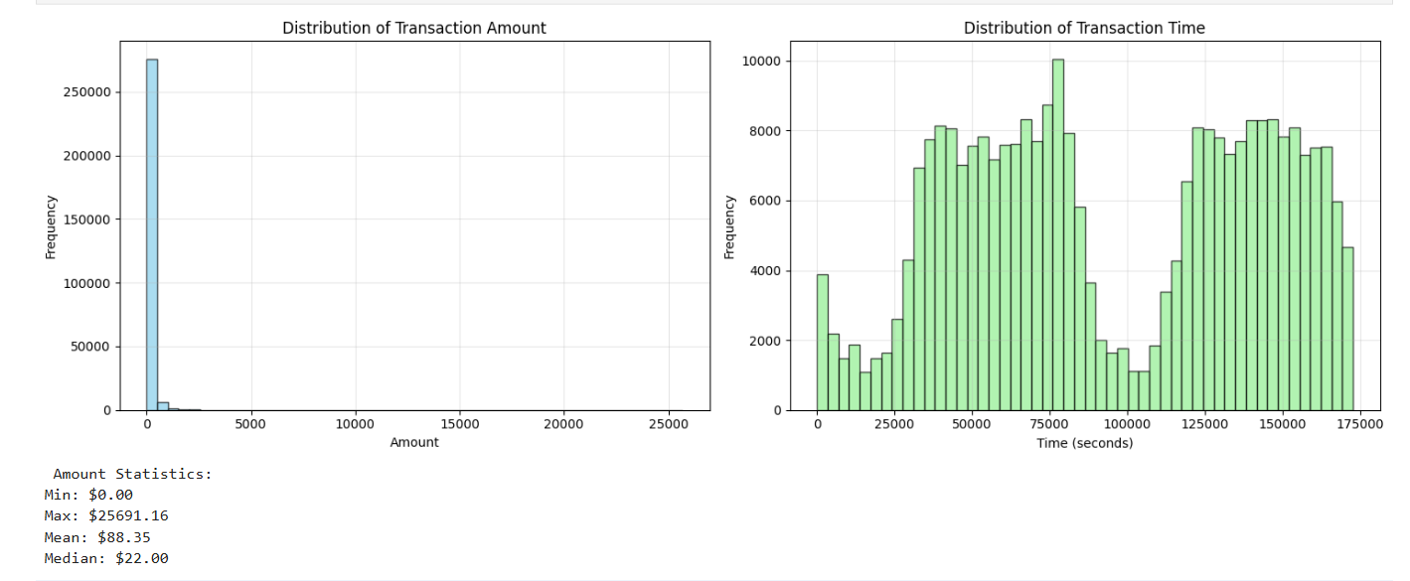
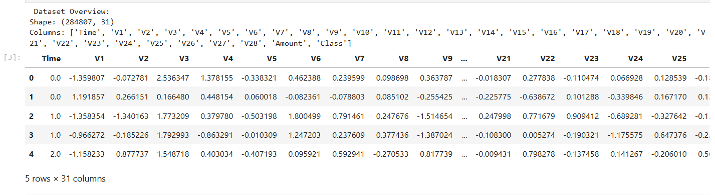
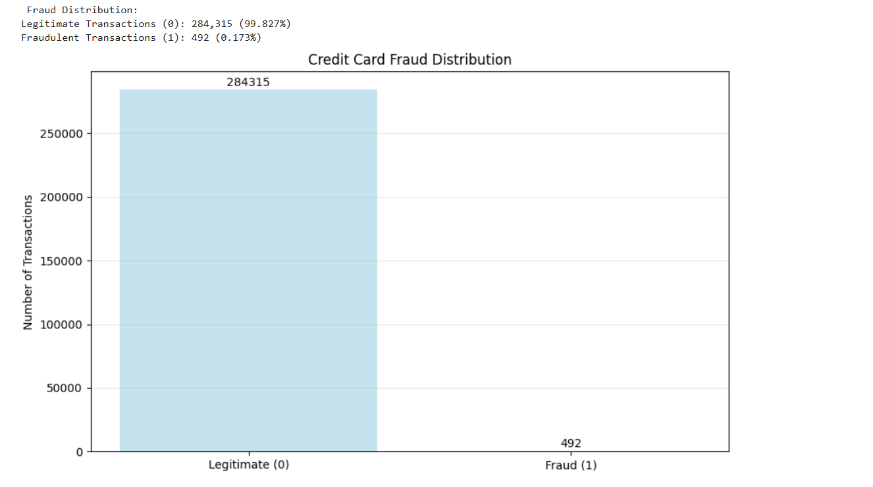
Project Working
Watch my project demo here : watch video
View live this project: visit the web app
Source code: view source code on github

Slide 6
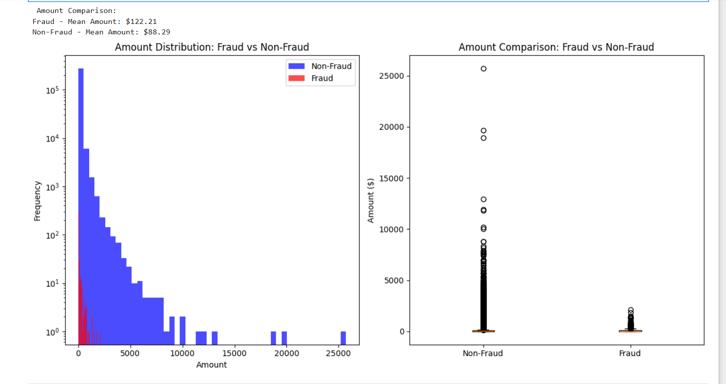
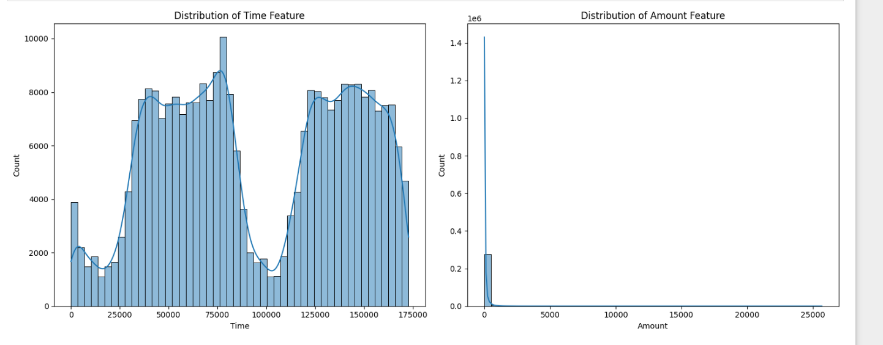

Slide 7
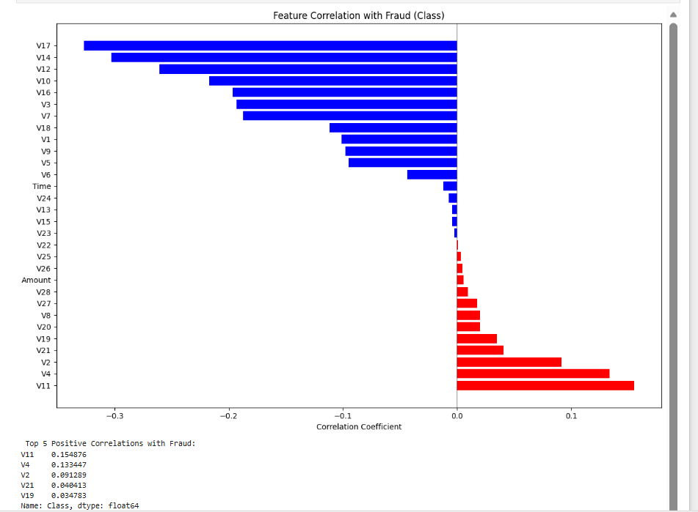
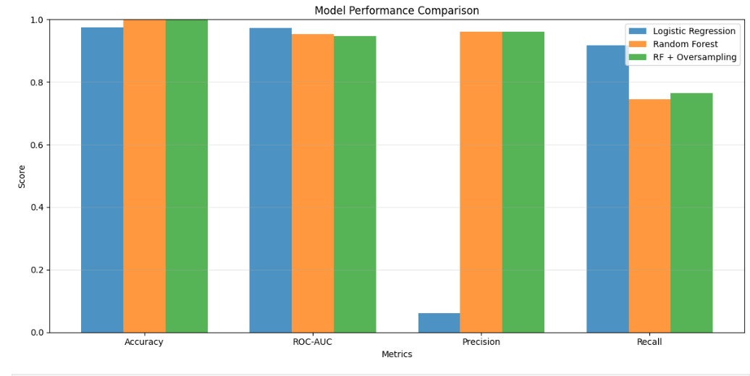
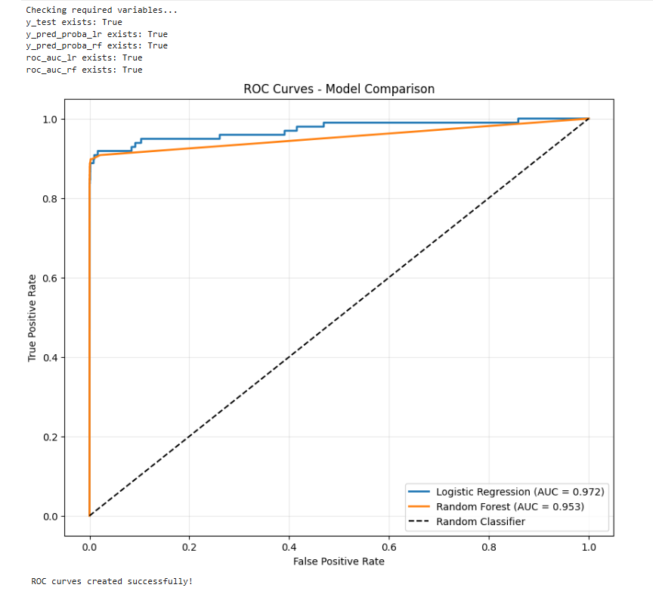
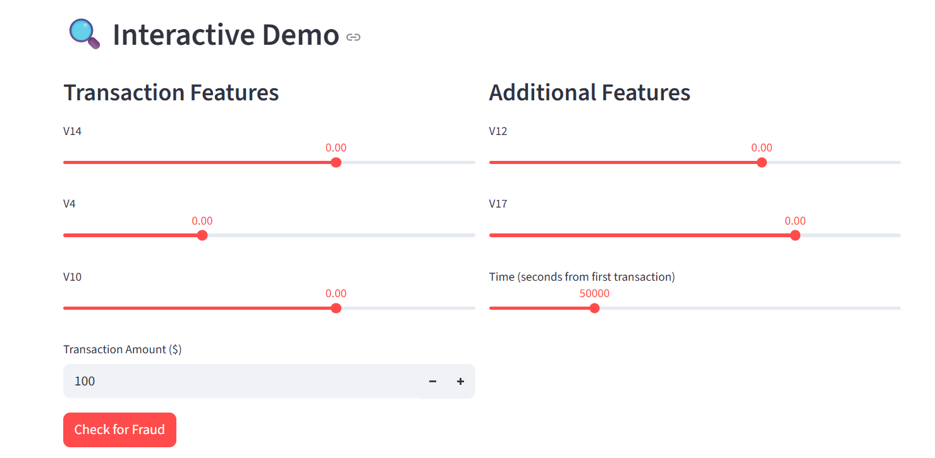

Slide 8
Application / Use Case
Real-World Applications:
Banking & Financial Institutions: Detect and block fraudulent credit card transactions in real-time.
E-commerce: Prevent fake purchases or account takeovers.
Payment Gateways: Improve fraud scoring and transaction authentication systems.
Impact:
Reduces financial loss
Builds customer trust
Enables smarter fraud prevention systems

Slide 9

Issues Faced
Highly Imbalanced Data: Fraud cases < 0.2% of total transactions.
High Dimensionality: Dataset contains many redundant or noisy features.
Model Overfitting: Early models performed well on training but poorly on test data.
Feature Correlation: Some features were strongly correlated, confusing the model.

Slide 10

Overcoming the Issues
Applied SMOTE – Balanced minority and majority classes. Feature Scaling & Normalization – Used MinMaxScaler for uniformity. Feature Selection – Used correlation heatmap and SelectKBest. Regularization (L2) – Prevented overfitting. Cross-Validation – Ensured generalization and stability of model performance.
Outcome:
Model AUC improved from 0.83 → 0.95
Precision and Recall increased significantly for fraud detection class.

Slide 11

Future Enhancements
Deep Learning Integration:
Implement Autoencoders and LSTM for sequence-based fraud detection.
Real-time Detection System:
Deploy using Streamlit or Flask API on IBM Cloud.
Explainable AI (XAI):
Use SHAP/LIME to interpret fraud predictions.
Continuous Learning:
Implement feedback-based retraining with new data.
Blockchain Integration:
Secure transaction data validation.

Slide 12
Conclusion
Feature Engineering is the backbone of an effective fraud detection system.
Improved data representation led to better model precision, recall, and AUC.
Demonstrated how intelligent preprocessing can drastically reduce false positives and negatives.
Watch my project demo here : watch video
View live this project: visit the web app
Source code: view source code on github

