Slide 1

FEATURE ENGINEERING FOR
CREDIT CARD FRAUD DETECTION
Submitted By
Name: Sajal Samanta
Institution: Techno India University
Instructor: Naina Devi
Domain: Machine Learning

Slide 2


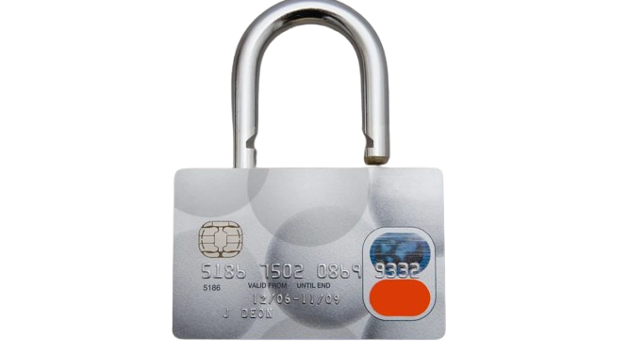
INTRODUCTION TO THE PROJECT
Credit card fraud is one of the major financial crimes worldwide.
Fraud detection is challenging due to the large volume of transactions and imbalanced data.
This project uses Machine Learning algorithms to detect fraudulent transactions based on patterns in the dataset.
Objective: To minimize financial losses by accurately predicting fraud in real time.
.

Slide 3

OVERVIEW
Credit card fraud poses a serious threat to financial institutions and customers. Detecting fraudulent transactions in real-time is challenging due to highly imbalanced datasets and complex patterns.
OBJECTIVES:
To apply feature engineering techniques that enhance the performance of machine learning models for fraud detection, improving both accuracy and interpretability..
KEY IDEA:
Transform raw transaction data into meaningful, informative features that enable ML algorithms to better distinguish between fraudulent and genuine transactions.

Slide 4







TECHNOLOGY STACK
Pandas, NumPy – Data manipulation
Scikit-learn – Feature selection & model building
Matplotlib, Seaborn – Data visualization
Python 3.10+
Random Forest, Logistic Regression, XGBoost – ML algorithms
Imbalanced-learn (SMOTE) – Handling class imbalance
Jupyter Notebook
.

Slide 5
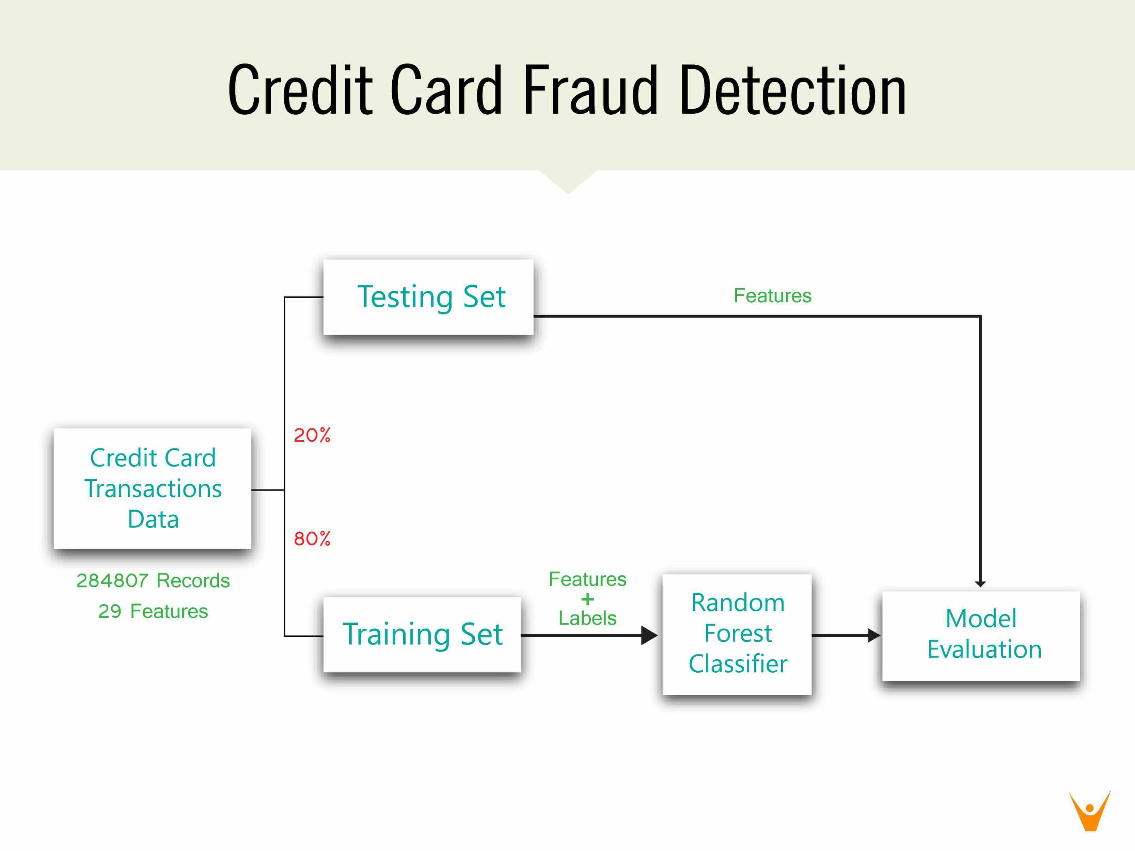

WORKFLOW
DATA PROCESSIN-
Missing value handling
Data normalization/scaling
Exploratory Data Analysis (EDA):
Fraud vs. Non-Fraud pattern visualization.
Feature Engineering::
Derived features: TransactionAmount_log, Time_Sin/Cos, TransactionFrequency
Correlation-based feature selection.
Balancing Dataset:
Used SMOTE to handle class imbalance.
Model Training
Random Forest & Logistic Regression.

Slide 6

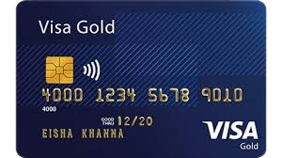
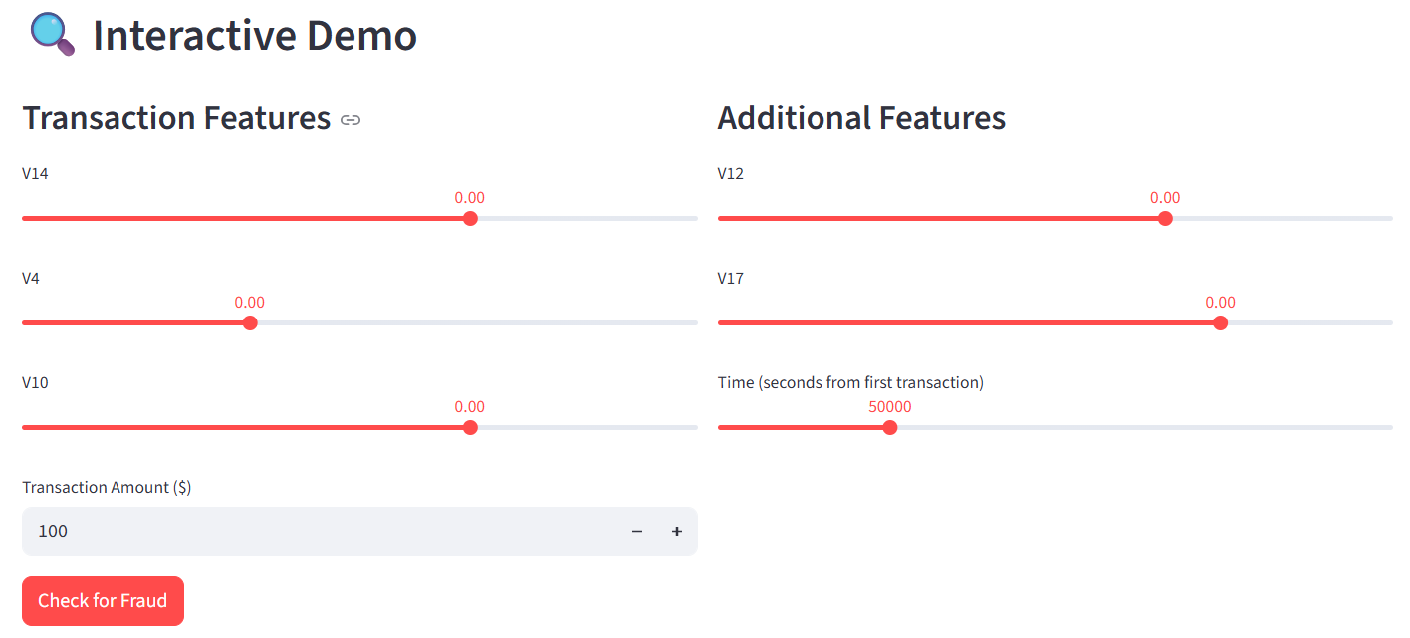
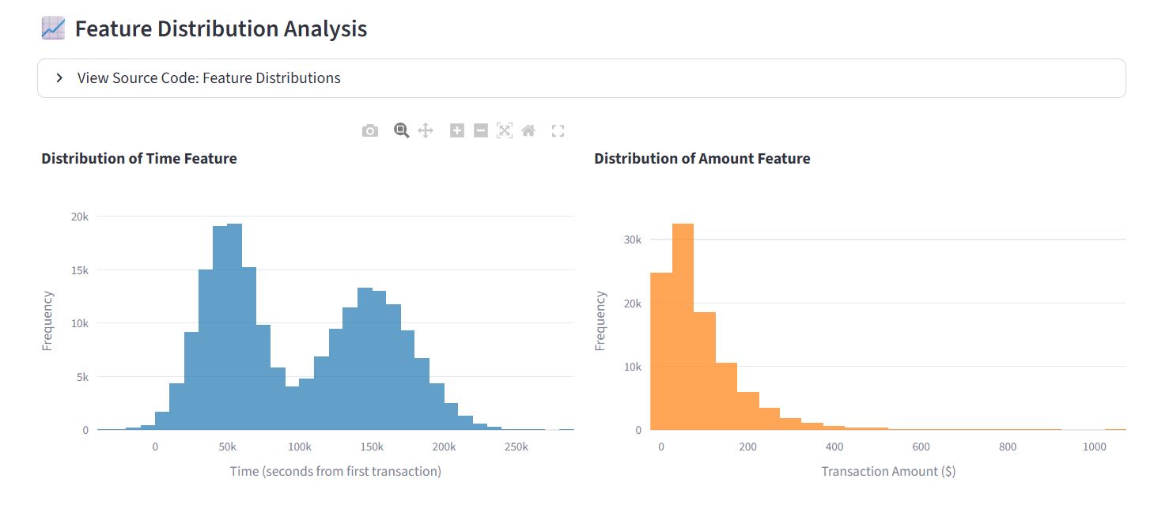
PROJECT WORKING
ABOUT US
Watch my project demo here : watch video
View live this project: visit the web app
Source code: view source code on github
Elaborate on what you want to discuss.

Slide 7
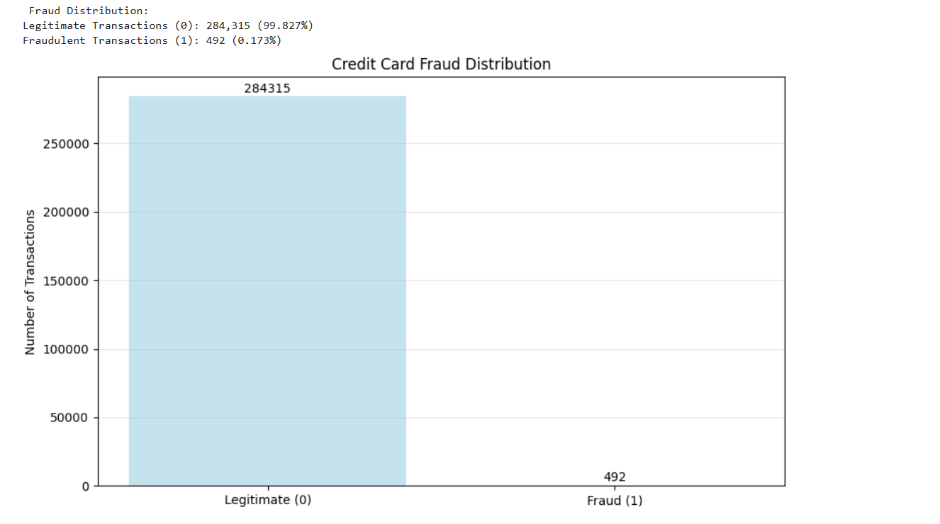
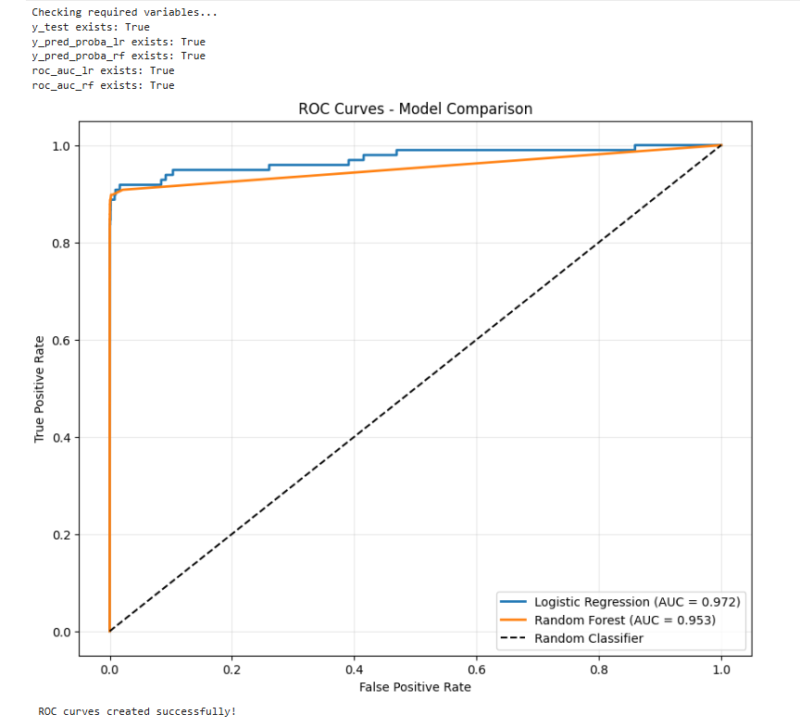
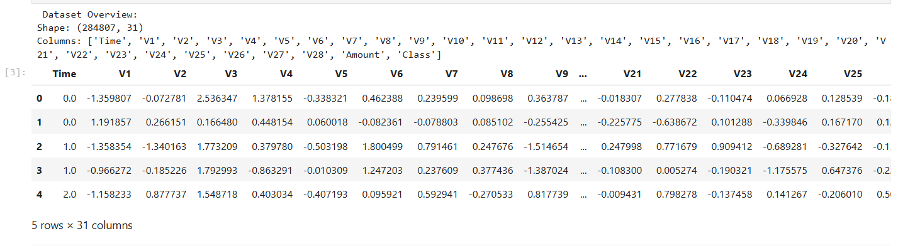
FRAUD DISTRIBUTION
PROJECT WORKING
ROC CURVES
DATASET OVERVIEW

Slide 8
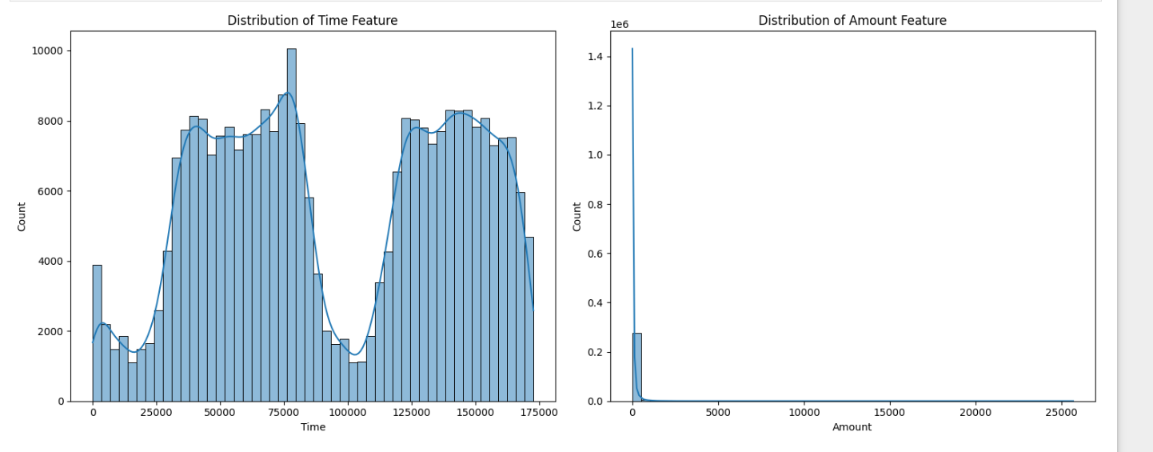
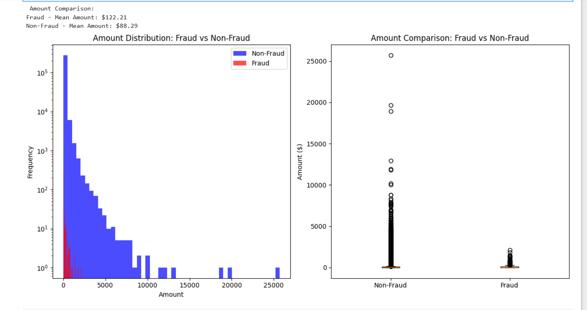
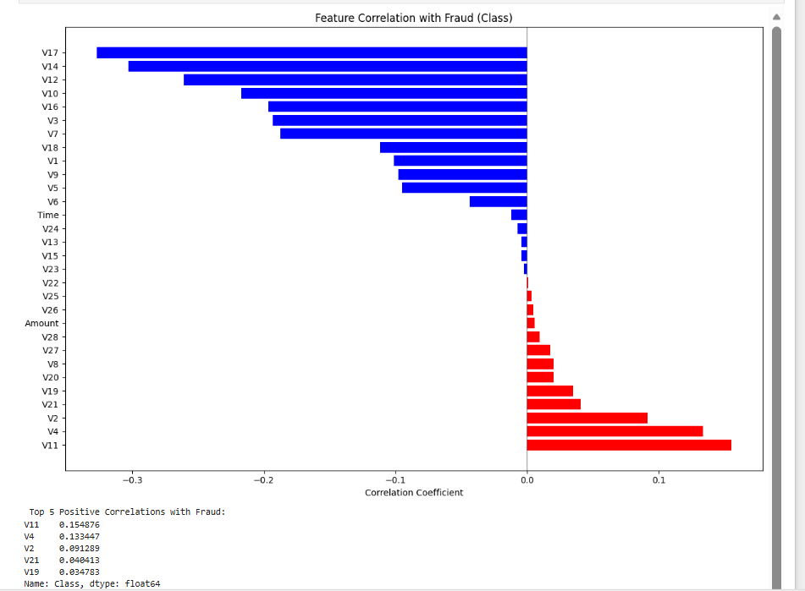
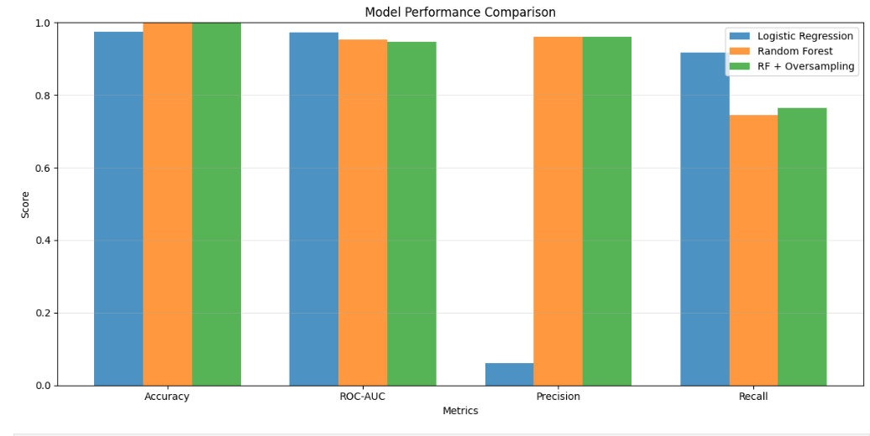
PROJECT WORKING
ABOUT US
Elaborate on what you want to discuss.

Slide 9
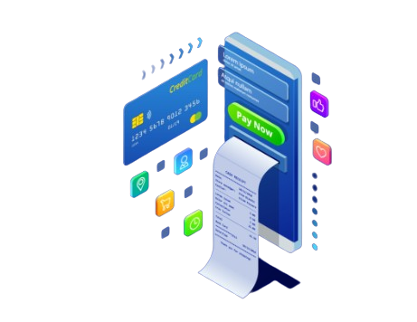
APPLICATIONS
.
Used by banks and financial institutions to prevent fraud.
Helps in real-time transaction monitoring.
Enhances customer trust by ensuring transaction safety.
Reduces financial losses caused by fraudulent activities.
Can be integrated into mobile banking or payment apps

Slide 10

PROBLEMS AND SOLUTIONS
PROBLEMS
SOLUTIONS
Used SMOTE technique to balance classes.
Applied cross-validation to avoid overfitting.
Compared multiple models and selected the one with highest F1-score.
Highly imbalanced dataset (fraud cases are very few).
Overfitting during model training.
Difficulty in choosing the best algorithm.

Slide 11

FUTURE SCOPE
Deep Learning Integration:
Implement Autoencoders and LSTM for sequence-based fraud detection.
Real-time Detection System:
Deploy using Streamlit or Flask API on IBM Cloud.
Explainable AI (XAI):
Use SHAP/LIME to interpret fraud predictions.
Blockchain Integration:
Secure transaction data validation.

Slide 12

CONCLUSION
Feature Engineering is the backbone of an effective fraud detection system.
Improved data representation led to better model precision, recall, and AUC.
Demonstrated how intelligent preprocessing can drastically reduce false positives and negatives.
Watch my project demo here : watch video
View live this project: visit the web app
Source code: view source code on github

Slide 13

THANK YOU
Watch my project demo here : watch video
View live this project: visit the web app
Source code: view source code on github

