Slide 1
Journey Planner Project
Oscar Goudet
Sayantan Biswas
Mathis Magnin
Sajal Chaurasia
Fletcher Collis

Slide 2
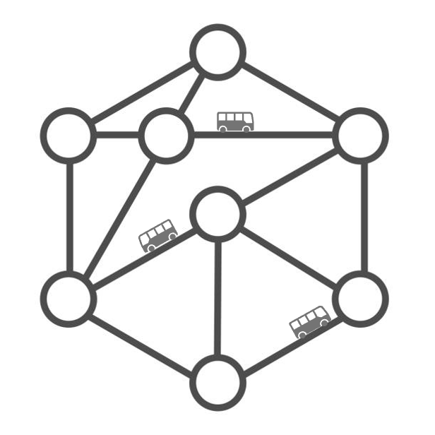
Presentation plan
Introduction
Data Structure
Routing algorithm
Modeling of the delays
Validation method
Visualization and user interface

Slide 3
Introduction

Slide 4
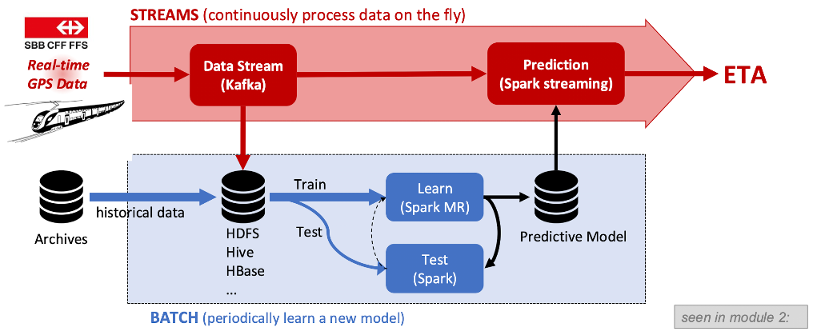
Introduction
Goal : Trying to be as realistic as possible in terms of data availability
→ using data after the query time we consider as data leakage

Slide 5
Respecting query time data boundaries
This project hypothesis
We implemented two different data pipelines
historical data we consider all data up until last month of data
current data we consider all data up to the query time.
last month
Query Time
Time

Slide 6
Data Structure

Slide 7
Routing Data Pipeline
How graph edges are built from raw SBB GTFS data
① SBB Source Data
② Derived Tables
③ Graph Edges
iceberg.com490_iceberg
user namespace (prepare)
built at query time
sbb_stops
stops
ride
Stop names, lat/lon, location type
Regional stops filtered by geo polygon
Board→alight along one trip leg
sbb_stop_times
stop_times
dwell
Departure & arrival times per trip
Times parsed to seconds + day booleans
Wait at a stop between arrivals
sbb_trips
stop_to_stop
walk
Trip → service_id mapping
Pairs within 500 m (Haversine dist)
Transfer on foot between stops
sbb_calendar
walk_edges
source
Mon–Sun operating day flags
Bidirectional pedestrian connections
Waiting cost from departure time
geo
sink
Region polygons (WKB geometry)
Zero-cost arrival at destination

Slide 8
Delay and Travel Times Modelling Data Pipeline
Primary Input Source: SBB istdaten having actual arrival/departure timestamps.
Narrowed down to User Defined Regions and Good Quality Trip data (REAL and GESCHAETZT)
Delay: (Actual Arrival - Scheduled Arrival), Travel time: Destination actual arrival - Source actual departure
inter-stop segment travel times distribution
(7-quantile profile)
stop-level delays distribution
(1-minute discrète PMF buckets)

Slide 9
Routing Algorithm

Slide 10
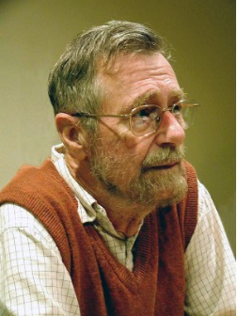
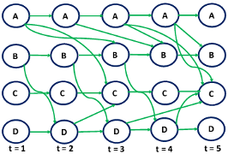
Chosen Routing Algorithm
Time Expanded Graph
Use the timetable to time-expand the graph where each trip between two stops becomes an edge with its own dep. and arr. time
Backwards Dijkstras Algorithm
Adaptation of classical algorithm to anchor at the arrival and search backwards in time to find the latest possible departure
Modified to give back the k-best paths (keeps running instead of stopping at best)

Slide 11


Chosen Routing Algorithm
Transfer Buffer
Variable buffer added at transfers as to give more conservative solutions
Backwards Sweep
Variable arrival time at destination as to give different alternative routes
→ Output = collection of paths from origin to destination that respect the arrival deadline

Slide 12
Delay Modeling

Slide 13
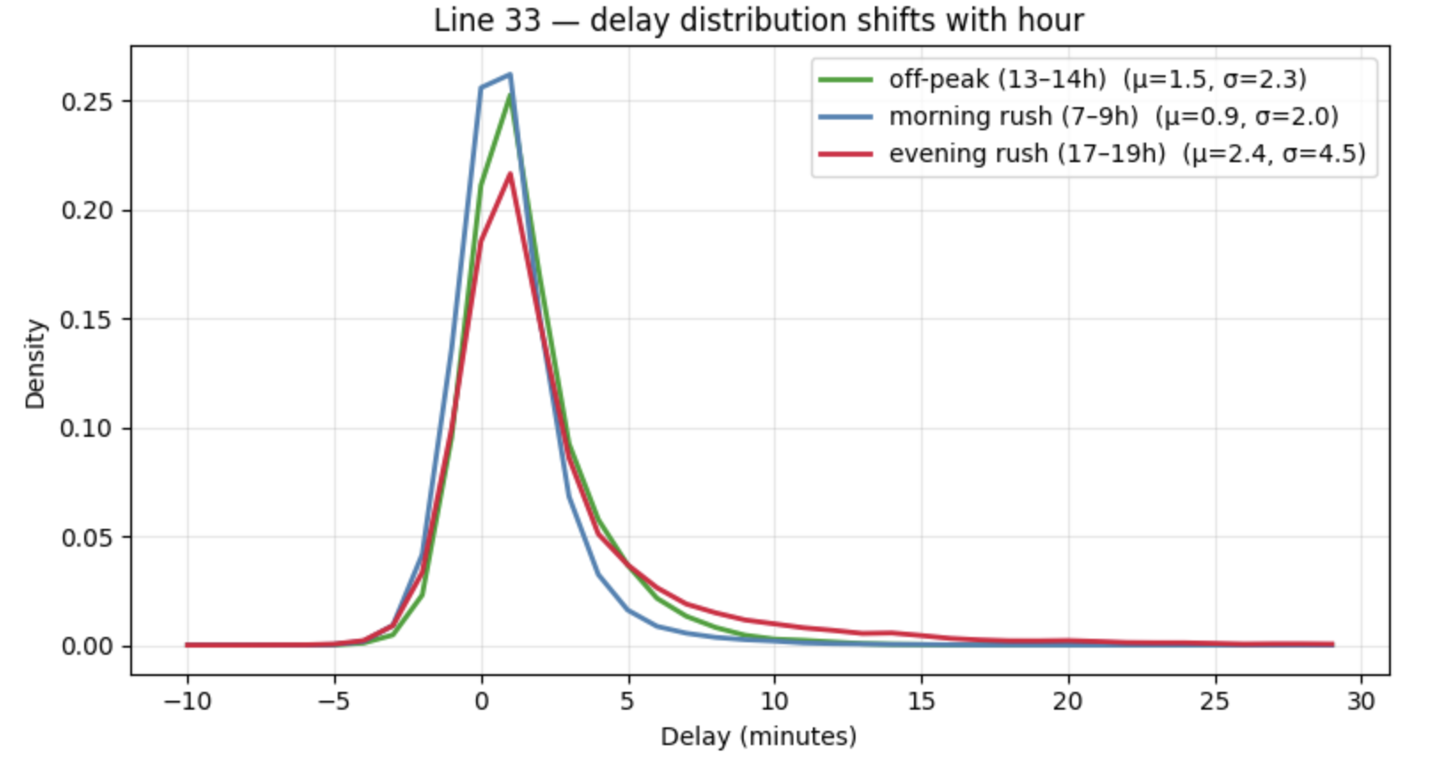
Modelling delays — empirical PMFs, conditioned by hour
Stop delay PMF
-no live observation of the bus yet.
-Sample a historical delay at the scheduled time.
Segment travel time
-bus is already running and we see its position.
-Forecast its travel time from current position to the next stop.
Notes:
"The Routing algorithm has two information regimes for any given bus. Either the bus has not been observed yet — in which case we use a historical stop delay distribution at the scheduled time. Or it's already running and we see its current position — in which case we forecast its travel time from where it is now to the selected stop and use it to model delay.
Both are empirical because if you Look at the chart, for the same line at the same stops, the tail varies by hour, and we want to model the exact shape of that tail to estimate missed-transfer risk.

Slide 14
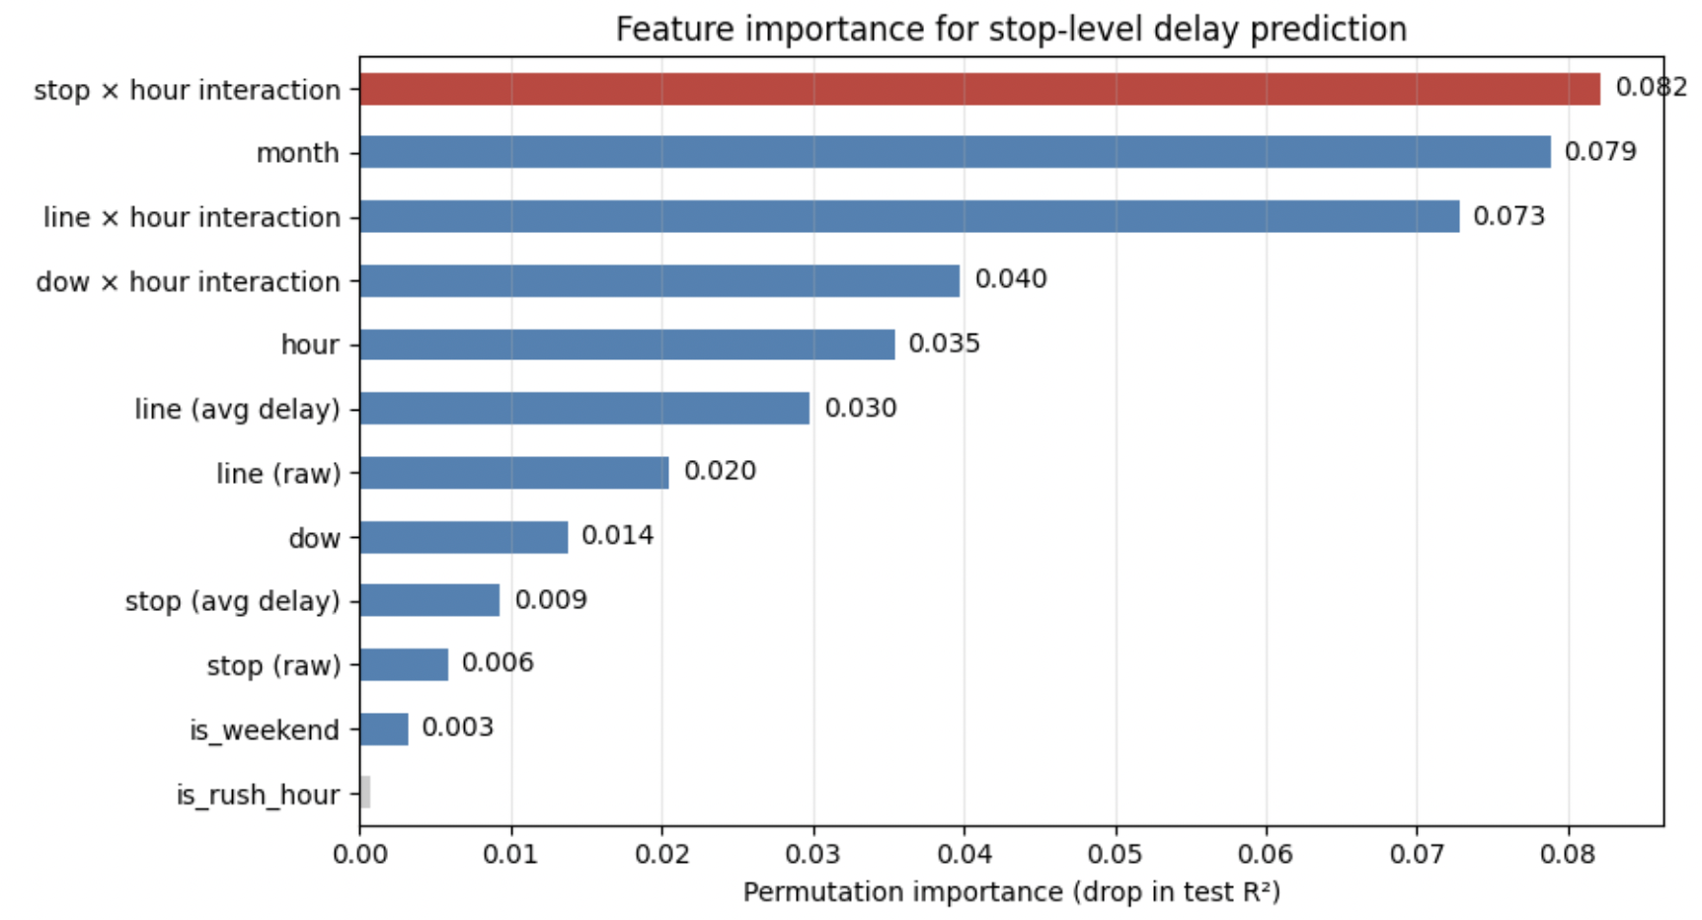
Validated features · fallback · holdout
Final conditioning
[dow] [line] [stop] [hour]
Top features are hour-interactions
→ conditioning anchors on hour
month strong but dropped → keep cell sample size > 50
Three-tier fallback (min 50 obs)
[dow] [line] [stop] [hour]
[line] [stop] [hour]
[stop] [hour]
Training / holdout split
Last available month
Model never sees the day it's tested on
Training (1 year)
Hold
Notes:
"We did validate the feature choice for the delay modeling with a gradient boosting model. The hour-interactions are the dominant features.. Month was meaningful at 8% but we dropped it to keep group samples above 50.
If we don’t have enough observations, Sparsity is handled by a three-tier fallback: we drop the weakest signals first so that we always have at least 50 observations.
Then the distributions are modeled only on data up to 30 days before the latest date. The last month is held out so the delay model never sees the day it's tested on."

Slide 15
Validation method

Slide 16
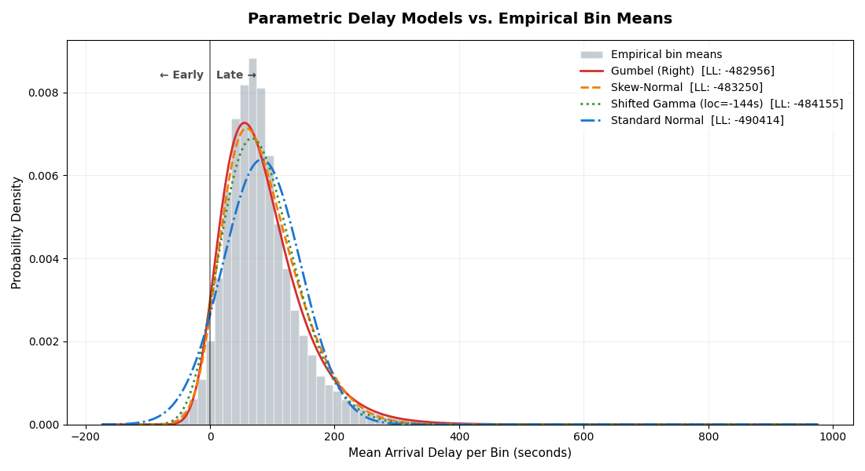
Parametric Model & Validation
Model | MAE (sec)
Stop-level Discrete Median | 98.04
Gumbel MAE | 97.49
Global Gumbel | 100.19
We Test parametric models as it provides faster inference and better generalization in production. Among all skewed distributions tested, Gumbel best captures our empirical data.
Threshold | Discrete MAE | Gumbel MAE | Gumbel Reg
-120 | 0.02577 | 0.03161 | 0.02600
0 | 0.14323 | 0.08210 | 0.11083
60 | 0.12928 | 0.08020 | 0.13192
180 | 0.05560 | 0.06638 | 0.08619
300 | 0.03264 | 0.04243 | 0.04811
600 | 0.01336 | 0.01441 | 0.01649

Slide 17
User Interface

Slide 18

Visualization

