Slide 1
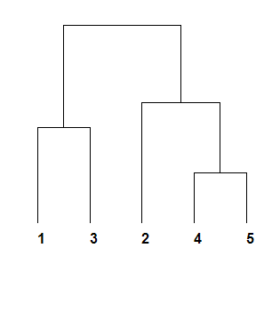
AGNES
on Filtered and Normalized X
Y -> Single Cells
(Neurons)
Y -> Single cells
[‘Cortex’, ‘Hippocampus’,
‘Subventricular’]

