Slide 1


Employee Retention
Sajal Kumar Mandal
Mentor
Noble Xavier

Slide 2
Hiring and retaining employees are extremely complex tasks that require capital, time and skills.
“Small business owners spend 40% of their working hours on tasks that do not generate any income such as hiring”.
“Companies spend 15%-20% of the employee's salary to recruit a new candidate”.

Slide 3
“An average company loses anywhere between 1% and 2.5% of their total revenue on the time it takes to bring a new hire up to speed”.
Hiring a new employee costs an average of $7645 (0-500 corporation).
It takes 52 days on average to fill a position.
You work as a data scientist at a multinational corporation.
The HR team collected extensive data on their employees and approached you to develop a model that could predict which employees are more likely to quit.

Slide 4
The team provided you with an extensive data, here's a sample of the dataset:
JobInvolvement
Education
JobSatisfaction
PerformanceRating
RelationshipSatisfaction
WorkLifeBalance

Slide 5
A confusion matrix is used to describe the performance of a classiﬁcation model:
True positives (TP): cases when classiﬁer predicted TRUE (they have the disease), and correct class was TRUE (patient has disease).
True negatives (TN): cases when model predicted FALSE (no disease), and correct class was FALSE (patient do not have disease).
False positives (FP) (Type I error): classiﬁer predicted TRUE, but correct class was FALSE (patient did not have disease).
False negatives (FN) (Type II error): classiﬁer predicted FALSE (patient do not have disease), but they actually do have the disease
Classiﬁcation Accuracy = (TP+TN) / (TP + TN + FP + FN)
Precision = TP/Total TRUE Predictions = TP/ (TP+FP) (When model predicted TRUE class, how often was it right?)
Recall = TP/ Actual TRUE = TP/ (TP+FN) (when the class was actually TRUE, how often did the classiﬁer get it right?)

Slide 6
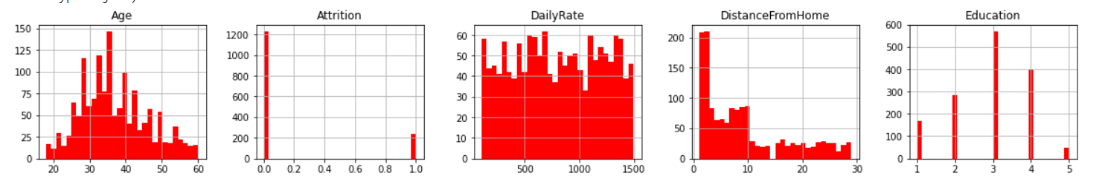
Steps
Import Libraries and Data Set
Basic Data Checks
Info ()
Describe()
Replace the 'Attrition' and 'overtime' column with integers
Check any missing data
Create the histogram to check data

Slide 7
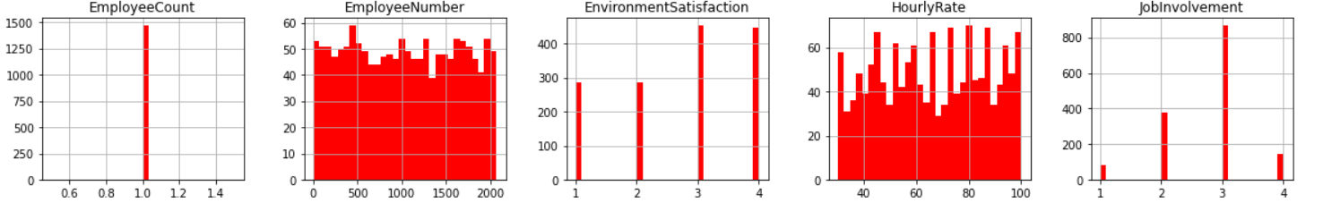
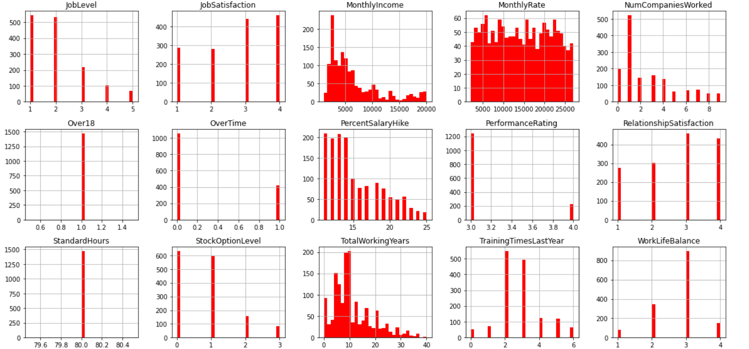

Slide 8
Drop 'EmployeeCount' , 'Standardhours' and 'Over18' since they do not change from one employee to the other.
How many employees left the company.
Percentage of employees who left the company
Number of employees who did not leave the company (stayed)
Percentage of employees who did not leave the company (stayed)
Count the number of employees who stayed and left

Slide 9
Compare the mean and std deviation of the employees who stayed and left
'age': mean age of the employees who stayed is higher compared to who left
'DailyRate': Rate of employees who stayed is higher.
'DistanceFromHome': Employees who stayed live closer to home (Create Graph)
'EnvironmentSatisfaction' & 'JobSatisfaction': Employees who stayed are generally more satisifed with their jobs- (Create Graph)
'StockOptionLevel': Employees who stayed tend to have higher stock option level (Create Graph)

Slide 10
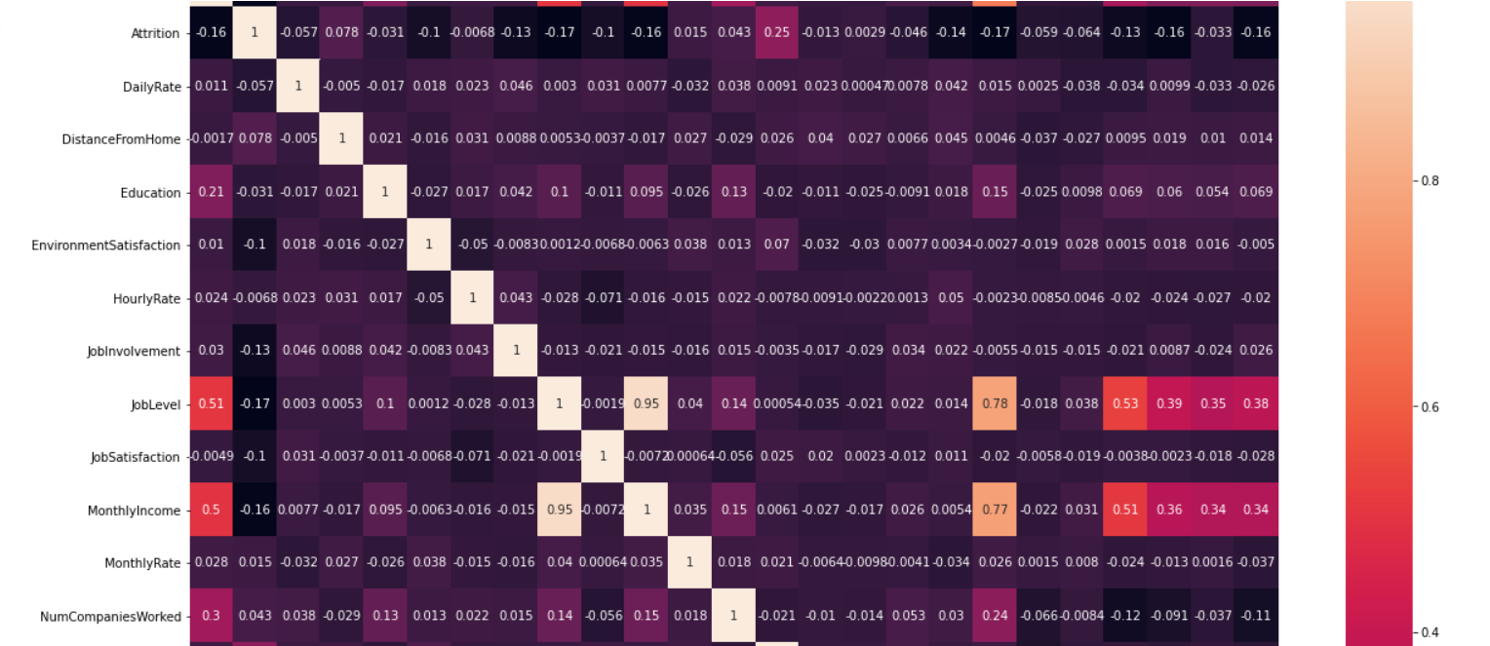
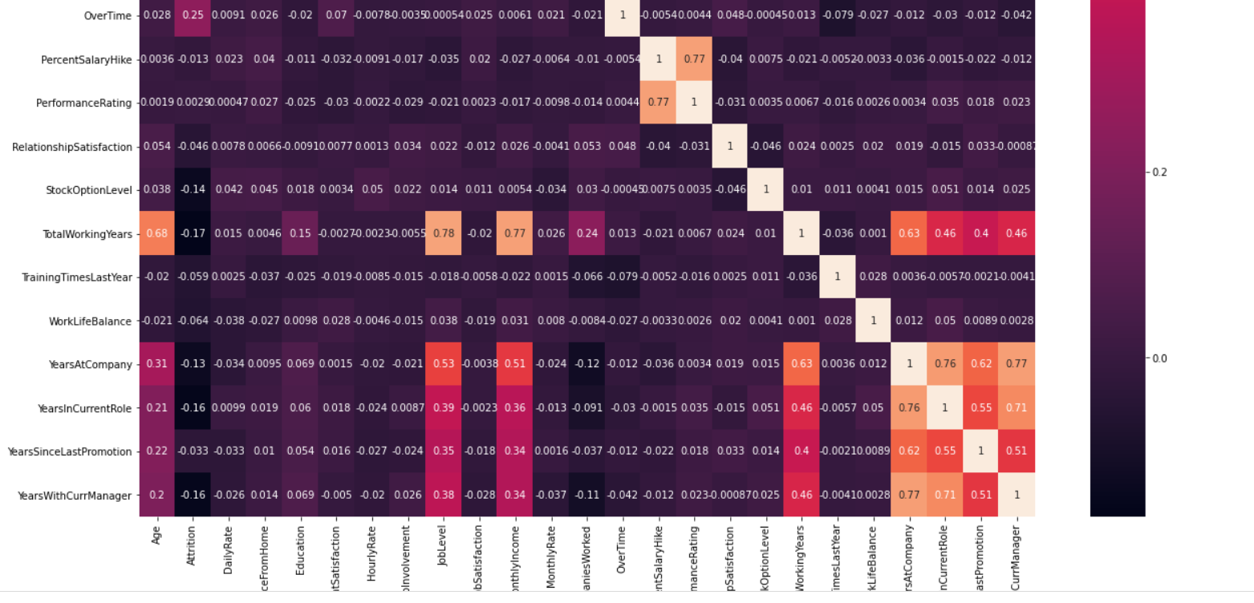
Create Co relation matrix – Heat Map

Slide 11
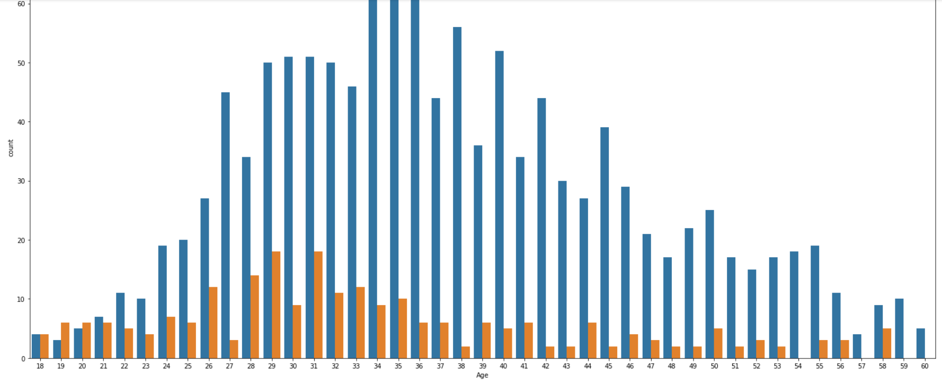
Compare Age and Attrition

Slide 12
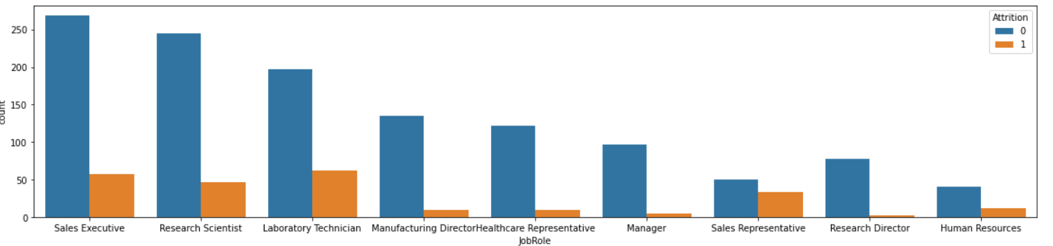
Count Plot - 'JobRole’ and 'Attrition’
sns.countplot(x = 'JobRole', hue = 'Attrition', data = df

Slide 13
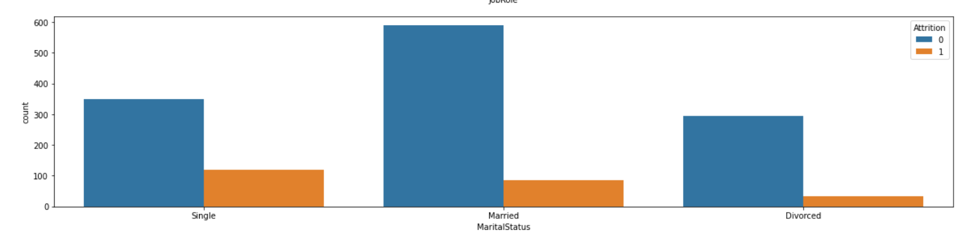
Count Plot – Marital Status and Attrition

Slide 14
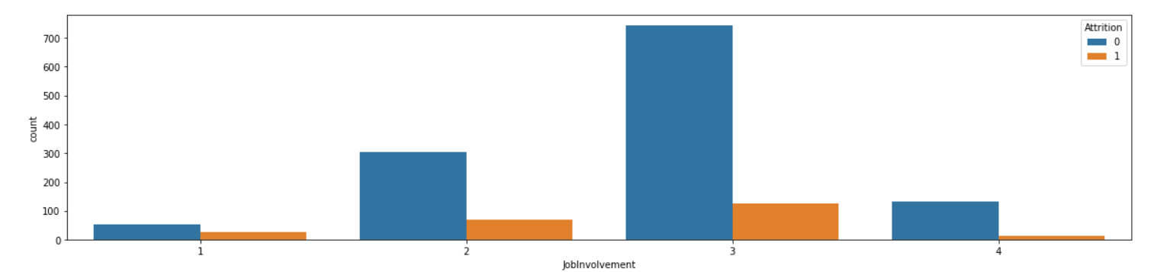
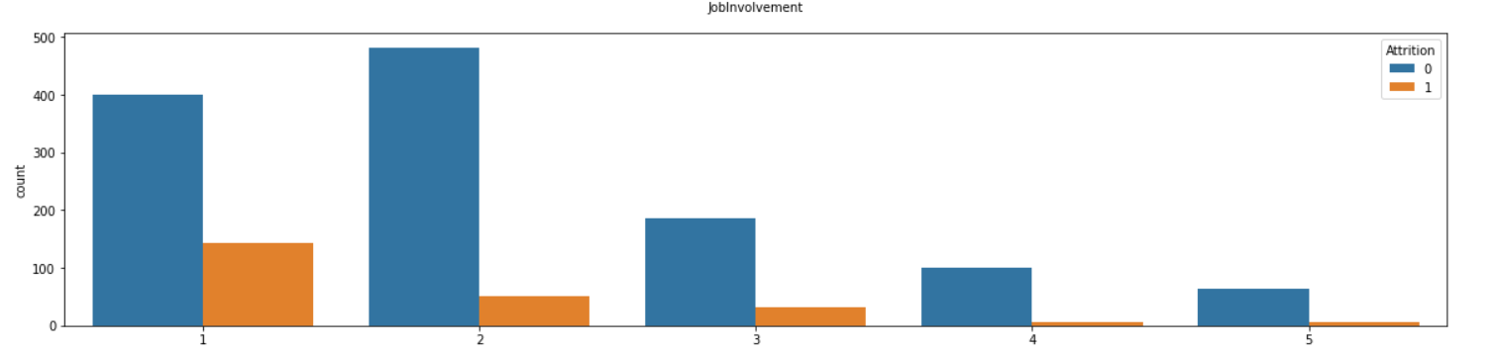

Slide 15
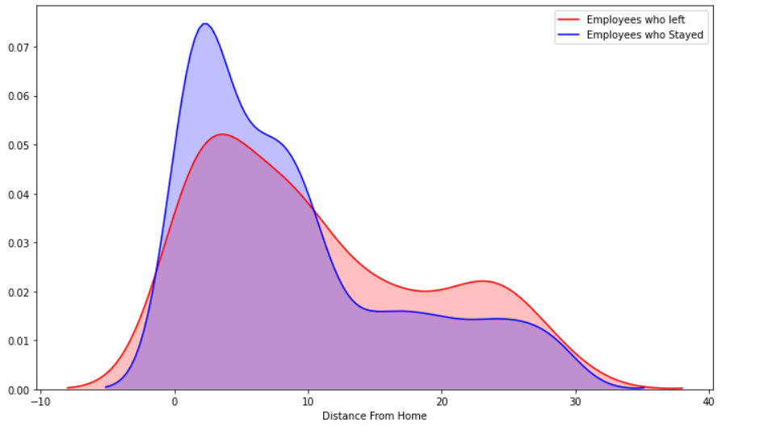
KDE Plot
plt.figure(figsize=(12,7))
sns.kdeplot(left_df['DistanceFromHome'], label = 'Employees who left', shade = True, color = 'r')
sns.kdeplot(stayed_df['DistanceFromHome'], label = 'Employees who Stayed', shade = True, color = 'b') plt.xlabel('Distance From Home')

Slide 16
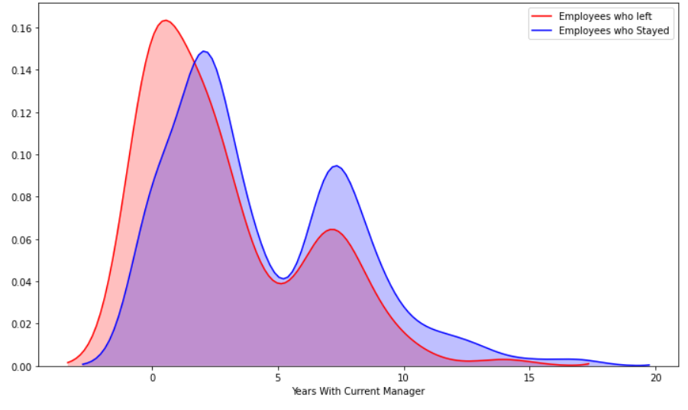

Slide 17
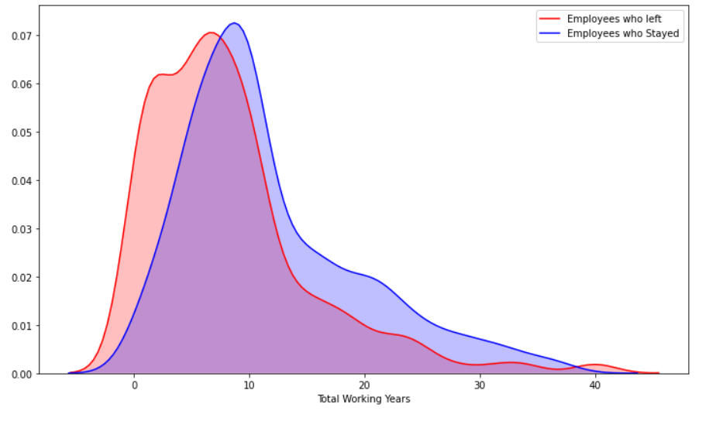

Slide 18
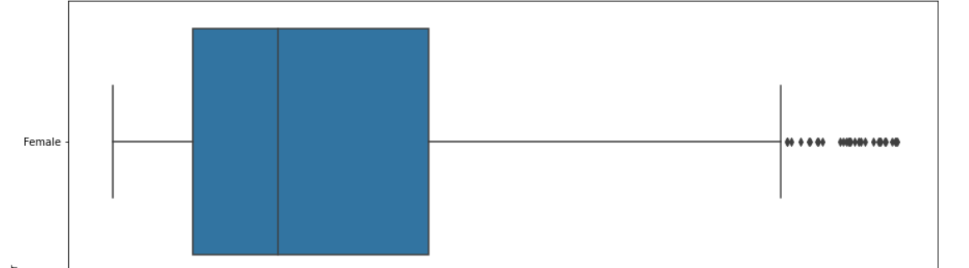
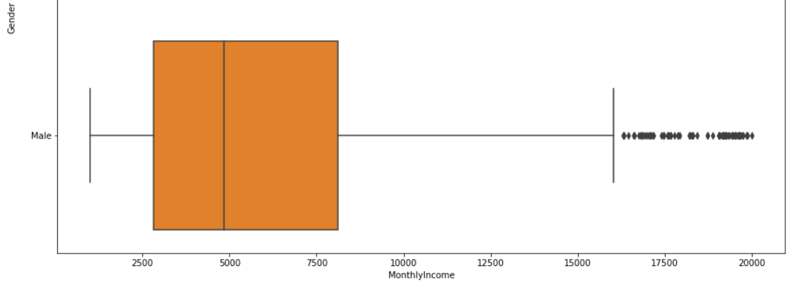
Boxplot -Gender vs. Monthly Income

Slide 19
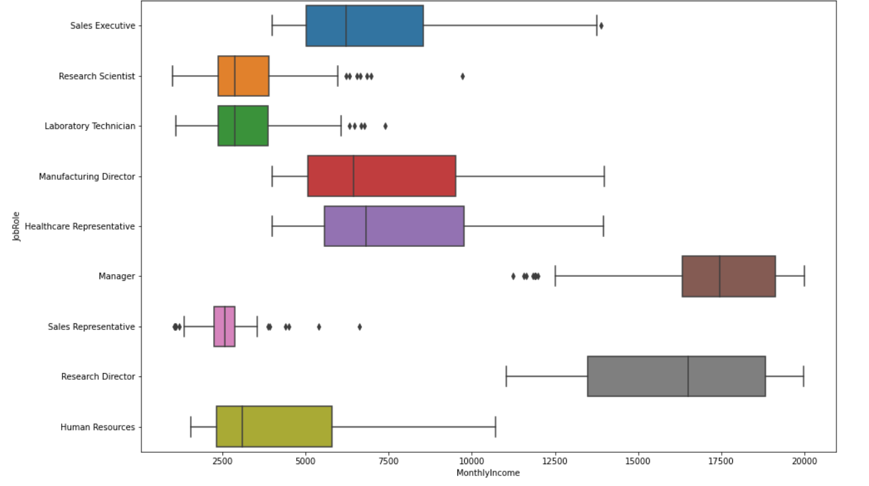
Boxplot –Monthly income Job Role

Slide 20
Data Cleaning
Label Encoding and One hot encoding of the following columns
'BusinessTravel', 'Department', 'EducationField', 'Gender', 'JobRole', 'MaritalStatus'

Slide 21
Data Cleaning
X = Create Independent variable
Y= Create Dependent variable – Attrition
Apply Min Max Scaler
Train Test Split
from sklearn.model_selection import train_test_split
X_train, X_test, y_train, y_test = train_test_split(X, y, test_size = 0.25)

Slide 22
Create Model
Logistic Regression
confusion_matrix, classification_report
Appx Accuracy – 90 %

Slide 23
Create Model
Random Forest Classifier
confusion_matrix, classification_report
Appx Accuracy – 90 %

Slide 24
Create Model
Support Vector Machine
confusion_matrix, classification_report

Slide 25
Create Model
XGBoost -Classification
confusion_matrix, classification_report

Slide 26
Generate the Pickle File

