Slide 1
Naïve Bayes

Slide 2
Probability
p(win=y) //probability of winning lottery
0 ≤ p ≤ 1
using historical information to predict future events

Slide 3
Calculating probability
from known data:
  dice has 6 sides, all are equally likely
  p(die=1) = 1/6
from historical data:
  divide number of times event has a certain outcome by the number of trials for the event
  4 people won the lottery this year
  4,000,000 people played the lottery
  p(win = y) = 1 / 1,000,000

Slide 4
Conditional probability
probability of a certain outcome under specific conditions
probability of getting a raise given gender = M
probability of snow storm for month = feb
probability of graduation for first in family
p(A | B) means probability of event A given B

Slide 5
Conditional probability (cont)
think of it like narrowing down the population size
  p(raise) = those that got a raise / total employees
  p(raise | male), consider only the male employees
  assume there are 300 employees and 200 are male. There were 50 raises given and 40 of those were male employees
  what is p(raise)? p(raise | male)?

Slide 6
Conditional probability (cont)
 | 1 | 2 | 3 | 4 | 5 | 6
heads | 1/12 | 1/12 | 1/12 | 1/12 | 1/12 | 1/12
tails | 1/12 | 1/12 | 1/12 | 1/12 | 1/12 | 1/12
what is the joint prob of rolling a 1 and flipping a coin and getting heads?
what is the prob of rolling a 1 given heads?
what is prob of getting tails given 5 was rolled?

Slide 7
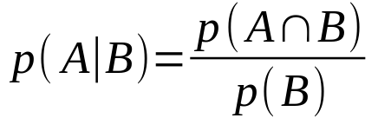
Conditional probability formula
definition:
in earlier example, let A=raise and B=male
  p(A ∩ B) = 40 / 300 = 4/30
  p(B) = 200/300 = 2/3
in other example, let A=roll is 1, B=heads
  p(A ∩ B) = 1/12
  p(B) = 1/2

Slide 8
Calculating from the data
Let A be the event of passing the exam and B be the event of being an honors student
To calculate p(A | B):
  select only those students that are honors students
  divide those who passed exam by the total (of honors students)

Slide 9
Independence
the idea that two events do not have any affect on each other (practically)
examples of independence:
  Detroit lions winning and ice cream sales
  temperature in GR and leap year
examples of dependence:
  temperature in GR and ice cream sales
  GDP and foreclosures

Slide 10

Independence (cont)
definition
example
  let A be the event that you get a raise
  let B be the event that you win the lottery
  the probability of getting a raise and winning the lottery is p(A)•p(B)

Slide 11



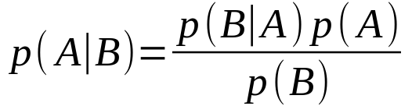
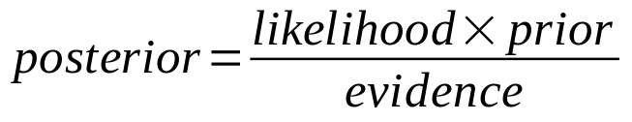
Bayes formula
recall conditional probability:
do some algebra:
also:
substituting:
Bayes rule:
in words:

Slide 12
Example of Bayes formula
let A be the event of cheating on tax
let B be the event of getting a refund
calculate the prob of cheating (prior), the prob of getting a refund given cheating (likelihood) and the prob of getting a refund (evidence)
use those to calculate the posterior

Slide 13
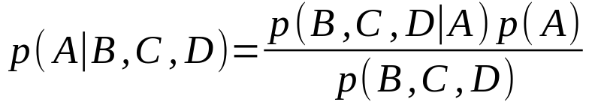
Bayes formula (multivariate)
using 3 attributes:
problems:
  as the number of attributes grows, the number of instances that are selected are fewer (maybe zero)
  cannot separate probabilities because of dependence

Slide 14
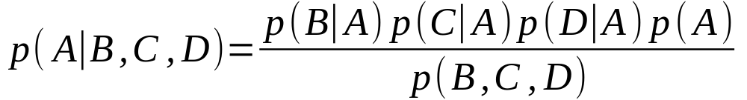
Bayes formula (multivariate)
solution is to take the naive approach – that all of the attributes are independent
replace
with
now, there is one likelihood for each attribute

Slide 15
General approach
assume binary class is C with 2 possible values
assume 3 attributes A₁=1, A₂=0, A₃=1
calculate both posteriors:
assign the C=0 or 1 based on which is higher
notice denominators are the same!

Slide 16

Example of calculating model
data
deg | car | marr | def
0 | 0 | 0 | n
0 | 0 | 1 | n
0 | 1 | 0 | y
1 | 0 | 0 | y
1 | 0 | 0 | n
1 | 0 | 1 | n
1 | 0 | 1 | n
1 | 1 | 1 | n
0 | 0 | 0 | n
0 | 0 | 1 | n
1 | 1 | 0 | y
0 | 1 | 1 | y
model | default=n | default=y
prior | 8/12 | 4/12
likelihoods
deg=0 | 4/8 | 2/4
deg=1 | 4/8 | 2/4
car=0 | 7/8 | 1/4
car=1 | 1/8 | 3/4
marr=0 | 3/8 | 3/4
marr=1 | 5/8 | 1/4

Slide 17
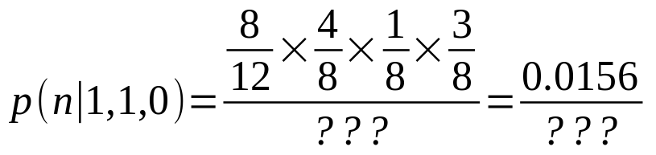
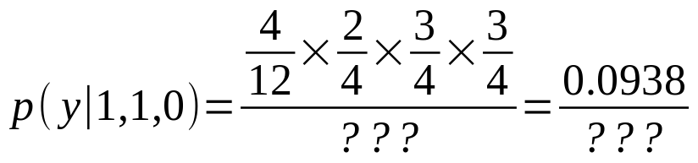
Using model to predict
model | default=n | default=y
prior | 8/12 | 4/12
likelihoods
deg=0 | 4/8 | 2/4
deg=1 | 4/8 | 2/4
car=0 | 7/8 | 1/4
car=1 | 1/8 | 3/4
marr=0 | 3/8 | 3/4
marr=1 | 5/8 | 1/4
predict deg=1, car=1, marr=0
we predict they will default because second number is larger

Slide 18
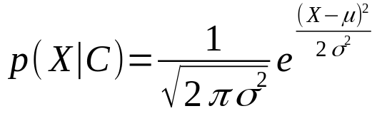
Numeric attributes
how do numeric attributes differ?
we assume a normal distribution
for each likelihood calculate the mean and sd
use normal formula to calculate probability:
(don’t worry, R has a built in formula ☺)

Slide 19
Summary
naive Bayes uses probabilities as the model
very fast to build model and do prediction
sort of helpful for describing data
overfitting is not a problem
assumes independence

Slide 20
Calculating numeric likelihoods
deg | car | marr | sal. | def
0 | 0 | 0 | 85 | n
0 | 0 | 1 | 31 | n
0 | 1 | 0 | 61 | y
1 | 0 | 0 | 45 | y
1 | 0 | 0 | 71 | n
1 | 0 | 1 | 105 | n
1 | 0 | 1 | 77 | n
1 | 1 | 1 | 64 | n
0 | 0 | 0 | 91 | n
0 | 0 | 1 | 82 | n
1 | 1 | 0 | 68 | y
0 | 1 | 1 | 51 | y
likelihoods for salary:
p(sal | def=n)
  mean = 75.75
  std dev = 21.97
p(sal | def=y)
  mean = 56.25
  std dev = 10.24

