Slide 1
Data Mining Classification: Basic Concepts and Techniques
Lecture Notes for Chapter 3
Introduction to Data Mining, 2nd Edition
by
Tan, Steinbach, Karpatne, Kumar
09/21/2020
Introduction to Data Mining, 2nd Edition
1

Slide 2
Classification: Definition
Given a collection of records (training set )
Each record is by characterized by a tuple (x,y), where x is the attribute set and y is the class label
x: attribute, predictor, independent variable, input
y: class, response, dependent variable, output
Task:
Learn a model that maps each attribute set x into one of the predefined class labels y
09/21/2020
Introduction to Data Mining, 2nd Edition
2

Slide 3
Examples of Classification Task
Task | Attribute set, x | Class label, y
Categorizing email messages | Features extracted from email message header and content | spam or non-spam
Identifying tumor cells | Features extracted from x-rays or MRI scans | malignant or benign cells
Cataloging galaxies | Features extracted from telescope images | Elliptical, spiral, or irregular-shaped galaxies
09/21/2020
Introduction to Data Mining, 2nd Edition
3

Slide 4
General Approach for Building Classification Model
09/21/2020
Introduction to Data Mining, 2nd Edition
4

Slide 5
Classification Techniques
Base Classifiers
Decision Tree based Methods
Rule-based Methods
Nearest-neighbor
Neural Networks, Deep Neural Nets
Naïve Bayes and Bayesian Belief Networks
Support Vector Machines
Ensemble Classifiers
Boosting, Bagging, Random Forests
09/21/2020
Introduction to Data Mining, 2nd Edition
5

Slide 6
Example of a Decision Tree
categorical
continuous
categorical
class
Splitting Attributes
Home Owner
Yes
No
NO
MarSt
Single, Divorced
Married
Income
NO
< 80K
> 80K
NO
YES
Training Data
Model: Decision Tree
09/21/2020
Introduction to Data Mining, 2nd Edition
6

Slide 7
Another Example of Decision Tree
categorical
categorical
continuous
class
Single, Divorced
MarSt
Married
NO
Home Owner
Yes
No
NO
Income
< 80K
> 80K
NO
YES
There could be more than one tree that fits the same data!
09/21/2020
Introduction to Data Mining, 2nd Edition
7

Slide 8
Apply Model to Test Data
Test Data
Start from the root of tree.
Home Owner
Yes
No
NO
MarSt
Single, Divorced
Married
Income
NO
< 80K
> 80K
NO
YES
09/21/2020
Introduction to Data Mining, 2nd Edition
8

Slide 9
Apply Model to Test Data
Test Data
Home Owner
Yes
No
NO
MarSt
Single, Divorced
Married
Income
NO
< 80K
> 80K
NO
YES
09/21/2020
Introduction to Data Mining, 2nd Edition
9

Slide 10
Apply Model to Test Data
Test Data
Home Owner
Yes
No
NO
MarSt
Single, Divorced
Married
Income
NO
< 80K
> 80K
NO
YES
09/21/2020
Introduction to Data Mining, 2nd Edition
10

Slide 11
Apply Model to Test Data
Test Data
Home Owner
Yes
No
NO
MarSt
Single, Divorced
Married
Income
NO
< 80K
> 80K
NO
YES
09/21/2020
Introduction to Data Mining, 2nd Edition
11

Slide 12
Apply Model to Test Data
Test Data
Home Owner
Yes
No
NO
MarSt
Single, Divorced
Married
Income
NO
< 80K
> 80K
NO
YES
09/21/2020
Introduction to Data Mining, 2nd Edition
12

Slide 13
Apply Model to Test Data
Test Data
Home Owner
Yes
No
NO
MarSt
Single, Divorced
Married
Assign Defaulted to “No”
Income
NO
< 80K
> 80K
NO
YES
09/21/2020
Introduction to Data Mining, 2nd Edition
13

Slide 14
Decision Tree Classification Task
Decision Tree
09/21/2020
Introduction to Data Mining, 2nd Edition
14

Slide 15
Decision Tree Induction
Many Algorithms:
Hunt’s Algorithm (one of the earliest)
CART
ID3, C4.5
SLIQ,SPRINT
09/21/2020
Introduction to Data Mining, 2nd Edition
15

Slide 16
General Structure of Hunt’s Algorithm
Let D_{t} be the set of training records that reach a node t
General Procedure:
If D_{t} contains records that belong the same class y_{t}, then t is a leaf node labeled as y_{t}
If D_{t} contains records that belong to more than one class, use an attribute test to split the data into smaller subsets. Recursively apply the procedure to each subset.
D_{t}
?
09/21/2020
Introduction to Data Mining, 2nd Edition
16

Slide 17
Hunt’s Algorithm
(7,3)
(3,0)
(4,3)
(3,0)
(3,0)
(3,0)
(1,3)
(3,0)
(1,0)
(0,3)
09/21/2020
Introduction to Data Mining, 2nd Edition
17

Slide 18
Hunt’s Algorithm
(7,3)
(3,0)
(4,3)
(3,0)
(3,0)
(3,0)
(1,3)
(3,0)
(1,0)
(0,3)
09/21/2020
Introduction to Data Mining, 2nd Edition
18

Slide 19
Hunt’s Algorithm
(7,3)
(3,0)
(4,3)
(3,0)
(3,0)
(3,0)
(1,3)
(3,0)
(1,0)
(0,3)
09/21/2020
Introduction to Data Mining, 2nd Edition
19

Slide 20
Hunt’s Algorithm
(7,3)
(3,0)
(4,3)
(3,0)
(3,0)
(3,0)
(1,3)
(3,0)
(1,0)
(0,3)
09/21/2020
Introduction to Data Mining, 2nd Edition
20

Slide 21
Design Issues of Decision Tree Induction
How should training records be split?
Method for specifying test condition
depending on attribute types
Measure for evaluating the goodness of a test condition
How should the splitting procedure stop?
Stop splitting if all the records belong to the same class or have identical attribute values
Early termination
09/21/2020
Introduction to Data Mining, 2nd Edition
21

Slide 22
Methods for Expressing Test Conditions
Depends on attribute types
Binary
Nominal
Ordinal
Continuous
Depends on number of ways to split
2-way split
Multi-way split
09/21/2020
Introduction to Data Mining, 2nd Edition
22

Slide 23
Test Condition for Nominal Attributes
Multi-way split:
Use as many partitions as distinct values.
Binary split:
Divides values into two subsets
09/21/2020
Introduction to Data Mining, 2nd Edition
23

Slide 24
Test Condition for Ordinal Attributes
Multi-way split:
Use as many partitions as distinct values
Binary split:
Divides values into two subsets
Preserve order property among attribute values
This grouping violates order property
09/21/2020
Introduction to Data Mining, 2nd Edition
24

Slide 25
Test Condition for Continuous Attributes
09/21/2020
Introduction to Data Mining, 2nd Edition
25

Slide 26
Splitting Based on Continuous Attributes
Different ways of handling
Discretization to form an ordinal categorical attribute
Ranges can be found by equal interval bucketing, equal frequency bucketing (percentiles), or clustering.
Static – discretize once at the beginning
Dynamic – repeat at each node
Binary Decision: (A < v) or (A ≥ v)
consider all possible splits and finds the best cut
can be more compute intensive
09/21/2020
Introduction to Data Mining, 2nd Edition
26

Slide 27
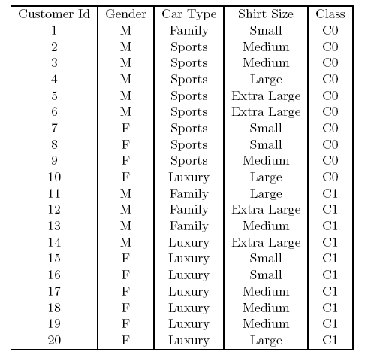
How to determine the Best Split
Before Splitting: 10 records of class 0, 10 records of class 1
Which test condition is the best?
09/21/2020
Introduction to Data Mining, 2nd Edition
27

Slide 28
How to determine the Best Split
Greedy approach:
Nodes with purer class distribution are preferred
Need a measure of node impurity:
High degree of impurity
Low degree of impurity
09/21/2020
Introduction to Data Mining, 2nd Edition
28

Slide 29
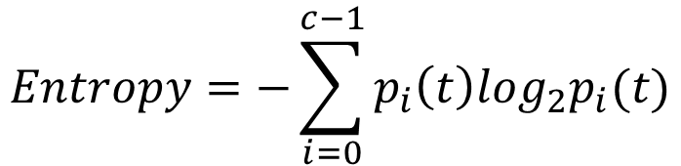
Measures of Node Impurity
Gini Index
Entropy
Misclassification error
$$GiniIndex=1−\sum_{i=0}^{c−1}{p_{i}{\left(t\right)}^{2}}$$
Where is the frequency of class at node t, and is the total number of classes
09/21/2020
Introduction to Data Mining, 2nd Edition
29

Slide 30
Finding the Best Split
Compute impurity measure (P) before splitting
Compute impurity measure (M) after splitting
Compute impurity measure of each child node
M is the weighted impurity of child nodes
Choose the attribute test condition that produces the highest gain
Gain = P - M or equivalently, lowest impurity measure after splitting (M)
09/21/2020
Introduction to Data Mining, 2nd Edition
30

Slide 31
Finding the Best Split
Before Splitting:
P
A?
B?
Yes
No
Yes
No
Node N1
Node N2
Node N3
Node N4
M11
M12
M21
M22
M1
M2
Gain = P – M1 vs P – M2
09/21/2020
Introduction to Data Mining, 2nd Edition
31

Slide 32
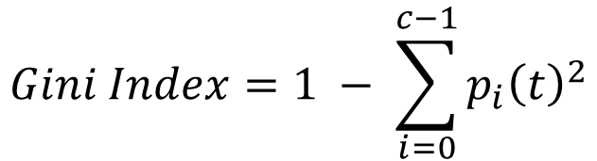
Measure of Impurity: GINI
Gini Index for a given node
Where is the frequency of class at node , and is the total number of classes
Maximum of when records are equally distributed among all classes, implying the least beneficial situation for classification
Minimum of 0 when all records belong to one class, implying the most beneficial situation for classification
Gini index is used in decision tree algorithms such as CART, SLIQ, SPRINT
09/21/2020
Introduction to Data Mining, 2nd Edition
32

Slide 33
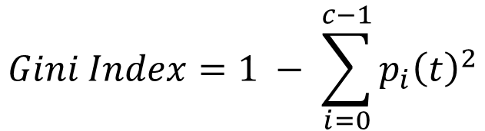
Measure of Impurity: GINI
Gini Index for a given node t :
For 2-class problem (p, 1 – p):
GINI = 1 – p² – (1 – p)² = 2p (1-p)
09/21/2020
Introduction to Data Mining, 2nd Edition
33

Slide 34
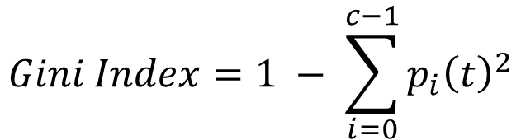
Computing Gini Index of a Single Node
P(C1) = 0/6 = 0 P(C2) = 6/6 = 1
Gini = 1 – P(C1)² – P(C2)² = 1 – 0 – 1 = 0
P(C1) = 1/6 P(C2) = 5/6
Gini = 1 – (1/6)² – (5/6)² = 0.278
P(C1) = 2/6 P(C2) = 4/6
Gini = 1 – (2/6)² – (4/6)² = 0.444
09/21/2020
Introduction to Data Mining, 2nd Edition
34

Slide 35
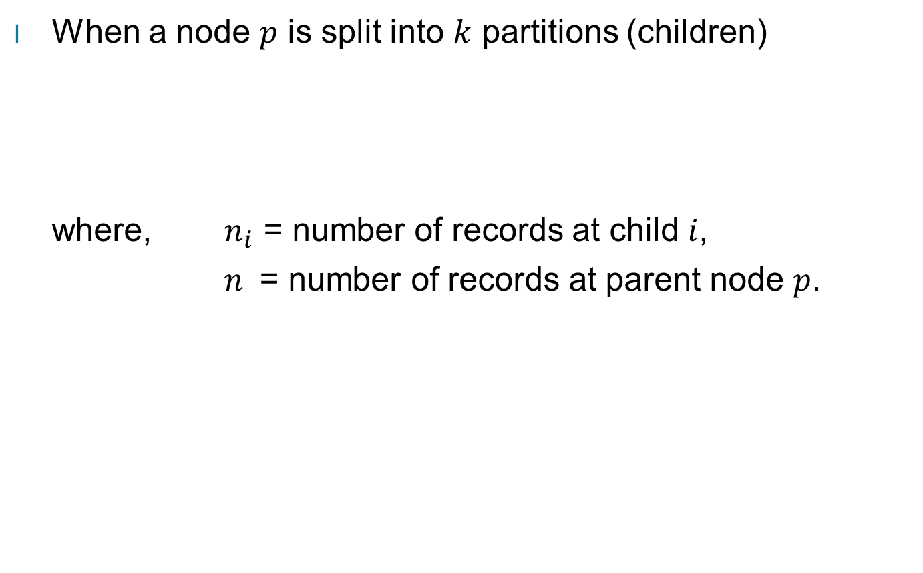
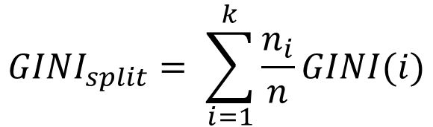
Computing Gini Index for a Collection of Nodes
09/21/2020
Introduction to Data Mining, 2nd Edition
35

Slide 36
Binary Attributes: Computing GINI Index
Splits into two partitions (child nodes)
Effect of Weighing partitions:
Larger and purer partitions are sought
B?
Yes
No
Node N1
Node N2
Gini(N1) = 1 – (5/6)² – (1/6)² = 0.278
Gini(N2) = 1 – (2/6)² – (4/6)² = 0.444
Weighted Gini of N1 N2 = 6/12 * 0.278 + 6/12 * 0.444 = 0.361
Gain = 0.486 – 0.361 = 0.125
09/21/2020
Introduction to Data Mining, 2nd Edition
36

Slide 37
Categorical Attributes: Computing Gini Index
For each distinct value, gather counts for each class in the dataset
Use the count matrix to make decisions
Multi-way split
Two-way split
(find best partition of values)
Which of these is the best?
09/21/2020
Introduction to Data Mining, 2nd Edition
37

Slide 38
Continuous Attributes: Computing Gini Index
Use Binary Decisions based on one value
Several Choices for the splitting value
Number of possible splitting values = Number of distinct values
Each splitting value has a count matrix associated with it
Class counts in each of the partitions, A ≤ v and A > v
Simple method to choose best v
For each v, scan the database to gather count matrix and compute its Gini index
Computationally Inefficient! Repetition of work.
Annual Income ?
 | ≤ 80 | > 80
Defaulted Yes | 0 | 3
Defaulted No | 3 | 4
09/21/2020
Introduction to Data Mining, 2nd Edition
38

Slide 39
Continuous Attributes: Computing Gini Index...
For efficient computation: for each attribute,
Sort the attribute on values
Linearly scan these values, each time updating the count matrix and computing gini index
Choose the split position that has the least gini index
Sorted Values
09/21/2020
Introduction to Data Mining, 2nd Edition
39

Slide 40
Continuous Attributes: Computing Gini Index...
For efficient computation: for each attribute,
Sort the attribute on values
Linearly scan these values, each time updating the count matrix and computing gini index
Choose the split position that has the least gini index
Sorted Values
Split Positions
09/21/2020
Introduction to Data Mining, 2nd Edition
40

Slide 41
Continuous Attributes: Computing Gini Index...
For efficient computation: for each attribute,
Sort the attribute on values
Linearly scan these values, each time updating the count matrix and computing gini index
Choose the split position that has the least gini index
Sorted Values
Split Positions
09/21/2020
Introduction to Data Mining, 2nd Edition
41

Slide 42
Continuous Attributes: Computing Gini Index...
For efficient computation: for each attribute,
Sort the attribute on values
Linearly scan these values, each time updating the count matrix and computing gini index
Choose the split position that has the least gini index
Sorted Values
Split Positions
09/21/2020
Introduction to Data Mining, 2nd Edition
42

Slide 43
Continuous Attributes: Computing Gini Index...
For efficient computation: for each attribute,
Sort the attribute on values
Linearly scan these values, each time updating the count matrix and computing gini index
Choose the split position that has the least gini index
Sorted Values
Split Positions
09/21/2020
Introduction to Data Mining, 2nd Edition
43

Slide 44
Measure of Impurity: Entropy
Entropy at a given node
Where is the frequency of class at node , and is the total number of classes
Maximum of when records are equally distributed among all classes, implying the least beneficial situation for classification
Minimum of 0 when all records belong to one class, implying most beneficial situation for classification
Entropy based computations are quite similar to the GINI index computations
$$Entropy=−\sum_{i=0}^{c−1}{p_{i}\left(t\right)log_{2}p_{i}\left(t\right)}$$
09/21/2020
Introduction to Data Mining, 2nd Edition
44

Slide 45
Computing Entropy of a Single Node
$$Entropy=−\sum_{i=0}^{c−1}{p_{i}\left(t\right)log_{2}p_{i}\left(t\right)}$$
P(C1) = 0/6 = 0 P(C2) = 6/6 = 1
Entropy = – 0 log 0 – 1 log 1 = – 0 – 0 = 0
P(C1) = 1/6 P(C2) = 5/6
Entropy = – (1/6) log₂ (1/6) – (5/6) log₂ (1/6) = 0.65
P(C1) = 2/6 P(C2) = 4/6
Entropy = – (2/6) log₂ (2/6) – (4/6) log₂ (4/6) = 0.92
09/21/2020
Introduction to Data Mining, 2nd Edition
45

Slide 46
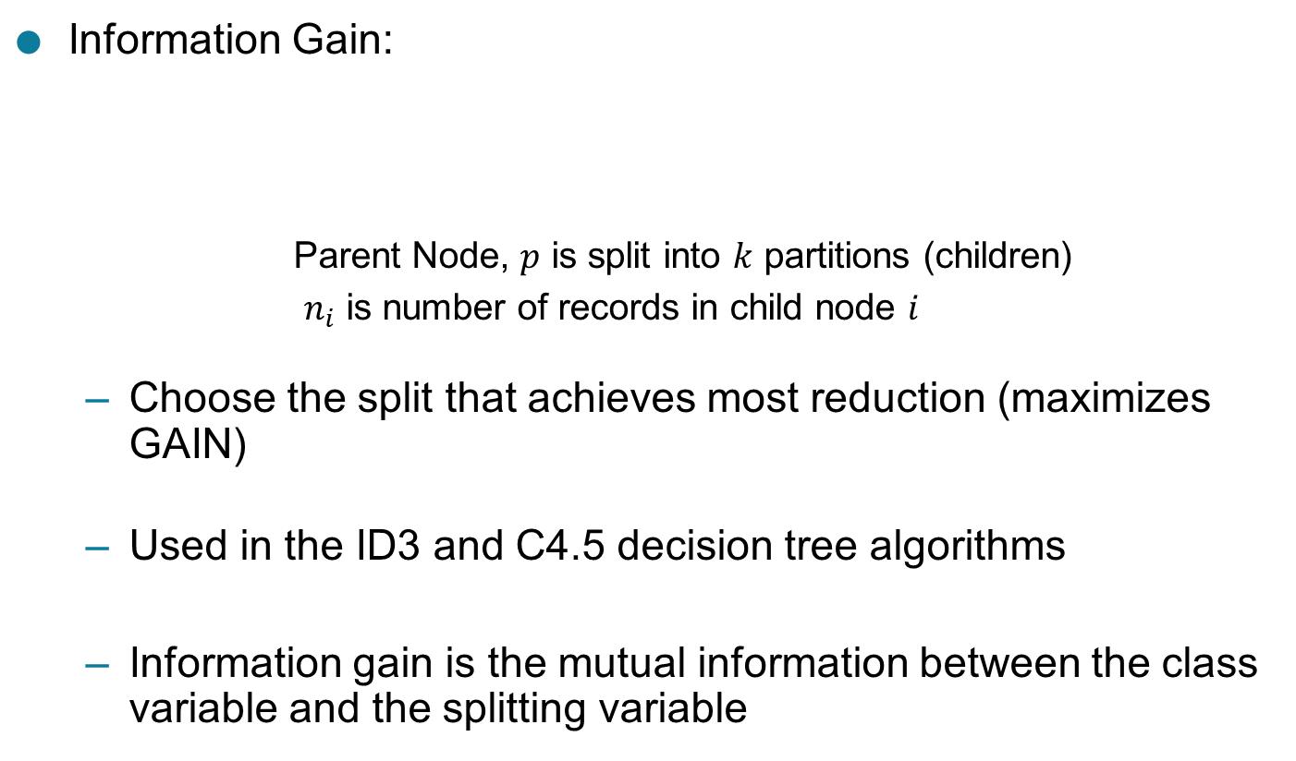
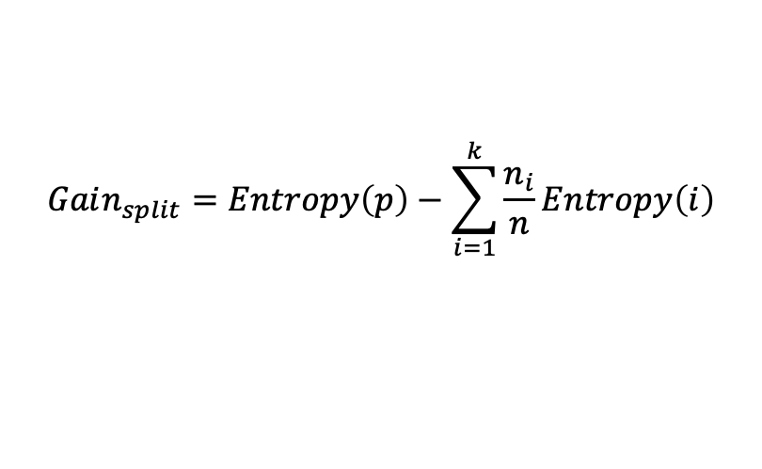
Computing Information Gain After Splitting
$$Gain_{split}=Entropy\left(p\right)−\sum_{i=1}^{k}{\frac{n_{i}}{n}Entropy\left(i\right)}$$
09/21/2020
Introduction to Data Mining, 2nd Edition
46

Slide 47
Problem with large number of partitions
Node impurity measures tend to prefer splits that result in large number of partitions, each being small but pure
Customer ID has highest information gain because entropy for all the children is zero
09/21/2020
Introduction to Data Mining, 2nd Edition
47

Slide 48
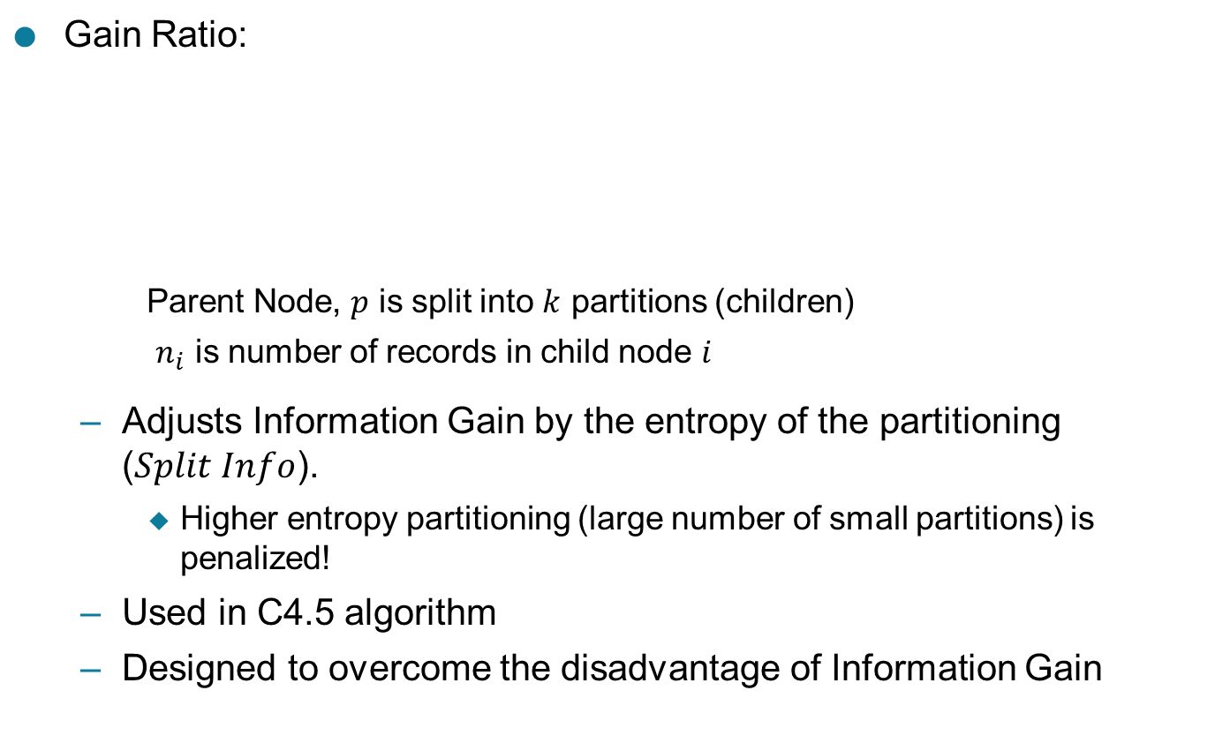
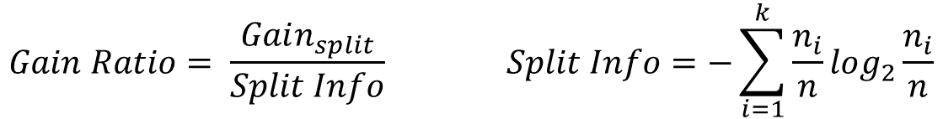
Gain Ratio
$$GainRatio=\frac{Gain_{split}}{SplitInfo}SplitInfo=−\sum_{i=1}^{k}{\frac{n_{i}}{n}log_{2}}\frac{n_{i}}{n}$$
09/21/2020
Introduction to Data Mining, 2nd Edition
48

Slide 49
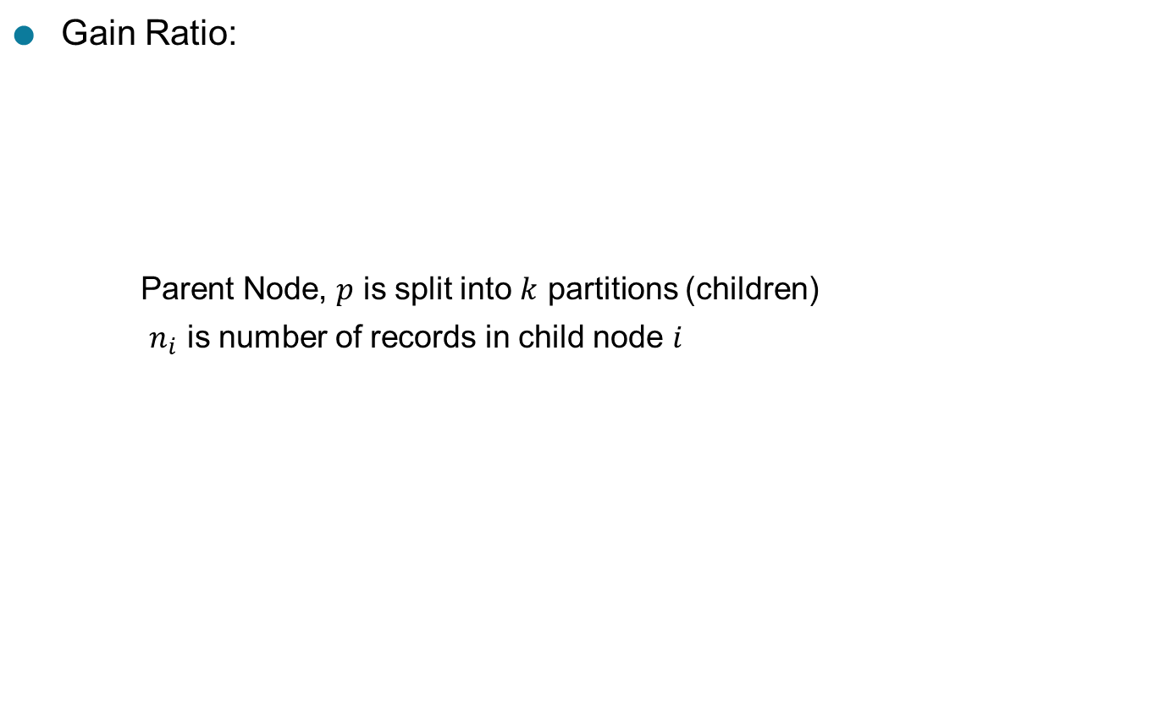
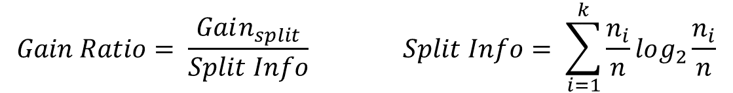
Gain Ratio
Gain Ratio:
Parent Node, is split into partitions (children)
is number of records in child node
$$GainRatio=\frac{Gain_{split}}{SplitInfo}SplitInfo=\sum_{i=1}^{k}{\frac{n_{i}}{n}log_{2}}\frac{n_{i}}{n}$$
SplitINFO = 1.52
SplitINFO = 0.72
SplitINFO = 0.97
09/21/2020
Introduction to Data Mining, 2nd Edition
49

Slide 50
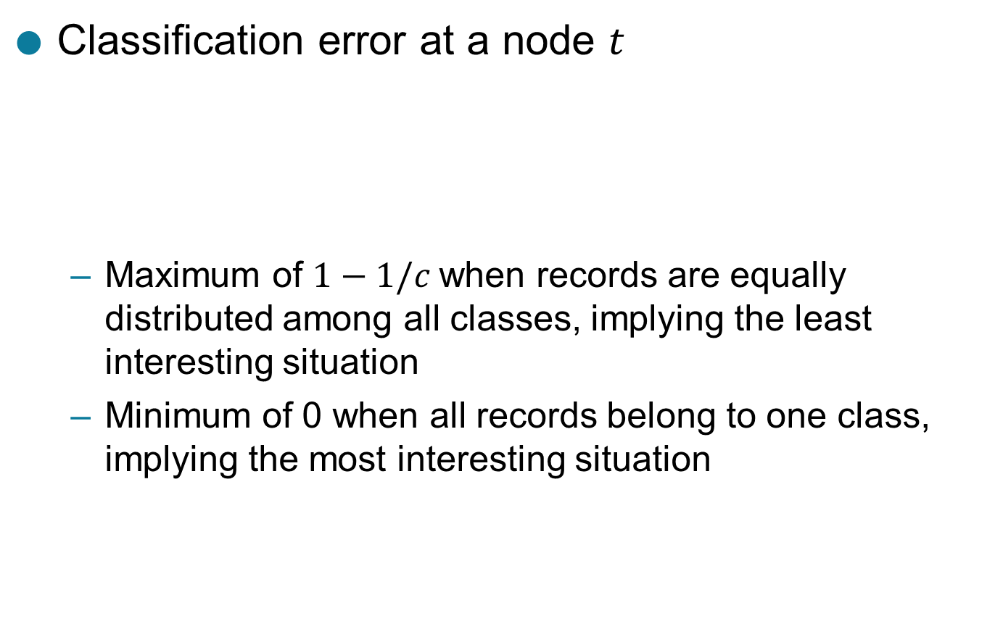

Measure of Impurity: Classification Error
Classification error at a node
Maximum of when records are equally distributed among all classes, implying the least interesting situation
Minimum of 0 when all records belong to one class, implying the most interesting situation
$$Error\left(t\right)=1−\max_{i}⁡\left[p_{i}\left(t\right)\right]$$
09/21/2020
Introduction to Data Mining, 2nd Edition
50

Slide 51

Computing Error of a Single Node
$$Error\left(t\right)=1−\max_{i}⁡\left[p_{i}\left(t\right)\right]$$
P(C1) = 0/6 = 0 P(C2) = 6/6 = 1
Error = 1 – max (0, 1) = 1 – 1 = 0
P(C1) = 1/6 P(C2) = 5/6
Error = 1 – max (1/6, 5/6) = 1 – 5/6 = 1/6
P(C1) = 2/6 P(C2) = 4/6
Error = 1 – max (2/6, 4/6) = 1 – 4/6 = 1/3
09/21/2020
Introduction to Data Mining, 2nd Edition
51

Slide 52
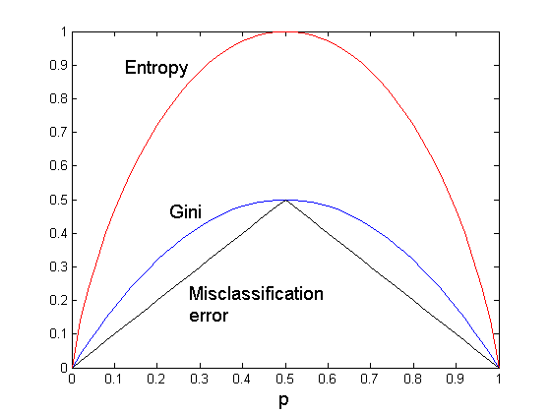
Comparison among Impurity Measures
For a 2-class problem:
09/21/2020
Introduction to Data Mining, 2nd Edition
52

Slide 53
Misclassification Error vs Gini Index
A?
Yes
No
Node N1
Node N2
Gini(N1) = 1 – (3/3)² – (0/3)² = 0
Gini(N2) = 1 – (4/7)² – (3/7)² = 0.489
Gini(Children) = 3/10 * 0 + 7/10 * 0.489 = 0.342
Gini improves but error remains the same!!
09/21/2020
Introduction to Data Mining, 2nd Edition
53

Slide 54
Misclassification Error vs Gini Index
A?
Yes
No
Node N1
Node N2
Misclassification error for all three cases = 0.3 !
09/21/2020
Introduction to Data Mining, 2nd Edition
54

Slide 55
Decision Tree Based Classification
Advantages:
Relatively inexpensive to construct
Extremely fast at classifying unknown records
Easy to interpret for small-sized trees
Robust to noise (especially when methods to avoid overfitting are employed)
Can easily handle redundant or irrelevant attributes (unless the attributes are interacting)
Disadvantages: .
Due to the greedy nature of splitting criterion, interacting attributes (that can distinguish between classes together but not individually) may be passed over in favor of other attributed that are less discriminating.
Each decision boundary involves only a single attribute
09/21/2020
Introduction to Data Mining, 2nd Edition
55

Slide 56
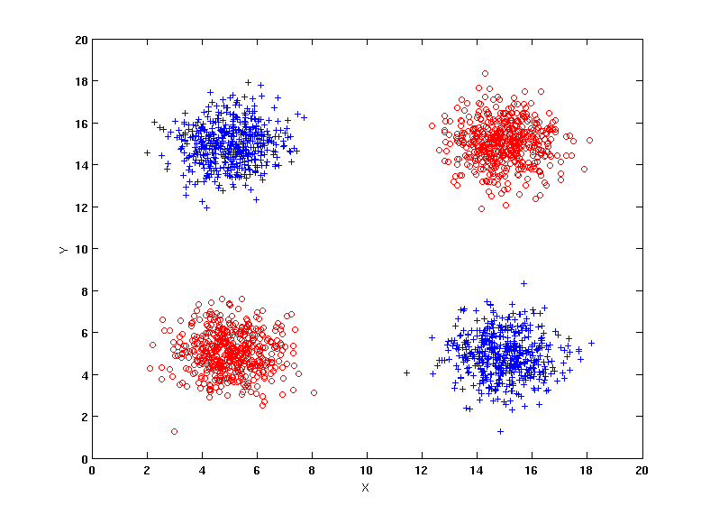
Handling interactions
+ : 1000 instances
o : 1000 instances
Entropy (X) : 0.99
Entropy (Y) : 0.99
Y
X
09/21/2020
Introduction to Data Mining, 2nd Edition
56

Slide 57
Handling interactions

Slide 58
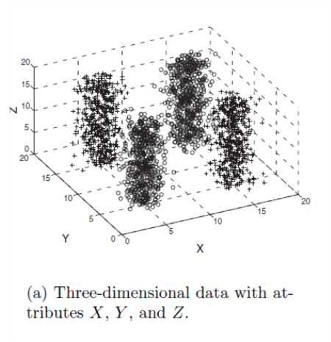
Handling interactions given irrelevant attributes
+ : 1000 instances
o : 1000 instances
Adding Z as a noisy attribute generated from a uniform distribution
Entropy (X) : 0.99
Entropy (Y) : 0.99
Entropy (Z) : 0.98
Attribute Z will be chosen for splitting!
Y
X
09/21/2020
Introduction to Data Mining, 2nd Edition
58

Slide 59
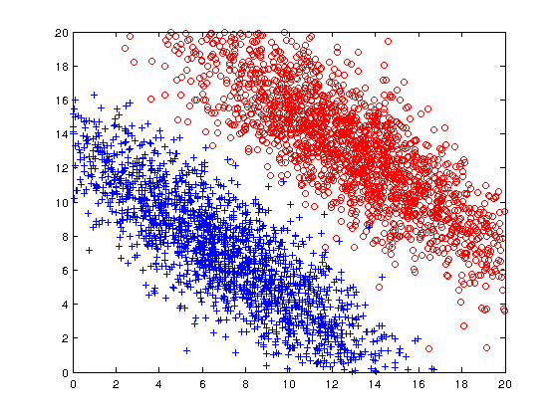
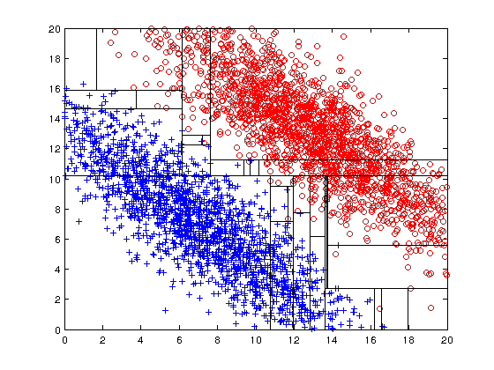
Limitations of single attribute-based decision boundaries
Both positive (+) and negative (o) classes generated from skewed Gaussians with centers at (8,8) and (12,12) respectively.
09/21/2020
Introduction to Data Mining, 2nd Edition
59

