Slide 1
Data Mining Classification: Alternative Techniques
Imbalanced Class Problem
Introduction to Data Mining, 2nd Edition
by
Tan, Steinbach, Karpatne, Kumar

Slide 2
Class Imbalance Problem
Lots of classification problems where the classes are skewed (more records from one class than another)
Credit card fraud
Intrusion detection
Defective products in manufacturing assembly line
COVID-19 test results on a random sample

Slide 3
Challenges
Evaluation measures such as accuracy are not well-suited for imbalanced class
Detecting the rare class is like finding a needle in a haystack

Slide 4
Confusion Matrix
Confusion Matrix:
 | PREDICTED CLASS
ACTUAL CLASS |  | Class=Yes | Class=No
 | Class=Yes | a | b
 | Class=No | c | d
a: TP (true positive)
b: FN (false negative)
c: FP (false positive)
d: TN (true negative)

Slide 5
Accuracy
Most widely-used metric:
 | PREDICTED CLASS
ACTUAL CLASS |  | Class=Yes | Class=No
 | Class=Yes | a (TP) | b (FN)
 | Class=No | c (FP) | d (TN)

Slide 6
Problem with Accuracy
Consider a 2-class problem
Number of Class NO examples = 990
Number of Class YES examples = 10

Slide 7
Problem with Accuracy
Consider a 2-class problem
Number of Class NO examples = 990
Number of Class YES examples = 10
 | PREDICTED CLASS
ACTUAL CLASS |  | Class=Yes | Class=No
 | Class=Yes | 0 | 10
 | Class=No | 0 | 990

Slide 8
Problem with Accuracy
Consider a 2-class problem
Number of Class NO examples = 990
Number of Class YES examples = 10
If a model predicts everything to be class NO, accuracy is 990/1000 = 99 %
This is misleading because the model does not detect any class YES example
Detecting the rare class is usually more interesting (e.g., frauds, intrusions, defects, etc)

Slide 9
Which model is better?
 | PREDICTED
ACTUAL |  | Class=Yes | Class=No
 | Class=Yes | 0 | 10
 | Class=No | 0 | 990
A
B
 | PREDICTED
ACTUAL |  | Class=Yes | Class=No
 | Class=Yes | 10 | 0
 | Class=No | 90 | 900

Slide 10
Which model is better?
 | PREDICTED
ACTUAL |  | Class=Yes | Class=No
 | Class=Yes | 5 | 5
 | Class=No | 0 | 990
A
B
 | PREDICTED
ACTUAL |  | Class=Yes | Class=No
 | Class=Yes | 10 | 0
 | Class=No | 90 | 900

Slide 11
Alternative Measures
 | PREDICTED CLASS
ACTUAL CLASS |  | Class=Yes | Class=No
 | Class=Yes | a | b
 | Class=No | c | d

Slide 12
Alternative Measures
 | PREDICTED CLASS
ACTUAL CLASS |  | Class=Yes | Class=No
 | Class=Yes | 10 | 0
 | Class=No | 10 | 980

Slide 13
Alternative Measures
 | PREDICTED CLASS
ACTUAL CLASS |  | Class=Yes | Class=No
 | Class=Yes | 10 | 0
 | Class=No | 10 | 980
 | PREDICTED CLASS
ACTUAL CLASS |  | Class=Yes | Class=No
 | Class=Yes | 1 | 9
 | Class=No | 0 | 990

Slide 14
Alternative Measures
 | PREDICTED CLASS
ACTUAL CLASS |  | Class=Yes | Class=No
 | Class=Yes | 40 | 10
 | Class=No | 10 | 40

Slide 15
Alternative Measures
 | PREDICTED CLASS
ACTUAL CLASS |  | Class=Yes | Class=No
 | Class=Yes | 40 | 10
 | Class=No | 10 | 40
A
B
 | PREDICTED CLASS
ACTUAL CLASS |  | Class=Yes | Class=No
 | Class=Yes | 40 | 10
 | Class=No | 1000 | 4000

Slide 16
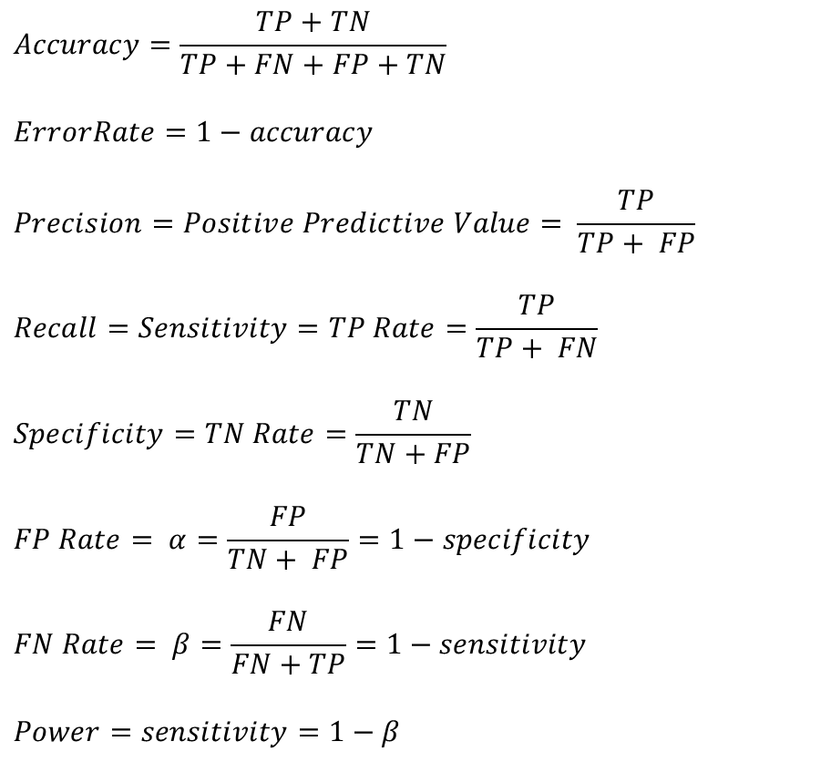
Measures of Classification Performance
 | PREDICTED CLASS
ACTUAL CLASS |  | Yes | No
 | Yes | TP | FN
 | No | FP | TN
α is the probability that we reject the null hypothesis when it is true. This is a Type I error or a false positive (FP).
β is the probability that we accept the null hypothesis when it is false. This is a Type II error or a false negative (FN).

Slide 17

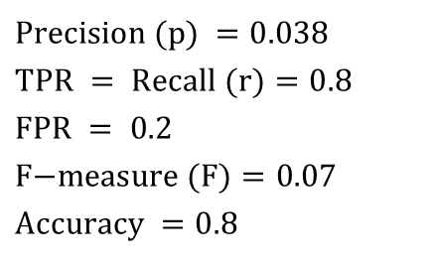

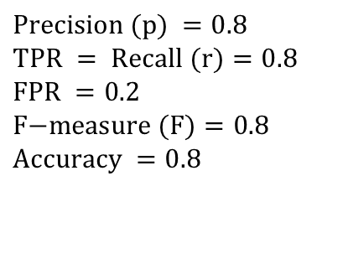
Alternative Measures
 | PREDICTED CLASS
ACTUAL CLASS |  | Class=Yes | Class=No
 | Class=Yes | 40 | 10
 | Class=No | 10 | 40
$$\text{Precision} (p) =0.8 \\ \text{TPR} = \text{Recall} (r)=0.8 \\ \text{FPR} =0.2 \\ \text{F}\text{−}\text{measure} (F)=0.8 \\ \text{Accuracy} =0.8$$
$$\frac{TPR}{FPR}=4$$
 | PREDICTED CLASS
ACTUAL CLASS |  | Class=Yes | Class=No
 | Class=Yes | 40 | 10
 | Class=No | 1000 | 4000
$$\text{Precision} (p) =0.038 \\ \text{TPR} = \text{Recall} (r)=0.8 \\ \text{FPR} =\text{ 0.2} \\ \text{F}\text{−}\text{measure} (F)=0.07 \\ \text{Accuracy} =0.8$$
$$\frac{TPR}{FPR}=4$$

Slide 18
Alternative Measures
 | PREDICTED CLASS
ACTUAL CLASS |  | Class=Yes | Class=No
 | Class=Yes | 10 | 40
 | Class=No | 10 | 40
 | PREDICTED CLASS
ACTUAL CLASS |  | Class=Yes | Class=No
 | Class=Yes | 25 | 25
 | Class=No | 25 | 25
 | PREDICTED CLASS
ACTUAL CLASS |  | Class=Yes | Class=No
 | Class=Yes | 40 | 10
 | Class=No | 40 | 10

Slide 19
ROC (Receiver Operating Characteristic)
A graphical approach for displaying trade-off between detection rate and false alarm rate
Developed in 1950s for signal detection theory to analyze noisy signals
ROC curve plots TPR against FPR
Performance of a model represented as a point in an ROC curve
Changing the threshold parameter of classifier changes the location of the point

Slide 20
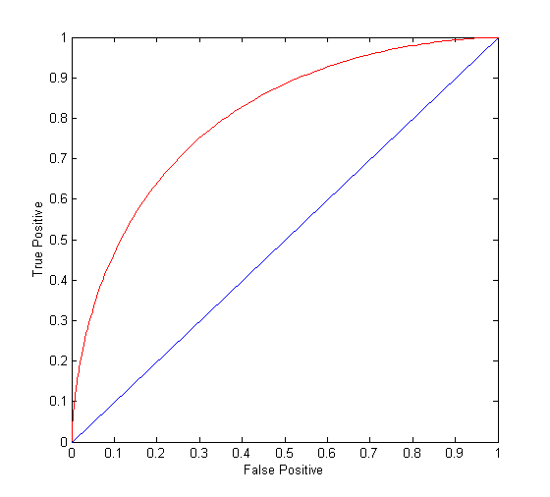
ROC Curve
(TPR,FPR):
(0,0): declare everything to be negative class
(1,1): declare everything to be positive class
(1,0): ideal
Diagonal line:
Random guessing
Below diagonal line:
prediction is opposite of the true class

Slide 21
ROC (Receiver Operating Characteristic)
To draw ROC curve, classifier must produce continuous-valued output
Outputs are used to rank test records, from the most likely positive class record to the least likely positive class record
Many classifiers produce only discrete outputs (i.e., predicted class)
How to get continuous-valued outputs?
Decision trees, rule-based classifiers, neural networks, Bayesian classifiers, k-nearest neighbors, SVM

Slide 22
Example: Decision Trees
Decision Tree
Continuous-valued outputs

Slide 23
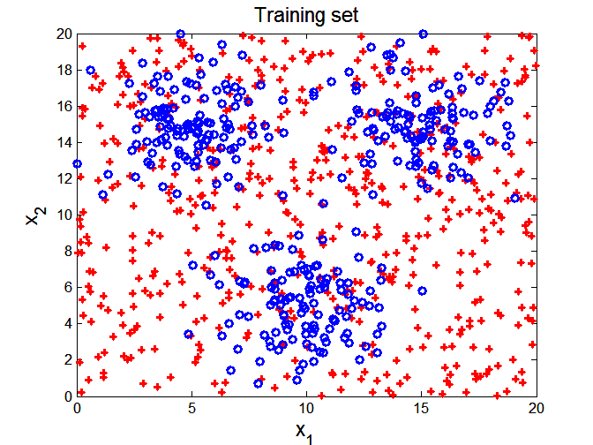

ROC Curve Example

Slide 24
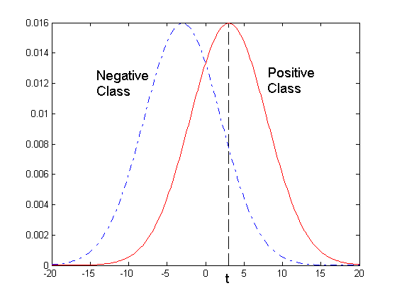
ROC Curve Example
- 1-dimensional data set containing 2 classes (positive and negative)
- Any points located at x > t is classified as positive
At threshold t:
TPR=0.5, FNR=0.5, FPR=0.12, TNR=0.88

Slide 25
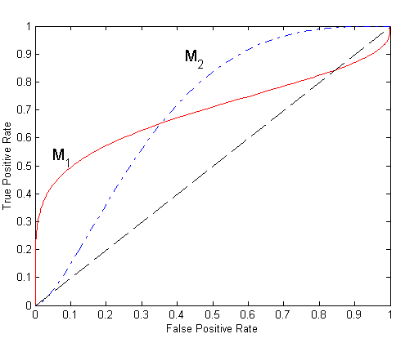
Using ROC for Model Comparison
No model consistently outperforms the other
M₁ is better for small FPR
M₂ is better for large FPR
Area Under the ROC curve
Ideal:
Area = 1
Random guess:
Area = 0.5

Slide 26
How to Construct an ROC curve
Use a classifier that produces a continuous-valued score for each instance
The more likely it is for the instance to be in the + class, the higher the score
Sort the instances in decreasing order according to the score
Apply a threshold at each unique value of the score
Count the number of TP, FP, TN, FN at each threshold
TPR = TP/(TP+FN)
FPR = FP/(FP + TN)
Instance | Score | True Class
1 | 0.95 | +
2 | 0.93 | +
3 | 0.87 | -
4 | 0.85 | -
5 | 0.85 | -
6 | 0.85 | +
7 | 0.76 | -
8 | 0.53 | +
9 | 0.43 | -
10 | 0.25 | +

Slide 27
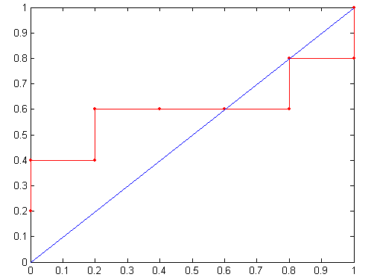
How to construct an ROC curve
Threshold >=
ROC Curve:

Slide 28
Building Classifiers with Imbalanced Training Set
Modify the distribution of training data so that rare class is well-represented in training set
Undersample the majority class
Oversample the rare class

Slide 29
Which model is better?
 | PREDICTED
ACTUAL |  | Class=Yes | Class=No
 | Class=Yes
 | Class=No
A
B
 | PREDICTED
ACTUAL |  | Class=Yes | Class=No
 | Class=Yes
 | Class=No

Slide 30
 | PREDICTED
ACTUAL |  | Class=Yes | Class=No
 | Class=Yes
 | Class=No
 | PREDICTED
ACTUAL |  | Class=Yes | Class=No
 | Class=Yes
 | Class=No

Slide 31
 | PREDICTED
ACTUAL |  | Class=Yes | Class=No
 | Class=Yes
 | Class=No
 | PREDICTED
ACTUAL |  | Class=Yes | Class=No
 | Class=Yes
 | Class=No

Slide 32
 | PREDICTED CLASS
ACTUAL CLASS |  | Class=Yes | Class=No
 | Class=Yes
 | Class=No

