Slide 1
Evaluating classifiers

Slide 2
Why do we want to evaluate?
to determine which algorithm performs best
  overall
  for specific classes
to find out which data sets are appropriate for which algorithm

Slide 3
example
x₁ | x₂ | cls | p1 | p2
 |  | y | n | y
 |  | n | n | y
 |  | n | n | n
 |  | n | n | y
 |  | y | y | y
 |  | y | y | y
 |  | n | n | n
 |  | n | n | y
 |  | n | n | n
 |  | y | n | y
which algorithm is best?
p1 is correct: 8/10
p2 is correct: 7/10
p1 misclassifies y as n
p2 misclassifies n as y

Slide 4
confusion matrix
x₁ | x₂ | cls | p1 | p2
 |  | y | n | y
 |  | n | n | y
 |  | n | n | n
 |  | n | n | y
 |  | y | y | y
 |  | y | y | y
 |  | n | n | n
 |  | n | n | y
 |  | n | n | n
 |  | y | n | y
in order to get the desired metrics, start with a confusion matrix
start with a c x c matrix where c is the number of classes (c=2 here)
label the left and top with the class values and sum up the counts

Slide 5
example
x₁ | x₂ | cls | p1 | p2
 |  | y | n | y
 |  | n | n | y
 |  | n | n | n
 |  | n | n | y
 |  | y | y | y
 |  | y | y | y
 |  | n | n | n
 |  | n | n | y
 |  | n | n | n
 |  | y | n | y
label with class values (n, y)
count actual = n, pred = n
count actual = n, pred = y
etc.
p1 |  | actual
 |  | n | y
p r e d | n | 6 | 2
 | y | 0 | 2
p2 |  | actual
 |  | n | y
p r e d | n | 3 | 0
 | y | 3 | 4

Slide 6
confusion matrix described
use positive (+) and negative (-) instead of n and y
tp = true positive, tn = true negative, fp = false positive and fn = false negative
this can be extended to multiple classes (later)
allows us to define helpful
metrics
p1 |  | actual
 |  | + | -
p r e d | + | tp | fp
 | - | fn | tn

Slide 7
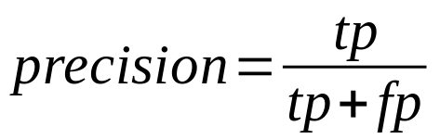
Precision
formula is
it is a measure of how well the algorithm predicts the positive class
used when it is important to not have fp values
p1 |  | actual
 |  | + | -
p r e d | + | tp | fp
 | - | fn | tn

Slide 8
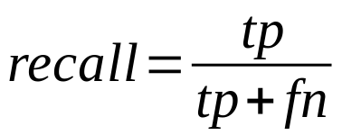
Recall
formula is
it is a measure of how well the algorithm finds the positive instances
used when it is important to not have fn values
p1 |  | actual
 |  | + | -
p r e d | + | tp | fp
 | - | fn | tn

Slide 9
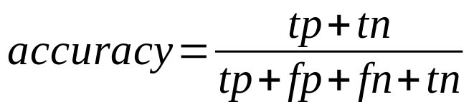
Accuracy
formula is
it is a measure of how well the algorithm predicts, regardless of the class
general measure, used when it is important to be accurate for both class values
p1 |  | actual
 |  | + | -
p r e d | + | tp | fp
 | - | fn | tn

Slide 10
for more than 2 class values
assume we are predicting a persons risk value, low, medium and high
accuracy is the sum of the diagonal divided by sum of all values
precision and recall are defined in terms of the class (e.g.):
  precision for low
  recall for medium
 |  | actual
 |  | low | md | hi
p r e d | low
 | md
 | hi

Slide 11
example calculation
x₁ | x₂ | cls | p1 | p2
 |  | y | n | y
 |  | n | n | y
 |  | n | n | n
 |  | n | n | y
 |  | y | y | y
 |  | y | y | y
 |  | n | n | n
 |  | n | n | y
 |  | n | n | n
 |  | y | n | y
what is the accuracy of p1? p2?
what is the precision (with respect to n) of p1? p2?
what is the precision (with respect to y) of p1? p2?
what is the recall (with respect to n) of p1? p2?
what is the recall (with respect to y) of p1? p2?
p1 |  | actual
 |  | n | y
p r e d | n | 6 | 2
 | y | 0 | 2
p2 |  | actual
 |  | n | y
p r e d | n | 3 | 0
 | y | 3 | 4

Slide 12
When to use which?
suppose you are testing covid patients and it is very important to identify each actual positive case?
quality assurance: predicting expensive engine block failures (don’t want to discard good blocks)
predicting whether we should buy or sell an investment bond (wrong decisions are equally bad)

