Slide 1


BMW
'The Ultimate Driving Machine'

Slide 2
HISTORY
BWM is German multinational manufacturer of luxury vehicle's and motorcycles headquartered in Munich, Bavaria, Germany. The company was founded in 1916 as a manufacturer of aircraft engines, which it produced from 1917 to 1918 and again from 1933 to 1945 creating engines for aircraft that were used in the Second World War.
There were 5 billion BMW cars served in World War One.
Automobiles are marketed under the brands BMW, Mini and Rolls-Royce, and motorcycles are marketed under the brand BMW Motorrad.
In 2017, BMW was the world's fourteenth-largest producer of motor vehicles, with 2,269,569 vehicles produced[

Slide 3
in 2022 the 7th largest by revenue. IN 2023, the company was ranked 46th in the Forbes Global 2000. The company has significant motor-sport history, especially in touring cars, sports cars, and the Isle of Man TT.
BMW is headquartered in Munich and produces motor vehicles in Germany, Brazil, China, India, Mexico, the Netherlands, South Africa, the United Kingdom, and the United States.
The Quandt family is a long-term shareholder of the company, following investments by the brothers Herbert and Harald Quandt in 1959 that saved BMW from bankruptcy, with the remaining shares owned by the public.
BMW became an automobile manufacturer in 1928 when it purchased Fahrzeugfabrik Eisenach, which, at the time, built the Austin 7 under license from Dixi. The first car sold as a BMW was a rebadged BMW Dixi called the BMW 3/15, following BMW's acquisition of the car manufacturer Automobilwerk Eisenach. Throughout the 1930s, BMW expanded its range into sports cars and larger luxury cars.

Slide 4
Struggles of BMW
BMW's factories were heavily bombed during the war and its remaining West German facilities were banned from producing motor vehicles or aircraft after the war. Again, the company survived by making pots, pans, and bicycles. In 1948, BMW restarted motorcycle production. BMW resumed car production in Bavaria in 1952 with the BMW 501 luxury saloon. The range of cars was expanded in 1955, through the production of the cheaper Isetta microcar under license. Slow sales of luxury cars and small profit margins from microcars meant BMW was in serious financial trouble and in 1959 the company was nearly taken over by rival Daimler-Benz.

Slide 5
In January 2021 BMW announced that its sales in 2020 fell by 8.4 percent due to the impact of the COVID-19 pandemic and the restrictions. However, in the fourth quarter of 2020, BMW witnessed a rise of 3.2% in its customers' demands.
On 18 January 2022 BMW announced a BMW 7 Series (G11) special edition simply called "The Final V12," the last BMW series production vehicle to be fitted with a V-12 engine.
BMW and Toyota aim to sell jointly-developed hydrogen fuel cell vehicles as soon as 2025.
In autumn 2023, BMW announced that it would invest £600m in the Mini plant in Cowley to increase production of electric cars.

Slide 6
Year | Revenue (€ bn) | Net income (€ bn) | Total Assets (€ bn) | Employees
2011 | 68.8 | 4.8 | 123 | 100,306
2012 | 76.8 | 5.0 | 131 | 105,876
2013 | 76.0 | 5.3 | 138 | 110,351
2014 | 80.4 | 5.7 | 154 | 116,324
2015 | 92.1 | 6.3 | 172 | 122,244
2016 | 94.1 | 6.8 | 188 | 124,729
2017 | 98.6 | 8.6 | 193 | 129,932
2018 | 97.4 | 7.1 | 208 | 134,682
2019 | 104 | 4.9 | 241 | 133,778
2020 | 98.9 | 3.7 | 216 | 120,726
2021 | 111 | 12.3 | 229 | 118,909
2022 | 142 | 17.9 | 246 | 149,475

Slide 7
Customer Reaching
BMW's target audience is typically affluent individuals who value luxury, performance, and innovative design in their vehicles. This demographic includes both men and women, although men tend to make up a s
This Is How BMW's Marketing Strategy Attracted More Customers
Brand Positioning and Premium Identity.
Understanding Target Audiences.
BMW's Most Successful Marketing Campaign.
Emotional Branding.
Multi-Channel Marketing Approach.
Digital Innovation and Online Presence.
Environmental Initiatives and Sustainability
lightly larger proportion of BMW's customer base.

Slide 8
Targeting Affluent Driving Enthusiasts BMW aims its marketing at affluent consumers with high disposable incomes who value performance driving. This includes wealthier professionals, corporate fleet customers, and automotive enthusiasts.
BMW will constantly innovate its customer services, accelerate digital development process and let more consumers know and experience its customer-oriented services which take 'service quality' as the cornerstone and 'value, convenience and care' as the core.

Slide 9
Inventory & market of BMW
BMW inventory from 2010 to 2023. Inventory can be defined as the total value of inventories in all stages of completion.BMW inventory for the quarter ending September 30, 2023 was $28.362B, a 28.83% increase year-over-year.
BMW inventory for 2022 was $21.077B, a 11.85% increase from 2021.
BMW inventory for 2021 was $18.844B, a 10.75% increase from 2020.
BMW inventory for 2020 was $17.016B, a 4.4% decline from 2019.

Slide 10
Inventory & market of BMW
BMW ANNUAL INVENTORY (MILLIONS OF US $)
2022 | $21,077
2021 | $18,844
2020 | $17,016
2019 | $17,798
2018 | $15,409
2017 | $14,363
2016 | $13,103
2015 | $12,285
2014 | $14,741
2013 | $12,732
2012 | $12,507
2011 | $13,424

Slide 11
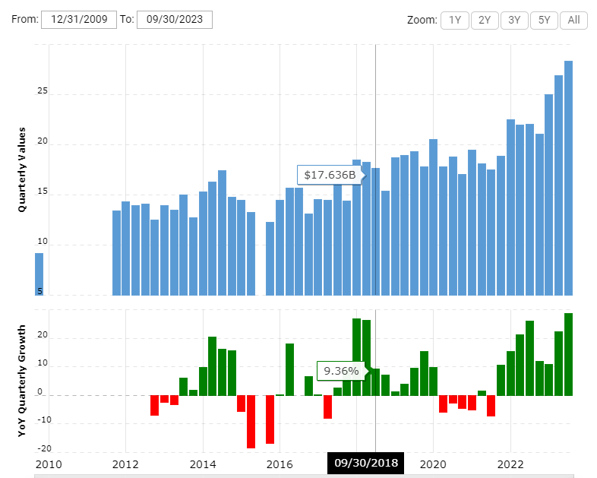
Inventory & market of BMW

Slide 12
Marketing Strategies
1 Product Strategy of BMW
BMW Group manufactured luxury automobiles. They manufacture personalized goods as well as standard goods. The brand is always been connected as a luxury product. The product strategy of BMW includes premium sedans, sports cars ad SUVs. The performance and style are always premium and are shown as a status symbol.
The product is continuously improved to give strong competition. Earlier, the company was focusing on luxury and style, but over the years, safety, efficiency, and reliability became important in the product offering.
The company also manufactured motorcycles and bicycles for certain markets. These are categorized as niche market products.

Slide 13
Lastly, we can say, in product strategy, the company is focusing on safety, improved efficiency, innovative product, and maintaining luxury and premium standards in the market. Let’s move to the next element of the marketing mix, i.e., the price strategy of BMW.
2 Price Strategy of BMW
The company consistently portrays itself as a premium brand, with premium pricing serving as a key component of its impeccable positioning. Car prices fluctuate based on the series and model.
However, in response to intense market rivalry and a drive to amplify its operational reach, the company has ventured into the realm of budget-friendly automobiles, exemplified by the introduction of models like the BMW X1. Commencing at a price point of 22.5 lacs, this offering adheres to BMW’s signature standards.

Slide 14
3 Place Strategy of BMW
The company has many manufacturing units around the world. In India, Chennai is the manufacturing hub for the company. The maximum output capacity to manufacture cars is 11,000 units per year. There is a spare part center too in Mumbai.
BMW has a network of dealers for taking care of sales of their automobiles. They do not appoint distributors, instead directly appoint showroom dealers, this allows them to provide more margins to the dealers which they have to invest in distributors if they appoint them. But for the distribution of spare parts, they have distributors at strategic locations. The showrooms are located in the urban city of India. In Mumbai, they only have 3-4 showrooms so that they don’t lose their brand image because of aggressive selling.

Slide 15
4 Promotion Strategy of BMW
The company has been promoting its brand with the most amazing commercials, print ads, and online advertisements. This has made them the world’s most reputed brand in 2012, as per Forbes
The company knows its target audience very well and according to that, the company markets its product in all the channels of marketing. There is always some exclusivity in the advertisement of the company.
The ads are more focused on the looks and style of the car. The company also focuses on customer satisfaction and every time a customer purchases the car, they always create some memorable moments for the customer.
BMW ads focus on both, the looks of the car and the engine and the technology of the car. BMW also focuses on customer delight and the purchase of a car is almost always accompanied by gifting a few memorable moments to the customer for the purchase of the car.

Slide 16
Quality Control of BMW
“Our INSPEKTO S70 is a self-contained product,” explained Harel Boren, CEO and co-founder of Inspekto. “It is self-learning, self-setting and self-adjusting — in other words, fully autonomous. This eliminates the lengthy and complex integration phases that characterize traditional machine vision projects.”
Having been convinced by Inspekto’s capabilities, BMW Group Plant Steyr has since purchased four systems, followed by a pilot phase, which has resulted in a noticeable improvement in quality and reduction of false detection instances upon the employment of two systems.
So what makes the INSPEKTO S70 so perfect for BMW, outside of an advanced technology that seeks to limit errors? Well, a shared concept between BMW and Inspekto is to bring Artificial Intelligence (AI) out of the sphere of mystery that such advanced technology can often be

Slide 17
wrapped in, thereby democratising it. Essentially, make it so easy to use that anybody in the field can confidently say that they work with AI, and not be overwhelmed with the idea of explaining how they do it.
“By eliminating pseudo-defects, the system has allowed us to avoid the extra loop of manual double-checks. But the more important thing for me is that with the INSPEKTO S70 we have brought AI closer to our production employees. In this sense, BMW and Inspekto have a shared vision,” concluded Birch.
This combination of technologies, mindsets and visions for the future seems to be nothing but a fruitful venture into the future of consistent, high-quality production, potentially setting a new standard for manufacturers across the globe.

Slide 18
In conclusion, BMW's case study underscores its commitment to innovation, sustainability, and customer-centricity. By leveraging cutting-edge technology and strategic partnerships, BMW has positioned itself as a leader in the automotive industry. Through initiatives like electric mobility and digitalization, the company addresses evolving consumer demands and environmental concerns. BMW's strong brand identity and focus on quality ensure continued success in an ever-changing market landscape. Embracing a future-oriented approach, BMW remains poised to drive growth and shape the future of mobility.
I like to apologies if I missed something
Thank you.
Not just car…its an art

