Slide 1





SMVDU TECH COMMUNITY
SMVDU Hackathon 2022

Slide 2



Team details
TEAM NAME: Your Team Name Here
VICKY KUMAR
SAURABH KUMAR RAJ
College: SMVDU
Stream: ECE
Year of graduation: 2024
College: SMVDU
Stream: ECE
Year of graduation: 2024
SAJAN KUMAR
Photo
College: SMVDU
Stream: ECE
Year of graduation: 2024
All fields are mandatory

Slide 3
Theme
ANTOMATIC ANTI COLLISION SYSTEM:
7.-
1.It is basically a collision avoidance system (CAS), also known as a pre-crash system, forward collision warning system, or collision mitigation system,
2.we use many transportation system to travel one place to another .
3.Collision avoidance systems range from widespread systems mandatory in some countries, such as autonomous emergency braking .
4.This is aiming to utilise the latest development in sensors technology and multi-level of redundancy approach, to improve the safety of electric vehicle and minimize the risk of road collision.
5.The paper is focused on the development of the anti-collision system. The system is a network of sensors utilising the near real time embedded system.
6.Four operational conditions were considered and some activities have been taken to control the speed and steering control system of the vehicle at an imminent collision without causing panic to the driver. Visual alerts using LEDs were developed to indicate vehicles or obstacles along the path of the host vehicle even at an opposite direction

Slide 4
Describe the problem statement (200 words)
Note:
The National Highway Authority of India (NHAI) was founded in 1988. NHAI is an autonomous body responsible for the development, maintenance and operation of National Highways. The longest road in India is G.T. Grand Trunk Road. G.T. The road was built by Shershah Suri. Now it connects from Kolkata to Amritsar. The first national road in India is the G.T. road. The freeway is known as the "Long Walk" is the G.T. road.
According to the report “Road Safety Assessment of NH-44”, which has been prepared by Traffic Adviser to state government Navdeep Asija, 880 people lost their lives and 525 sustained serious injuries from 2016 to 2018. The report has analysed this three-year data of accidents on the GT Road from Shambhu Barrier to Jalandhar, which is a 212-km-long stretch.
Road accident is most unwanted thing to happen to a road user, though they happen quite often. The most unfortunate thing is that we don't learn from our mistakes on road. Most of the road users are quite well aware of the general rules and safety measures while using roads but it is only the laxity on part of road users, which cause accidents and crashes. Main cause of accidents and crashes are due to human errors. We are elaborating some of the common behaviour of humans which results in accident.
1.Over Speeding
2.Drunken Driving
3.Distractions to Driver
4.Red Light Jumping
5.Avoiding Safety Gears like Seat belts and Helmets

Slide 5
Proposed solution / your big Idea (200 words)
Autonomous vehicle navigation is a booming area of research and development with far-reaching cross-market appeal. The simplicity of current-generation autonomous mobile robots (AMRs) makes them ideal for many industrial functions, but – as mentioned – there are certain safety issues to bear in mind. Safety certified anti-collision is a mandatory feature for many industrial mobile robots.
he anti-collision sensor is a detection device meant to avoid or reduce the collision by sensing objects in the path and aware the driver by sending warning signals and alarms, and also provides security and safety during the operation.
Automatic Emergency Braking :Some forward collision warning systems work together with Automatic Emergency Braking. If your vehicle has automatic emergency braking, the system helps you avoid a crash by urgently applying the brakes when a crash is imminent if you fail to do so in time.
The Science of Risk Mitigation
Despite best practices, traffic laws, and numerous safety campaigns, collisions still happen every single day. So it’s no surprise that engineers have opted to tackle this problem from an automated standpoint. In 2016, the National Highway Traffic Safety Administration (NHTSA) and 20 major automakers, (link is external) agreed to make automatic emergency braking a standard feature in all new vehicles by 2022.
Describe TECHNOLOGY USED :

Slide 6
How is your solution different/unique from other solutions in market (150 words)
Old Technology Performing New Trick :
Since the late 1950’s, engineers have been looking at ways to prevent collisions using sensors. The Cadillac Cyclone(link is external), a futuristic concept car designed by Harley Earl, included a radar detection system for collision avoidance among its many innovative features. Deemed too expensive for mass production back then, radar systems would still play a significant role in collision avoidance technology in the future.
yes we do have a prototype ready ,yes we will be able to show up our prototype working during presentation .o it is a user friendly and versatile system which can prevent road accidents, reduce the rate of accidents as well as accidental death of human life. It can be used in any kind of automobile vehicle as it's a cost effective system.
PATENT FILED: No
Do you have a working model/prototype: NO/YES
If not, will you be able to show working prototype during finale. Yes/NO

Slide 7
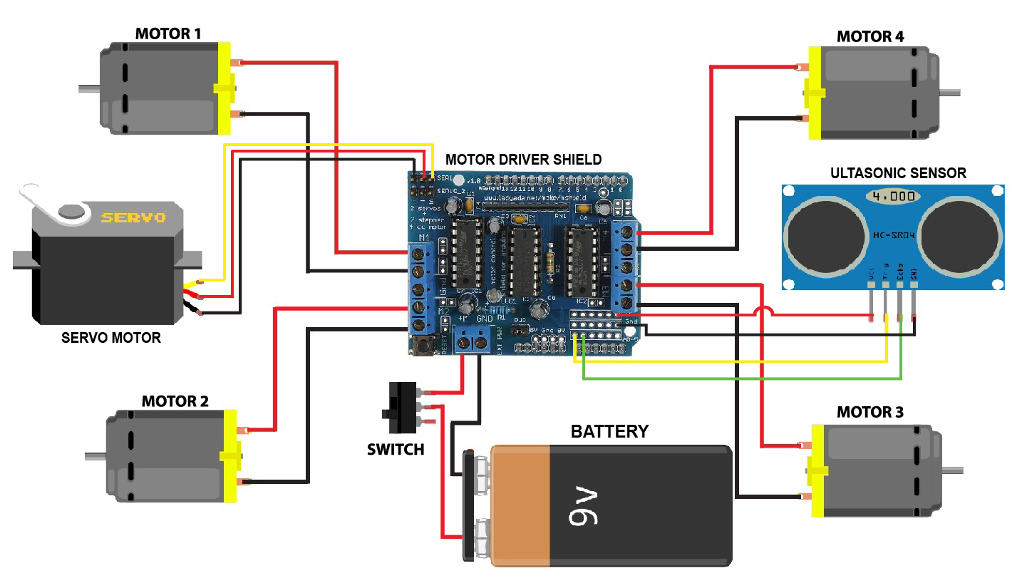
Any testimonials received?
Circuits Diagram
Share the links/photos of the testimonials you’ve received

Slide 8
Elevator pitch video (1 minute) Share the public link along with the code link
Project Demo Video Link -https://youtu.be/iPbfFsE_XCE
GitHub Link -https://github.com/Vickyaryan33/smvduhackathon2022

Slide 9
Thank you!

