Slide 1
CSS
HTML describes the structure of a document:
Cascading Style Sheets (CSS) specify the presentation of web pages.
CSS simplifies site updates, developer can just modify the styles to change the web pages look.
A style is a rule that describes how a specific part of a web page is formatted.
A style sheet is a set of style rules.

Slide 2
Applying CSS
External style sheet
Embedded style sheet
Inline style sheet

Slide 3
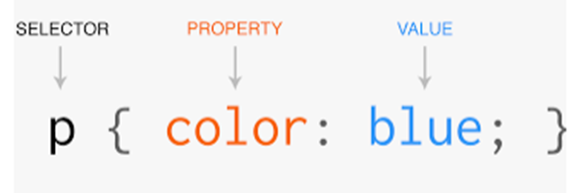
Syntax

Slide 4
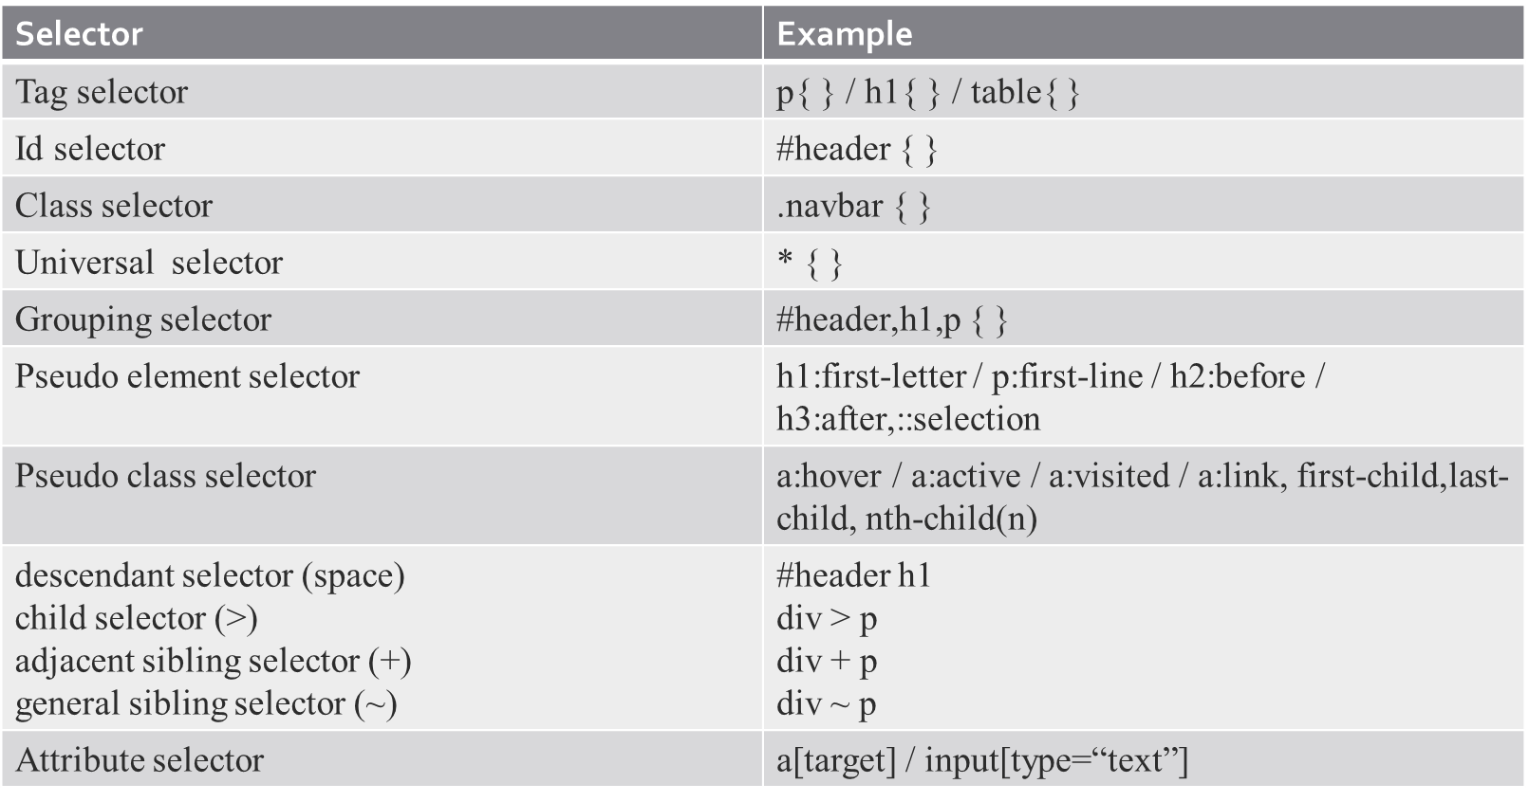
Selectors

Slide 5
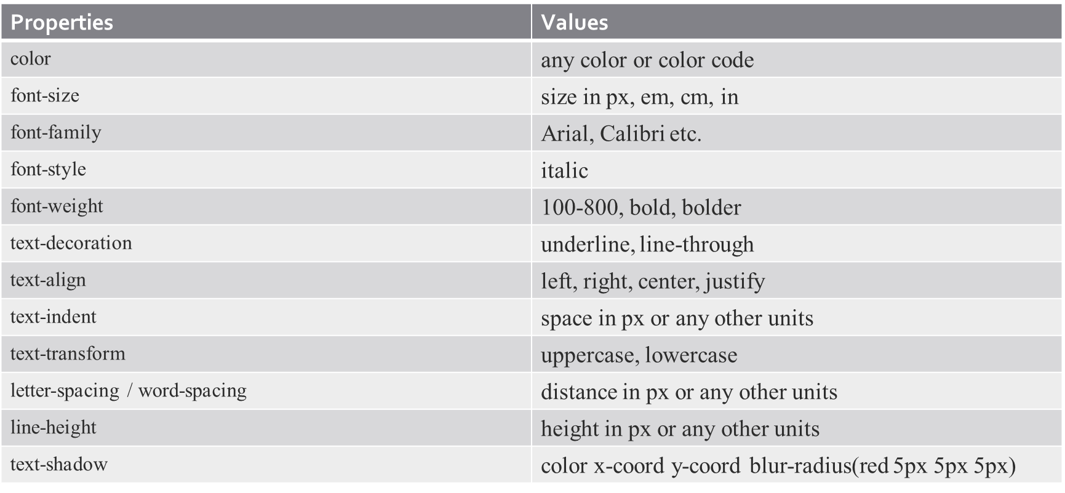
Properties
Text Properties :

Slide 6
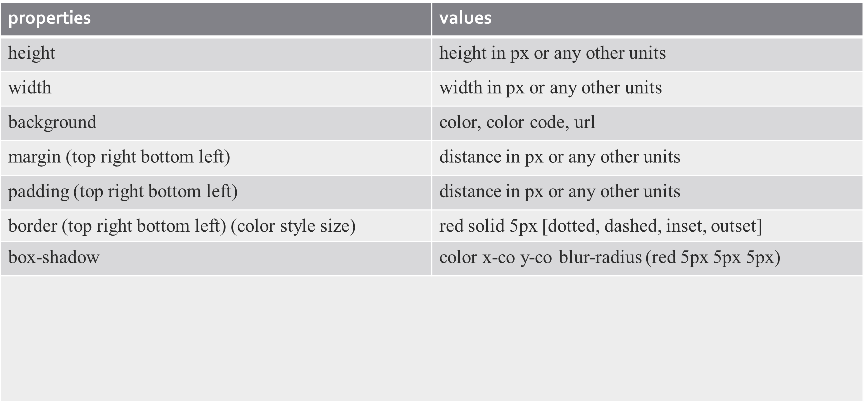
Box Properties

Slide 7
Flexbox for layout
Flexbox container and items
Alignment and distribution of space
Responsive design with Flexbox

Slide 8
Parent Flexbox container
display:flex
flex-direction: row | row-reverse |column | column-reverse
flex-wrap: nowrap | wrap | wrap-reverse
flex-flow: column wrap;
justify-content: flex-start | flex-end | center | space-between | space-around | space-evenly | start | end | left | right ... + safe | unsafe
align-items: stretch | flex-start | flex-end | center | baseline | first baseline | last baseline | start | end | self-start | self-end + ... safe | unsafe;
align-content: flex-start | flex-end | center | space-between | space-around | space-evenly | stretch | start | end | baseline | first baseline | last baseline + ... safe | unsafe
gap: 10px; gap: 10px 20px; /* row-gap column gap */ row-gap: 10px; column-gap: 20px;

Slide 9
Children flex items
order: 5; /* default is 0 */
flex-grow: 4; /* default 0 */
flex-shrink: 3; /* default 1 */
flex-basis: | auto; /* default auto */
flex: none | [ <'flex-grow'> <'flex-shrink'>? || <'flex-basis'> ] This is the shorthand for flex-grow, flex-shrink and flex-basis combined.
align-self: auto | flex-start | flex-end | center | baseline | stretch

Slide 10
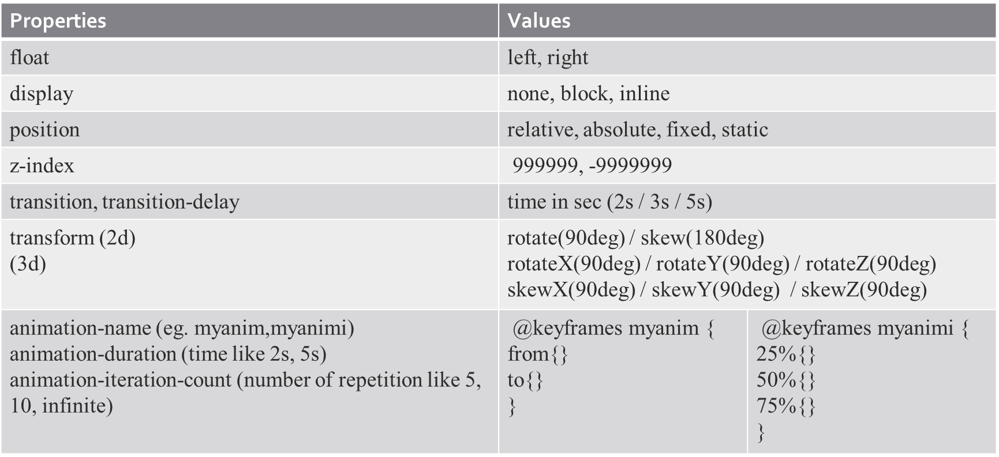
CSS positioning / animation and transition

Slide 11
Practical use case for animation
Loading : .spinner {
border: 16px solid #f3f3f3;
border-top: 16px solid #3498db;
border-radius: 50%;
width: 120px;
height: 120px;
animation: spin 2s linear infinite;
}
@keyframes spin {
0% { transform: rotate(0deg); }
100% { transform: rotate(360deg); }
}

Slide 12
Practical use case for transition
Hover:
.button {
background-color: #4CAF50;
transition: background-color 0.3s ease;
}
.button:hover {
background-color: #45a049;
}

Slide 13
Responsive design and media query
@media (min-width: 0px) and (max-width: 576px) {
// css
}
@media (min-width: 577px) and (max-width: 768px) {
// css
}
@media (min-width: 769px) and (max-width: 992px) {
// css
}

Slide 14
Responsive design principle
https://docs.google.com/document/d/1KO4v2yqvEwYN6JjwWfRM5eMyfw6mosGAy1YYEbLDiZ0/edit#heading=h.otibkffh66mv

