Slide 1
Core Javascript
Basic JavaScript Syntax
Introduction to JavaScript
Variables (let, const, var) and data types
Operators and expressions

Slide 2
Introduction
Lightweight, interpreted programming language
JavaScript runs right inside the browser
JavaScript is dynamically typed
JavaScript is object oriented in that almost everything in the language is an object

Slide 3
What is not?
Although it contains the word Java, JavaScript and Java are vastly different programming languages with different uses. Java is a full-fledged compiled, object-oriented language, popular for its ability to run on any platform with a JVM installed.
Conversely, JavaScript is one of the world’s most popular languages, with fewer of the object-oriented features of Java, and runs directly inside the browser, without the need for the JVM.

Slide 4
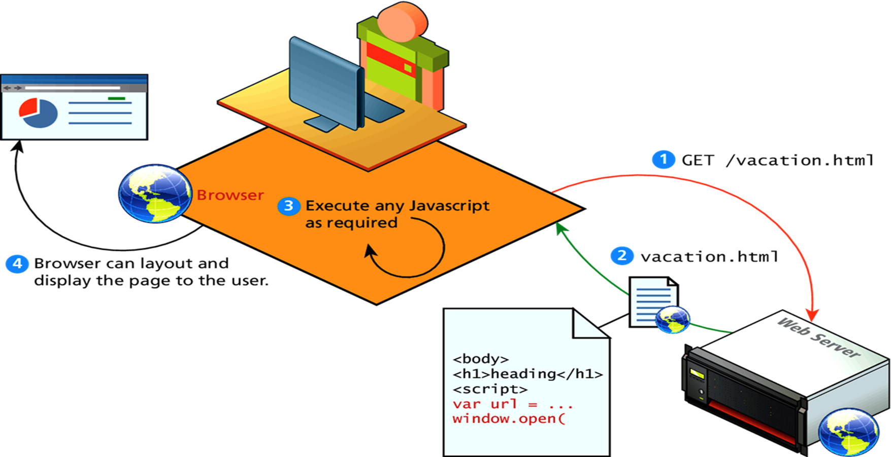
How it works

Slide 5
Why we need
Processing can be offloaded from the server to client machines, thereby reducing the load on the server.
The browser can respond more rapidly to user events than a request to a remote server ever could, which improves the user experience.
JavaScript can interact with the downloaded HTML in a way that the server cannot, creating a user experience more like desktop software than simple HTML ever could.

Slide 6
Link Js in HTML
Inline
Embedded
External

Slide 7
Scope in js
In programming, scope refers to the context in which variables and functions are declared and accessed.

Slide 8
Types of scope
Global Scope
Function scope
Block scope

Slide 9
LET, VAR, CONST
var:
Global or function scoped
undefined when accessing a variable before it's declared
let:
block scoped
ReferenceError when accessing a variable before it's declared
const:
block scoped
ReferenceError when accessing a variable before it's declared
can't be reassigned

Slide 10
Example of var
if(1==1)
{
var a = 10;
}
document.write(a); // output will be 10 since var can be accesed inside a function, in this case it’s a global function

Slide 11
Example of LET
if(1==1)
{
let a = 10;
}
document.write(a);
// a is not defined . Since its scope ends inside the if block

Slide 12
Example of CONST
Const a = “somethig”;
Const a = “somethig”;// invalid
a = “something“; // invalid
We cannot redeclare the const variable

Slide 13
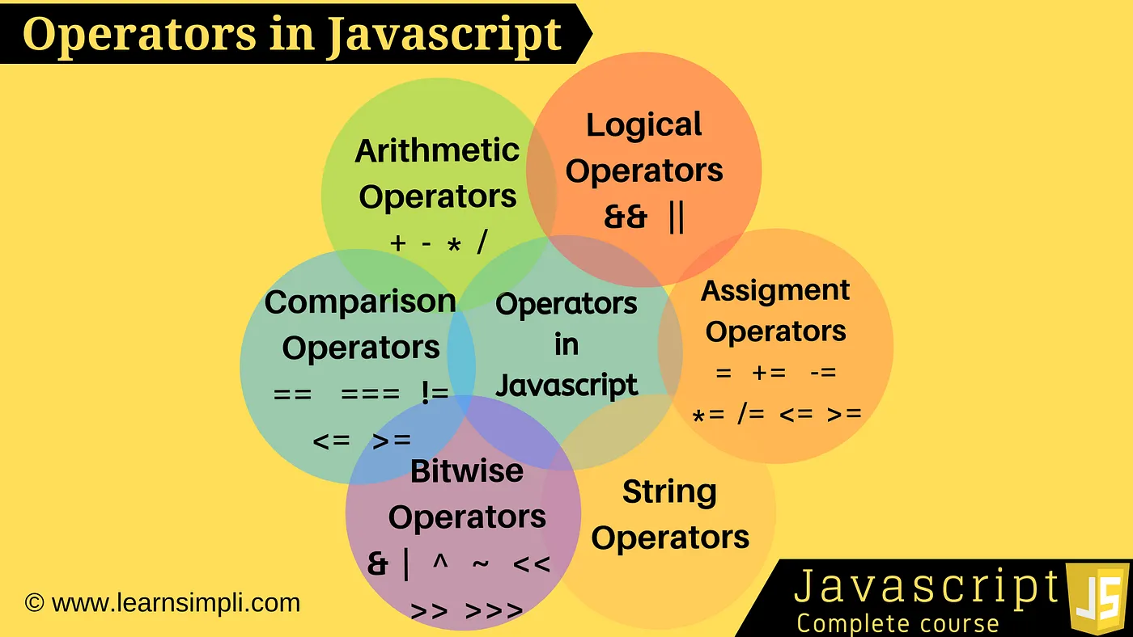
Operator and Expression , typeof

Slide 14
Type conversion
let value = true;
alert(typeof value); // boolean value = String(value); // now value is a string "true"
alert(typeof value); // string
alert( Number(" 123 ") ); // 123
alert( Boolean(1) );

Slide 15
Loops
While and for
Example of while
let i = 0; while (i < 3) { // shows 0, then 1, then 2 alert( i ); i++; }
do { // loop body } while (condition);
Example of for
for (let i = 0; i < 3; i++) { // shows 0, then 1, then 2 alert(i); }
Breaking loop
let sum = 0; while (true) { let value = +prompt("Enter a number", ''); if (!value) break; // (*) sum += value; } alert( 'Sum: ' + sum );
continue to next iteration
for (let i = 0; i < 10; i++) { // if true, skip the remaining part of the body if (i % 2 == 0) continue; alert(i); // 1, then 3, 5, 7, 9 }

Slide 16
IF…else / Switch case
example of swicth case
let a = 3;
switch (a) {
case 4:
alert('Right!');
break;
case 3: // (*) grouped two cases
case 5:
alert('Wrong!');
alert("Why don't you take a math class?");
break;
default:
alert('The result is strange. Really.');
}

Slide 17
Example of if…else
let a = +prompt('a?', '');
if (a == 0) {
alert( 0 );
}
if (a == 1) {
alert( 1 );
}
if (a == 2 || a == 3) {
alert( '2,3' );
}

Slide 18
Use Strict
"use strict"; // this code works the modern way ..

Slide 19
Functions
A function is a group of reusable code which can be called anywhere in the program.
To define functions in javascript we use function keyword.
<script>
function test()
{
document.write(“do something”);
}
</script>

Slide 20
Function Expression vs Function Declaration
// Function Declaration function sum(a, b) { return a + b; }
// Function Expression let sum = function(a, b) { return a + b; };

Slide 21
Arrow Function
let sum = (a, b) => a + b;
/* This arrow function is a shorter form of:
let sum = function(a, b) {
return a + b;
};
*/
alert( sum(1, 2) ); // 3

Slide 22
Document object model
JavaScript can access all the elements in a webpage making use
of Document Object Model (DOM). In fact, the web browser creates
a DOM of the webpage when the page is loaded.

Slide 23
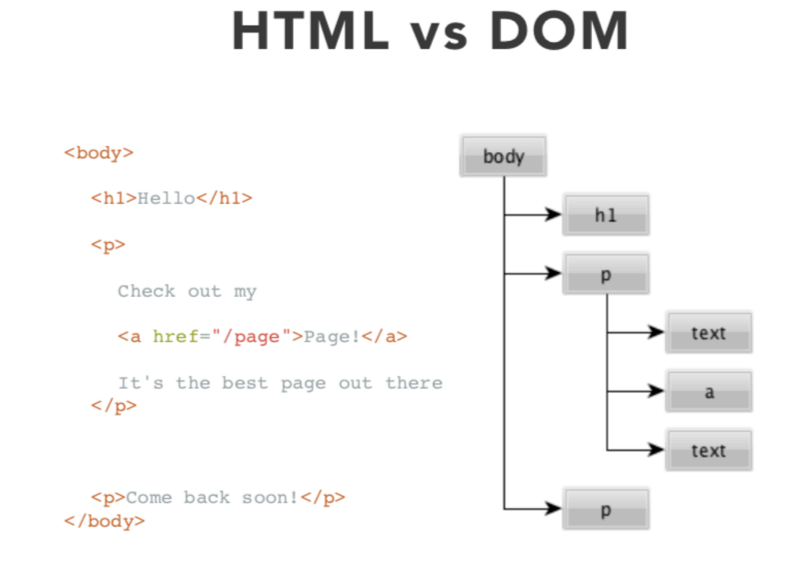
HTML VS DOM

Slide 24
Selecting elements
getElementById - finds node with a certain ID attribute • document.getElementById(“will”); •
getElementsByClassName - finds nodes with a certain CLASS attribute • document.getElementsByClassName(“will”)
getElementsByTagName - finds nodes with a certain HTML tag • document.getElementsByTagName(“div”);
querySelector, querySelectorAll - searches using CSS selectors • document.querySelector(“#will .will:first-child”);

