Slide 1
Working with the Document Object Model
DOM tree and document structure
Selecting and manipulating elements
Creating, appending, and removing elements

Slide 2
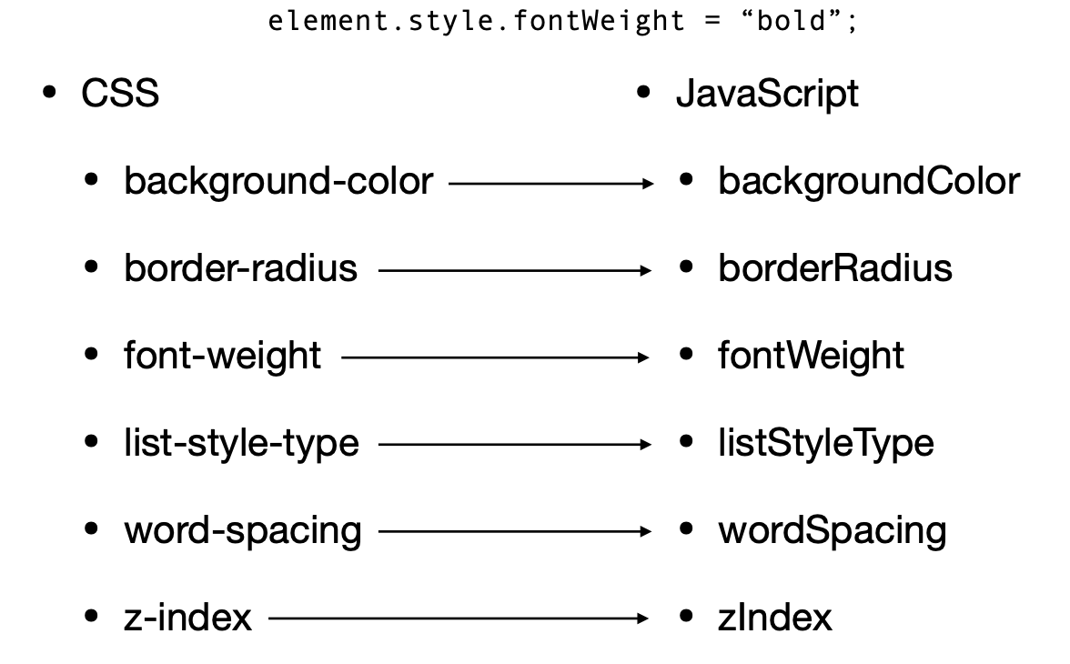
Manipulating elements : Changing CSS

Slide 3
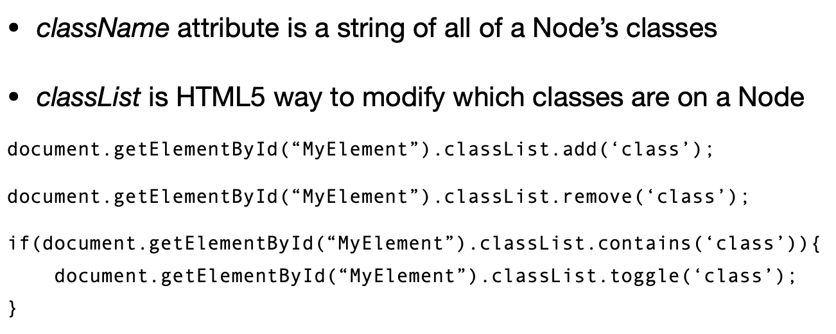
Changing Classes

Slide 4
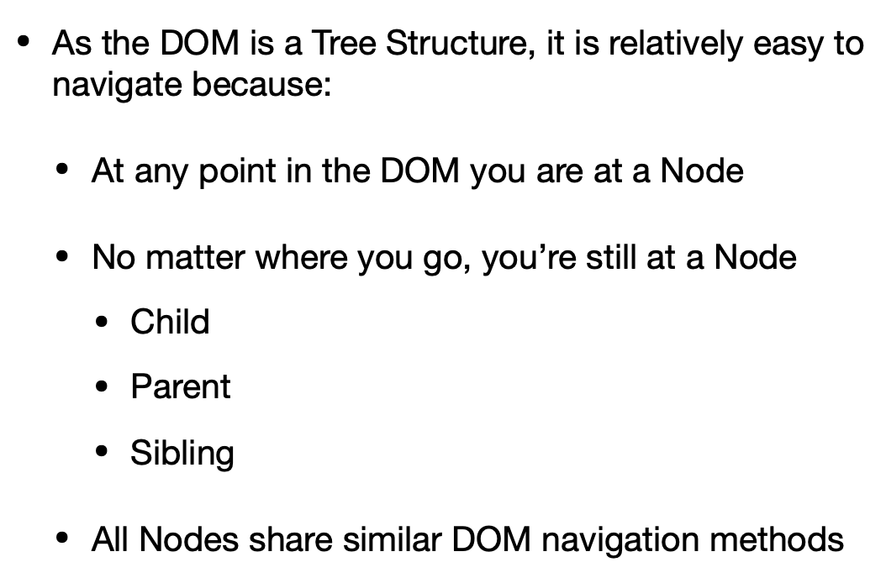
Traverse the DOM
Walking or navigating to DOM with parent child and sibling properties

Slide 5
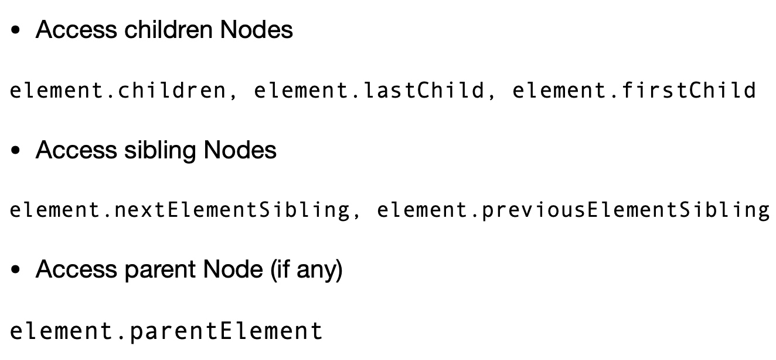
Traversing the DOM

Slide 6
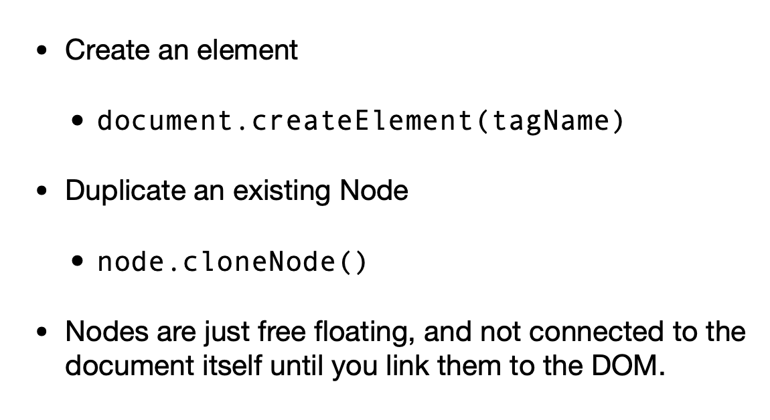
Creating Element

Slide 7
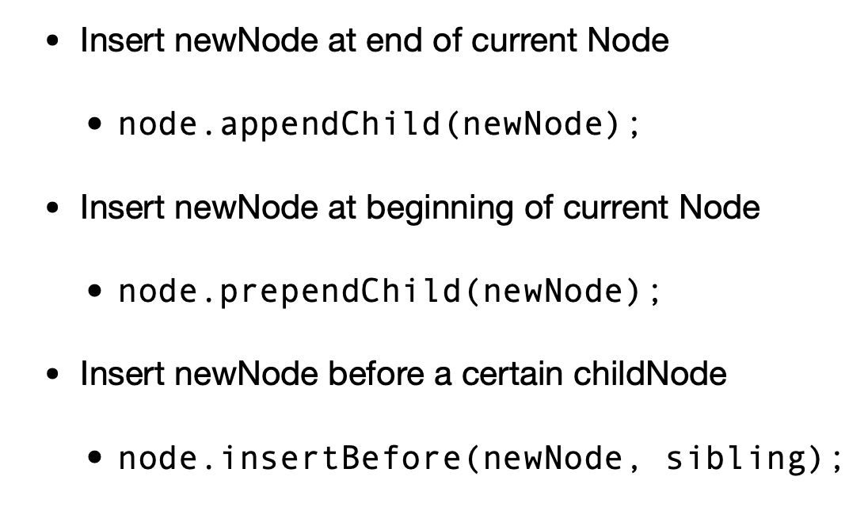
Adding Element to DOM

Slide 8
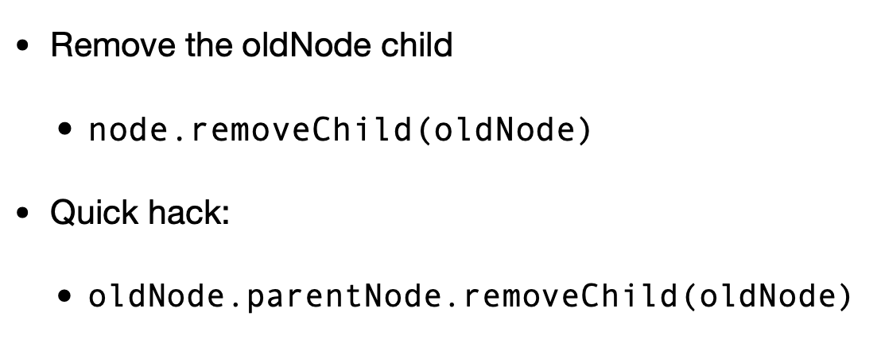
Removing Element

