Slide 1
Event, Event Listener And Event Handler
Adding and removing event listeners
Event object and event delegation
Common events

Slide 2
Events
Form level events :
Onchange, onsubmit, onreset, onselect, onblur, onfocus
Keyboard events:
Onkeydown, onkeypress, onkeyup
Mouse Events:
Onclick, ondblclick, onmousedown, onmousemove, onmouseout, onmouseover, onmouseup

Slide 3
Event Handler Vs Event Listener
You can only have one event handler for a specific event type, but you can add multiple event listeners for it.

Slide 4
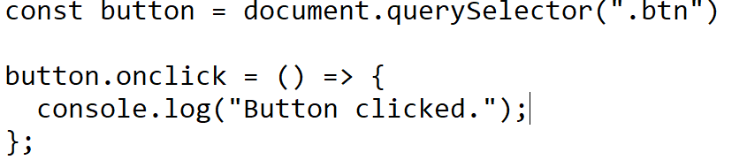
Example of Event Handler

Slide 5
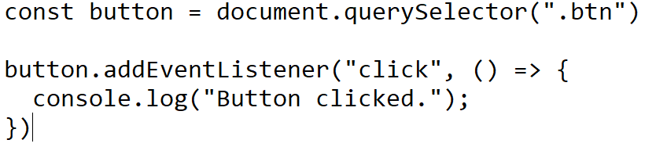
Example of Event Listener

Slide 6
Remove Event Listener
myDiv.removeEventListener("mousemove", myFunction);

Slide 7
Event Delegation
The pattern of handling an event on an parent or ancestor element is called Event Delegation.
Example:
<div>
<span>
<button>Click Me!</button>
</span>
</div>

Slide 8
How event delegation work
const div = document.getElementsByTagName("div")[0]
div.addEventListener("click", (event) => {
if(event.target.tagName === 'BUTTON') {
console.log("button was clicked")
}
})

Slide 9
Event Bubbling
Event Bubbling is a concept in the DOM (Document Object Model). It happens when an element receives an event, and that event bubbles up (or you can say is transmitted or propagated) to its parent and ancestor elements in the DOM tree until it gets to the root element.
Child click garnu is = parent

Slide 10
Example of event bubbling
<body>
<div>
<span>
<button>Click Me!</button>
</span>
</div>
</body>

Slide 11
Event Capture
Parent click garnu is = parent matrai click garnu

Slide 12
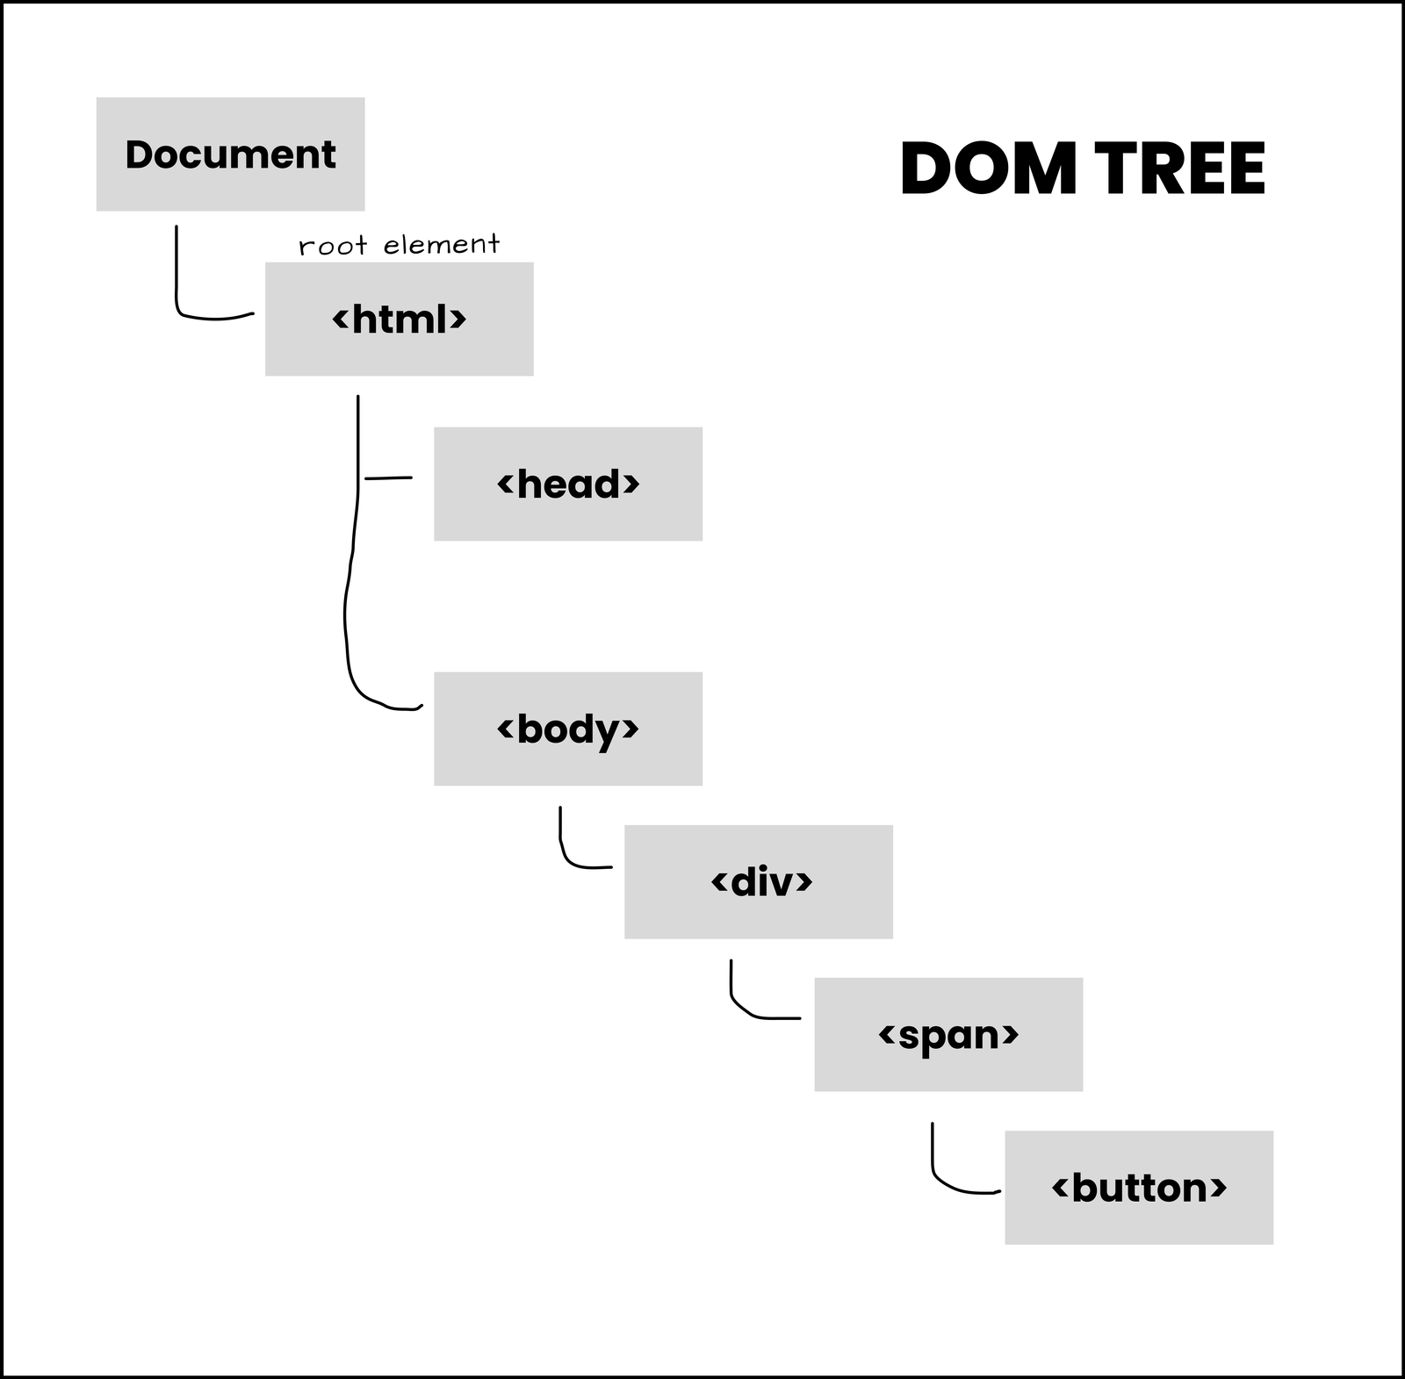

Slide 13
const body = document.getElementsByTagName("body")[0]
const div = document.getElementsByTagName("div")[0]
const span = document.getElementsByTagName("span")[0]
const button = document.getElementsByTagName("button")[0]
body.addEventListener('click', () => {
console.log("body was clicked")
})
div.addEventListener('click', () => {
console.log("div was clicked")
})
span.addEventListener('click', () => {
console.log("span was clicked")
})
button.addEventListener('click', () => {
console.log("button was clicked")
})

Slide 14
How To stop event propagation
body.addEventListener('click', () => {
console.log("body was clicked")
})
div.addEventListener('click', () => {
console.log("div was clicked")
})
span.addEventListener('click', () => {
console.log("span was clicked")
})
button.addEventListener('click', (event) => {
event.stopPropagation()
console.log("button was clicked")
})

Slide 15
How To stop preventDefault()
Example :
<form id=”form”>
<input name="email" />
<input name="password" />
<input type="submit" />
</form>
const form = document.getElementById('form')
form.addEventListener('submit', (event) => {
event.preventDefault()
// process data and submit a request manually
})

Slide 16
Example of Form Handling
function validateForm() {
let x = document.forms["myForm"]["fname"].value;
if (x == "") {
alert("Name must be filled out");
return false;
}
}

Slide 17
Example of Form Handling
<form name="myForm" action="/action_page.php" onsubmit="return validateForm()" method="post">
Name: <input type="text" name="fname">
<input type="submit" value="Submit">
</form>

Slide 18
What is event Capturing
Event capturing occurs when a nested element gets clicked. The click event of its parent elements must be triggered before the click of the nested element. This phase trickles down from the top of the DOM tree to the target element.
Event Capturing is opposite to event bubbling, where in event capturing, an event moves from the outermost element to the target.

