Slide 1
Search Engine
Done by:
Radoslawa Zukowska
Anna Sajdokova
Tymoteusz Oczowiński
José Luis Perdomo de Vega
Eduardo López Fortes

Slide 2

Index
01. | Introduction
02. | Project Modules
03. | Inverted Index Data Structures
04. | BenchMark
05. | Results
06. | Future Work

Slide 3

Introduction
Context: Efficient search in large data volumes is crucial in today’s information-driven world, and search engines are fundamental tools for this.
Project Objective: Develop a Python-based search engine using an inverted index for literary texts sourced from the Gutenberg Project.
Challenges: Efficient data collection, scalable indexing, and query optimization in terms of speed and memory management.

Slide 4




Project Modules
Web Crawler
Automatically collects literary works from the Gutenberg Project.
Inverted Index
Stores each word along with its position in the documents.
Query Engine
Allows users to search for words, returning results with the specific locations of the words in the documents.

Slide 5
Inverted Index Data Structures
Trie Node
Hash Index
-Efficient for searches involving common prefixes.
-Disadvantages: Higher memory usage if words do not share many prefixes.
-Implementation: Words are inserted character by character, with each path representing a word. A special marker indicates the end of a valid word.
-Persistence: The Trie is serialized to JSON format for future use.
-Each word is assigned to a bucket based on its hash value, allowing for quick retrieval.
-Advantages: Quick lookups with constant time complexity.
-Concurrency: Parallel processing is used to handle large data efficiently.
-Collision Handling: Multiple words with the same hash are handled using lists in the same bucket.

Slide 6
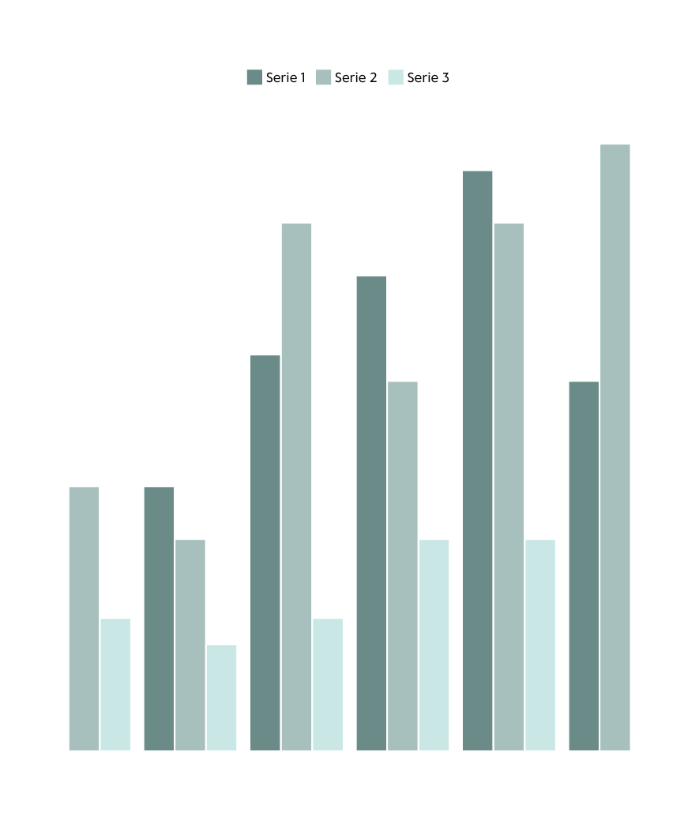

BenchMark
We benchmarked both of the data structure in order to test which one of them gives a better performance.

Slide 7
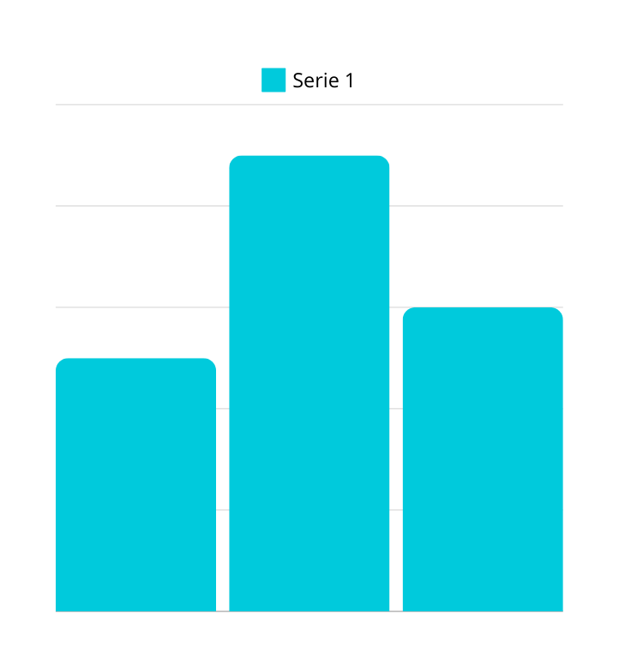
Results
24.5 s
Benchmarking of the Indices
Trie Index:
Mean time to index 25 books: 24.5 seconds.
Standard deviation: 3.35 seconds, showing some variability in performance.
Hashed Index:
Mean time to index 75 books: 19.53 seconds.
Standard deviation: 43.48 seconds, indicating more consistent performance.
Search Engine Benchmark:
Trie: 4.64 seconds for single-word queries; 9.94 seconds for multi-word queries.
Hashed Index: 0.018 seconds for single-word queries; 0.051 seconds for multi-word queries.
19.53 s
9.94 s

Slide 8

Conclusion
and
Future Work
The Hashed Index outperforms the Trie structure in terms of speed and consistency, making it the superior choice for large-scale applications.
Transitioning to a more efficient programming language like Java would improve performance and scalability.
Future improvements include code modularization, better data storage solutions, and more advanced parallelization techniques for enhanced efficiency.

Slide 9
Thanks for your atention!

