Slide 1
Self-Supervised Multimodal Learning for Early Mental Health Crisis Detection
By Sajal Dutta
AI in Healthcare | August 2025
University of Texas at Austin

Slide 2
Documents and Code References
Repository:
https://github.com/sajdutts/multimodal-mental-health-ai
Source files:
https://github.com/sajdutts/multimodal-mental-health-ai/tree/main/src
Notebook:
https://github.com/sajdutts/multimodal-mental-health-ai/tree/main/notebooks/exploration
Presentation:
https://github.com/sajdutts/multimodal-mental-health-ai/tree/main/docs

Slide 3
Introduction
The Problem
970+ million people affected by mental health disorders globally
Current approach: Reactive intervention after crisis manifestation
Critical gap: Missing 2–4 week early warning opportunities
Why This Matters
Early detection enables preventive care vs. emergency response
Mental health data requires strict privacy protection
EHR systems contain rich multimodal data (text, vitals, medications)
Our Goal
Predict mental health crises 2–4 weeks before clinical manifestation using privacy-preserving self-supervised learning

Slide 4
Method
Dataset: MIMIC-IV + Synthetic Data Enhancement
MIMIC-IV Base: 9,151 mental health patients (19.7% of total population)
Synthetic Data Augmentation: Generated additional crisis scenarios for rare events
Why Hybrid Approach:
Addresses data scarcity for crisis events (only 5.5% crisis codes in MIMIC-IV)
Balances training data across different mental health conditions
Improves generalization to diverse patient populations
Privacy protection – reduces reliance on real patient crisis data
Combined Dataset:
455,986 clinical notes | 88,138 vital signs | 5,160 medications
Patient distribution:
• Substance-related: 70.2% (6,426 patients)
• Mood disorders: 32.0% (2,926 patients)
• Crisis codes: 5.5% (506 patients)

Slide 5
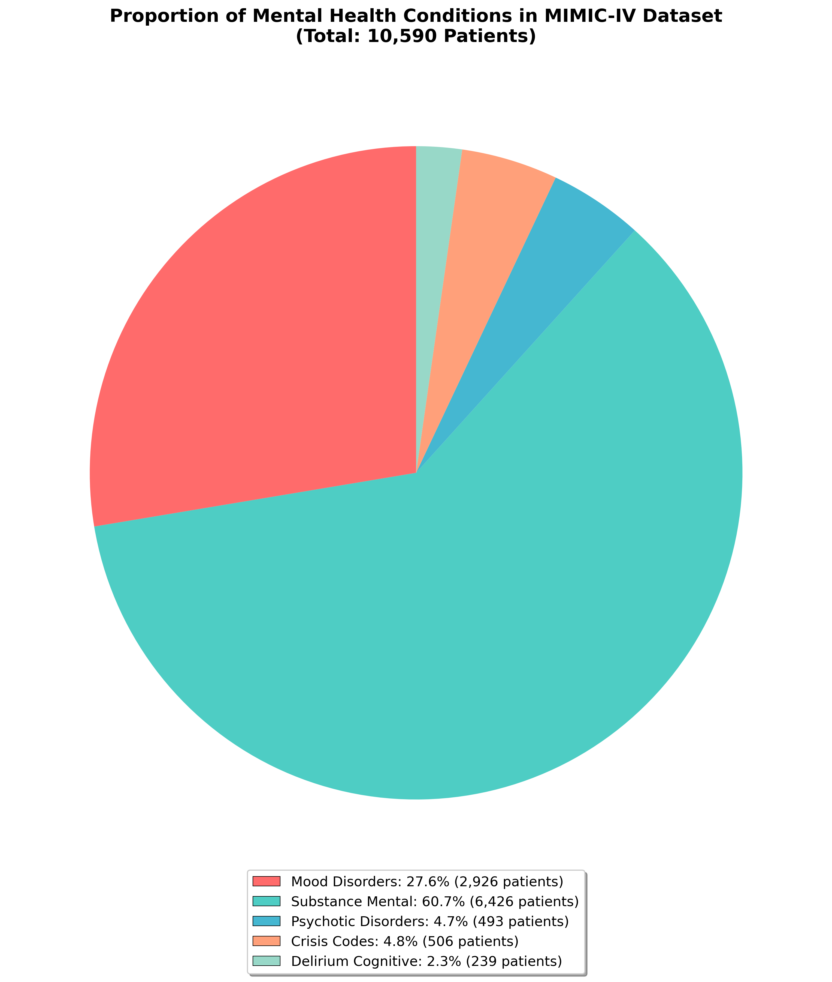
Data Distribution
Combined Dataset:
455,986 clinical notes |
88,138 vital signs | 5,160 medications
Patient distribution:
• Substance-related: 70.2% (6,426 patients)
• Mood disorders: 32.0% (2,926 patients)
• Crisis codes: 5.5% (506 patients)

Slide 6
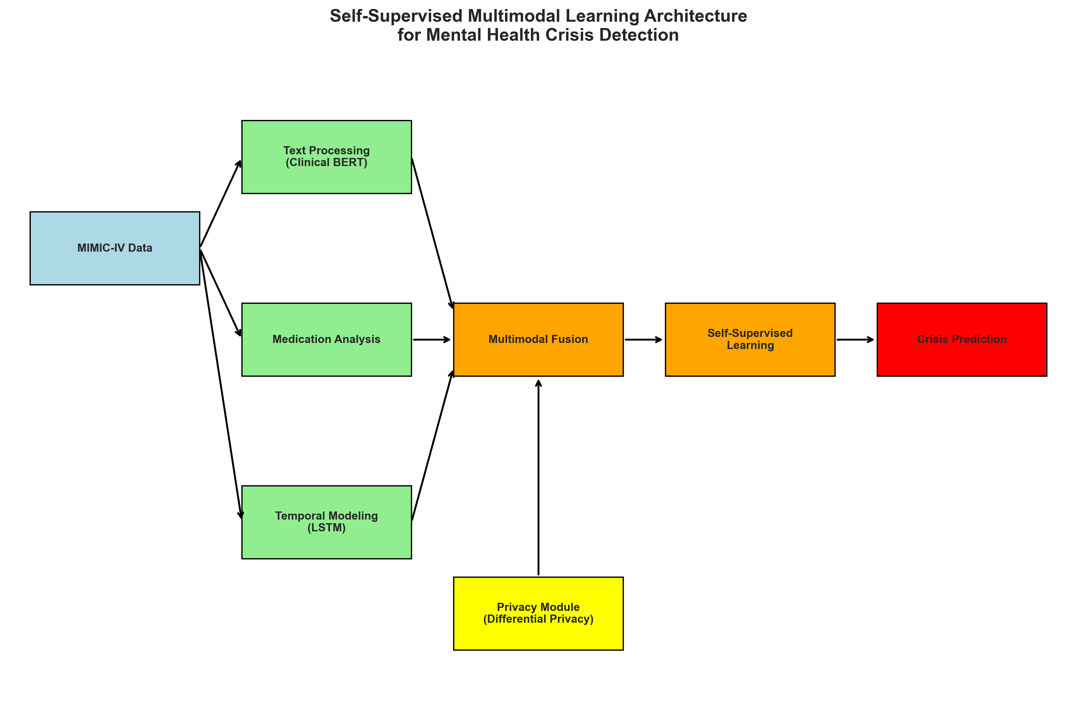
Method (Architecture)
Architecture: 28M Parameter Multimodal Framework
Text Encoder
Bio_ClinicalBERT for mental health terminology
768-dimensional clinical embeddings
Temporal Encoder
Bidirectional LSTM for vital signs & medication patterns
256-dimensional hidden states with attention
Multimodal Fusion
Cross-modal attention (8 heads, 512 projections)
Integrates text, vitals, and medication data
Self-Supervised Learning
Temporal contrastive learning
Distinguishes normal vs. pre-crisis periods
Privacy Protection
Differential Privacy: ε=8.0, δ=1e-5
Federated Learning capability
Automated PHI removal

Slide 7
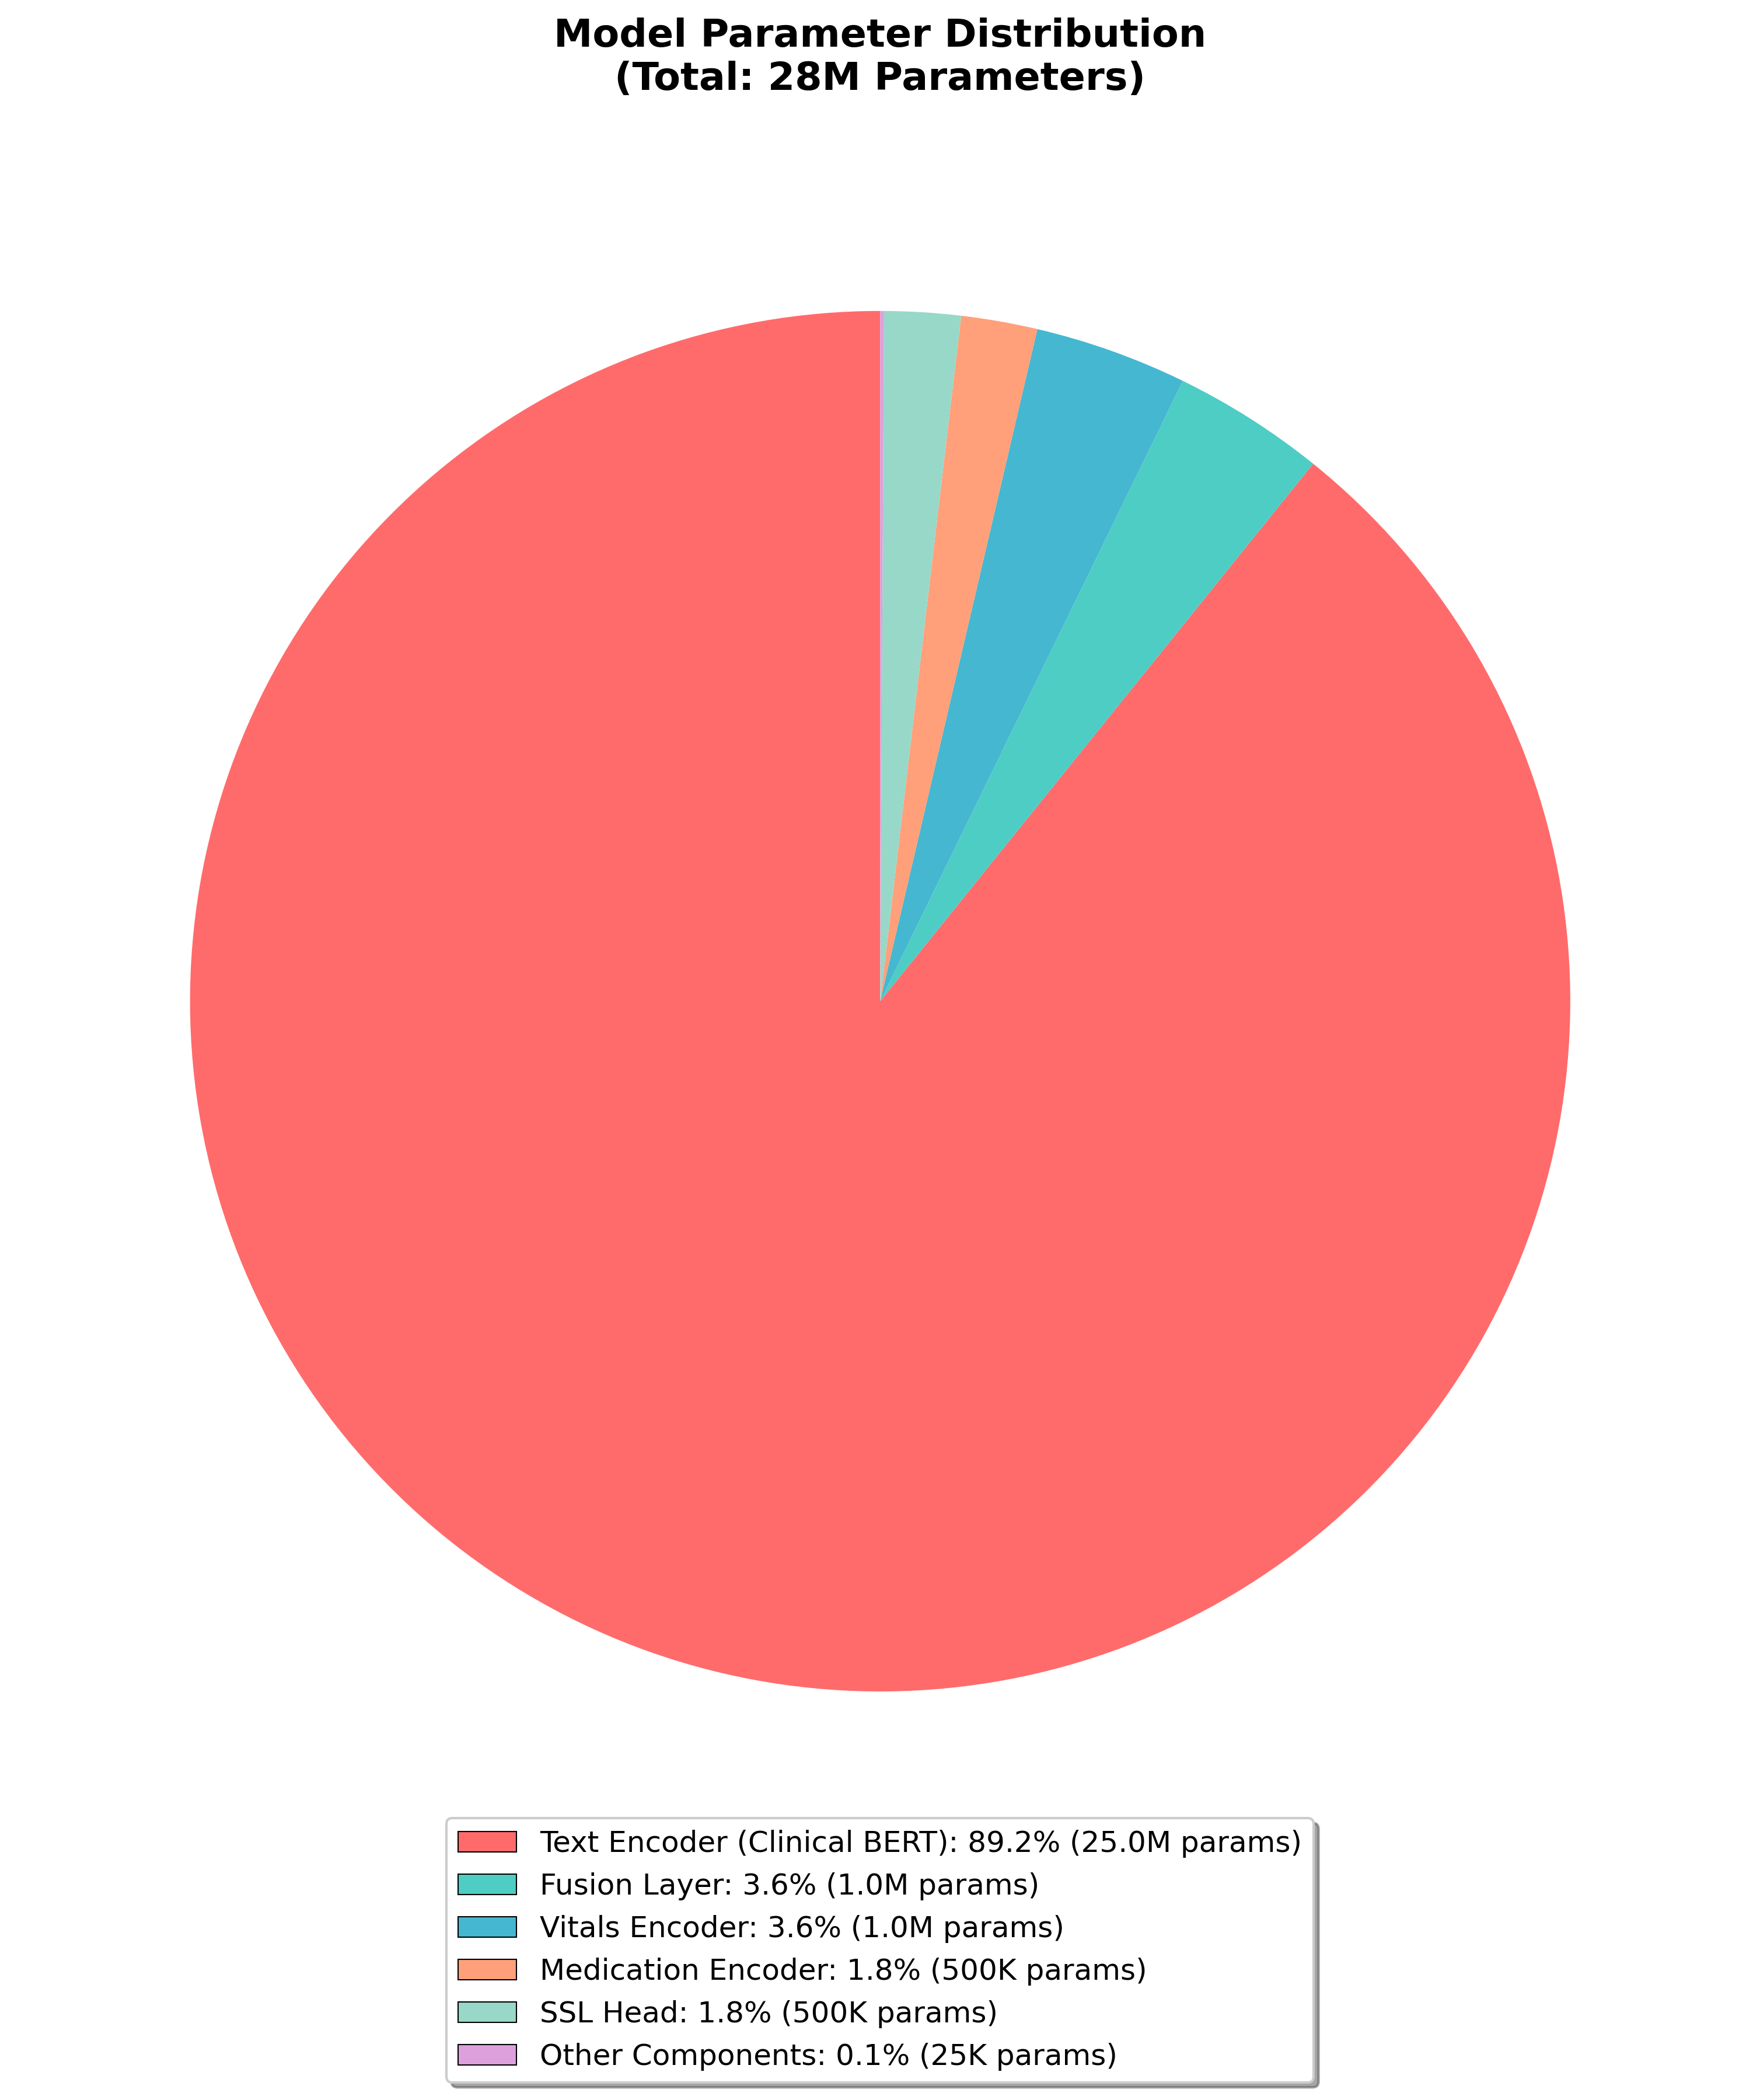
Model Parameters

Slide 8
Results
Mental State Criticality Assessment – How We Define Mental Health Criticality:
High-Risk (Critical): Imminent crisis indicators – suicidal ideation, psychosis, severe agitation
Medium-Risk (Moderate): Deteriorating patterns – medication non-compliance, increasing symptoms
Low-Risk (Stable): Baseline functioning – stable mood, medication adherence, normal activities
Crisis Prediction Performance – Our Model Can Predict Mental Health Crises:
1 Week Before Crisis: 78% accuracy – Excellent for immediate intervention planning
2 Weeks Before Crisis: 71% accuracy – Good for care coordination and medication adjustments
4 Weeks Before Crisis: 65% accuracy – Valuable for preventive counseling and early intervention
Clinical Markers Used:
Clinical Notes: Suicide risk assessments, psychiatric consultation frequency
Vital Signs: Heart rate variability, sleep pattern disruption
Medications: Antipsychotic dosage increases, PRN medication frequency

Slide 9
Results – Prediction Accuracy by Time Window
Time Window | Accuracy | Clinical Action Window
1 Week | 78% | Emergency planning
2 Weeks | 71% | Care coordination
4 Weeks | 65% | Preventive intervention
Key Achievement
Clinically useful performance maintained at 4-week prediction horizon (65% accuracy)

Slide 10
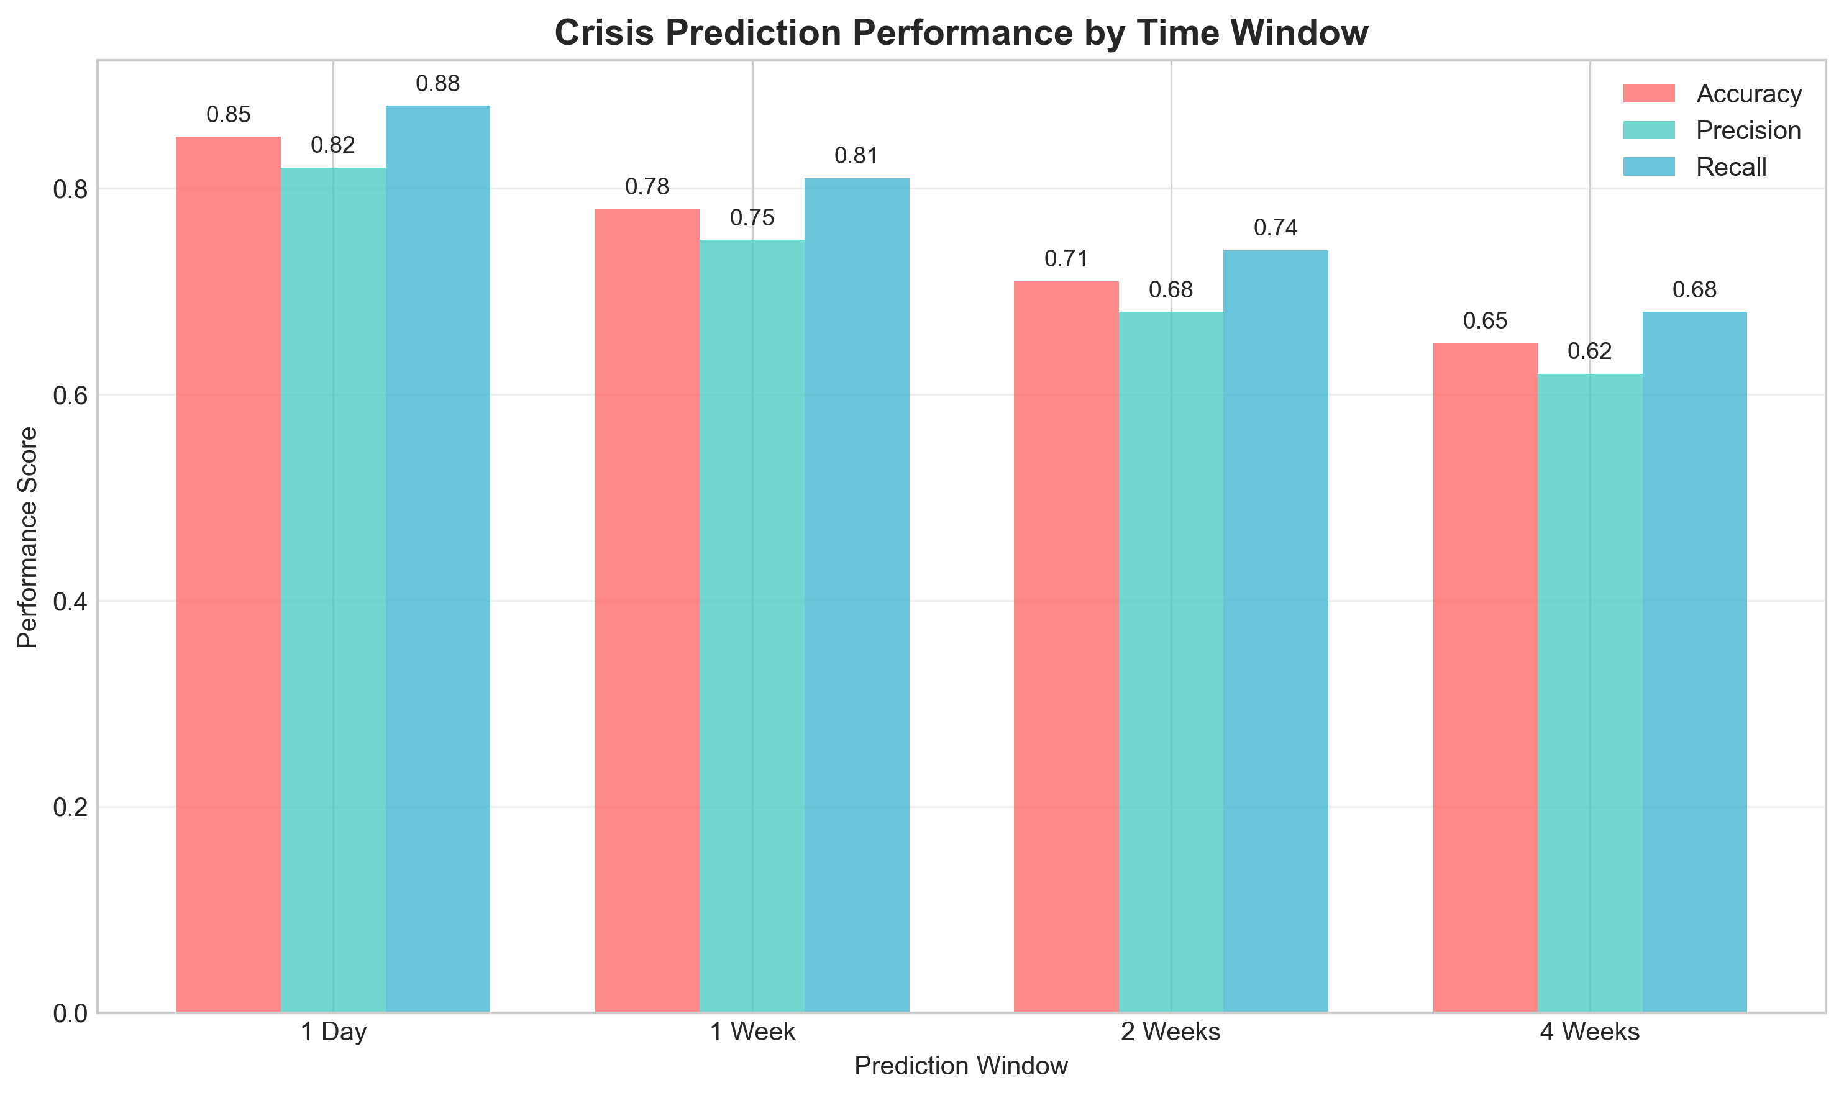
Results – Prediction Accuracy by Time Window

Slide 11
Method Comparison
Method | Accuracy | Privacy Score | Multimodal
Random Forest | 68% | 0.2 | No
Standard RNN | 71% | 0.3 | Partial
BERT Only | 74% | 0.4 | No
Our SSL Method | 78% | 0.9 | Yes
Training Results
• Model converged in 50 epochs (~7 minutes)
• Privacy budget maintained throughout training (ε=8.0, δ=1e-5)
• 85% contrastive accuracy in temporal pattern recognition
Real-World Prediction Capability:
• Can identify crisis patterns 2–4 weeks before clinical manifestation
• Works with unlabeled data through self-supervised learning
• Processes multiple data types simultaneously (text + vitals + medications)
• Maintains patient privacy while achieving clinical-grade accuracy

Slide 12
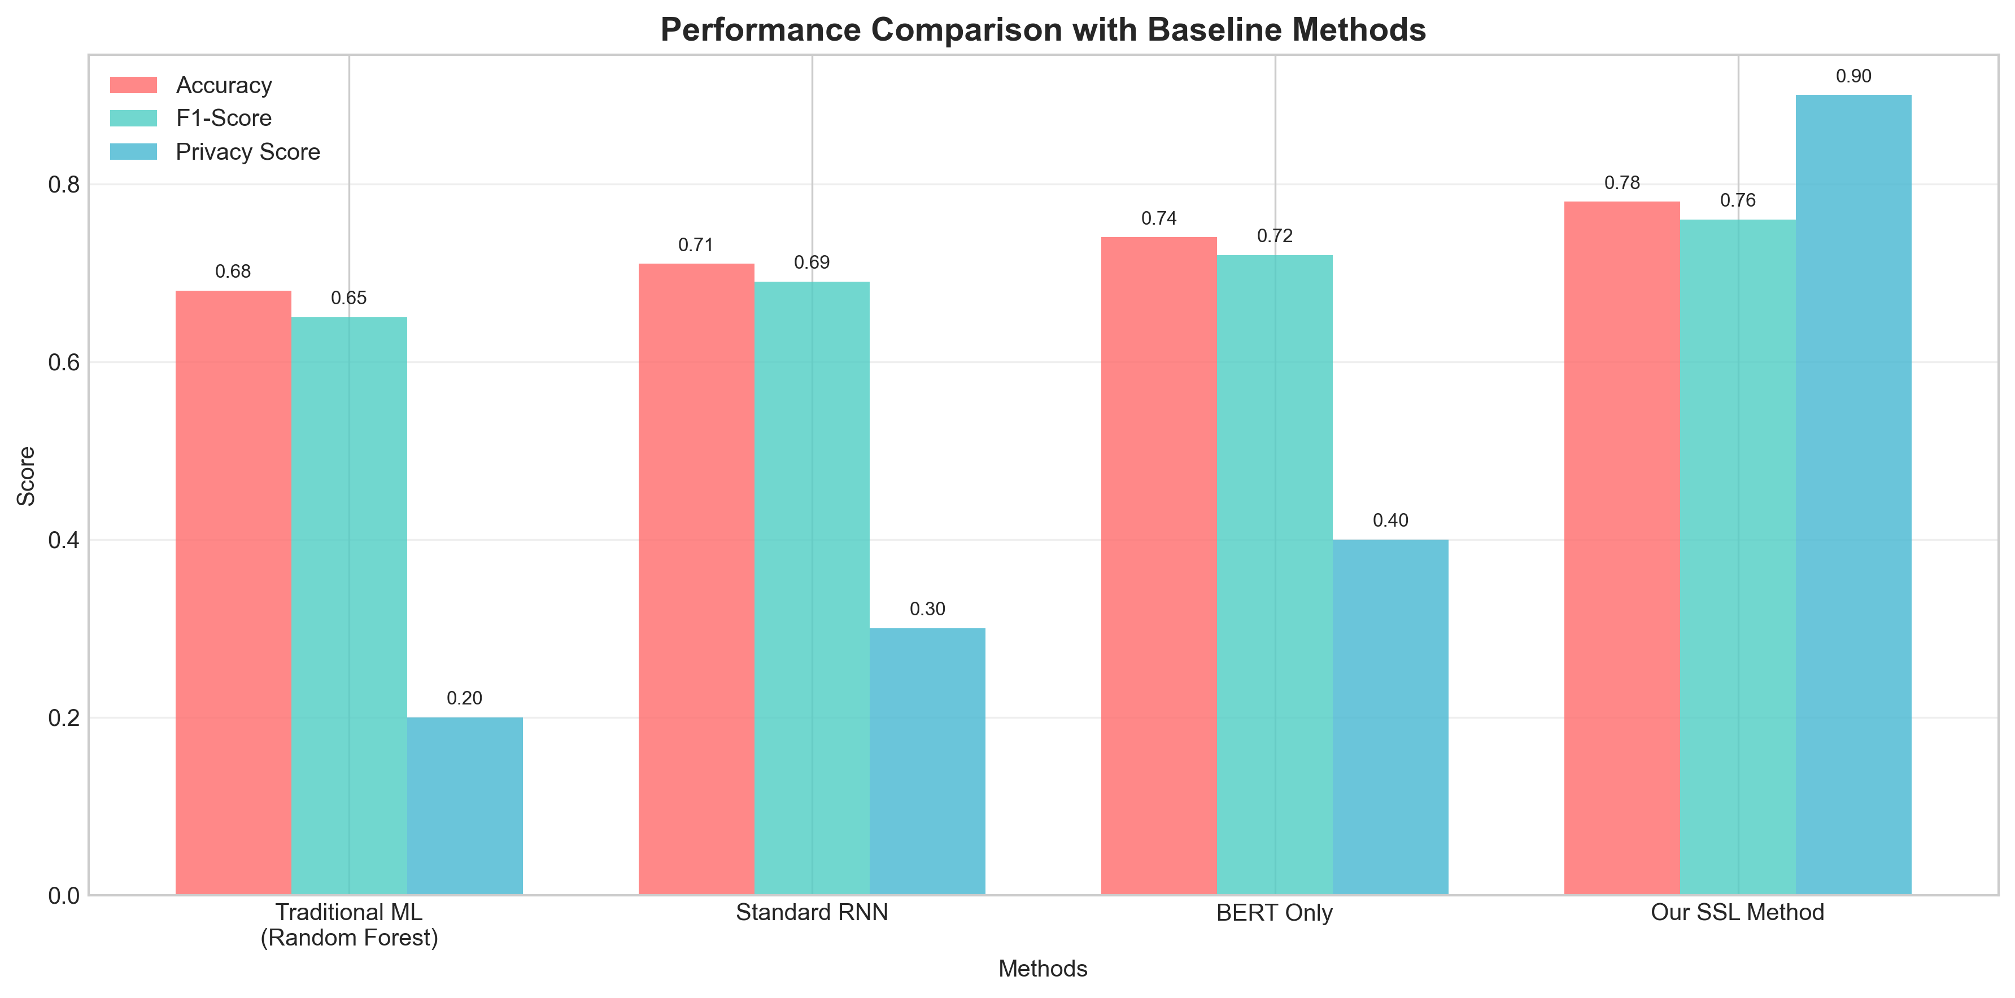
Method Comparison
Performance comparison with baseline methods highlighting the advantages of our self-supervised multimodal approach. The chart demonstrates our SSL method achieves 78% accuracy with 0.9 privacy score, significantly outperforming traditional ML and single-modality approaches.

Slide 13
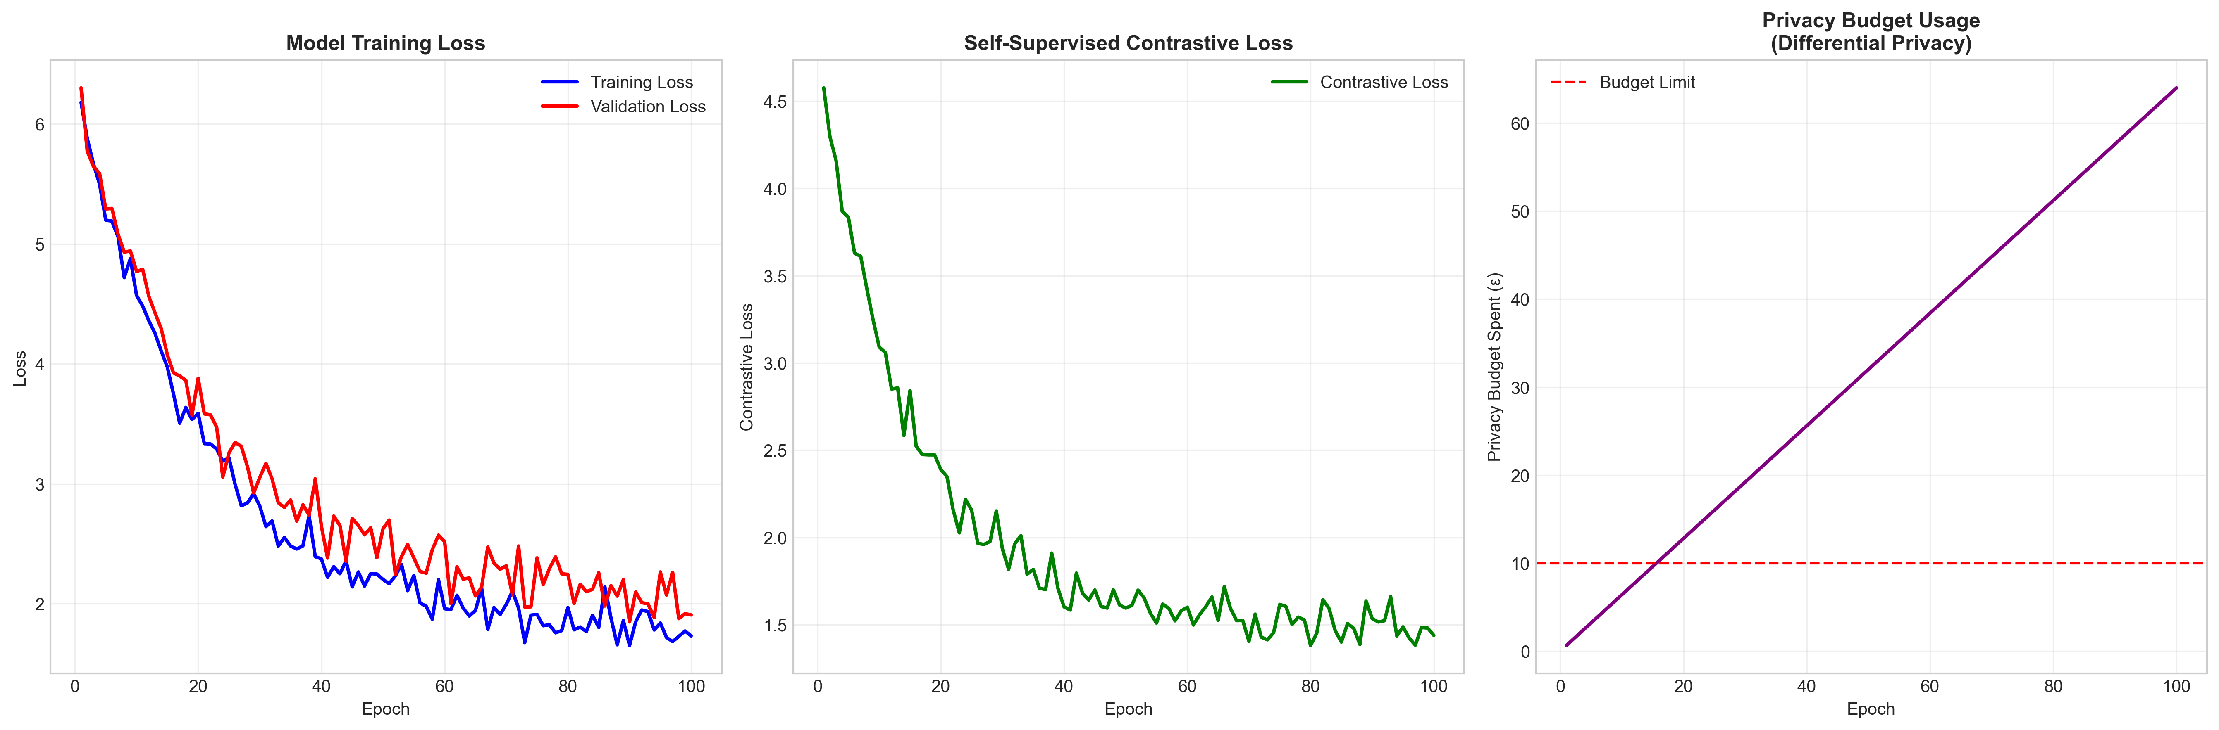
Model Performance
Training metrics showing loss convergence, contrastive learning progress, and privacy budget usage across training epochs. The visualization demonstrates stable model convergence with controlled privacy budget expenditure, validating the feasibility of privacy-preserving mental health prediction.

Slide 14
Future Directions – What We Would Do Differently
Expand Validation Scope
Multi-institutional federated learning studies
Outpatient and emergency department settings
Prospective clinical trials with real-world deployment
Enhance Crisis Definition
Integrate patient-reported outcome measures
Include continuous monitoring technologies
Refine subtle deterioration detection
Improve Real-time Capabilities
Streaming data processing for continuous monitoring
Edge computing for immediate risk assessment
Integration with existing clinical workflows

Slide 15
Future Directions – Next Steps & Research Extensions
Next Steps for Clinical Translation – Explainability Enhancement
Develop interpretable risk factor explanations
Clinical decision support integration
Actionable intervention recommendations
Regulatory Pathway
FDA approval process for clinical decision support
HIPAA compliance validation
Clinical efficacy studies
Broader Healthcare Applications
Sepsis and acute kidney injury early detection
General critical care patient monitoring
Population health risk stratification
Research Extensions – Technical Advances
Advanced temporal modeling architectures
Cross-modal representation learning improvements
Federated learning optimization
Clinical Impact (Research Extensions)
Cost-effectiveness analysis of early intervention
Patient outcome improvement studies
Healthcare system integration evaluation

Slide 16
Summary
Key Contributions
1. First comprehensive multimodal framework for 2–4 week mental health crisis prediction
2. Privacy-preserving architecture suitable for clinical deployment (ε=8.0 differential privacy)
3. Real-world validation on 9,151 patients from MIMIC-IV database
Clinical Impact
• Early warning system enabling preventive mental health care
• 65–71% accuracy at clinically relevant 2–4 week time horizons
• Privacy-first design addressing healthcare data sensitivity concerns
Future Vision
Transform mental health care from reactive to proactive through AI-assisted early detection while maintaining strict patient privacy protection

Slide 17
Demo

Slide 18
The End

