Slide 1
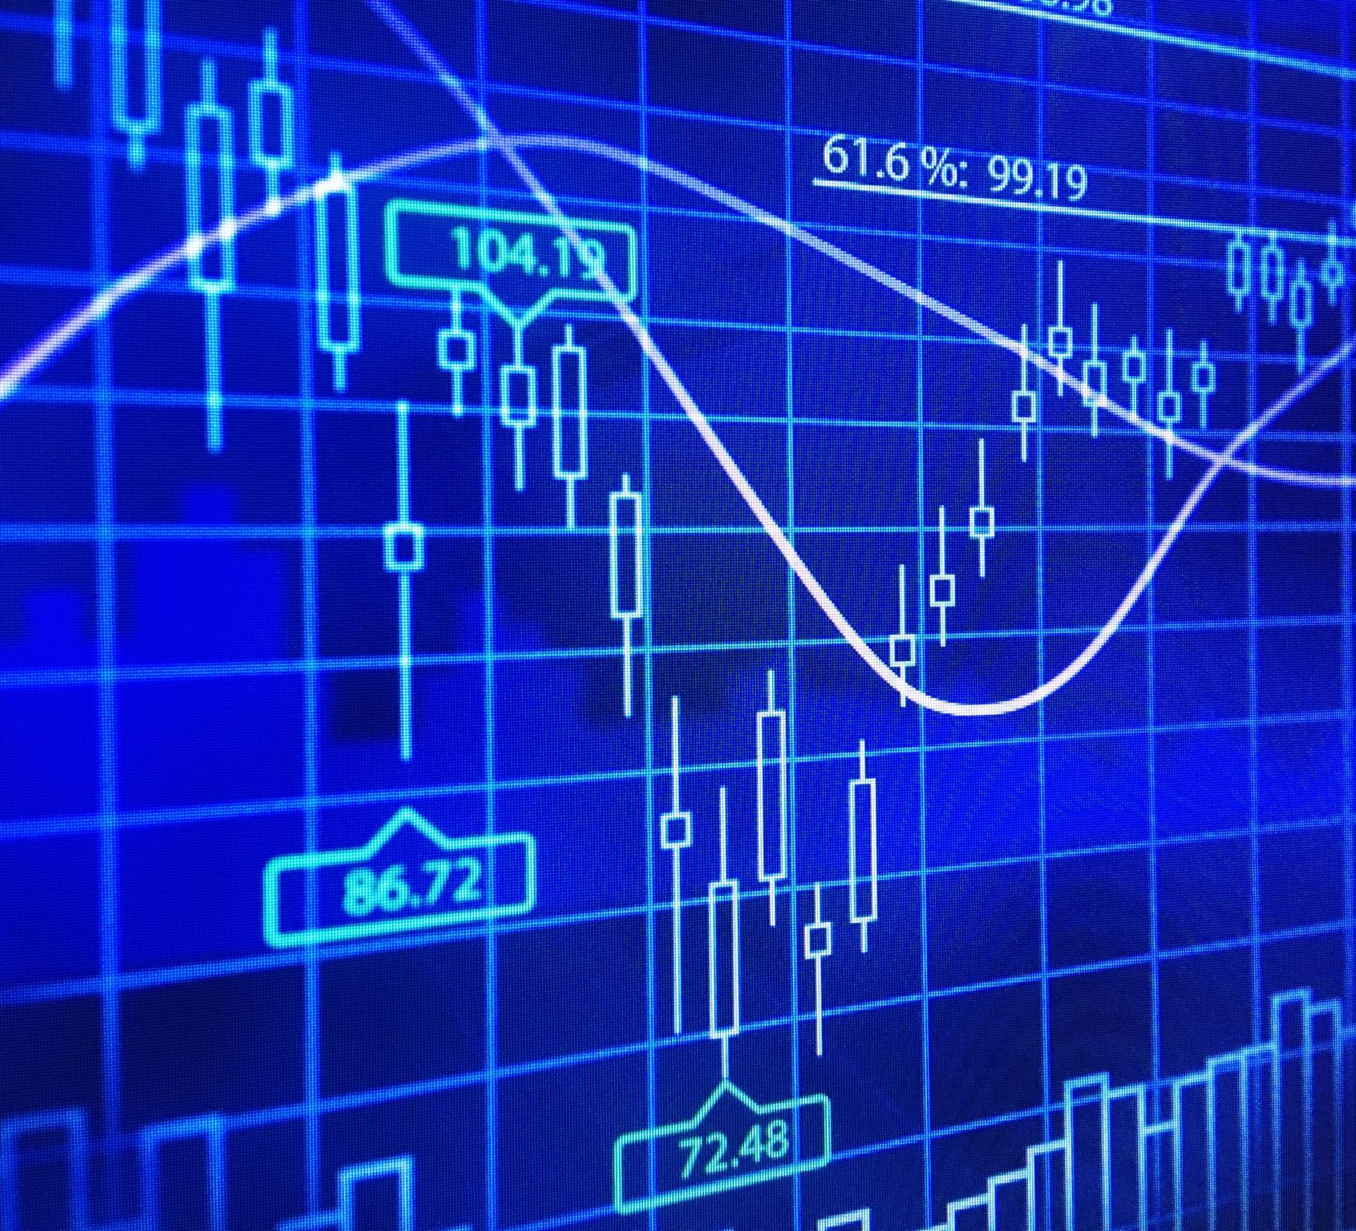
Standard & Poor 500 Stock Market Trend & Risk Prediction Using Machine Learning
Group5_Cohor1
Team Members:
Raghad |Qusy | Ghufran | Sajeda | Tasneem

Slide 2

Problem Statement & Scope
Problem Statement: Global financial markets (such as the S&P 500 index) are characterized by sharp and random price fluctuations driven by economic factors and investor sentiment. This makes price direction prediction extremely difficult and carries high risks of financial loss.
Scope & Limitations: Although stock markets are influenced by macro-level factors (such as macroeconomic indicators, interest rates, political news, and corporate earnings), this project focuses in its current phase on building a predictive model based on historical price action, trading volume, and technical indicators derived from them as a baseline, leaving room for future expansion to include macroeconomic variables.

Slide 3
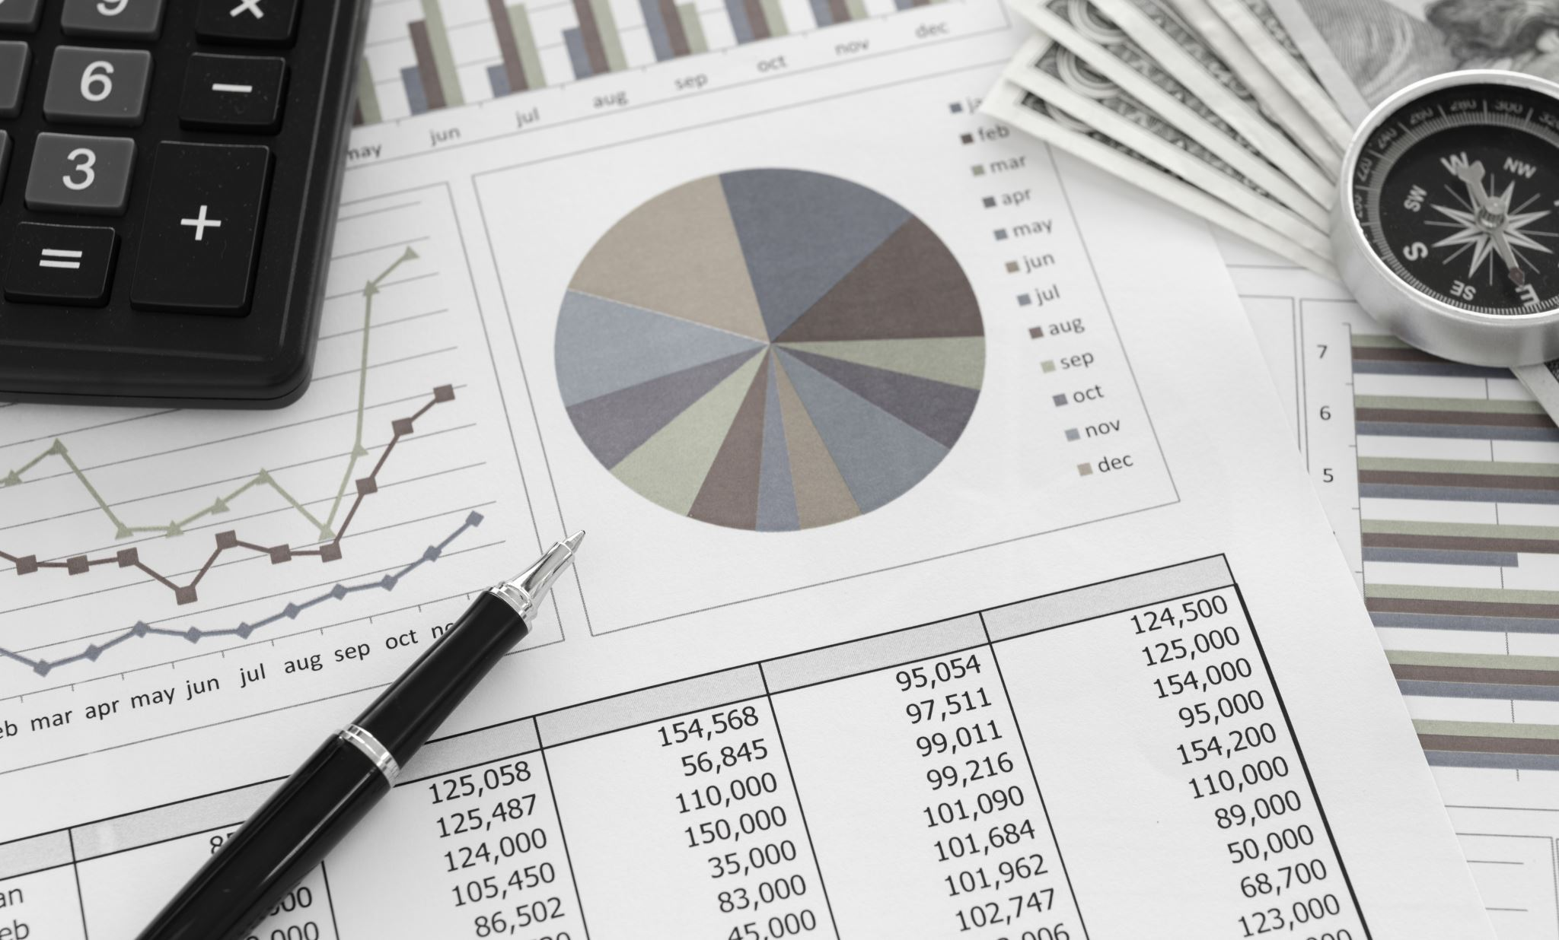
Significance & Objectives
Project Significance: Providing proactive, data-driven insights to minimize risks and financial losses for investors instead of relying purely on human intuition.
Model Objectives & Outcomes:
Engineering a Target Variable to predict the price direction of the next trading session (Up vs. Down).
Assisting investors in reducing the risk of capital loss through data-backed trading decisions.

Slide 4
Dataset Detailed Breakdown
date: Represents the trading session day; used for time-series ordering, tracking gaps, and handling holidays.
open: The opening price of the stock at the sound of the opening bell in the morning.
high / low: The maximum and minimum prices reached by the stock during the session, reflecting buying and selling pressure.
close: The final closing price, which is considered the most crucial and widely used column for mathematical and financial analysis.
volume: The total quantity of shares traded, measuring market liquidity and momentum.
Name: The company ticker symbol used to separate and classify data across hundreds of corporations.

Slide 5
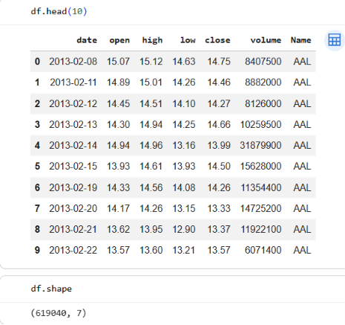
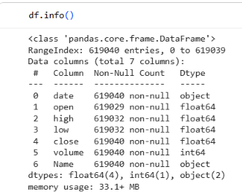
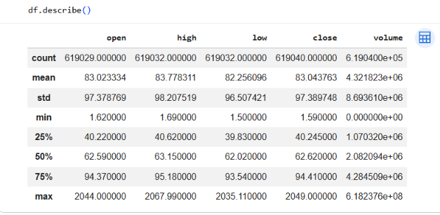
Code Execution & Outputs:

Slide 6

Thank You

