Slide 1
Welcome
To
Project Overview

Slide 2
Stock Management System

Slide 3
At a Glance
Maintains an optimal stock level
Track goods during transport between locations
Receive new items
Manage warehouse processes such as picking, packing, and shipping
Ensure products are never out of stock.
Report Publishing: Daily, Weekly, Monthly

Slide 4
Project Overview : Stock Management System
Name of Project: Stock Management System
Language used: PHP
Used Database: My SQL
Design Interface: HTML, CSS, Bootstrap, JavaScript, Ajax, jQuery
Browser: Opera/Mozilla/Google Chrome/ IE8,
Software: WAMP/ XAMPP/ LAMP/MAMP/Web Hosting

Slide 5
Features of Stock Management System
Add Items
Update Items
Insert New Items
Monitor Stock
Change Password
View In/Out items
Report Publishing

Slide 6
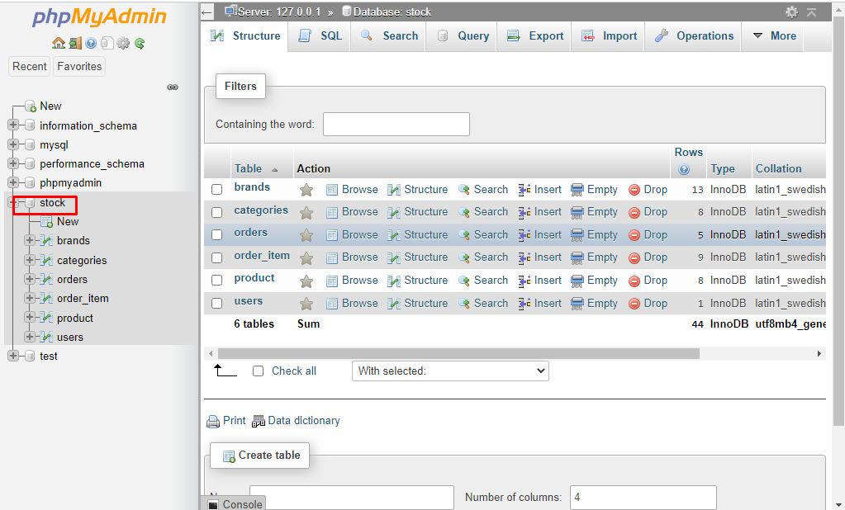
Database:

Slide 7
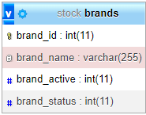
Database Table Structure: Brand

Slide 8
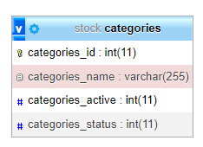
Table Structure: Categories

Slide 9
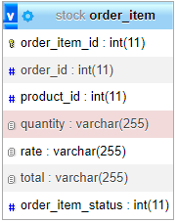
Table Structure: Order_item

Slide 10
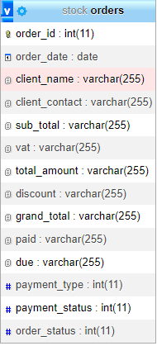
Table Structure: Order

Slide 11
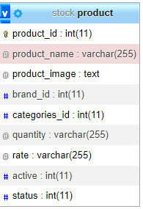
Table Structure: Product

Slide 12
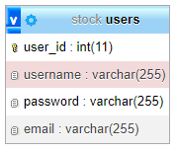
Table Structure: User

Slide 13
Table Structure: User

Slide 14
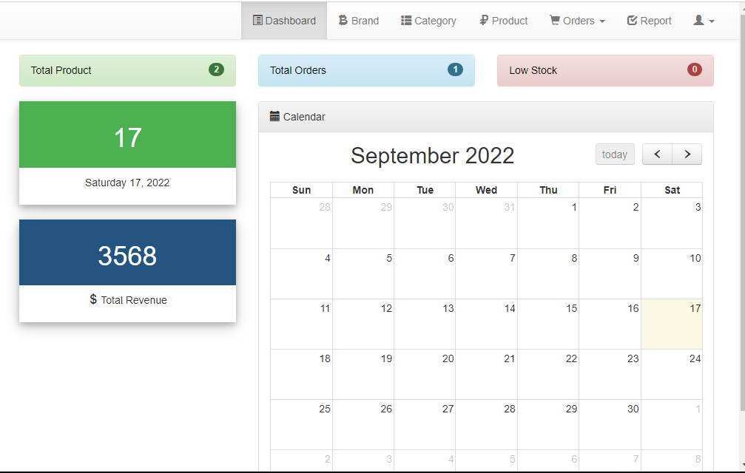
Admin Page:

Slide 15
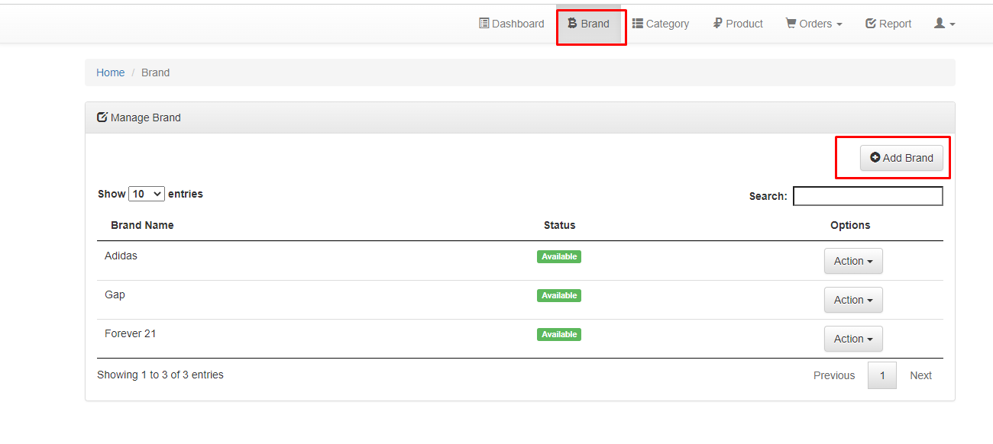
Admin Page:

Slide 16
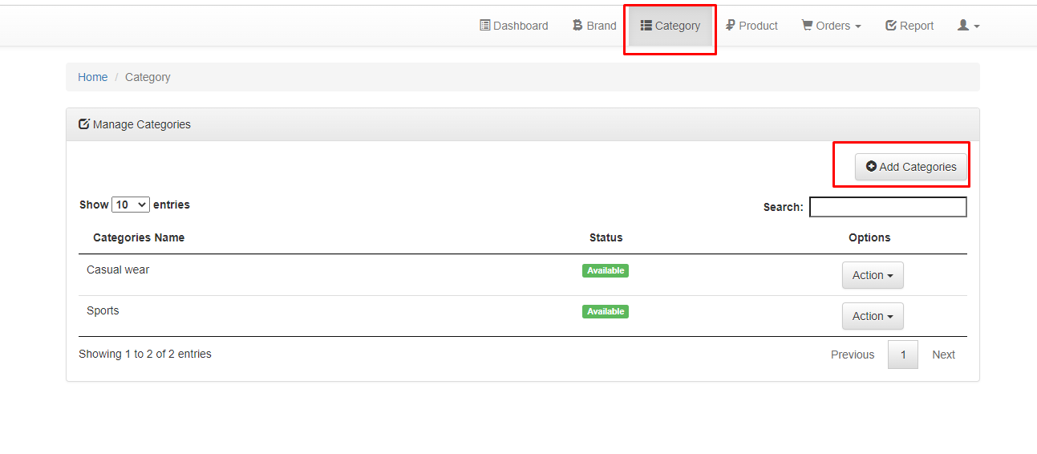
Admin Page:

Slide 17
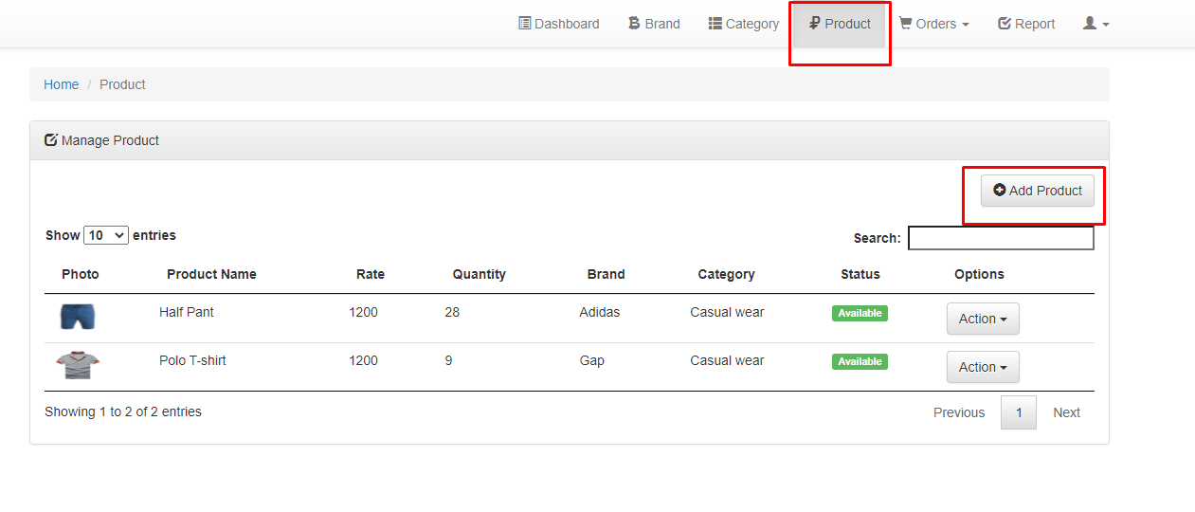
Admin Page:

Slide 18
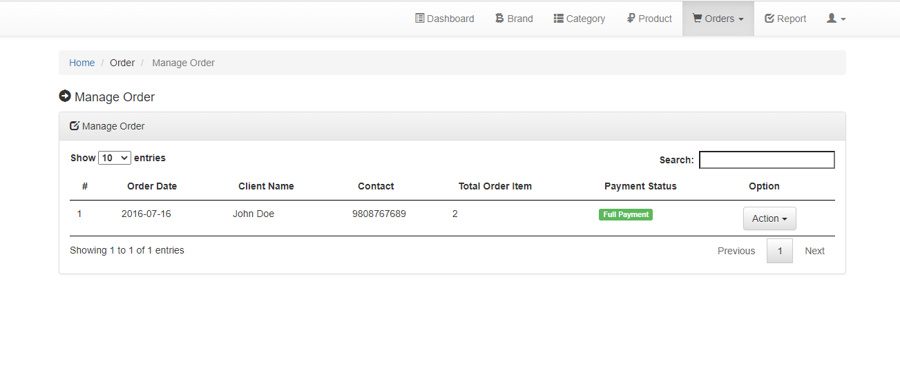
Admin Page:

Slide 19
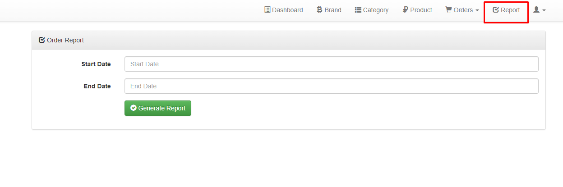
Admin Page:

Slide 20
Thank You

