Slide 1
Unveiling Personality Traits through Bangla Speech using Morlet Wavelet Transformation and Soft-Voting Classifier
Thesis Student
Md. Sajeebul Islam Sk.
Student Id: 22366027
MSc in CSE Program
Supervisor
Dr. Md. Golam Rabiul Alam
Department of Computer Science & Engineering
BRAC University

Slide 2
Presentation Outline
Introduction
Existing Works
Research Gaps
Research Objective
Research Contributions
Methodology
Result Analysis
Conclusion
References

Slide 3

Introduction what is personality?
Fingerprint of our inner selves
Personality remains dynamic
Speech potent medium for expression
Necessity of Personality
Picture from Google

Slide 4
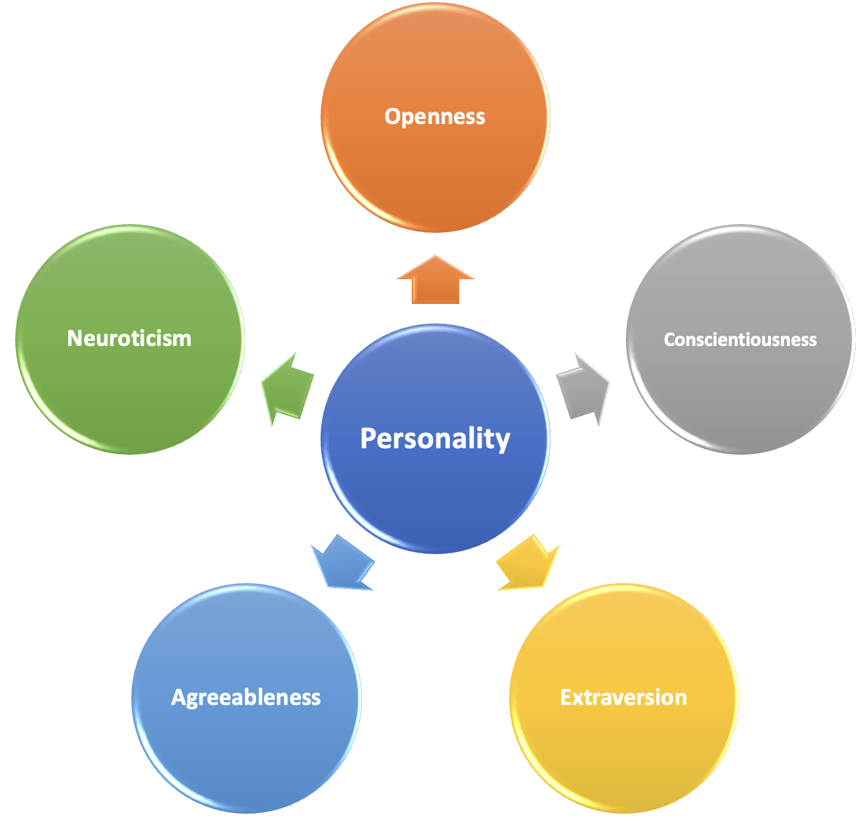
Introduction (1)
Personality types (Big-Five)
- agreeableness : cooperative, compassionate, and polite
- conscientiousness : organized, disciplined, and goal-oriented
- extroversion : sociable, outgoing, and energetic
- neuroticism : emotionally stable, confident, and calm
- openness : open-minded, curious, and imaginative

Slide 5
Introduction (2)
Agreeableness example
১৯৮০ এর দশকে বিল গেটস প্রতিষ্ঠিত মাইক্রোসফট এ মেলিন্ডা গেটস যুক্ত হলে দুজনের মধ্যে পরিচয় হয় এবং পরবর্তীতে তারা একত্রে গড়ে তোলেন, গেটস ফাউন্ডেশন
Conscientiousness example
বঙ্গবন্ধুর ভাষণের কিছু অংশ ব্যাখ্যা করলে দেখা যায়, তিনি সেদিন যুদ্ধের ঘোষণা যেমন পরোক্ষাভাবে প্রদান করেন- আবার যুদ্ধে কীভাবে জয়ী হতে হবে সে ব্যাপারেও দিকনির্দেশনা দেন
Extroversion example
নব উন্মাদনা ও উদ্ভাবনা মুখরতায় পুরানো বৃত্ত ভেঙে নতুন অভিমুখে তাঁর কারার ঐ লৌহ কপাট ভেঙে ফেল, কর রে লোপাট রক্ত-জমাট শিকল পূজার পাষাণ বেদীতে তারুণ্যের প্রত্যাশা হয়ে ওঠে দীপ্র
Neuroticism example
দৃশ্যমান ভিড়ের বহুল্যতায় কোন এক নিভৃত প্রান্তের বিদায়ী মঞ্চে,সময় আজ বাজিয়ে দিলো বিদায়ের বাঁশি
Openness example
অন্ধকার যতই প্রকট হোক না কেন, নতুন ভোরে সূর্য তাঁর রোশনাই ছড়িয়ে দিয়ে হাসতে থাকে

Slide 6
Existing Works
Tim Phozel [1] refers events “speech base personality” in English and German Languages, uses the Big Five personality traits, extracted these features automatically using various tools, applies linear regression, support vector machines, and artificial neural networks
Hans Christian et al. [3] refers as “text base personality”, introduces a new prediction method using multi-model deep learning architecture combined with multiple pre-trained language models, such as BERT, RoBERTa, and XLNet. And achieve 91% f1 measure scores on Faebook datasets, and 88% f1 measure scores on Twitter datasets.
Utpal Rudra et al. [2] refers as text base personality classification based on Facebook and YouTube comments in Bangla Language and achieve 37% f1 measure scores on the dataset.

Slide 7
Research Gaps
As far we have studied, no prior work on Bangla speech base personality traits classification
Tim Phozel [1] utilize traditional Machine Learning model and statistical features. Therefore, their proposed model is unable to extract depth level discriminative features to successfully classify speech base personality traits.
Rudra et al. [2] utilize TF-IDF base feature extraction and deep learning models for text base personality traits classification. However, this research is unable to grab the semantic relationship among the words. Therefore, the results are not impressive.

Slide 8
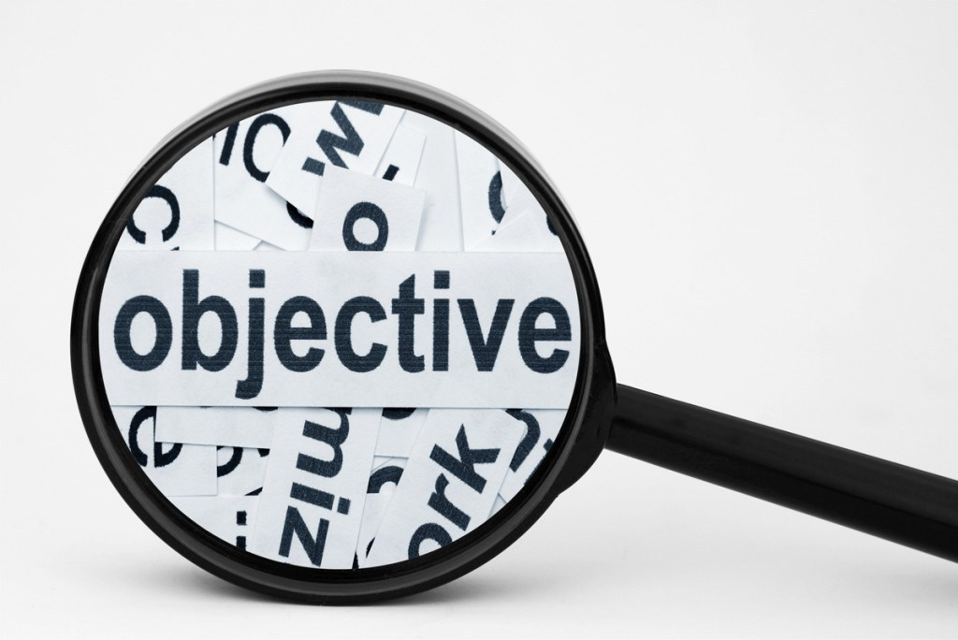
Research Objective
To propose a model for Bangla text base personality traits classification
To propose a model for Bangla speech base personality traits recognition
To prepare a dataset for Bangla text and speech personality traits

Slide 9
Research Contributions
The research presents a set of noteworthy contributions:
We proposed models for classifying personality traits based on the spoken Bangla language. As far as we are aware, there has been no prior work specifically focusing on personality classification using Bangla speech.
The absence of a pre-existing dataset tailored for personality detection from Bangla speech necessitated the creation of our own dataset.
We introduce Morlet base Feature extraction (MoMF)
We proposed DistilRo and BiG

Slide 10
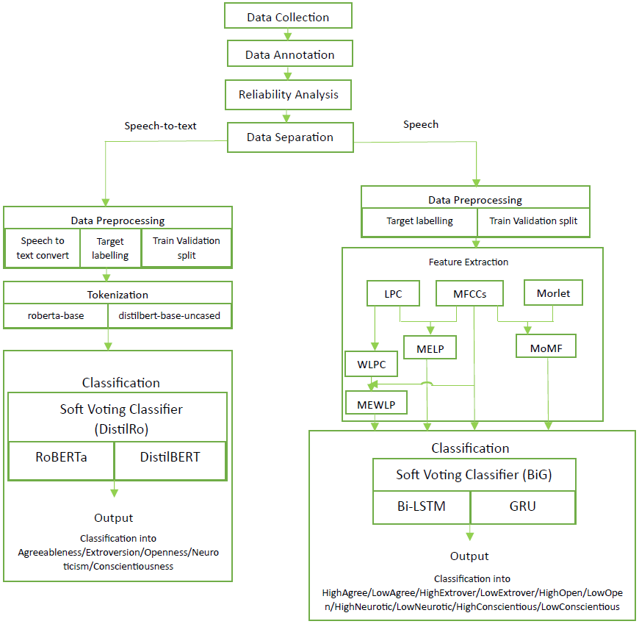
Methodology

Slide 11
Methodology(1)
Data Collection
- online Bangla newspapers & renowned Bangla novels
- enlisted graduate students from Bangla Depertment
- maintain correct semantic information
- 90% script from Bangla newspapers, 10% from Bangla novels

Slide 12
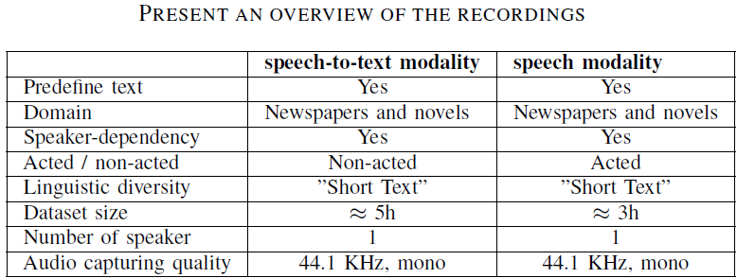
Methodology(2)
Data Collection
- speech-to-text modality
- non-professional speaker
- 5 personality profile
- 1750 recorded files
- speech modality (10 personality profile)
- 1000 recorded files
- 71% script form perdefine material to enact 10 distinct personality

Slide 13
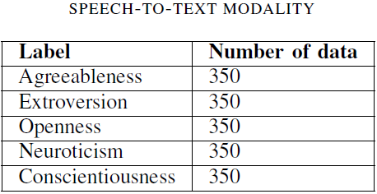
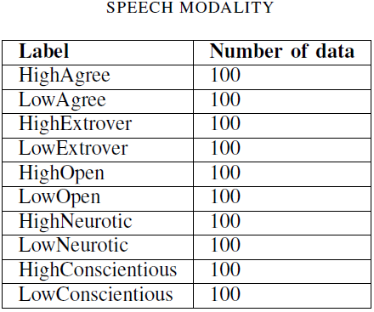
Methodology(3)
Data Annotation
- speech-to-text modality
- random audio files
- speech modality
- random audio files with NEO-FFI questionnaires

Slide 14
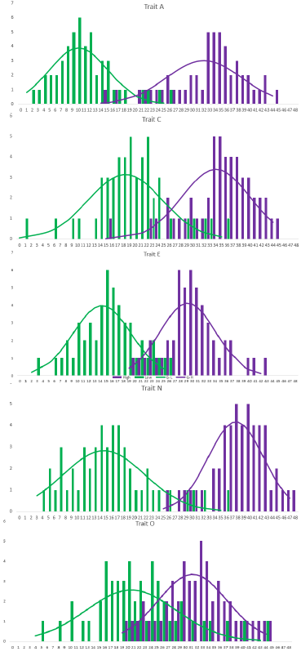
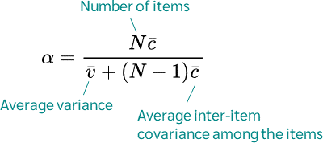
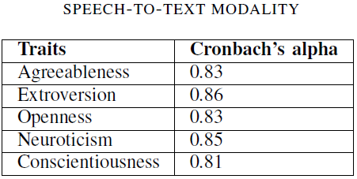
Methodology(4)
Reliability Analysis
- Cronbach’s alpha
- five-point Likert scale

Slide 15
Methodology(5)
Data Preprocessing
- audio to text convert (speech-to-text modality)
- in-built tokenizer DistilBertTokenizerFast
- in-built tokenizer RoBertaTokenizerFast
- labels of audio files were determined based on the directory structure
- 80% reserved for training data and 20% allocated for validation data

Slide 16
Methodology(6)
Feature Extraction
- four feature extraction techniques: MFCCs, MELP, MEWLP, and MoMF
Mel-frequency cepstral coefficients (MFCCs)
- captured a snapshot of the audio
- using Fourier Transform
- Mel scale
- using DCT to convert the information into a set of coefficients

Slide 17
Methodology(7)
Mel-Frequency Cepstral Coefficients with Linear Predictive Coding (MELP)
- perform feature level fusion
- describe the filter
- tries to predict the next sound sample based on previous samples
- concatenation of MFCCs and LPC
- MFCCs capture spectral features and intensity-related information, LPC delves into the vocal tract's characteristics

Slide 18
Methodology(8)
Mel-Frequency Cepstral Coefficients with Wiener Linear Predictive Coding (MEWLP)
- Winere filter designed to minimize mean square error
- used for noise reduction in signals
- concatenate WLPC coefficients of the denoised signal with MFCCs to obtain feature vector

Slide 19


Methodology(9)
Morlet-based Mel-frequency Cepstral Coefficients (MoMF)
- introduce a new feature extraction technique
- Morlet low pass filter of the Morlet wavelet that retains the low-frequency information in the analysis of time-frequency representations of signals
- we can define the Morlet wavelet formula:
- convolution operation:

Slide 20



Methodology(10)
Morlet-based Mel-frequency Cepstral Coefficients (MoMF)
- Fast Fourier Transform (FFT) to compute the magnitude spectrum (x[j]) of the filtered signal
- Mel filterbank is applied
- applies a logarithmic compression to the Mel spectrum:
- DCT (Discrete Cosine Transform) is applied to the log compressed energies to obtain the feature
vector:
- concatenate with MFCC:

Slide 21
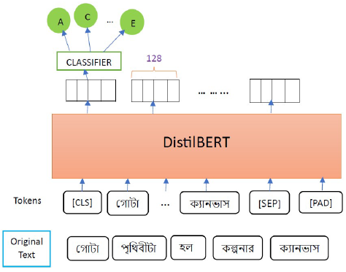
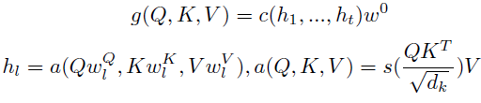


Model(1)
DistilRo : Soft Voting Ensemble Models for Personality Classification in Speech-to-Text Modalities
- Ensemble learning models leverage the decisions made by various baseline models to enhance overall performance
- DistilRo is a soft voting classifier that combines the strengths of DistilBERT and RoBERTa baseline models
- DistilBERT

Slide 22
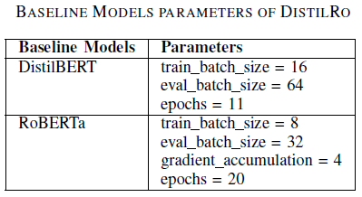
Model(2)
DistilRo : Soft Voting Ensemble Models for Personality Classification in Speech-to-Text Modalities

Slide 23
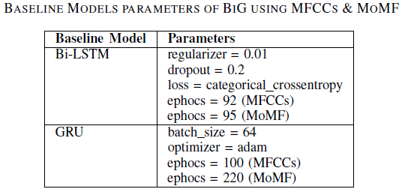
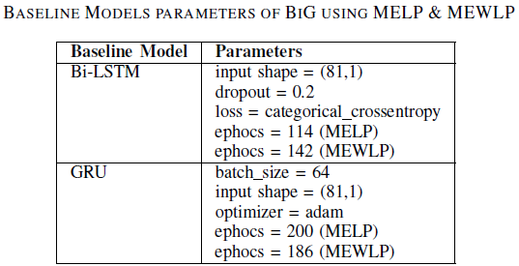
Model(3)
BiG : Soft Voting Ensemble Models for Personality Classification in Speech Modalities
- BiG model is a sophisticated soft voting classifier, bringing together the two baseline models: Bi- LSTM and GRU
- prevent overfitting use l2 regularizer and also use early stopping

Slide 24
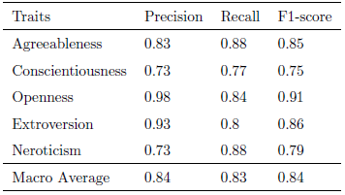
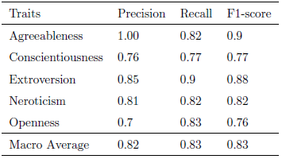
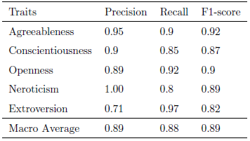
Experimentation(1)
Personality Traits Classification using DistilRo

Slide 25
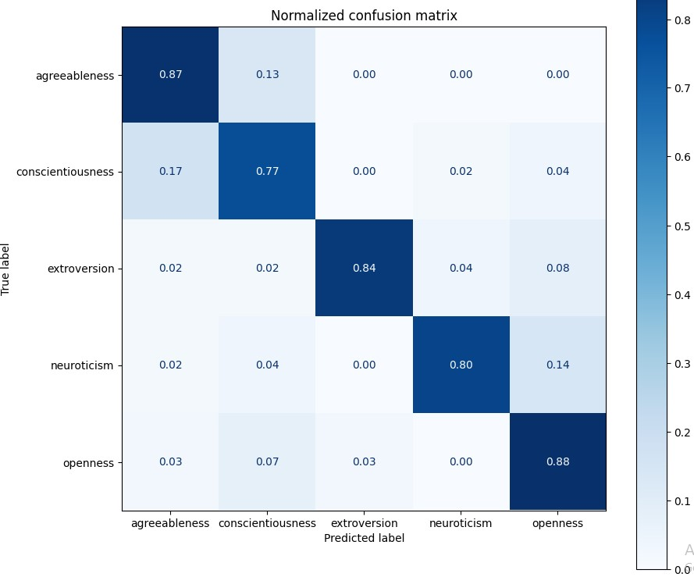

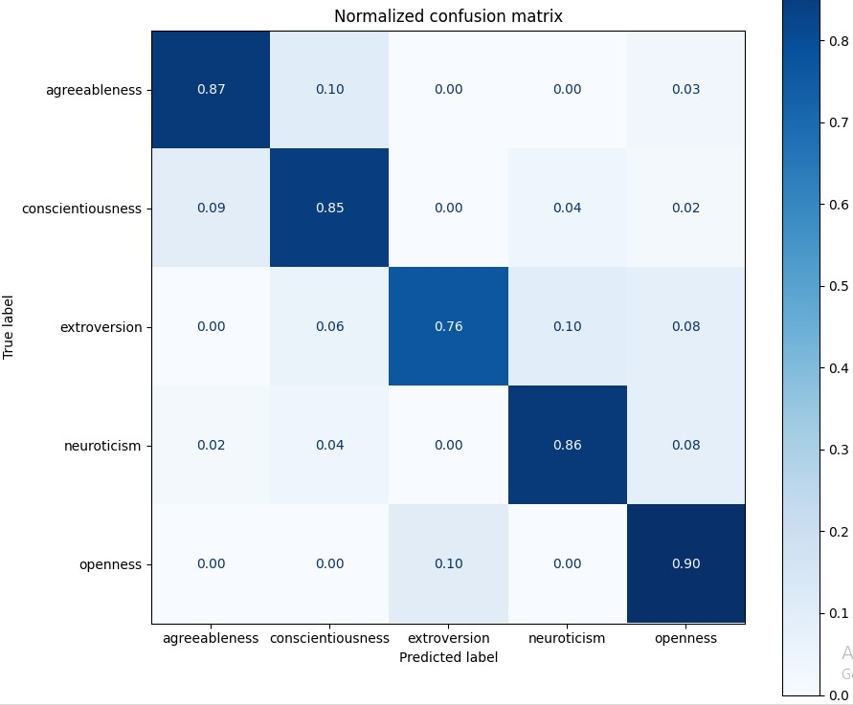
Experimentation(2)
Personality Traits Classification using DistilRo
RoBERTa Classification Results
DistilBERT Classification Results
Proposed DistilRo Classification Results

Slide 26
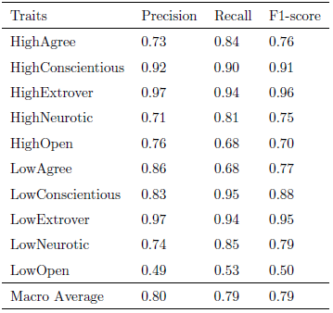
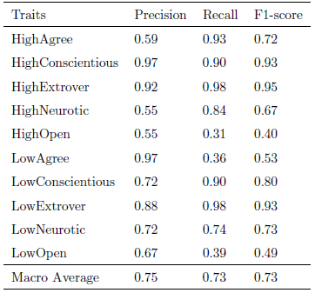
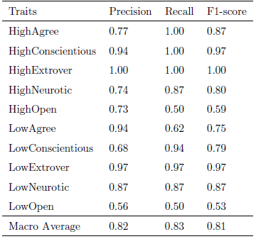
Experimentation(3)
Personality Traits Classification using BiG
MFCCs base findings
Bi-LSTM Classification Results
GRU Classification Results
Proposed BiG Classification Results

Slide 27
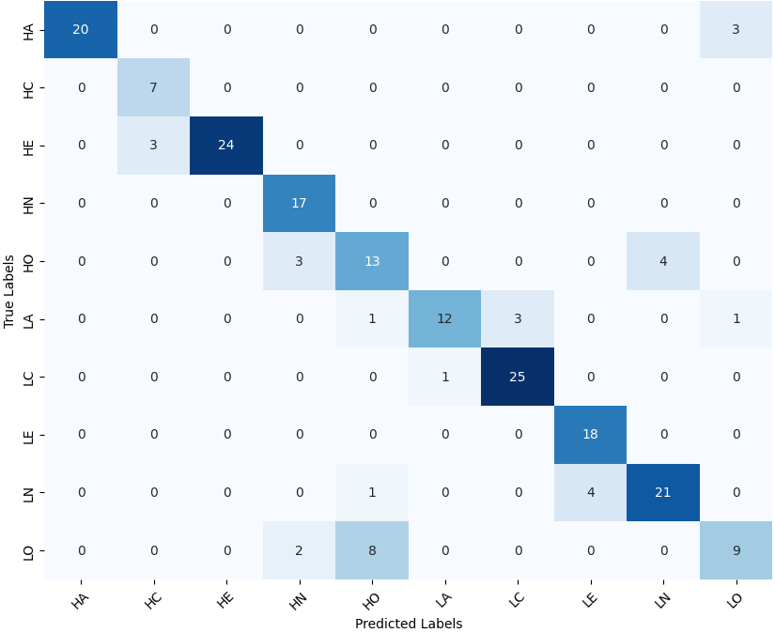
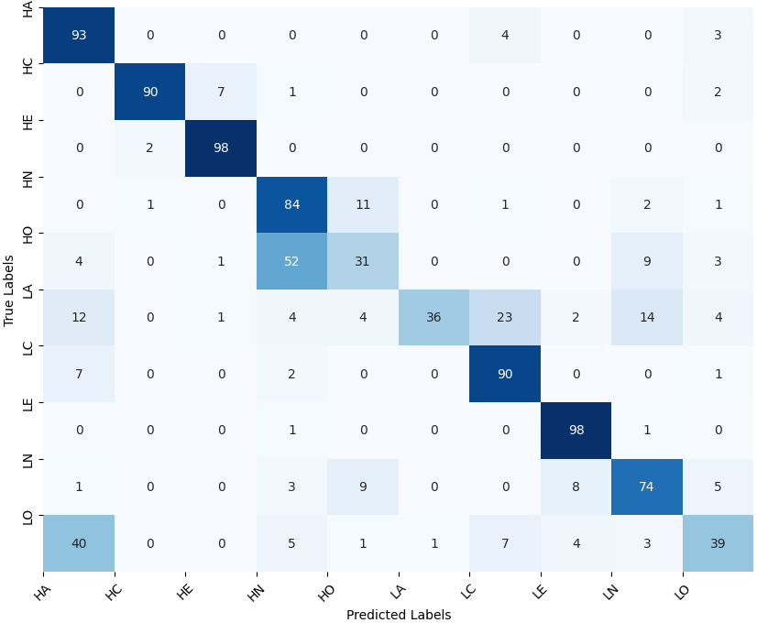
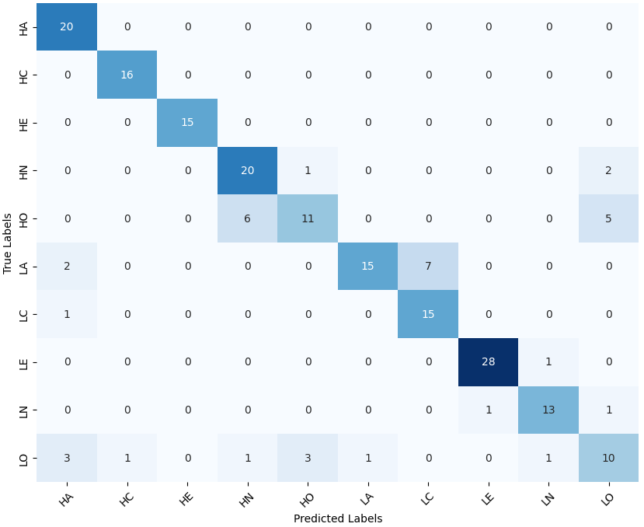
Experimentation(4)
Personality Traits Classification using BiG
MFCCs base findings
Bi-LSTM Classification Results
GRU Classification Results
Proposed BiG Classification Results

Slide 28
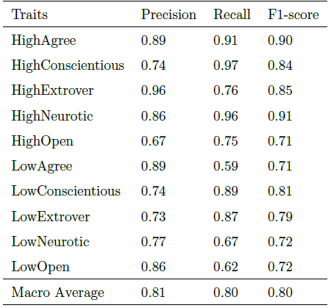
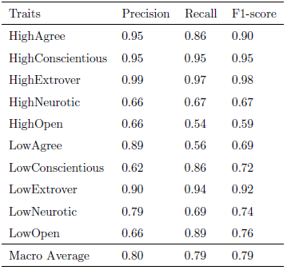
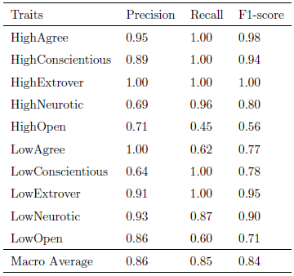
Experimentation(5)
Personality Traits Classification using BiG
MoMF base findings
Bi-LSTM Classification Results
GRU Classification Results
Proposed BiG Classification Results

Slide 29
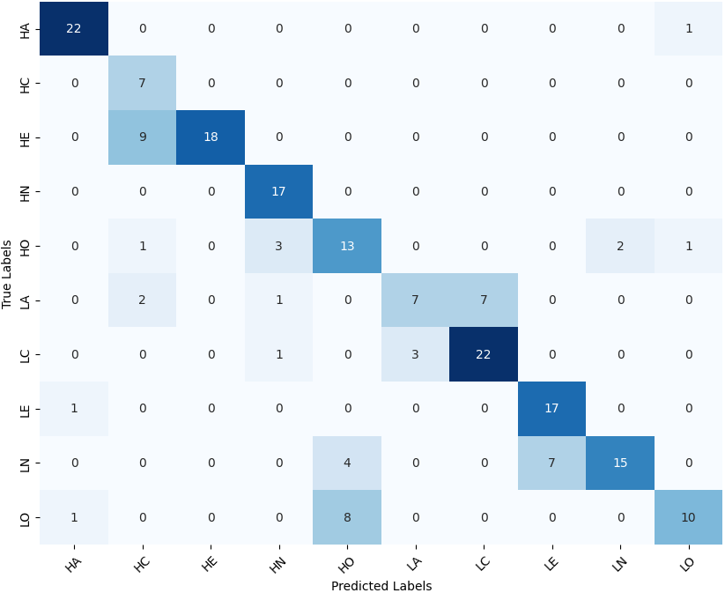
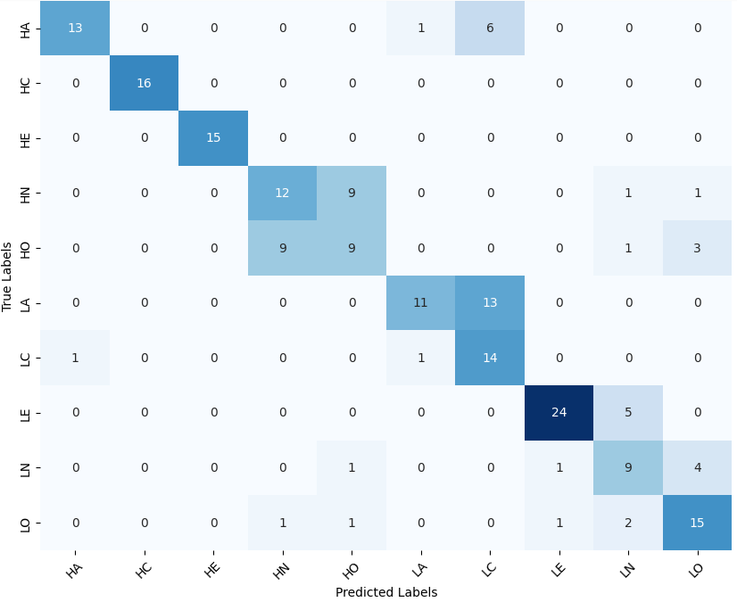
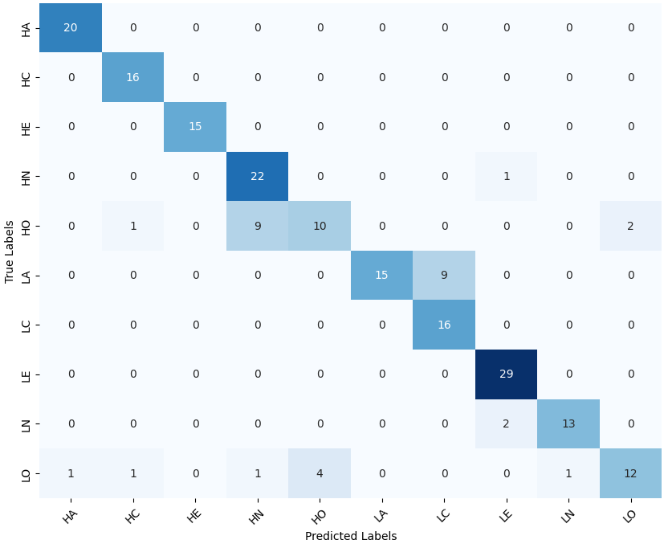
Experimentation(6)
Personality Traits Classification using BiG
MoMF base findings
Bi-LSTM Classification Results
GRU Classification Results
Proposed BiG Classification Results

Slide 30
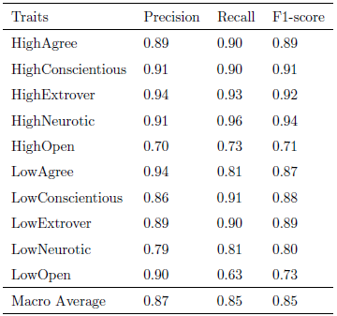
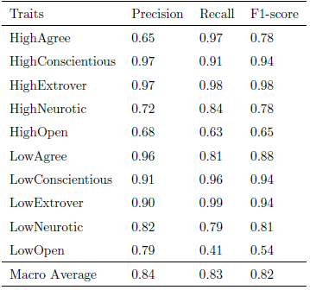
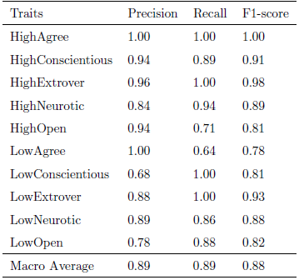
Experimentation(7)
Personality Traits Classification using BiG
MELP base findings
Bi-LSTM Classification Results
GRU Classification Results
Proposed BiG Classification Results

Slide 31
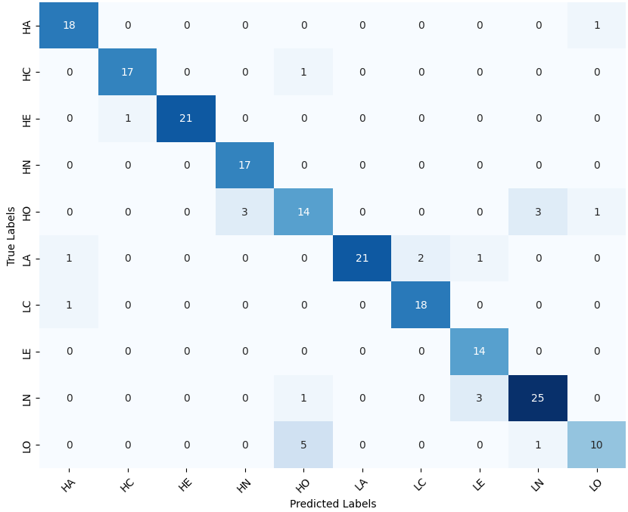
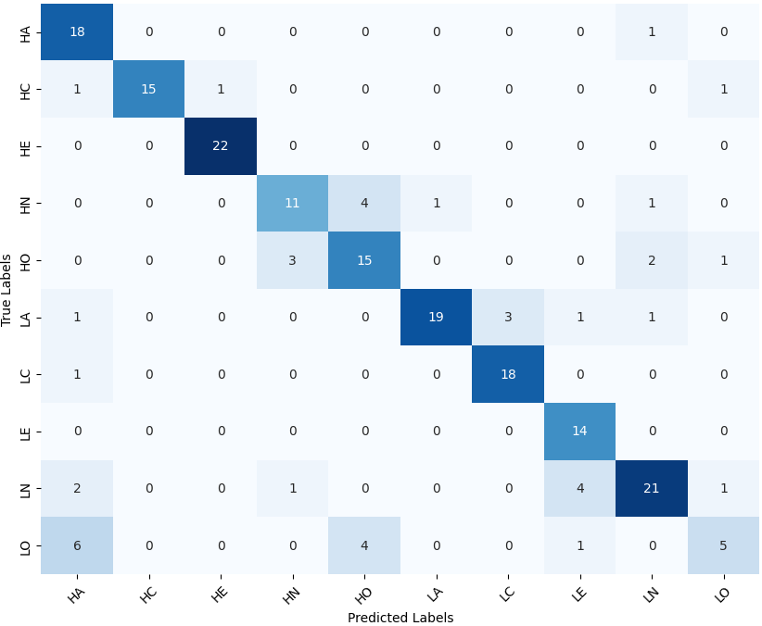
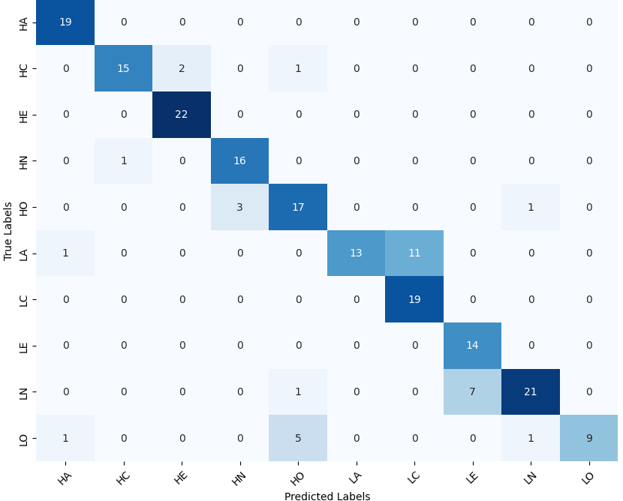
Experimentation(8)
Personality Traits Classification using BiG
MELP base findings
Bi-LSTM Classification Results
GRU Classification Results
Proposed BiG Classification Results

Slide 32
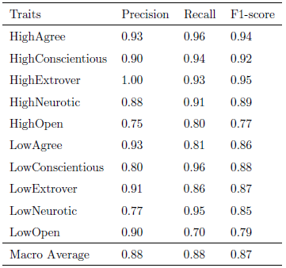
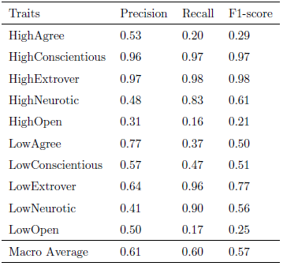
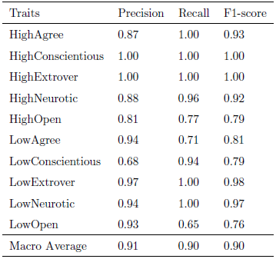
Experimentation(9)
Personality Traits Classification using BiG
MEWLP base findings
Bi-LSTM Classification Results
GRU Classification Results
Proposed BiG Classification Results

Slide 33
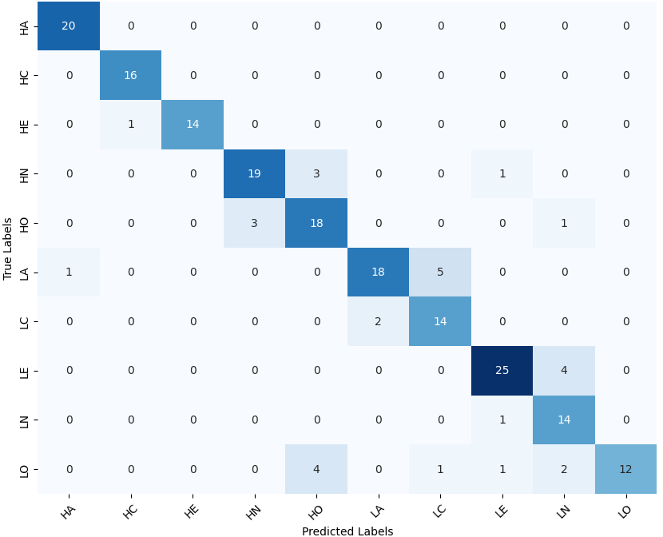
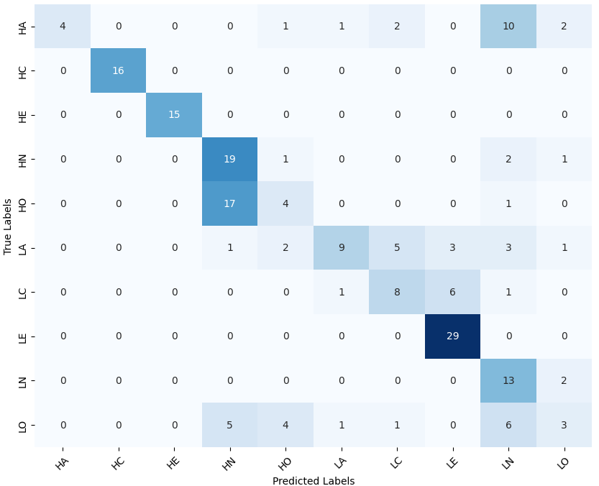
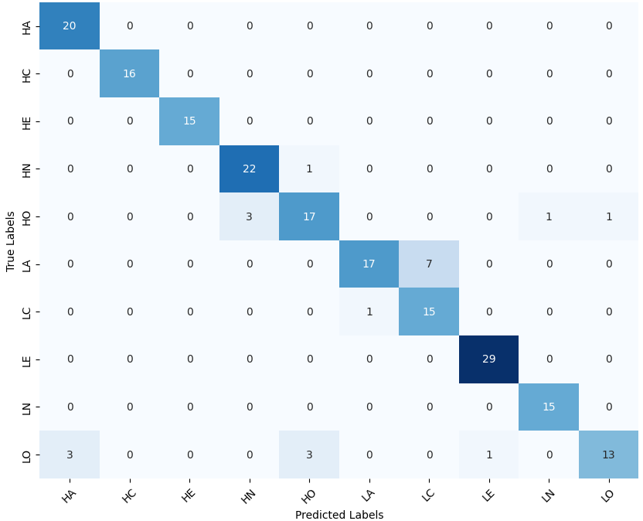
Experimentation(10)
Personality Traits Classification using BiG
MEWLP base findings
Bi-LSTM Classification Results
GRU Classification Results
Proposed BiG Classification Results

Slide 34
Conclusion
we categorized data into five distinct personality trait classes, while latter featured ten classes
DistilRo achieved 89% F-1 score
BiG achieved 81% F-1 score based on MFCCs, 84% F-1 score based on MoMF, 88% F-1 score based on MELP, and 90% F-1 score based on MEWLP
energy consumed is 50.40 kWh and carbon emissions 30.24 Kg

Slide 35
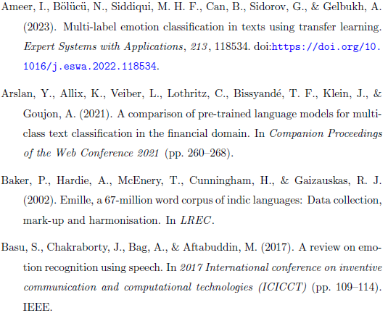
References

Slide 36
Thanks to Everyone

