Slide 1

Parametric Study of Different Shaped Planar Antennas with DGS for Handheld
Wireless Communication.
Submitted by:
Sajeeb Chandra Das
Roll No. : 150542
Reg. No. : 1054179
Dept. of Electrical, Electronic, and Communication Engineering,
Pabna University of Science and Technology.
Thesis Supervisor:
Liton Chandra Paul
Assistant Professor
Dept. of Electrical, Electronic, and Communication Engineering,
Pabna University of Science and Technology.

Slide 2
Contents
Objectives
What is antenna ?
Why planar microstrip antennas are most popular for handheld communications ?
Introduction and motivation.
Literature reviews.
Workflow.
Basic Antenna design procedures.
Basic concept of performance parameters.
List of frequency bands for different countries and regions.
Design of different shaped planar antennas.
Parametric study of simulation results.
Summarization of the research.
Conclusion.
Recommendation for future work.
Appendix.

Slide 3
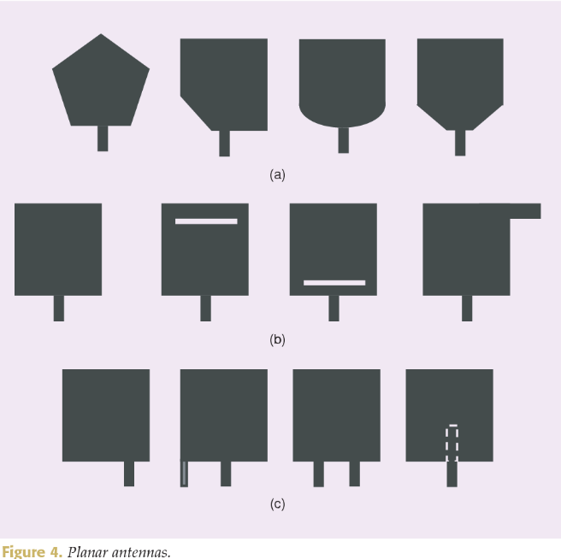
Objectives
  To Parametric Study of Different Shaped Planar Antennas with DGS for Handheld Wireless Communication.

Slide 4
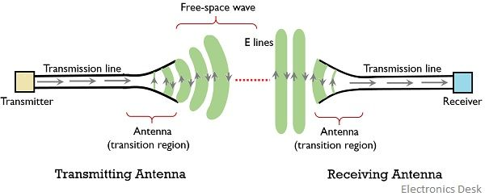
What is Antenna ?
Metallic Device.
Capture and transmit electromagnetic waves.
Used in both transmitter and receiver.
Type: Wire Antennas, Aperture Antennas, Microstrip Antennas, Array Antennas, Reflector antennas, Lens Antennas.

Slide 5
Why Planar Microstrip Antennas are Most Popular for Handheld Communications ?
Light weight.
Low volume.
Low fabrication cost.
Easy to implement.
Efficient radiator.
Conformal to both planar and non-planar surfaces.
Robust and well compatible for handheld devices.

Slide 6
Introduction and motivation
Wireless communication has brought the technological revolution in 21st century.
Higher data rate, wider coverage, ultra-low latency and massive connectivity.
Planar microstrip patch antenna.
Different shaped radiator and DGS method.
Mm-wave 5G, Sub-6 GHz 5G, WiFi-5/6, WiMAX bands.
The mm-wave 5G is power efficient with very faster data rate.
Sub-6 GHz 5G is more ready to go technology with wider coverage.

Slide 7
Literature Reviews
Numerous antennas are developed by RF researchers.
In terms of mm-wave a 28/38 GHz slotted microstrip antenna is introduced in [1] and a dual band mm-wave antenna with the size of 4×9.45 mm² is presented in [2] for 5G applications.
A square-shaped slot antenna and a TLY-5-0200 dielectric substrate based patch antenna is introduced in [3-4].
In [5], a multi-slotted rectangular stepped patch antenna and in [6], a simple circular patch antenna are introduced for Sub-6 GHz band.
A compact F-shaped slotted antenna is proposed in [7] for WLAN/WiMAX applications.
In [8], a partially slotted ground rectangular printed antenna is designed for the Sub-6 GHz band.
An oval-shaped CPW-Fed monopole antenna is introduced in [9] for Wi-Fi and a compact antenna with rectangular slot and inverted U-shaped stub is presented in [10] for sub-6 GHz 5G application.

Slide 8
List of Frequency Bands for Different Countries and Regions
Country / Region | Frequency Band (GHz) Sub-6 GHz | Frequency Band (GHz) Mm-wave
USA | 3.7 - 4.2 | 27.5 - 28.35
Europe | 3.4 - 3.8 | 24.5 - 27.5
China | 3.3 - 3.6 and 4.8 - 5 | 24.75 – 27.5
Japan | 3.6 – 4.1 and 4.5 – 4.9 | 26.6 – 27 and 27 – 29.5
Korea | 3.4 - 3.7 and 3.7 – 4 | 26.5 – 28.9 and 28.9 – 29.5
India | 3.3 – 3.6 | 27.5 – 29.5
Australia | 3.4 - 3.7 | 24.25 – 27.5

Slide 9
Workflow
Design of different shaped planar antennas with DGS.
Parametric study of simulation results.
Summarization of the research.

Slide 10



Basic Antenna Design Factors
Calculation of patch width:
Calculation of effective dielectric constant:
Calculation of patch effective length:
Where c = speed of light, h = substrate thickness, εr = dielectric constant and
fo = operating frequency.

Slide 11
Basic Antenna Performance Parameters
Directivity
Gain
Bandwidth
Antenna Efficiency
Radiation Pattern
Reflection Coefficient
VSWR
Return Loss
Surface Current
Impedance matching

Slide 12
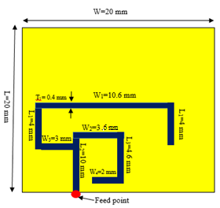
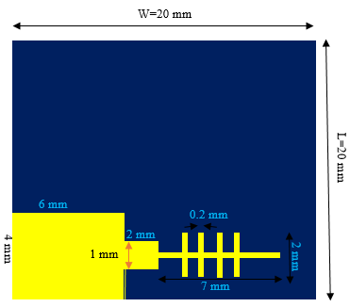
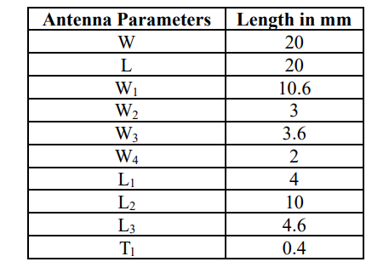
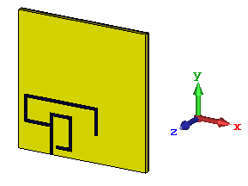
Design of Slotted Ground Plane Patch Antenna
Design summary:
(a) Front View
(b) Back View
Substrate-Rogers RT5880 (lossy), Dielectric constant – 2.2 and Tangent loss – 0.0009. T= 0.79 mm.
Copper (annealed), T=0.035 mm.
CST Microwave Studio Suite.
TD and FD Solver.
(c) 3D View
Fig-1: Proposed slotted Antenna

Slide 13
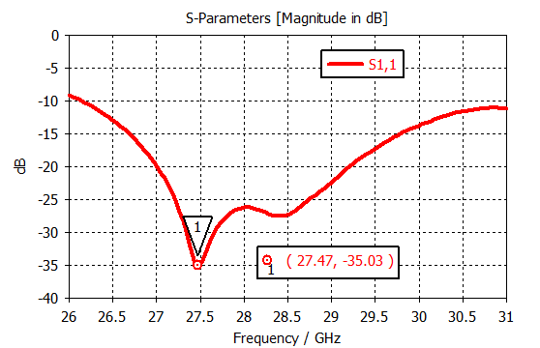
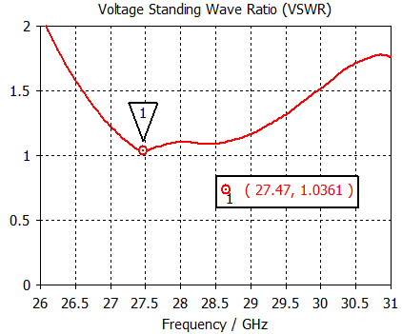
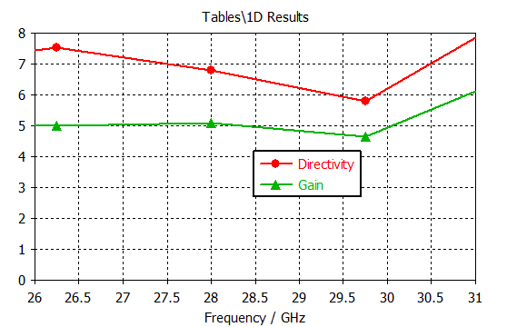
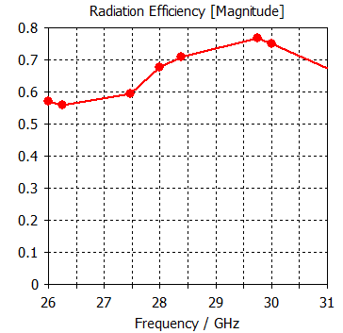
Simulation Results of Slotted Ground Plane Patch Antenna
Performance Parameter | Value
Resonant frequency (GHz) | 27.47
Lower Cut off Frequency (GHz) | 26.154
Higher Cut off Frequency (GHz) | 31
-10 dB Bandwidth (GHz) | 4.846
S parameter (dB) | -35.064
Gain (dB) | 5.22
Directivity (dBi) | 7.48
VSWR | 1.036
Avg. Rad. Efficiency (%) | ≈ 70
Fig-2: S11 Curve
Fig-3: VSWR Curve
Fig-4: Gain & Directivity VS Frequency
Fig-5: Radiation Efficiency

Slide 14
Comparison with Recent Relevant Works
Parameter | Reference No. |  |  |  | This work
 | [11] | [12] | [13] | [14]
Size (L×W) Mm² | 55 × 115 | 55 × 110 | 5×5 | 35×36 | 20×20
Substrate material | Rogers RT 5880 | Rogers RT 5880 | Rogers RT 5880 | Teflon | Rogers RT 5880
Centre frequency (GHz) | ≈27.9 | ≈27.5 | 38 | 28.49 | 27.47
Return loss (dB) | -27.908 | ≈ -37 | ≈ -43 | -39.55 | -35.03
Gain (dB) | 7.182 | 7.88 | 4 | 8.841 | 5.22
BW (GHz) | 2.305 | 1.0683 | 22 | 0.814 | 4.846

Slide 15
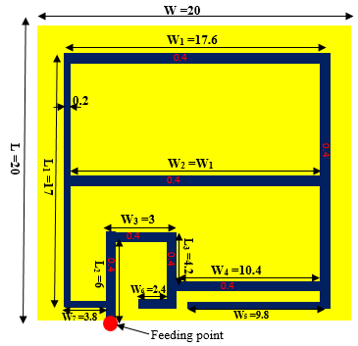
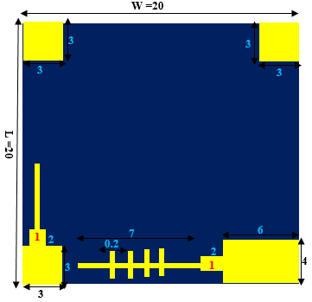
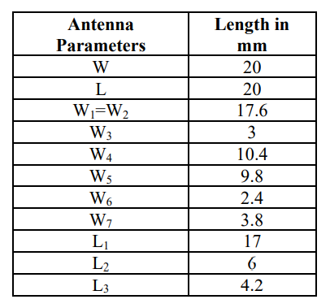
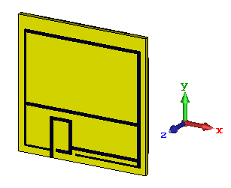
Design of Low Profile Patch Antenna with DGS
Design summary:
(a) Front View
(b) Back View
Substrate-Rogers RT5880 (lossy), Dielectric constant – 2.2 and Tangent loss – 0.0009. T= 0.79 mm.
Copper (annealed), T=0.035 mm.
CST Microwave Studio Suite.
TD and FD Solver.
(c) 3D View
Fig-6: Proposed Antenna

Slide 16
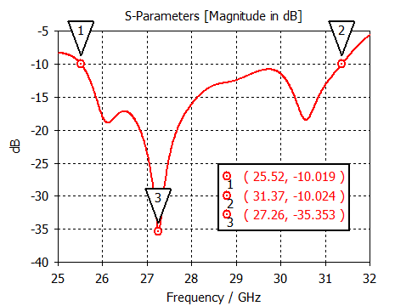
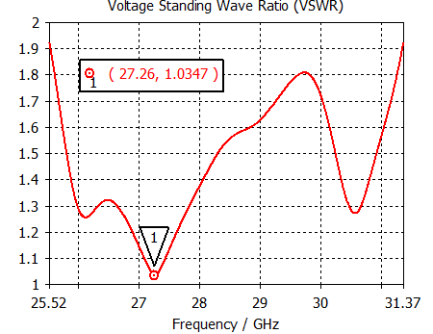
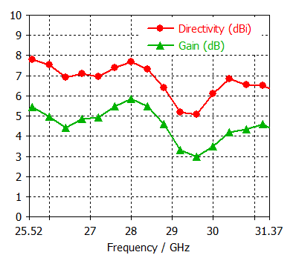
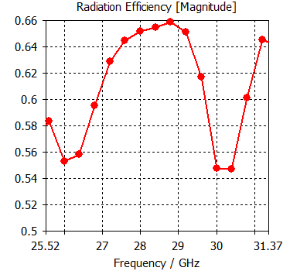
Simulation Results of Patch Antenna with DGS
Name of the parameter | Value
Return loss (dB) | -35.353
Resonant frequency (GHz) | 27.26
Gain (dB) | 5.11
Directivity (dBi) | 7.1
-10 dB Bandwidth (GHz) | 5.85
Lower cut off frequency (GHz) | 25.52
Higher cut off frequency (GHz) | 31.37
VSWR | 1.034
Maximum Radiation Efficiency (%) | ≈66
Fig-7: S11 Curve
Fig-8: VSWR Curve
Fig-9: Gain & Directivity VS Frequency
Fig-10: Radiation Efficiency

Slide 17
Comparison with Recent Relevant Works
Parameter | Reference No. |  |  |  | This work
 | [15] | [16] | [17] | [18]
Size (L×W) mm² | 33×44 | 4×9.45 | 5× 5 | 35×36 | 20×20
Substrate material | TLY-5-0200 | Material (εr=4.4) | Rogers RT5880 | Teflon | Rogers RT 5880
Frequency Range (GHz) | 27.3 − 28.8 | 25.2-34.3 | 20-42 | 28.1-28.914 | 25.52-31.37
Centre frequency | 28 | ≈27.4 | 38 | 28.49 | 27.26
Return loss (dB) | ≈ -30 | -30 | ≈ -43 | -39.55 | -35.353
Gain (dB) | 9.9 | 2.3 | 4 | 8.841 | 5.11
BW (GHz) | 1.5 | 9.1 | 22 | 0.814 | 5.85

Slide 18
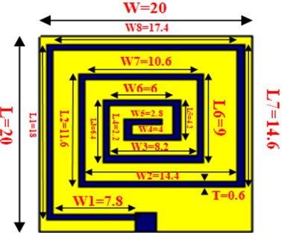
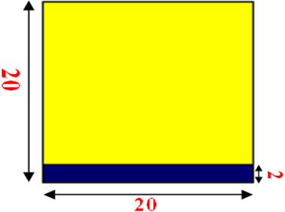
Design of Spiral-Shaped Patch Antenna
Substrate-Rogers RT5880 (lossy), Dielectric constant – 2.2 and Tangent loss – 0.0009. T= 0.79 mm.
Copper (annealed), T=0.035 mm.
CST Microwave Studio Suite.
TD and FD Solver.
(a) Front View (dimensions in mm)
(b) Back View (dimensions in mm)
Fig-11: Spiral-shaped patch antenna.
Pabna University of Science and Technology, Pabna-6600, Bangladesh.

Slide 19
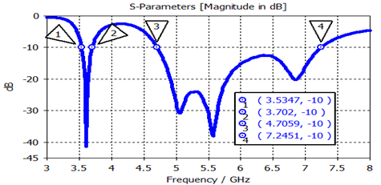
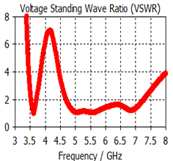
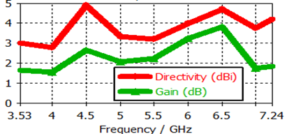
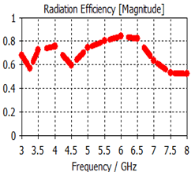
Simulation Results of Spiral-Shaped Patch Antenna
Parameter | Value
Centre frequency (GHz) | 3.61 and 5.56
Reflection coefficient (dB) | -41.29 and -37.85
Gain (dB) | 1.5 and 2.67
BW (GHz) | 0.166 and 2.53
Efficiency | 83
Fig-12: S11 Curve
Fig-13: VSWR Curve
Fig-14: Gain & Directivity VS Frequency
Fig-15: Radiation Efficiency.

Slide 20
Comparison with Recent Relevant Works
Parameter | Reference No. |  |  |  | This work
 | [19] | [20] | [21] | [22]
Size (L×W) mm² | 20 × 30 | 20 × 28 | 20×8.7 | 20×40 | 20×20
Centre frequency (GHz) | 4.8 | 4.8 | 6.2 | 3.5 and 5.2 | 3.61 and 5.56
Reflection coefficient (dB) | -32.6 | ≈ -28 | ≈ -27 | ≈ -25 and ≈ -30 | -41.29 and -37.85
Gain (dB) | 2.35 | 2.45 | 2.25 | 2.6 and 2.3 | 1.5 and 2.67
BW (GHz) | 2.4 | 2.77 | 2.14 | 0.4 and 1.4 | 0.166 and 2.53

Slide 21
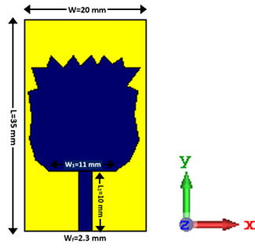
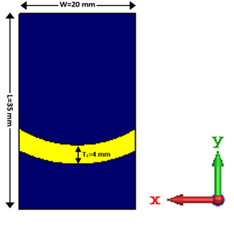
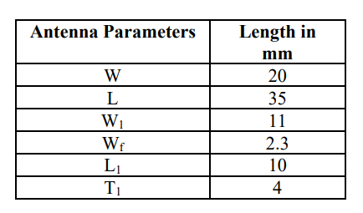
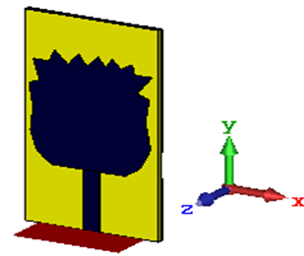
Design of Rose-Shaped patch antenna
Design summary of the RSPA:
(a) Front View
(b) Back View
Substrate-Rogers RT5880 (lossy), Dielectric constant – 2.2 and Tangent loss – 0.0009. T= 0.79 mm.
Copper (annealed), T=0.035 mm.
CST Microwave Studio Suite.
TD and FD Solver.
(c) 3D View
Fig-16: Proposed Antenna

Slide 22
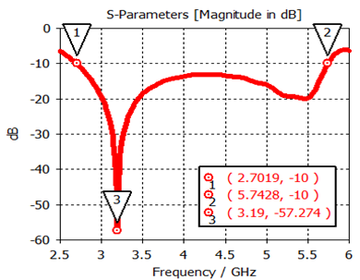
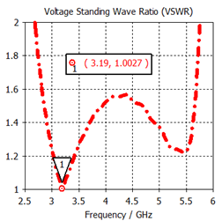
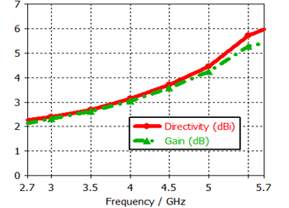
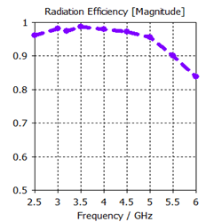
Simulation Results of Rose-Shaped Patch Antenna
Name of the parameter | Value
Return loss (dB) | -57.27
Resonant frequency (GHz) | 3.19
Gain (dB) | 2.81
Directivity (dBi) | 2.55
-10 dB Bandwidth (GHz) | 3.04
Lower Cut-off (GHz) | 2.7
Higher Cut-off (GHz) | 5.74
VSWR | 1.002
Maximum Radiation Efficiency (%) | 98%
Fig-17: S11 Curve
Fig-18: VSWR Curve
Fig-19: Gain & Directivity VS Frequency
Fig-20: Radiation Efficiency

Slide 23
Comparison with Recent Relevant Works
Parameter | Reference No. |  |  |  | This work
 | [23] | [24] | [25] | [26]
Size (L×W) mm² | 20×28 | 58×78 | 28×40 | 24×30 | 20×35
Substrate material | FR4 | PET | FR4 | FR4 | Rogers RT 5880
Centre frequency (GHz) | 4.8 | 5.2 | 3.83 | 4.8 | 3.19
Return loss (dB) | ≈ -28 | ≈ -23.5 | -31.15 | ≈ -41 | -57.27
Gain (dB) | 2.45 | 3 | 2.5 | 2.36 | 2.81
BW (GHz) | 2.77 | 2.08 | 0.7 | 2.46 | 3.04
Efficiency (%) | 65.35 | 80 | ---- | 67.22 | 95

Slide 24
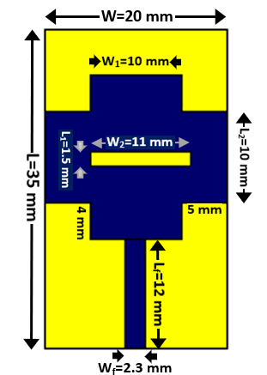
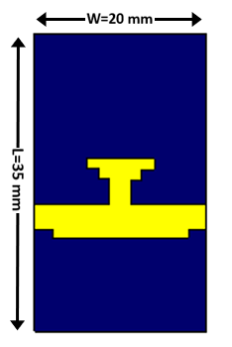
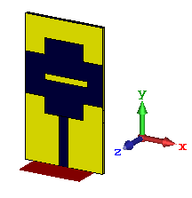
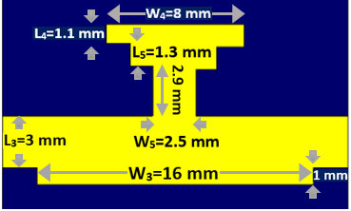
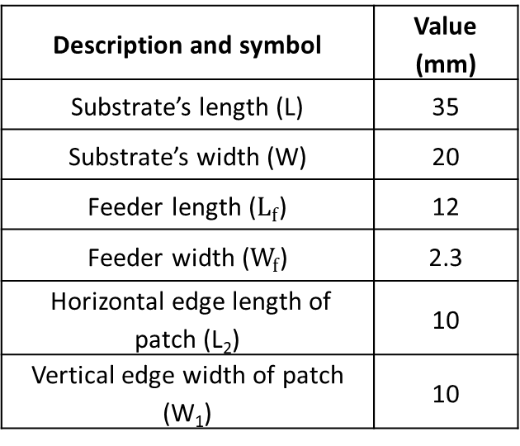
Design of Plus-Shaped patch antenna
Design summary of the PSPA:
Description and symbol | Value (mm)
Substrate’s length (L) | 35
Substrate’s width (W) | 20
Feeder length ($L_{f}$) | 12
Feeder width ($W_{f}$) | 2.3
Horizontal edge length of patch (L₂) | 10
Vertical edge width of patch (W₁) | 10
(a) Front View
(b) Back View
Substrate-Rogers RT5880 (lossy), Dielectric constant – 2.2 and Tangent loss – 0.0009. T= 0.79 mm.
Copper (annealed), T=0.035 mm.
CST Microwave Studio Suite.
TD and FD Solver.
(d) Amplified slot
(c) 3D View
Fig-21: Proposed Antenna

Slide 25
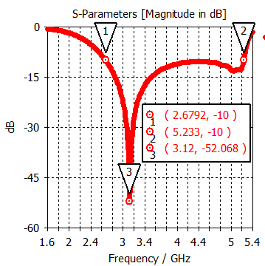
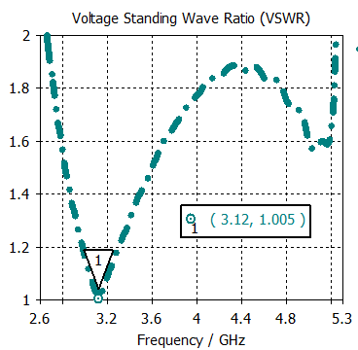
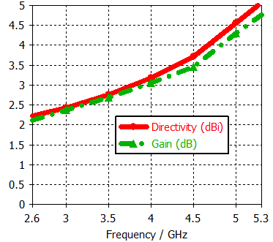
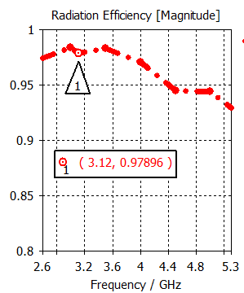
Simulation Results of Plus-Shaped Patch Antenna
Name of Parameters | Value
Lower cut off (GHz) | 2.67
Upper cut off (GHz) | 5.23
-10 dB Bandwidth (GHz) | 2.56
Resonant frequency (GHz) | 3.12
Return loss (dB) | -52.06
VSWR | 1.005
Maximum gain (dB) | 4.65
Maximum directivity (dBi) | 4.95
Maximum radiation efficiency (%) | 98
Fig-22: S11 Curve
Fig-23: VSWR Curve
Fig-24: Gain & Directivity VS Frequency
Fig-25: Radiation Efficiency.

Slide 26
Comparison with Recent Relevant Works
Parameter | Reference No. |  |  |  | This work
 | [27] | [28] | [29] | [30]
Size (L×W) mm² | 20 × 28 | 20× 30 | 36×31 | 46×26 | 20×35
Substrate material | FR4 | FR4 | FR4 | FR4 | Rogers RT 5880
Centre frequency (GHz) | 4.8 | 4.71 | 3.3 and 4.5 | 3.5 | 3.12
Return loss (dB) | ≈ -28 | -32.6 | ≈ -22 and -23 | -20.44 | -52.06
Maximum Gain (dB) | 2.45 | 2.69 | 7.17 | 4.42 | 4.65
BW (GHz) | 2.77 | 2.4 | 0.34 and 0.81 | 2.15 | 2.56
Maximum Efficiency (%) | 87.13 | 79.6 | ≈ 80 | ----- | 98

Slide 27
Summarization of the Research
PARAMETER | CHAPTER NUMBER
 | 3 (Slotted) | 4 (DGS) | 5 (Spiral) | 6 (Rose) | 7 (Plus)
Size (L×W) mm² | 20×20 | 20×20 | 20×20 | 20×35 | 20×35
Substrate material | Rogers RT5880 | Rogers RT5880 | Rogers RT5880 | Rogers RT5880 | Rogers RT5880
Centre frequency (GHz) | 27.47 | 27.26 | 3.61 and 5.56 | 3.19 | 3.12
Return loss (dB) | -35.03 | -35.353 | -41.29 and -37.85 | -57.27 | -52.06
Gain (dB) | 6.1 | 6 | 3.95 | 5.44 | 4.65
Directivity (dBi) | 7.8 | 7.9 | 5 | 6 | 4.95
BW (GHz) | 4.846 | 5.85 | 0.166 and 2.53 | 3.04 | 2.56
Efficiency (%) | 77 | 66 | 83 | 98 | 98
Applications | 5G (mm-wave) | 5G (mm-wave) | 5G (Sub-6 GHz), WiFi-5/6 | Sub-6 GHz, 5G | Sub-6 GHz, WiMAX
Comments | Wideband, 28 GHz 5G, Patch antenna | Low Profile, Microstrip Patch | Dual Band, Miniatu-rized, RT5880 | Ground Slot, Wideband, Omni-directional | Slotted, DGS, High efficiency, PSPA

Slide 28
Conclusion
Parametric study of different shaped planar antennas.
CST Microwave Studio Suite is used to design and simulate.
Different shapes and defected ground structure (DGS) are introduced to optimize.
DGS helps to improve the bandwidth and gain.
Different shapes facilitate proper current distribution and omnidirectional radition.
These antennas can operate in Sub-6 GHz and mm-wave bands.
They shows wider bandwidth, high gain, and directivity with very good reflection coefficients.
Suitable candidates for handheld wireless applications.

Slide 29
Recommendation for Future Work
The size of these antennas can be reduced more by further optimization.
Split-ring resonators, parasitic elements and different types of slots can be introduced to get more optimized performance.
Same methodology can be applied in MIMO, UWB antennas.
Machine learning can be added to them.
Highly optimized antennas can used in AI, Bio-medical and space applications.

Slide 30
Appendix
List of Publications:
Title: A Wideband Microstrip Patch Antenna with Slotted Ground Plane for 5G Application, Name of conference: International Conference on Science & Contemporary Technologies (ICSCT), 2021, pp. 1-5, doi: 10.1109/ICSCT53883.2021.9642597, Publisher: IEEE.
Title: A Low Profile Microstrip Patch Antenna with DGS for 5G Application, Name of conference: International Conference on Science & Contemporary Technologies (ICSCT), 2021, pp. 1-5, doi: 10.1109/ICSCT53883.2021.9642644., Publisher: IEEE.
Title: A Dual Band Miniaturized Spiral-shaped Patch Antenna for 5G and WiFi-5/6 Applications, Name of conference: International Conference on Signal Processing, Information, Communication and Systems (SPICSCON), Publisher: IEEE.
Title: A Wideband Rose-shaped Patch Antenna with a Ground Slot for Sub-6 GHz Applications, Name of conference: Indian Conference on Antennas and Propagation (InCAP), 2021, pp. 901-904, doi: 10.1109/InCAP52216.2021.9726293, Publisher: IEEE.

Slide 31
References
[1] H.M. Marzouk, M.I. Ahmed, and A.A. Shaalan, “A Novel Dual-band 28/38 GHz slotted microstrip MIMO antenna for 5G mobile applications,” Proceedings of the International Symposium on Antennas and Propagation and USNC-URSI Radio Science Meeting, 2019, pp. 607-608.
[2] C. Han, G. Huang, T. Yuan, and C. Sim, “A Dual-Band Millimeter-Wave Antenna for 5G Mobile Applications,” Proceedings of the IEEE International Symposium on Antennas and Propagation and USNC-URSI Radio Science Meeting, 2019.
[3] J. L. Li, M. H. Luo, and H. Liu, “Design of a slot antenna for future 5G wireless communication systems,” Proceedings of the Progress In Electromagnetics Research Symposium 2017, pp. 739-741.
[4] F. Xiao, X. Lin, and Y. Su, “Dual-band structure-shared antenna with large frequency ratio for 5G communication applications,”IEEE Antennas and Wireless Propagation Letters, vol. 19, no. 12, pp. 2339-2343, Dec. 2020.
[5] R. Azim et al., “A multislotted antenna for LTE/5G Sub-6 GHz wireless communication applications,” Int’l Journal of Microwave and Wireless Technologies, vol. 13, no. 5, pp.486– 496, 2021.
[6] R. Azim, R. Akter, A.K.M.M.H. Siddique, L. C. Paul, M.T. Islam, “Circular patch planar ultra-wideband antenna for 5G sub-6 GHz wireless communication applications,” Journal of Optoelectronics and Advanced Materials, Vol. 23, no. 3-4, pp. 127-133, 2021.
[7] A. K. Gautam, L. Kumar, B. K. Kanaujia and K. Rambabu, "Design of Compact F-Shaped Slot Triple-Band Antenna for WLAN/WiMAX Applications," in IEEE Transactions on Antennas and Propagation, vol. 64, no. 3, pp. 1101-1105, March 2016, doi: 10.1109/TAP.2015.2513099.

Slide 32
References
[8] A. Kapoor, R. Mishra and P. Kumar, "Compact wideband-printed antenna for sub-6 GHz fifth generation applications", Int. Journal on Smart Sensing and Intelligent Systems, vol 13, no 1, pp. 1-10, 2020.
[9] J. Kulkarni and C. Y. D. Sim, "Wideband CPW-Fed Oval-Shaped Monopole Antenna for WiFi5 and Wi-Fi6 Applications," Progress In Electromagnetics Research C, vol. 107, pp. 173- 182, 2021.
[10] I. Ishteyaq, I. S. Masoodi and K. Muzaffar, “A compact double-band planar printed slot antenna for sub-6 GHz 5G wireless applications,” Int. Journal of Microwave and Wireless Technologies, vol 13, no 5, pp. 469 - 477, 2020.
[11] M.I. Ahmed, H.M. Marzouk, and A. Shaalan, “A two-element microstrip antenna 28/38 GHz for 5G mobile applications,” Proceedings of the6thInternational Conference on Advanced Control Circuits and Systems & 5th International Conference on New Paradigms in Electronics & Information Technology, 2019, pp. 71-76.
[12] H.M. Marzouk, M.I. Ahmed, and A.A. Shaalan, “A Novel Dual-band 28/38 GHz slotted microstrip MIMO antenna for 5G mobile applications,” Proceedings of the International Symposium on Antennas and Propagation and USNC-URSI Radio Science Meeting, 2019, pp. 607-608.
[13] J. L. Li, M. H. Luo, and H. Liu, “Design of a slot antenna for future 5G wireless communication systems,” Proceedings of the Progress In Electromagnetics Research Symposium 2017, pp. 739-741.
[14] L.C. Paul and M.M. Alam, “Millimeter-wave hexagonal grid microstrip array antenna for 5G communication,” Proceedings of the 3rd International Conference on Electrical Information and Communication Technology 2017, pp. 1-6.
[15] F. Xiao, X. Lin, and Y. Su, “Dual-band structure-shared antenna with large frequency ratio for 5G communication applications,”IEEE Antennas and Wireless Propagation Letters, vol. 19, no. 12, pp. 2339-2343, Dec. 2020.

Slide 33
References
[16] C. Han, G. Huang, T. Yuan, and C. Sim, “A Dual-Band Millimeter-Wave Antenna for 5G Mobile Applications,” Proceedings of the IEEE International Symposium on Antennas and Propagation and USNC-URSI Radio Science Meeting, 2019.
[17] J. L. Li, M. H. Luo, and H. Liu, “Design of a slot antenna for future 5G wireless communication systems,”Proceedings of the Progress In Electromagnetics Research Symposium 2017,pp. 739-741.
[18] L.C. Paul and M.M. Alam, “Millimeter-wave hexagonal grid microstrip array antenna for 5G communication,” Proceedings of the 3rd International Conference on Electrical Information and Communication Technology 2017, pp. 1-6.
[19] R. Azim et al., “A multislotted antenna for LTE/5G Sub-6 GHz wireless communication applications,” Int’l Journal of Microwave and Wireless Technologies, vol. 13, no. 5, pp.486– 496, 2021.
[20] R.Azim, R. Aktar, A. K. M.M.H. Siddique, L. C. Paul and M.T. Islam, “Circular patch planar ultra-wideband antenna for 5G sub-6 GHz wireless communication applications,” Journal of Optoelectronics and Advanced Materials, vol. 23, no. 3-4, pp. 127-133, 2021.
[21] J. Kulkarni and C. Y. D. Sim, "Wideband CPW-Fed Oval-Shaped Monopole Antenna for Wi-Fi5 and Wi-Fi6 Applications," Progress In Electromagnetics Research C, vol. 107, pp. 173-182, 2021.
[22] M. Rezvani; L Asadpor; R. Vahedpour, "A Compact Dual-Band Microstrip Monopole Antenna for WiMAX and WLAN Applications",5th Conf. on Engineering Electromagnetics, Iran, 19-20 April, 2017, pp. 1-4.

Slide 34
References
[23] R. Azim, R. Akter, A.K.M.M.H. Siddique, L. C. Paul, M.T. Islam, “Circular patch planar ultra-wideband antenna for 5G sub-6 GHz wireless communication applications,” Journal of Optoelectronics and Advanced Materials, Vol. 23, no. 3-4, pp. 127-133, 2021.
[24] A. Desai, T. Upadhyaya, J. Patel, R. Patel, M. Palandoken, “Flexible CPW fed transparent antenna for WLAN and sub-6 GHz 5G applications,” Microwave and Optical Technology Letters, vol 62, no. 12, pp. 1-14, 2020.
[25] A. Kapoor, R. Mishra and P. Kumar, "Compact wideband-printed antenna for sub-6 GHz fifth-generation applications", Int. Journal on Smart Sensing and Intelligent Systems, vol 13, no 1, pp. 1-10, 2020.
[26] R. Azim, T. Alam, L. C. Paul, R. Aktar, A. K. M. Moinul Hoque Meaze and M. T. Islam, "Low Profile Multi-slotted Patch Antenna for Lower 5G Application,” IEEE Region 10 Symposium, 2020, pp. 366-369.
[27] R.Azim, R. Aktar, A. K. M.M.H. Siddique, L. C. Paul and M.T. Islam, “Circular patch planar ultra-wideband antenna for 5G sub-6 GHz wireless communication applications,” Journal of Optoelectronics and Advanced Materials, vol. 23, no. 3-4, pp. 127-133, 2021.
[28] R. Azim et al., “A multislotted antenna for LTE/5G Sub-6 GHz wireless communication applications,” International Journal of Microwave and Wireless Technologies, vol 13, pp. 486–496, 2020.
[29] I. Ishteyaq, I. S. Masoodi and K. Muzaffar, “A compact double-band planar printed slot antenna for sub-6 GHz 5G wireless applications,” Int. Journal of Microwave and Wireless Technologies, vol 13, no 5, pp. 469 - 477, 2020.
[30] M. M. Hasan, Z. Rahman, R. Shaikh, I. Alam, M. A. Islam and M. S. Alam, "Design and Analysis of Elliptical Microstrip Patch Antenna at 3.5 GHz for 5G Applications,“ IEEE TENSYMP, 2020, pp. 981-984, doi: 10.1109/TENSYMP50017.2020.9230897.

Slide 35

Thank You for Listening
Any suggestion?

