Slide 1
Lecture 2 Probability and Measurement Error, Part 1
Notes:
Probability is relevant to data analysis because all data contains noise, and noise can be understood using concerpts drawn from probability.

Slide 2
Syllabus
Lecture 01 Describing Inverse Problems Lecture 02 Probability and Measurement Error, Part 1 Lecture 03 Probability and Measurement Error, Part 2 Lecture 04 The L₂ Norm and Simple Least Squares Lecture 05 A Priori Information and Weighted Least Squared Lecture 06 Resolution and Generalized Inverses
Lecture 07 Backus-Gilbert Inverse and the Trade Off of Resolution and Variance Lecture 08 The Principle of Maximum Likelihood Lecture 09 Inexact Theories Lecture 10 Nonuniqueness and Localized Averages Lecture 11 Vector Spaces and Singular Value Decomposition
Lecture 12 Equality and Inequality Constraints Lecture 13 L₁ , L∞ Norm Problems and Linear Programming Lecture 14 Nonlinear Problems: Grid and Monte Carlo Searches Lecture 15 Nonlinear Problems: Newton’s Method Lecture 16 Nonlinear Problems: Simulated Annealing and Bootstrap Confidence Intervals Lecture 17 Factor Analysis Lecture 18 Varimax Factors, Empircal Orthogonal Functions Lecture 19 Backus-Gilbert Theory for Continuous Problems; Radon’s Problem Lecture 20 Linear Operators and Their Adjoints Lecture 21 Fréchet Derivatives Lecture 22 Exemplary Inverse Problems, incl. Filter Design Lecture 23 Exemplary Inverse Problems, incl. Earthquake Location Lecture 24 Exemplary Inverse Problems, incl. Vibrational Problems

Slide 3
Purpose of the Lecture
review random variables and their probability density functions
introduce correlation and the multivariate Gaussian distribution
relate error propagation to functions of random variables

Slide 4
Part 1 random variables and their probability density functions
Notes:
A key idea is the random variable.

Slide 5
random variable, d
no fixed value until it is realized
d=?
d=?
d=1.04
d=0.98
indeterminate
indeterminate
Notes:
Explain that in this analogy, the random variable, d, has indeterminate value when it is in the box. Every time it is taken out of the box, it takes on a new value.

Slide 6
random variables have systematics
tendency to takes on some values more often than others
Notes:
Even though realizations of a random variable are all different, the underlying variable has well-defined properties.

Slide 7
N realization of data
10
d_{i}
5
0
index, i
Notes:
200 realizations of a random variable, d

Slide 8
(A)
(B)
(C)
Notes:
The probability density function (p.d.f.) in (B) completely describes the behavior of the random variable. It is the idealization of a histogram of the realizations, in the limit of an indefinitely large number of realizations.
Fig 2.1. (A) Histogram showing data from 200 repetitions of an experiment in which datum, d, is measured. Noise causes observations to scatter about their mean value, <d>=5. (B) Probability density function (p.d.f), p(d), of the data. (C) Histogram (blue) and p.d.f. (red) superimposed. Note that the histogram has a shape similar to the p.d.f.. MatLab script gda01_??.

Slide 9
probability of variable being between d and d+Δd
is p(d) Δd
p(d)
d
Δd
Notes:
The p.d.f. describes the probability that a realization with be close to a given value, d.
Fig. 2.2. The shaded area, p(d)Δd, of the probability density function, p(d), gives the probability, P, that the observation will fall between d and d+Δd. MatLab sctipt gda02_?.

Slide 10
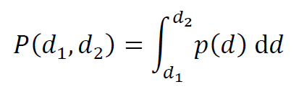
in general probability is the integral
probability that d is between d₁ and d₂
Notes:
The probability P is a number between 0 and 1 (0% and 100%).
The probability that the random variable will take on a value between d₁ and d₂ is given by the intergal.

Slide 11
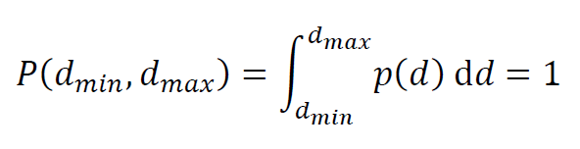
the probability that d has some value is 100% or unity
probability that d is between its minimum and maximum bounds, d_{min} and d_{max}
Notes:
The random variable must take on some value, so the probability that it falls somewhere between its minimum and maximum bounds is unity (100%).

Slide 12
How do these two p.d.f.’s differ?
p(d)
d
0
5
p(d)
d
0
5
Notes:
Try to get the class to describe what these two p.d.f.’s mean. In the red p.d.f. case, most of the probability is concentrated on a fairly narrow range near d=4. In the blue p.d.f. case, the most of the probability is at lower values, near 2-3, but its is less concentrated.

Slide 13
Summarizing a probability density function
typical value
“center of the p.d.f.”
amount of scatter around the typical value
“width of the p.d.f.”
Notes:
Two properties of a p.d.f. are the typical value of a realization and the amount of scatter of realizations about the typical one.

Slide 14
Several possibilities for a typical value
p(d)
d
d_{ML}
point beneath the peak or “maximum likelihood point” or “mode”
Notes:
Fig. 2.3. The maximum likelihood point, d_{ML}, of the probability density function, p(d), gives the most probable value of the datum, d. MatLab sctipt gda02_?.

Slide 15
p(d)
50%
50%
d
d_{median}
point dividing area in half or “median”
Notes:
Fig. 2.3. Firty percent of realization are less than the median, d_{medin} of the probability density function, p(d), and 50% are greater. MatLab sctipt gda02_?.

Slide 16
p(d)
d
<d>
balancing point or “mean” or “expectation”
Notes:
Fig. 2.3. The mean or “expected” datum, <d>, is at the “balancing point” of the distribution., (in the sense that it would balance if a fulcrum were placed at that point) MatLab sctipt gda02_?.

Slide 17
can all be different
d_{ML} ≠ d_{median} ≠ <d>
Notes:
The mean, median and mode are, in general, all different.

Slide 18
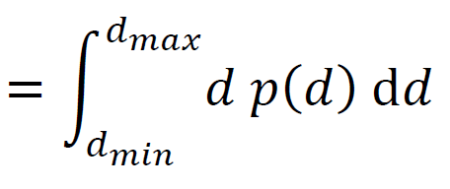
formula for
“mean” or “expected value”
<d>
Notes:
Formula for the mean is an integral.

Slide 19
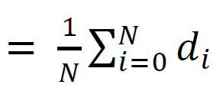
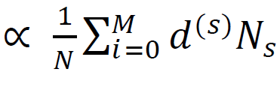
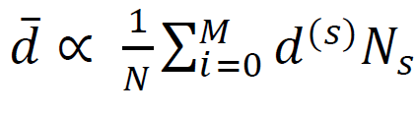
step 1: usual formula for mean
<d>
d
data
step 2: replace data with its histogram
N_{s}
<d>
≈
d_{s}
s
histogram
step 3: replace histogram with probability distribution.
N_{s}
<d>
≈
s
N
p
≈
P(d_{s})
s
d_{s}
probability distribution
Notes:
This derivation shows that the integral formula for the mean can be derived from the usual formula for the “sample mean”. Note that the last summation is very similar to the integral.

Slide 20
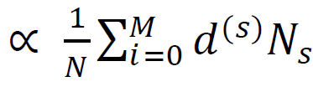
If the data are continuous, use analogous formula containing an integral:
<d>
≈
P(d_{s})
s
<d>
Notes:
In fact, it becomes the intergral in the case where the histogram has indefinitely narrow bins.

Slide 21
quantifying width
Notes:
The width of a p.d.f. quantifies scatter. Small width, small scatter, low observational noise. Large width, large scatter, high observational noise.

Slide 22
This function grows away from the typical value:
q(d) = (d-<d>)²
so the function q(d)p(d) is
small if most of the area is near <d> , that is, a narrow p(d)
large if most of the area is far from <d> , that is, a wide p(d)
so quantify width as the area under q(d)p(d)
Notes:
Measures of with are based on multiplying the p.d.f. by a quadratic.

Slide 23
(A)
(B)
(C)
(D)
(E)
(F)
Notes:
Graphical interpretation. (Top row) Narrow p.d.f. (Bottom row) Wide p.d.f. Area (yellow) is a quantitative measure of width.
Fig. 2.4. (A and D). Parabola of the form, q(d)=(d-<d>)², is used to measure the width of two probability density functions, p(d) (B and E), which have the same mean, <d>, but different widths. The product, qp, is everywhere small for the narrow function (C) but had two large peaks for the wider distribution (F). The area (shaded orange) under qp is a measure of the width of the function, p(d), and is called the variance. The variances of A) and F) are (0.5)² and (1.5)², respectively. MatLab sctipt gda02_?.

Slide 24
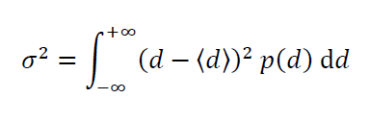
variance
mean
width is actually square root of variance, that is, σ
Notes:
Variance as a measure of the width of the p.d.f. is the first of the two important concepts of the chapter. Be sure to emphasize it. Explain that width is a measure of uncertainty. Narrow p.d.f. corresponds to certain data. Wide p.d.f. corresponds to uncertain data.

Slide 25
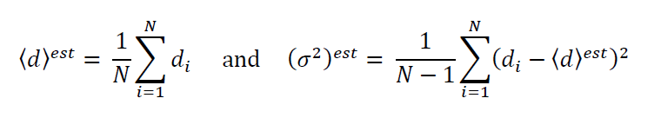
estimating mean and variance from data
Notes:
We will derive these in a future lecture. Point out that at “estimate” of the mean and variance made from realizations of a random variable is not the same as the true mean and true variance of the p.d.f., as determined by performing the integral. One would hope that the estimated would become very close to the true when the number of data are made indefinitely large.

Slide 26
estimating mean and variance from data
usual formula for square of “sample standard deviation”
usual formula for “sample mean”
Notes:
In the literature, the word “sample” is often used instead of “estimated”.
Note the lingo “standard deviation” for the “square root of the variance”. However, “standard deviation” often is used synonymously with “sample standard deviation”.

Slide 27
MabLab scripts for mean and variance
from tabulated p.d.f. p
dbar = Dd*sum(d.*p);
q = (d-dbar).^2;
sigma2 = Dd*sum(q.*p);
sigma = sqrt(sigma2);
from realizations of data
dbar = mean(dr);
sigma = std(dr);
sigma2 = sigma^2;
Notes:
First section, we presume that we know the p.d.f. and are computing the true mean and variance from it. Go through each of the steps. The starting point are two vectors, d and p. The first line computes the mean. The second creates a quadratic function centered at the mean. The third computes the area under the product q(d)p(d) by approximating the integral as a sum. The fourth just takes the square root of variance to produce a measure of the width of p(d).
In the section, we assume that the p.d.f. is unknown; we just have realizations of the data and need to estimate the mean and variance from it.

Slide 28
two important probability density functions:
uniform
Gaussian (or Normal)
Notes:
Point out that there are hundreds of named p.d.f.’s. But these are two very important ones.

Slide 29
uniform p.d.f.
p(d)
box-shaped function
1/(d_{max-} d_{min})
d
d_{min}
d_{max}
probability is the same everywhere in the range of possible values
Notes:
Explain that this p.d.f. is useful for characterizing a state of no information. A datum can be anything between its minimum and maximum bound, with equal probability. Mention that the area must be unity, so the amplitude is 1/(dmax-dmin).

Slide 30
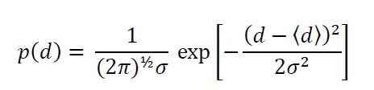
bell-shaped function
Gaussian (or “Normal”) p.d.f.
2σ
d
Large probability near the mean, d. Variance is σ².
Notes:
Mention the basic characteristics of the distribution: Symmetric around the mean, so mean=median=mode. Relatively short-tailed (little probability far from the mean).

Slide 31
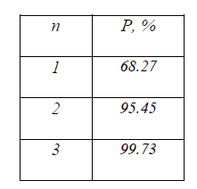
probability between <d>±nσ
Gaussian p.d.f.
Notes:
Discuss what level of certainty is needed to make decisions of various kinds. Suppose that you knew to 68.27% certainty that a pair of shoes were going to fit. Would you buy them. Suppose that you knew to 99.73% certainty that a wild mushroom was non-poisonus. Would you eat it?

Slide 32
Part 2 correlated errors
Notes:
Correlation means that a relationship exists between the noise in two different data types.
Suppose that many people measured the width and height of an object with their own personal rulers, but that these rulers were inaccurate; some had too large a scale, some too small. One would then tend to find that, in a pair of measurements of width and height performed by the same person, a measurement of width that was unusually large would tend to be accompanied by measurement of height that was also unusually large. This is correlation. Correlation is usually an undesirable aspect of measurement.

Slide 33
uncorrelated random variables
no pattern of between values of one variable and values of another
when d₁ is higher than its mean
d₂ is higher or lower than its mean
with equal probability
Notes:
Lingo – “uncorrelated” sometimes described as d₁ is independent of d₂.

Slide 34
joint probability density function uncorrelated case
0
<d₂ >
10
p
0
d₂
0.2
<d₁ >
10
0.0
d₁
Notes:
Fig. 2.5. The probability density function, p(d₁,d₂), is displayed as an image, with values given by the accompanying color bar. These data are uncorrelated, since especially large values of d₂ are no more or less likely if d₁ is large or small. In this example, the variance of d₁ and d₂ are σ₁²=(1.5)² and σ₂²=(0.5)², respectively. MatLab script gda02_?.

Slide 35
0
<d₂ >
10
p
0
d₂
0.2
<d₁ >
10
0.0
d₁
no tendency for d₂ to be either high or low when d₁ is high
Notes:
Uncorrelated: No tendency for d₂ to be either high or low when d₁ is high

Slide 36

in uncorrelated case
joint p.d.f. is just the product of individual p.d.f.’s
Notes:
Uncorrelated: Joint p.d.f. just product of individual p.d.f.’s.

Slide 37
<d₂ >
0
10
p
0
d₂
0.25
<d₁ >
10
0.00
2σ₁
d₁
Notes:
Explain the idea of a joint distribution as quantifying the probability that, given a realization of the pair (d1,d2), that d1 is near a given value and d2 is near a given value.
Fig. 2.6. The probability density function, p(d₁,d₂), is displayed as an image, with values given by the accompanying color bar. These data are positively correlated, since large values of d₂ are especially probable if d₁ is large. The function has means, < d₁>=5 and < d₂ >=5 and widths in the coordinate directions, σ₁=1.5 and σ₂=0.5. The angle, θ ,is a measure of the degree of correlation and is related to the covariance, cov(d₁,d₂)=0.4. MatLab script gda02_?.

Slide 38
<d₂ >
0
10
p
0
d₂
0.25
<d₁ >
10
0.00
2σ₁
d₁
tendency for d₂ to be high when d₁ is high
Notes:
Positive Correlation: When d1 is high, d2 tends to be high, too.
Fig. 2.6. The probability density function, p(d₁,d₂), is displayed as an image, with values given by the accompanying color bar. These data are positively correlated, since large values of d₂ are especially probable if d₁ is large. The function has means, < d₁>=5 and < d₂ >=5 and widths in the coordinate directions, σ₁=1.5 and σ₂=0.5. The angle, θ ,is a measure of the degree of correlation and is related to the covariance, cov(d₁,d₂)=0.4. MatLab script gda02_?.

Slide 39
<d₂ >
0
10
p
0
d₂
0.25
θ
<d₁ >
2σ₁
2σ₂
10
0.00
2σ₁
d₁
Notes:
Variance measures the width of the distribution along the two coordinate axed. To describe correlation, you must somehow quantify the “tilt” or “theta” of the p.d.f.
Fig. 2.6. The probability density function, p(d₁,d₂), is displayed as an image, with values given by the accompanying color bar. These data are positively correlated, since large values of d₂ are especially probable if d₁ is large. The function has means, < d₁>=5 and < d₂ >=5 and widths in the coordinate directions, σ₁=1.5 and σ₂=0.5. The angle, θ ,is a measure of the degree of correlation and is related to the covariance, cov(d₁,d₂)=0.4. MatLab script gda02_?.

Slide 40
<d₂>
d₂
<d₁>
2σ₁
d₁
Notes:
Fig. 2.7. The function, q(d₁,d₂)=(d₁-<d₂>)(d2-<d₂>), divides the (d₁,d₂) plane into four quadrants of alternating sign. The idea is to multiply the p.d.f. by this function.

Slide 41
(A)
<d₂>
(B)
<d₂>
d₂
(C)
<d₂>
d₂
d₂
<d₁>
<d₁>
<d₁>
d₁
d₁
d₁
Notes:
Fig. 2.8. The probability density function, p(d₁,d₂), displayed as an image, when the data are (A) uncorrelated, (B) positively correlated and (C) negatively correlated. The dashed lines indicated the four quadrants of alternating sign used to determine the correlation (see Figure 2.?). MatLab script gda02_?.

Slide 42
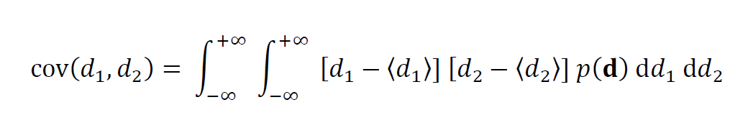
formula for covariance
+ positive correlation high d₁ high d₂
- negative correlation high d₁ low d₂
Notes:
Formula for the covariance, in the special case of a two-dimensiona p.d.f., p(d1,d2)

Slide 43
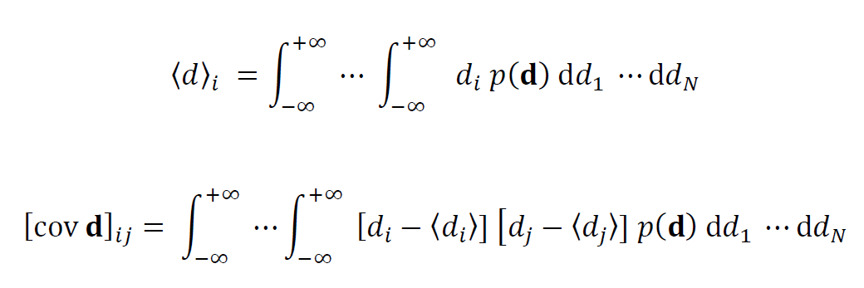
joint p.d.f. mean is a vector covariance is a symmetric matrix
diagonal elements: variances
off-diagonal elements: covariances
Notes:
For a higher dimensional p.d.f., a very powerful idea is to group the means into a vector and the variances/covariances into a matrix. This arrangement substantially simplifies calculations.

Slide 44
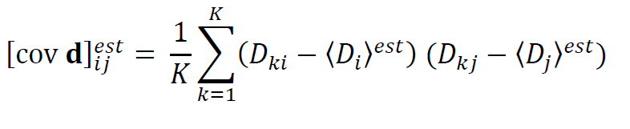
estimating covariance from a table D of data
D_{ki}: realization k of data-type i
in MatLab, C=cov(D)
Notes:
Just as with mean and variance, covariance can also be estimated from data.

Slide 45
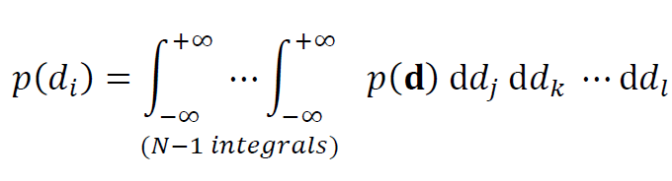
univariate p.d.f. formed from joint p.d.f.
p(d) → p(d_{i})
behavior of d_{i} irrespective of the other ds
integrate over everything but d_{i}
Notes:
A univariate distribution can describes the behavior of a single random variable. It can always be computed from a joint p.d.f. by integrating over the other variables.

Slide 46



p(d₁,d₂)
d₂
p(d₁)
integrate over d₂
d₁
d₁
integrate over d₁
p(d₂)
d₂
Notes:
Graphical interpretation of computing univariate probability density functions, p(d₁) and p(d₂), from the joint probability density function, p(d₁,d₂). One adds up all the probability along lines parallel to the given axis.

Slide 47
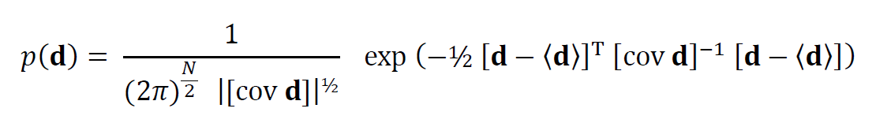
multivariate Gaussian (or Normal) p.d.f.
Notes:
Here’s the formula for a multivariate Gaussian distribution. The formula has been chosen so that it has A) Unit area, B) Mean <d> and C) Covariance [cov d] and so that it reduces to the product of univariate Gaussian distributions in the uncorrelated case.

Slide 48
mean
covariance matrix
Notes:
Note that it explicitly contains the mean and covariance. There is no need to compute them.

Slide 49
Part 3 functions of random variables
Notes:
Data contain noise and are thus random variables. Model parameters are functions of data. Thus model parameters are random variables, too.

Slide 50
functions of random variables
data with measurement error
inferences with uncertainty
data analysis process
Notes:
This is one of the most important concepts of the lecture. Be sure to emphasize it.

Slide 51
functions of random variables
given p(d)
with m=f(d)
what is p(m) ?

Slide 52
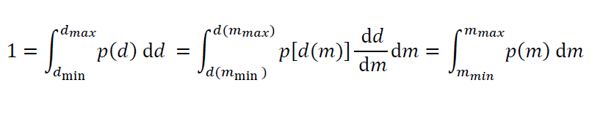
univariate p.d.f. use the chair rule
Notes:
Note the first two terms just says that the total probability of d is unity. We then use the chain rule to derive the equivalent statement for the model parameters; their total probability is unity, too.

Slide 53

univariate p.d.f. use the chair rule
rule for transforming a univariate p.d.f.
Notes:
By comparing intermediate terms, we find the relationship between p(d) and p(m).

Slide 54
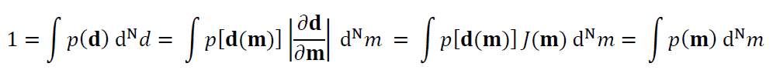

multivariate p.d.f.
Jacobian
determinant
determinant of matrix with elements ∂d_{i}/∂m_{j}
Notes:
The rule for a multivariate distribution is similar, but it requires knowing dow to transform the volume element. This involves the so-called Jabobian determinant.

Slide 55
multivariate p.d.f.
Jacobian determinant
rule for transforming a multivariate p.d.f.
Notes:
The rule for a multivariate distribution is similar, but it requires knowing dow to transform the volume element. This involves the so-called Jabobian determinant.

Slide 56
simple example
data with measurement error
inferences with uncertainty
data analysis process
one datum, d
uniform p.d.f.
0<d<1
one model parameter, m
m = 2d
Notes:
Simple because: p(d) is uniform and thus very simple; and d and m have a simple linear proportional relationship.

Slide 57

m=2d and d=½m
d=0 → m=0
d=1 → m=2
dd/dm = ½
p(d ) =1
p(m ) = ½
Notes:
Go through each step.
Note the need to invert the m(d) to d(m) in order to compute dd/dm.
Note the way the limits of the distribution are computed.

Slide 58
p(d)
1
0
d
0
1
2
p(m)
1
0
m
0
1
2
Notes:
Note that the limits change according to f(d), from (0,1) to (0,2).
Note that a sliver of area is stretched by a factor of 2. This is the meaning of the |dd/dm| in the formula. It adjusts for stretching and squeezing of areas.
Note that in both cases the total area is unity A = 1x1 = 2x1/2 = 1.

Slide 59
another simple example
data with measurement error
inferences with uncertainty
data analysis process
one datum, d
uniform p.d.f.
0<d<1
one model parameter, m
m = d²
Notes:
Note that the function is non-linear, involving a square.

Slide 60
m=d² and d=m^{½}
d=0 → m=0
d=1 → m=1
dd/dm = ½m^{-½}
p(d ) =1
p(m ) = ½ m^{-½}
Notes:
Go through each step.
Note the need to invert the m(d) to d(m) in order to compute dd/dm.
Note the way the limits of the distribution are computed.

Slide 61
A)
2.0
p(d)
1.0
0.0
0.2
0.4
0.6
0.8
1.0
d
B)
2.0
p(m)
1.0
0.0
0.2
0.4
0.6
0.8
1.0
m
Notes:
Note that the limits are the same in both case, (0,1).
Note that a sliver of area is stretched or squeezed, depending upon its position.
Fig. 2.10. A) The uniform probability density function, p(d)=1 on the interval 0<d<1. B) The transformed probability density function, p(m), given the relationship, m=d². Note areas of equal probability, which are of equal height and width in the variable, d, are transformed into areas of unequal height and width in the variable, m. MatLab script gda02_?.

Slide 62
multivariate example
data with measurement error
inferences with uncertainty
data analysis process
2 data, d₁ , d₂
uniform p.d.f.
0<d<1
for both
2 model parameters, m₁ and m₂
m₁ = d₁+d₂
m₂ = d₁-d₂
Notes:
Note that the function is linear.

Slide 63
(A)
m₂=d₁-d₂
-1
-1
1
d₂
1
m₁=d₁+d₂
d₁
Notes:
The p.d.f. d(d1,d2) is shown in red. It has constant amplitude of unity. Note that its area is unity as well.
The two linear functions are shown as dashed lines.

Slide 64

m=Md with
and |det(M)|=2
d=M⁻¹m so ∂d/ ∂ m = M⁻¹ and J= |det(M⁻¹)|= ½
p(d ) = 1
p(m ) = ½
Notes:
It pays to use matrix notation here. Note that the determinant of a matrix inverse is the reciprocal of the determinant of the original matrix.

Slide 65
(A)
(C)
m₂=d₁-d₁
-1
-1
-1
1
1
0
p(d₁)
d₂
1
1
m₁=d₁+d₁
d₁
d₁
(B)
(D)
-1
-1
Note that the shape in m is different than the shape in d
-1
1
0.5
m₂
0
p(m₁)
1
1
2
2
m₁
m₁
Notes:
Although the p.d.f. is “uniform” in the sense of having constant amplitude, the shape of its region has changed.

Slide 66
(A)
(C)
m₂=d₁-d₁
-1
-1
-1
1
1
0
p(d₁)
d₂
1
1
m₁=d₁+d₁
d₁
d₁
(B)
(D)
-1
-1
The shape is a square with sides of length √2. The amplitude is ½. So the area is ½⨉√2⨉√2 = 1
-1
1
0.5
m₂
0
p(m₁)
1
1
2
2
m₁
m₁
Notes:
Everything works out so that the p.d.f. has unit area.

Slide 67
(A)
(C)
m₂=d₁-d₁
-1
-1
-1
1
1
0
p(d₁)
d₂
1
1
m₁=d₁+d₁
d₁
d₁
(B)
(D)
-1
-1
-1
1
0.5
m₂
0
p(m₁)
1
1
2
2
m₁
m₁
Notes:
The multivariate p.d.f. p(m1,m2) is integrated to give a univariate p.d.f. p(m1). Its shape is triangular, in contrast to p(d1), which is uniform. This emphasizes that the p.d.f. of the model parameters can be very different than the p.d.f. of the data.
Fig. 2.11. A) The uniform probability density function, p(d₁,d₂)=1 on the interval 0<d₁<1, 0<d₂<1. Also shown are (m₁,m₂) axes, where m₁=d₁+d₂ and m₂=d₁-d₂. B) The transformed probability density function, p(m₁, m₂)=0.25. C) The univariate distribution, p(d₁), is formed by integrating p(d₁,d₂) over d₂. It is a uniform distribution of amplitude 1. The univariate distribution, p(m₁), is formed by integrating p(m₁,m₂) over m₂. It is a triangular distribution of peak amplitude 0.5.

Slide 68
moral
p(m) can behavior quite differently from p(d)

