Slide 1
Lecture 24 Exemplary Inverse Problems including Vibrational Problems
Notes:
Today’s lecture discusses several exemplary inverse problems.
Key issues are
indentifying the underlying theory, that is the relationship between data and model parameters
determining a formula for the data kernel
and if possible analytic formula for the other matrices like G^{T}G that involve the data kernel
choosing a solution method
assessing the results

Slide 2
Syllabus
Lecture 01 Describing Inverse Problems Lecture 02 Probability and Measurement Error, Part 1 Lecture 03 Probability and Measurement Error, Part 2 Lecture 04 The L₂ Norm and Simple Least Squares Lecture 05 A Priori Information and Weighted Least Squared Lecture 06 Resolution and Generalized Inverses
Lecture 07 Backus-Gilbert Inverse and the Trade Off of Resolution and Variance Lecture 08 The Principle of Maximum Likelihood Lecture 09 Inexact Theories Lecture 10 Nonuniqueness and Localized Averages Lecture 11 Vector Spaces and Singular Value Decomposition
Lecture 12 Equality and Inequality Constraints Lecture 13 L₁ , L∞ Norm Problems and Linear Programming Lecture 14 Nonlinear Problems: Grid and Monte Carlo Searches Lecture 15 Nonlinear Problems: Newton’s Method Lecture 16 Nonlinear Problems: Simulated Annealing and Bootstrap Confidence Intervals Lecture 17 Factor Analysis Lecture 18 Varimax Factors, Empircal Orthogonal Functions Lecture 19 Backus-Gilbert Theory for Continuous Problems; Radon’s Problem Lecture 20 Linear Operators and Their Adjoints Lecture 21 Fréchet Derivatives Lecture 22 Exemplary Inverse Problems, incl. Filter Design Lecture 23 Exemplary Inverse Problems, incl. Earthquake Location Lecture 24 Exemplary Inverse Problems, incl. Vibrational Problems

Slide 3
Purpose of the Lecture
solve a few exemplary inverse problems
tomography
vibrational problems
determining mean directions
Notes:
The three exemplary problems are tomography, vibrational problems and determining mean directions.
We’ll explain each when the time comes.

Slide 4
Part 1
tomography
Notes:
The “tomo” in “tomography” comes from the Greek word “tomos”, meaning slice.

Slide 5
tomography:
data is line integral of model function
y
assume ray path is known
ray i
x
d_{i} = ∫_{ray i} m(x(s), y(s)) ds
Notes:
Thus, tomography is the subset of inverse problems
where the data are line integrals of the model function.
The problem is continuous, but quite comonly ...

Slide 6
discretization:
model function divided up into M pixels m_{j}
Notes:
But quite commonly the problem is discretised.
Many different strategies are used to perform the discritization,
but pixels (voxels in 3D) are very common.

Slide 7
data kernel G_{ij} = length of ray i in pixel j
Notes:
We’ve derived the data kernel very early on in course,
it gives the length of each ray in each pixel

Slide 8
data kernel G_{ij} = length of ray i in pixel j
here’s an easy, approximate way to calculate it
Notes:
The key question is how to calculate it.
Here’s a easy – but approximate - way

Slide 9
start with G set to zero
ray i
then consider each ray in sequence
Notes:
You start wih G=0
and then consider each ray in sequence.

Slide 10
divide each ray into segments of arc length ∆s
∆s
and step from segment to segment
Notes:
You divide each ray in segments of constant length Delta-s
and now you step along the ray, from one segment to another.

Slide 11
determine the pixel index, say j, that the center of each line segment falls within
add ∆s to G_{ij}
repeat for every segment of every ray
Notes:
You calculate the coordinates of the middle of each ray (cricles)
figure out which pixel this point is in
and then add the length of the whole segment to the corresponding element of G.
In other words, you make no attemp to figure out whether the segment is really entirely within a single pixel.
You pretend its entirely within whatever pixel its center point is within.
That’s just an approximation ...

Slide 12
You can make this approximation indefinitely accurate simply by decreasing the size of ∆s (albeit at the expense of increase the computation time)
Notes:
That’s just an approximation,
but one that can be made indefinitely better by decreasing the size of the segments.
Of course, the smaller the segment, the more segments and the longer it takes to build G.

Slide 13
Suppose that there are M=L² voxels A ray passes through about L voxels G has NL² elements NL of which are non-zero so the fraction of non-zero elements is 1/L hence G is very sparse
Notes:
G is a very big matrix. If the image is L by L and L=100, then there are m=10,000 pixels in the image.
That means that you need N=10,000 rays to obtain a unique solution,
so G is probably 10,000 by 10,000. However, a single ray interacts with only a few – say L – pixels,
and only a fraction 1/L (1% in this case) of the elements of G are nonzero.
So G is very sparse.
In seismology, experiments with lots of rays are expensive (meaning $)
so that the underdetermined case where N<M is more common than the
overdetermined N>M case.

Slide 14
In a typical tomographic experiment some pixels will be missed entirely and some groups of pixels will be sampled by only one ray
Notes:
Medical tomography uses a very well-controlled experimental geometry, so the ray coverage is near perfect.
But in geophysics, the ray coverage is usually much poorer, especially when natural sources such as earthquakes
are used as sources.
Misses pixels are common,
as is poor ray coverage.

Slide 15
In a typical tomographic experiment some pixels will be missed entirely and some groups of pixels will be sampled by only one ray
the value of these pixels is completely undetermined
only the average value of these pixels is determined
hence the problem is mixed-determined
(and usually M>N as well)
Notes:
If a pixel is missed, its value is of course undetermined.
But equally common is the case where a group of pixels is sampled only by one ray,
in which case, only their average properties can be determined.

Slide 16
so you must introduce some sort of a priori information to achieve a solution say a priori information that the solution is small or a priori information that the solution is smooth
Notes:
So a priori information is needed to achieve a solution.
Smallness – that the solution is close to an a priori value
and
smoothness – that the solution has small second derivative
are both reasonable types of a priori information

Slide 17
Solution Possibilities
Damped Least Squares (implements smallness):
Matrix G is sparse and very large
use bicg() with damped least squares function
2. Weighted Least Squares (implements smoothness):
Matrix F consists of G plus
second derivative smoothing
use bicg()with weighted least squares function
Notes:
Either type of a priori information can be implemented with biconjucate gradients

Slide 18
Solution Possibilities
Damped Least Squares:
Matrix G is sparse and very large
use bicg() with damped least squares function
2. Weighted Least Squares:
Matrix F consists of G plus
second derivative smoothing
use bicg()with weighted least squares function
test case has very good ray coverage, so smoothing probably unnecessary
Notes:
Our example has excellent ray coverage, so we use simple damping to implement smallness.
This just drives unsampled parts of the image to zero.
In patched where only average properties are constained, it drives the image to the average.

Slide 19
True model
sources and receivers
y
x
Notes:
Here’s the true 64x64 image
The ticks along the edges are the sources and receivers.
We plaster the image with rays by connecting every source to every receiver.
Fig. 12.6. Acoustic Tomography problem. (A) True image. (B) Ray paths (only a few percent of rays are shown, else the image would be black). (C) Travel time data, organized by the distance r and angle θ of the ray from the midpoint of the image. (D) Reconstructed image. See text for further discussion. MatLab script gda12_04.

Slide 20
just a “few” rays shown
else image is black
Ray Coverage
y
y
x
x
Notes:
Here’s just a few percent of the total number of rays.
If we put them all in, the image would be completely black.
Note that both spatial and angular coverage is excellent.
Fig. 12.6. Acoustic Tomography problem. (A) True image. (B) Ray paths (only a few percent of rays are shown, else the image would be black). (C) Travel time data, organized by the distance r and angle θ of the ray from the midpoint of the image. (D) Reconstructed image. See text for further discussion. MatLab script gda12_04.

Slide 21
Data, plotted in Radon-style coordinates
distance r of ray to center of image
minor data gaps
angle θ of ray
Lesson from Radon’s Problem:
Full data coverage need to achieve exact solution
Notes:
The data can be sumamrized by a radon-style plot,
where the data for one ray is a dot on the diagram,
with a position determined by
the ray’s closest distance from the center of the original image – that the variable r
and by its angle – that’s the variable theta
The data fill up most of the (r, theta) plane,
except that there are minor gaps in data covereage
due to the source/receiver spacing being larger than the size of the pixels.
Fig. 12.6. Acoustic Tomography problem. (A) True image. (B) Ray paths (only a few percent of rays are shown, else the image would be black). (C) Travel time data, organized by the distance r and angle θ of the ray from the midpoint of the image. (D) Reconstructed image. See text for further discussion. MatLab script gda12_04.

Slide 22
True model
Estimated model
y
x
Notes:
The estimated solution (left) matches the true solution well.
Fig. 12.6. Acoustic Tomography problem. (A) True image. (B) Ray paths (only a few percent of rays are shown, else the image would be black). (C) Travel time data, organized by the distance r and angle θ of the ray from the midpoint of the image. (D) Reconstructed image. See text for further discussion. MatLab script gda12_04.

Slide 23
Estimated model
Estimated model
y
x
streaks due to minor data gaps
they disappear if ray density is doubled
Notes:
Except that there are a few streaks due to the minor data gaps.
These streaks disappear if the number of sources and receivers are doubled.
Fig. 12.6. Acoustic Tomography problem. (A) True image. (B) Ray paths (only a few percent of rays are shown, else the image would be black). (C) Travel time data, organized by the distance r and angle θ of the ray from the midpoint of the image. (D) Reconstructed image. See text for further discussion. MatLab script gda12_04.

Slide 24
but what if the observational geometry is poor so that broads swaths of rays are missing ?
Notes:
However, the situation is not so rosy
when the ray coverage is poorer.
If we delete all rays from sources/receivers on the bottom edge of the image,
we get a poorer reconstruction.

Slide 25
complete angular coverage
(A)
(B)
y
y
x
x
(C)
(D)
r
y
θ
x
Notes:
Here’s the case we just looked out, which has full ray coverage.
Fig. 12.6. Acoustic Tomography problem. (A) True image. (B) Ray paths (only a few percent of rays are shown, else the image would be black). (C) Travel time data, organized by the distance r and angle θ of the ray from the midpoint of the image. (D) Reconstructed image. See text for further discussion. MatLab script gda12_04.

Slide 26
incomplete angular coverage
(A)
(B)
y
y
x
x
(C)
(D)
r
y
θ
x
Notes:
Here’s the case with the bottom sources/receivers deleted.
The upper left is the true image.
Note that the ray diagram (upper right) is deficient in sub-vertical rays.
This corresponds to missing swaths near plus/minus 90 degrees in the radon-style plot (lower left).
The estimated image (lower right) is missing a lot of detail.
Features have been smoothed out horizontally,
because there are not enough sub-vertical rays to define their edges.
Fig. 12.7. Acoustic Tomography problem with deficient distribution of rays. (A) True image. (B) Ray paths (only a few percent of rays are shown, else the image would be black). (C) Travel time data, organized by the distance r and angle θ of the ray from the midpoint of the image. (D) Reconstructed image. See text for further discussion. MatLab script gda12_05.

Slide 27
Part 2
vibrational problems
Notes:
Heat transport is a diffusive process.
An initial pattern of temperature variation is slowly “washed away”
as the heat spreads out.
We deal with the question of how well an initial pattern can be determined,
given measurements at some later time.
In a way, this problem is conceptually similar to the deblurring one that we consider last lecture,
except that the form of the blurring is more complicated.

Slide 28
statement of the problem
Can you determine the structure of an object
just knowing the
characteristic frequencies at which it vibrates?
frequency
Notes:
A musical instrument like a bell vibrates at only certain distinct frequencies.
The same is true of a planet like the earth.
A big earthquake causes it to ring like a bell.
The issue is how to use measurements of the frequencies of vibration
to derive structural information about the earth.

Slide 29
the Fréchet derivative of frequency with respect to velocity is usually computed using perturbation theory hence a quick discussion of what that is ...
Notes:
The quantity that we want to understand is the
Frechet derivative of frequency with respect to structure
that is
how the frequency of vibration of an object is perturbed
when you change its structure, such as the density of seismic velocity at a particular point
The Frechet derivative is usually computed using perturbation theory
so we do a quick synopsis of that method here ...

Slide 30
perturbation theory
a technique for computing an approximate solution to a complicated problem, when
1. The complicated problem is related to a simple problem by a small perturbation
2. The solution of the simple problem must be known
Notes:
Pertubation theory
is useful when you can consider a complicated problem
to be a small modification of a simple problem
the complicated problems is a “perturbed” version of the simple problem
and when you the solution of the simple problem.
It allows you to use your knowledge of the solution of the simple problem
to construct an approximate solution to the complicated problem

Slide 31
simple example
Notes:
Here’s an example

Slide 32
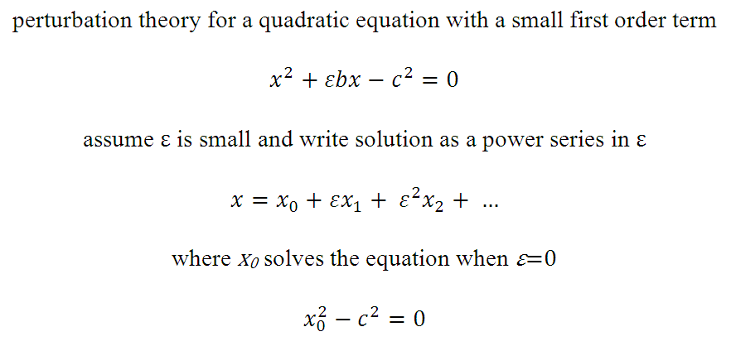
Notes:
Suppose that we want to solve a quadratic equation
where the middle term is small.
We indicate that its small by putting an epsilon in the middle term
epsilon stands for a small number
If the middle term were zero, then the solution would be very easy to derive
x = plus/minus c.
No suppose that we write the solution as a power series in epsilon,
with unknown coefficients x0, d1. x2 and so forth
we already know x0, since ...

Slide 33
we know the solution to this equation: x₀=±c
Notes:
we already know x0, since it is the solution to the simple problem
the case where epsilon is zero

Slide 34

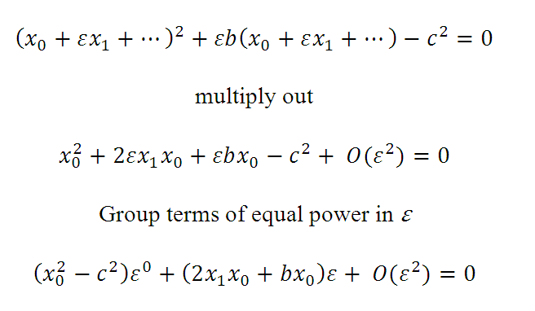
Notes:
now plus the power series into the original equation
an multiply out
grouping terms of equal powers of epsilon

Slide 35
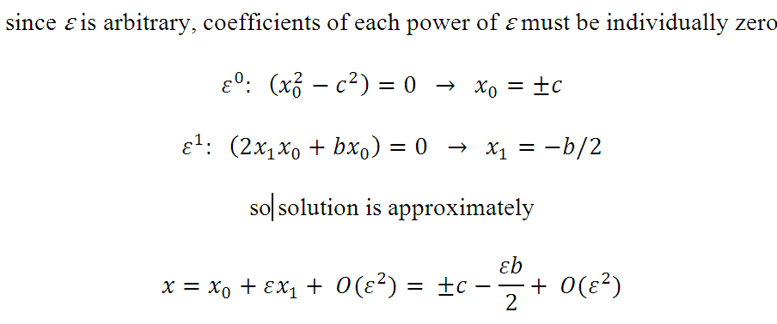
Notes:
The key argument is that
the equation needs to be satisfied for any value of epsilon
so since epsilon is arbitrary
the coefficients for each powers of epsilon must be individually zero.
That gives a sequence of coefficients for x0, x1, etc.
The equation for x0 is just the equation for the unperturbed problem,
which has solution plus/minus c.
the equation for epsilon to the first power allows us to calculate x1
Just knowing these two coefficients
allow us to write a formula that approximatey gives x
That’s the solution to the problem

Slide 36
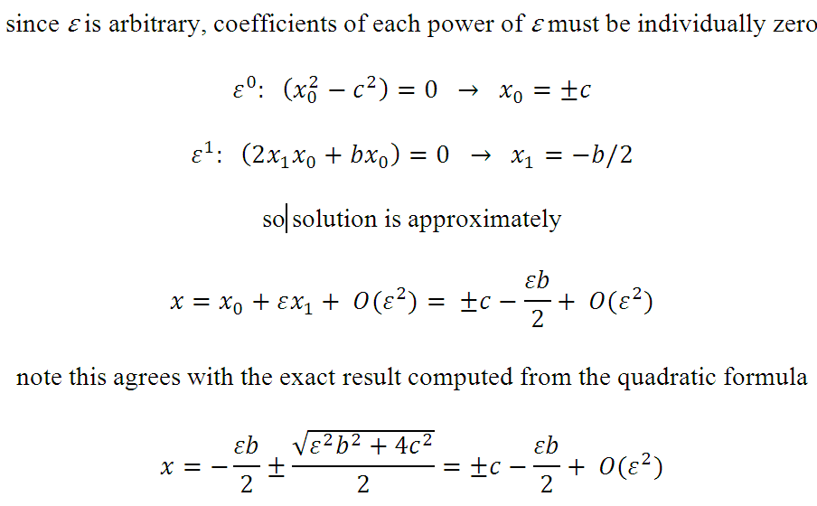
Notes:
note that the perturbation theory solution to the problem
is exactly the same as what we would get
if we started with the exact solution given by the quadratic formula
and approximated it to first order in epsilon
And we did this without every having to derive the exact solution

Slide 37
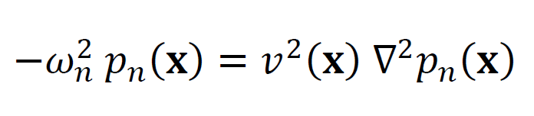
Here’s the actual vibrational problem acoustic equation with spatially variable sound velocity v
Notes:
A vibrational problem
is more complicated than an quadratic equation
Well consider the acoustic vibration problem
It’s a differential equation
involving spatially-variable a material propertiy, the acoustic velocity v
frequencies of vibration, omega
and patterns of vibration, p

Slide 38
acoustic equation with spatially variable sound velocity v
patterns of vibration
or
eigenfunctions
or
modes
frequencies of vibration
or
eigenfrequencies
Notes:
The frequencies of vibrations are often called eigenfrequenies
because this differential equation is just the continuous analog of the algebraic eigenvalue problem.
And the corresonding patterns of vibration.
are called eigenfunctions or modes.
Note that there are infinite number of solutions
indexed by n
each consisting of a distinct pattern of vibration p-sub-n
and its associated frequency of vibration omega-sub-n

Slide 39
v(x) = v⁽⁰⁾(x) + εv⁽¹⁾(x) + ...
assume velocity can be written as a perturbation
around some simple structure
v⁽⁰⁾(x)
Notes:
In order to turn this into a perturbation problem
we assume that the velocity structure is represented by a small perturbation
about some reference velocity v⁽⁰⁾
The catch is, however, that we have to be able to solve the unperturbed problem.
Only then can we use perturbation theory

Slide 40
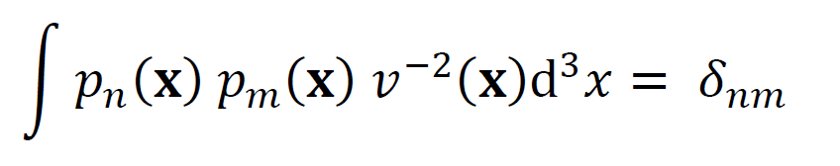
eigenfunctions known to obey orthonormality relationship
Notes:
Just as the eigenvectors of the algebraic eigenvalue problem are orthonormal,
the eigenfunctions of the vibrational problem are orthonormal
but note that the orthonormality is expressed in terms of an inner product, not a dot product
and that the inner product involves the velocity v(x) as well as the modes.

Slide 41


now represent eigenfrequencies and eigenfunctions as power series in ε
Notes:
This problem has two sets of unknowns
The eigenfrequenices and the eigenfunction
We represent both as power series in the small parameter, epsilon.
The coefficients omena-sub-n are just numbers, as they were in the quadratic formula problem we solved earlier
But note that coefficients of the modes are functions, and that’s more complicated.
What we will do to is approximate each with a sum of known functions.
The coefficients of the sum are just numbers, which are easier to work with,
but what functions to use?

Slide 42
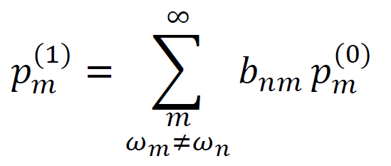
now represent eigenfrequencies and eigenfunctions as power series in ε
represent first-order perturbed shapes as sum of unperturbed shapes
Notes:
It turns out that the unperturbed modes are good functions to use.
So we write the perturbation p⁽¹⁾_{n}
as a sum of the unperturbed modes
note that we omit the m=n case
since p⁽⁰⁾_{n} already contains this mode.
The unknows are now the coefficients b_{nm}, which are simple numbers

Slide 43
plug series into original differential equation
group terms of equal power of ε
solve for first-order perturbation
in eigenfrequencies ω_{n}⁽¹⁾
and eigenfunction coefficients b_{nm}
(use orthonormality in process)
Notes:
The rest is just algebra.
We plug the series for omena_{n} and p_{n} into the original differential equation
and group terms of equal power in epsilon
and solve the resulting equations
The orthogonality relationship is needed in this process, which is why we mentioned it
The results are ...

Slide 44
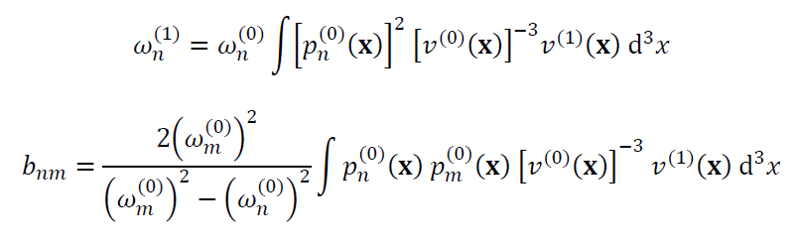
result
Notes:
The results are formulas for the first order terms in the two series
We only care about the first formula, because we are concerned with perturbation
in the frequencies of vibaration
and not of mode shape

Slide 45

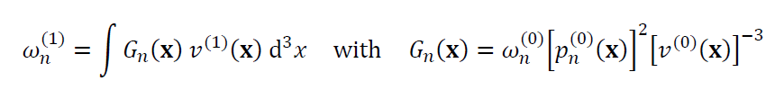
result for eigenfrequencies
write as standard inverse problem
Notes:
Note that it is already more-or-less in the form of a standard continuous inverse problem

Slide 46
standard continuous inverse problem
Notes:
It’s a standard linear inverse problem ...

Slide 47
standard continuous inverse problem
perturbation in the eigenfrequencies are the data
perturbation in the velocity structure is the model function
Notes:
That related a perturbation of the velocity structure
to a perturbation in the frequencies of vibration
through an inner product (integral)
that contains a data kernel

Slide 48
standard continuous inverse problem
data kernel or Fréchet derivative
depends upon the
unperturbed velocity structure,
the unperturbed eigenfrequency
and the unperturbed mode
Notes:
The data kernel depends upon
the unperturbed velocity structure
the unperturbed frequency of vibration
and
the unperturbed mode

Slide 49
1D organ pipe
open end,
p=0
unperturbed problem has constant velocity
0
perturbed problem has variable velocity
h
closed end
dp/dx=0
x
Notes:
We now solve a test case.
For simplicity, we choose a one dimensional problem,
an organ pipe where everything is a function of one spatial variable x
The unperturbed problem has constant velocity
and the perturbed problem has velocity that varies with spatial position x

Slide 50
p₁
p₂
p₃
p=0
0
modes
h
dp/dx=0
x
x
x
x
frequencies
𝜔
𝜔₁
𝜔₂
𝜔₃
0
Notes:
The constant velocity organ pipes has sinusoidal modes.
The lowest frequency mode is a one-quarter wavelength segment of a sine wave.
The next highest frequency is a three-quarter wavelength segment of a sine wave.
The next is a five-quarter wavelength segment of a sine wave.
The frequencies of the modes is evenly spaced.

Slide 51


solution to unperturbed problem
Notes:
The modes formulas for the modes and frequencies can ne found by solving the
differrential equation.
The modes are just sinusoids.
Note the leading coefficients on the modes.
They have been chosen so that the modes obey the right orthonormality relationship.

Slide 52
10
velocity structure
8
6
4
velocity, v
2
0
0
0.2
0.4
0.6
0.8
1
1.2
1.4
1.6
1.8
2
position , x
unperturbed
perturbed
Notes:
We’ve cooked up a spatially variable structure (solid black line)
which we are treating as a small perturbation around a constant unperturbed structure (dotted)
Figure 12.21 Organ pipe example. (A) Ladder diagram for unperturbed (black), true (red) and observed (green) eigenfrequencies of the organ pipe. (B) True (black) and estimated (red) velocity structure).Arrow points to an artifact in the estimated solution. (C) Data kernel, G. (D) Model resolution matrix, R. MatLab script gda12_14.

Slide 53
How to discretize the model function?
our choice is very simple
m is veloctity function evaluated at sequence of points equally spaced in x
Notes:
The unknown is the perurbation v⁽¹⁾(x) in velocity
It is a function, so we will discretize it
to turn the continuous inverse problem into a discrete one.
There are many ways to do this.
We use the simplest, sampling the velocity function at equal increments in x
“one dimensional pixels”

Slide 54
the data a list of frequencies of vibration
frequency
true, unperturbed
true, perturbed
observed = true, perturbed + noise
Notes:
Here’s a “ladder diagram”.
a simple depiction of the data.
The unperturbed problem with constant velocity has equally-spaced frequencies of vibration (black).
The peturbed structure shown a few slides ago
has frequencies of vibration (red) that differ somewhat from the constant-velocity case.
Of course, in the real world, observational noise is always present,
So our data (green) is created by adding random noise to the true perturbed frequencies.
Figure 12.21 Organ pipe example. (A) Ladder diagram for unperturbed (black), true (red) and observed (green) eigenfrequencies of the organ pipe. (B) True (black) and estimated (red) velocity structure).Arrow points to an artifact in the estimated solution. (C) Data kernel, G. (D) Model resolution matrix, R. MatLab script gda12_14.

Slide 55
the data kernel
m_{j}
ω_{i}
Notes:
Here’s the data kernel.
Very pretty.
It contains products of two sines, and so if highly oscillatory.
Figure 12.21 Organ pipe example. (A) Ladder diagram for unperturbed (black), true (red) and observed (green) eigenfrequencies of the organ pipe. (B) True (black) and estimated (red) velocity structure).Arrow points to an artifact in the estimated solution. (C) Data kernel, G. (D) Model resolution matrix, R. MatLab script gda12_14.

Slide 56
Solution Possibilities
Damped Least Squares (implements smallness):
Matrix G is not sparse
use bicg() with damped least squares function
2. Weighted Least Squares (implements smoothness):
Matrix F consists of G plus
second derivative smoothing
use bicg()with weighted least squares function
Notes:
The number of unknowns M is determined by the fineness of our discretization of the velocity structure.
The number of data N is the number of frequencies that we observe.
We don’t yet know whether there are any nonuniquesses in the problem,
even if N>M,
so we should allow for some a priori information to be added,
either smallness or smoothness

Slide 57
Solution Possibilities
Damped Least Squares (implements smallness):
Matrix G is not sparse
use bicg() with damped least squares function
2. Weighted Least Squares (implements smoothness):
Matrix F consists of G plus
second derivative smoothing
use bicg()with weighted least squares function
our choice
Notes:
We try smallness, implemented with damped least squares.

Slide 58
the solution
velocity, v
position , x
true
estimated
Notes:
Here are the true (black) and estimated (red) models.
Superficially they look pretty good.
Figure 12.21 Organ pipe example. (A) Ladder diagram for unperturbed (black), true (red) and observed (green) eigenfrequencies of the organ pipe. (B) True (black) and estimated (red) velocity structure).Arrow points to an artifact in the estimated solution. (C) Data kernel, G. (D) Model resolution matrix, R. MatLab script gda12_14.

Slide 59
the solution
velocity, v
position , x
true
estimated
Notes:
But if you look carefully,
you will see that the estimated solution has little jumps
in places where the true solution is flat.
Why?
We examine the resolution matrix to answerthis question.
Figure 12.21 Organ pipe example. (A) Ladder diagram for unperturbed (black), true (red) and observed (green) eigenfrequencies of the organ pipe. (B) True (black) and estimated (red) velocity structure).Arrow points to an artifact in the estimated solution. (C) Data kernel, G. (D) Model resolution matrix, R. MatLab script gda12_14.

Slide 60
the model resolution matrix
m_{j}
m_{i}
Notes:
We are expecting an identity matrix,
with a single diagonal from upper left to lower right
but instead we get an X
Figure 12.21 Organ pipe example. (A) Ladder diagram for unperturbed (black), true (red) and observed (green) eigenfrequencies of the organ pipe. (B) True (black) and estimated (red) velocity structure).Arrow points to an artifact in the estimated solution. (C) Data kernel, G. (D) Model resolution matrix, R. MatLab script gda12_14.

Slide 61
the model resolution matrix
m_{j}
m_{i}
what is this?
Notes:
The unexpected extra diagonal is big trouble
it means that two spatially-distant parts of the model are trading off.
The little jump we notices in the estimated model is actually in the wrong place.
Figure 12.21 Organ pipe example. (A) Ladder diagram for unperturbed (black), true (red) and observed (green) eigenfrequencies of the organ pipe. (B) True (black) and estimated (red) velocity structure).Arrow points to an artifact in the estimated solution. (C) Data kernel, G. (D) Model resolution matrix, R. MatLab script gda12_14.

Slide 62
This problem has a type of nonuniqueness that arises from its symmetry a positive velocity anomaly at one end of the organ pipe trades off with a negative anomaly at the other end
Notes:
So this problem has a serious nonuniqueness.
Two parts of the model are trading off,
but with opposite sign.
A positive perturbation at x0
causes the same shift in freqency
as a hegative perturnation at h-x0.
That’s very bad.
But there’s nothing we can do about it.
Its an inherent limitation of the method.

Slide 63
this behavior is very common and is why eigenfrequency data are usually supplemented with other data e.g. travel times along rays that are not subject to this nonuniqueness
Notes:
This problem is associated with an underlying symmetry.
It happens in the earth too.
The only way to get around it is to add a second kind of data
travel times for example
that break the symmetry.

Slide 64
Part 3
determining mean directions
Notes:
Our last exemplary problem is very simple.
We all know how to determine the mean of a set of numbers.
How do we determine the mean of a set of ‘directions in space” ?

Slide 65
statement of the problem
you measure a bunch of directions (unit vectors)
what’s their mean?
data
mean
z
y
x
Notes:
We can understand this in terms of a vector diagram.
The black vectors are the data.
They scatter about a central vector, shown in red.
What’s the best estimate of the central vector?
Fig. 12.12. Several unit vectors (black) scattering about a central direction (red). MatLab script gda12_08.

Slide 66
what’s a reasonable probability density function for directional data?
Gaussian doesn’t quite work
because
its defined on the wrong interval
(-∞, +∞)
Notes:
A key part of this problem is recognizing that
a gaussian p.d.f.
is not applicable to directional data, because its defined on the wrong interval.
Gaussians are defined from plus to minus infinity
Since an observed data can be anything to the left or the right of its mean
whereas directions, when represented by the angle
can scatter no more than 180 degrees from the central vector
and no less than zero

Slide 67
coordinate system
central vector
θ
datum
ϕ
distribution should be symmetric in ϕ
Notes:
We can view directional data as dots on a unit sphere
and use spherical coordinates, theta and phi, to represent their positions.
Theta is the angle between a dautm and the “mean” or central vector
its colatitude
and phi is its longitude.
We will assume that that data scatter symmetrically around the central direction
so that the p.d.f. is not a function of phi.
Fig. 12.13. Unit sphere, showing coordinate system used in Fisher distribution. MatLab script gda12_09.

Slide 68
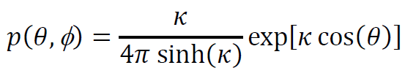
Fisher distribution similar in shape to a Gaussian but on a sphere
p(θ)
-π
π
angle, θ
Notes:
The fisher distribution has been cooked up
to look something like a gaussian
at least when its narrow.
Fig. 12.14. Fisher distribution, p(θ,, ϕ), for a large precision parameter (κ=5, blue curve) and a small precision parameter (κ=1, red curve). MatLab script gda12_10.

Slide 69
Fisher distribution similar in shape to a Gaussian but on a sphere
κ=5
p(θ)
κ=1
-π
π
angle, θ
“precision parameter”
quantifies width of p.d.f.
Notes:
Its narrowness is controlled by a “precision parameter”, kappa
When kappa is large
the p.d.f. is narrow.
When kappa is small
the p.d.f. tends to a uniform distribution.
the normalization out in front of the exponential
has been chosen so that the intergal of the p.d.f.
over the surface of a unit sphere is unity.
Fig. 12.14. Fisher distribution, p(θ,, ϕ), for a large precision parameter (κ=5, blue curve) and a small precision parameter (κ=1, red curve). MatLab script gda12_10.

Slide 70
solve by direct application of principle of maximum likelihood
Notes:
Previously, we used the principle of maximum likelihood
to demonstrate that when the data are gaussian distributed
the arithmentic mean is the best estimate
of the true mean.
Now we will apply this same principle to the problem of central directions.

Slide 71
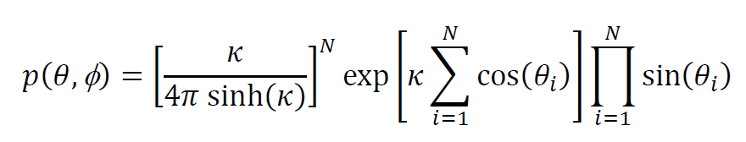
maximize joint p.d.f. of data
with respect to
κ and cos(θ)
Notes:
The joint distribution of the data is given by this formula,
which has two unknowns, cos(theta) and kappa.
Note the addition of the sine factor
That comes from the fact that an area intergral over a sphere contains a factor of sine theta

Slide 72

x: Cartesian components of observed unit vectors m: Cartesian components of central unit vector; must constrain |m|=1
Notes:
The central vector is parameterized by its cartestian components, m.
Note that cos(theta) is just the dot product of the cartesian components of an observed direction
with the central vector

Slide 73
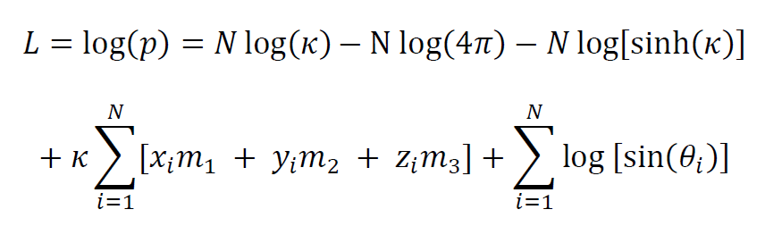

likelihood function
constraint
C =
= 0
unknowns
m, κ
Notes:
So the formula for the likelihood function is as shown.
We need to maximize it with respect to the unknowns, m and kappa.
But we need to add a constraint, since m must represent the cartesian components of a unit vector.
hence we need to use lagrange multipliers

Slide 74
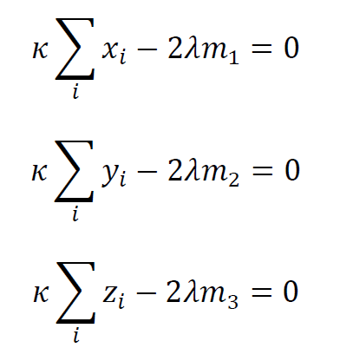
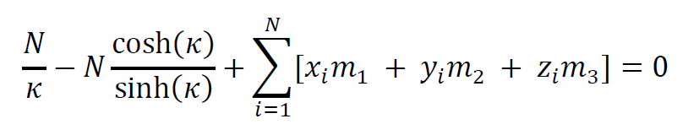
Lagrange multiplier equations
Notes:
Here are the lagrange multiplier equations.
We can solve the first three, for m very easily.
The last one, for kappa, is harder.

Slide 75
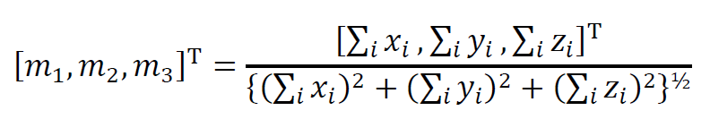
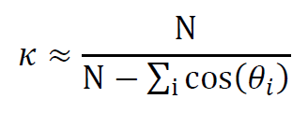
Results
valid when κ>5
Notes:
Here are the results.
Note that the formula for kappa is approximate and valid only when it is large, say greater than 5.

Slide 76
Results
central vector is parallel to the vector that you get by putting all the observed unit vectors end-to-end
Notes:
The central or “mean” vector is just the length-normalized
vector sum of the individual observed unit vectors,
what you would get by putting the observed unit vectors end to end.
That’s intuitively reasonable.

Slide 77
Solution Possibilities
Determine m by evaluating simple formula
Determine κ using simple but approximate formula
2. Determine κ using bootstrap method
only valid when κ>5
our choice
Notes:
The solution m can be computed very simply.
The only significant question is whether to use the approximate formula for kappa,
or whether to derive a measure of the certainty of the central vector empirically
using bootstraps.
We choose the latter.

Slide 78
Application to Subduction Zone Stresses
Determine the mean direction of
P-axes
of deep (300-600 km) earthquakes
in the Kurile-Kamchatka subduction zone
Notes:
We apply the technique to subduction zone data.
Each earthquake that occurs in the subduction zone has an associated “P axis”,
which is related to the direction of maximum compressional stress.
The P-axis direction can be seismologically, using earthquake focal mechanisms.
We process data from many Kurile subduction zone earthquakes
to find the “centra” or “mean” P axis direction.

Slide 79
N
E
data
central direction
bootstrap
Notes:
Here are the results.
The back dots are the data.
The red dot is the central direction, as determined by the method.
The blue dots is the scatter of the central direction, as determined by the boostrap method.
Fig. 12.15. Lower-hemisphere stereonet showing P-axes of deep (300-600 km) earthquakes in the Kurile-Kamchatka subduction zone. The axes mostly dip to the west, parallel to the direction of subduction, indicating that the subducting slab is in down-dip compression. (Black circles) Axes of individual. (Red circle) central axis, computed by maximum-lilelihood technique. (Blue dots) Scatter of central axis determined by bootstrapping. Data courtesy of the Global CMT Project. MatLab script gda12_11.

