Slide 1
SpaceX Launch Success Prediction
Sajeev Karunakaran
09/11/2025

Slide 2
Executive Summary
Project Objective:
Predict SpaceX rocket landing success using data analytics and machine learning.
Key Findings:
- 55 launches from CCAFS SLC 40
- Success rate: 64.89%
- 41 successful drone-ship landings
- Decision Tree achieved 83.33% accuracy

Slide 3
Methodology
1. Data Wrangling & Cleaning
2. Exploratory Data Analysis (EDA)
3. SQL Query Exploration
4. Folium Map Visualization
5. Plotly Dashboard Analysis
6. Machine Learning Model Development

Slide 4
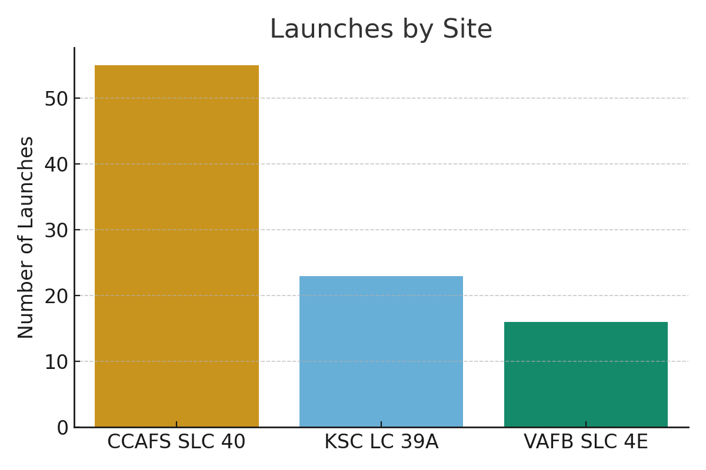
Launches by Site
CCAFS SLC 40 had the highest number of launches.

Slide 5
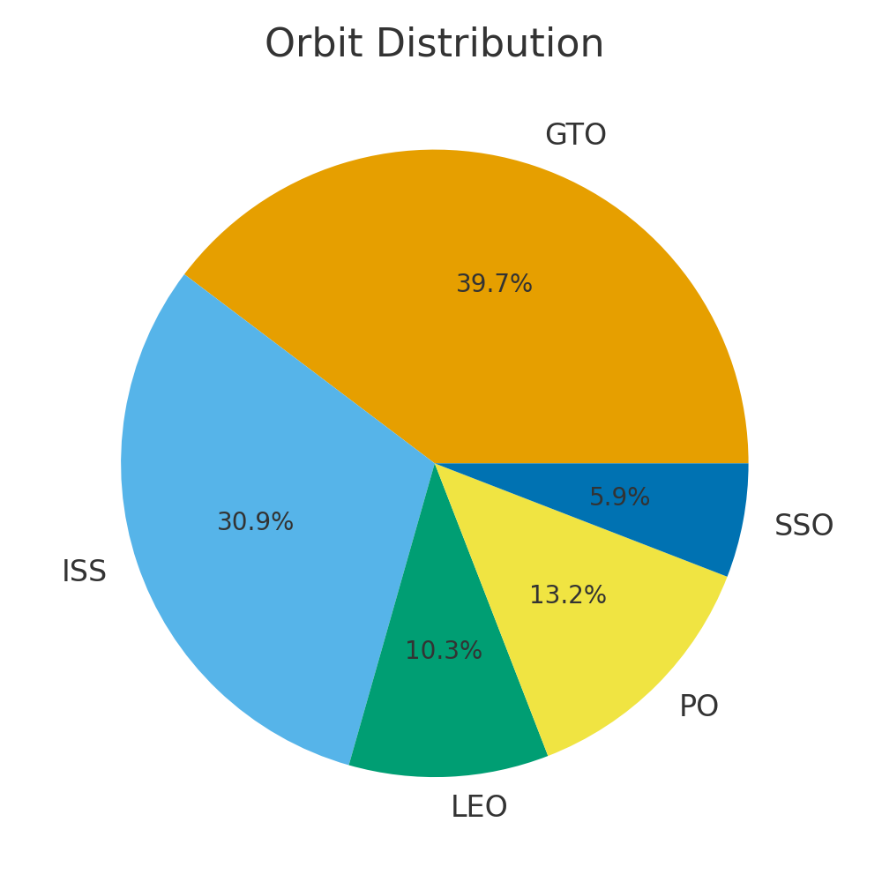
Orbit Distribution
Most missions targeted GTO and ISS orbits.

Slide 6
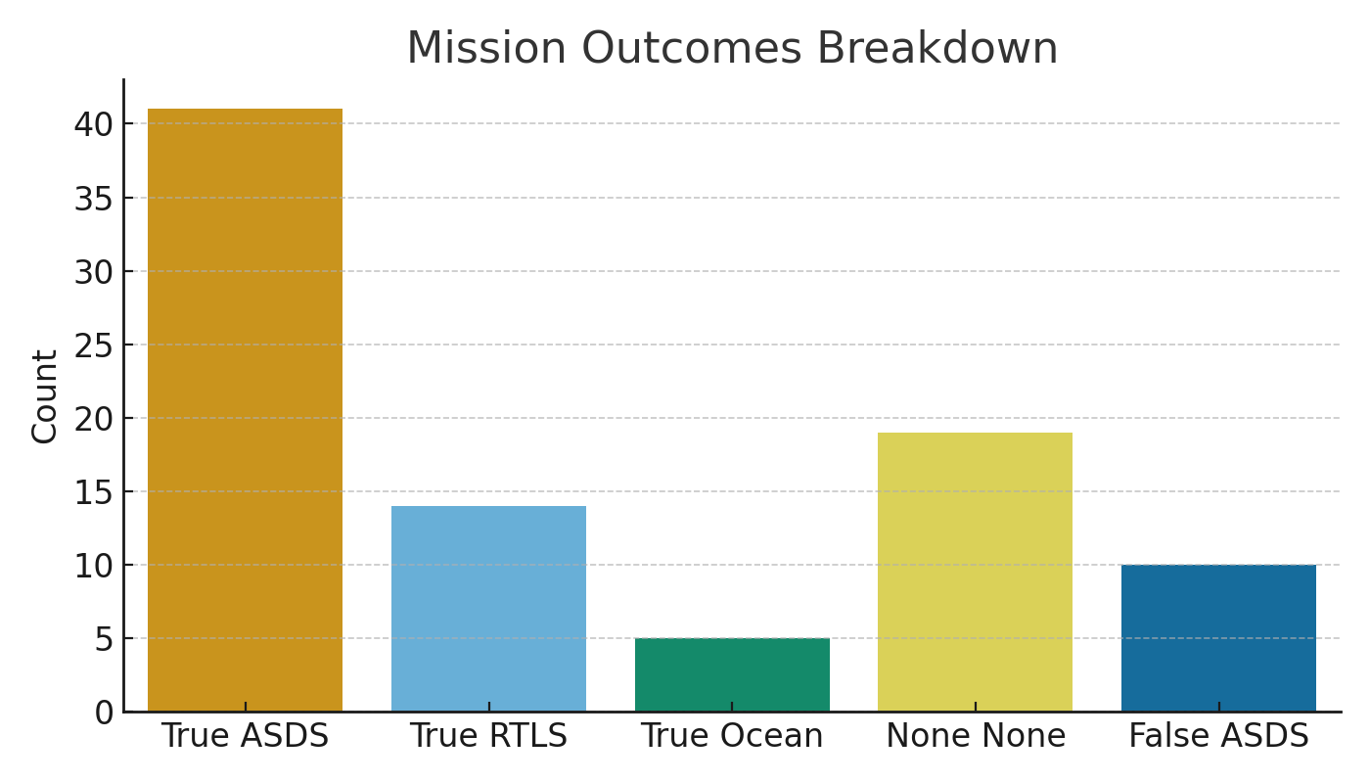
Mission Outcomes Breakdown
True ASDS (drone-ship success) had the highest frequency.

Slide 7
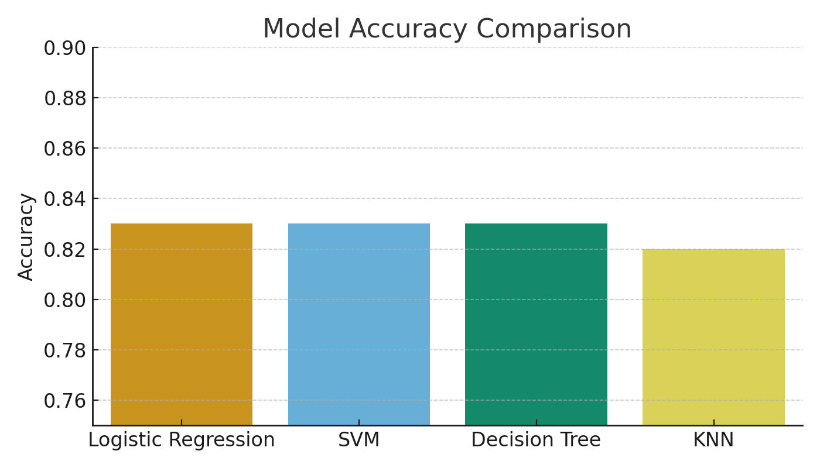
Model Accuracy Comparison
Decision Tree achieved the highest accuracy of 83.33%.

Slide 8
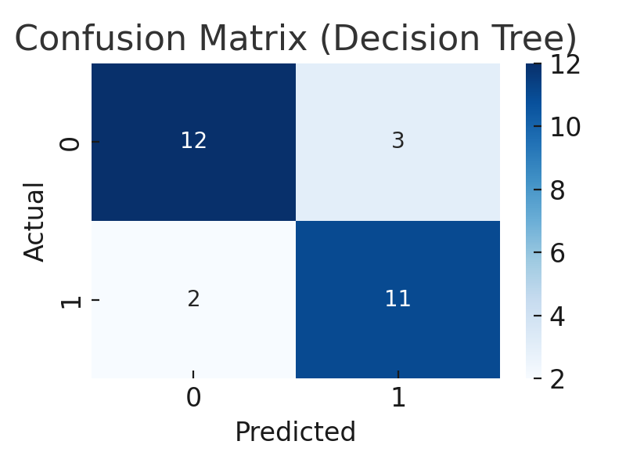
Confusion Matrix (Decision Tree)
Model correctly predicted 12 successful landings and 11 failures.

Slide 9
Conclusion
Summary:
- 18 test samples used for model evaluation.
- Best SVM kernel: RBF.
- Decision Tree achieved 83.33% accuracy.
Insights:
- Launch site and orbit type influence success probability.
- Data-driven models can effectively predict mission success.
Future Work:
- Implement ensemble models (Random Forest, XGBoost)
- Explore time-series prediction of launch trends.

