Slide 1
Operations Management
Work-force management
work standards & work measurement methods
IPE 323
Lecture # 8
M. Abu Hayat Mithu, PhD
Associate Professor
Department of Industrial & Production Engineering
Shahjalal University of Science and Technology, Sylhet, Bangladesh. Email: mithu-ipe@sust .edu ; mithuipe@gmail.com
Department of Industrial and Production Engineering
Shahjalal University of Science and Technology (SUST)
Sylhet, Bangladesh

Slide 2
Work-force management
Reasons for Lost Time at Work
Work related interruptions
Non-work related interruptions
Machine breakdowns
Waiting for materials or parts
Receiving instructions from foreman
Talking to co-workers about work-related matters
Rest breaks for fatigue
Cleaning up at end of shift
Personal needs (restroom breaks, washroom, fooding)
Talking to co-workers about matters unrelated to work
Lunch break
Smoke break
Beverage break
Personal telephone call
Gaming, watching television

Slide 3
Work-force management
How to Allow for Lost Time
Two approaches used:
Scheduled rest breaks during the shift
Breaks are planned periods set aside during the shift as break time from work. Lunch breaks, or supper break for evening and night shifts are almost always handled this way. The duration of these breaks is typically 5 to 15 minutes. All workers take their breaks during these specified times, workers are paid during these breaks.
A PFD allowance is added to the normal time
Personal time: Rest room breaks, phone calls, water fountain stops, cigarette breaks (5% typical)
Fatigue: Rest allowance to overcome fatigue due to work-related stresses and conditions (5% or more)
Delays: Machine breakdowns, foreman instructions (5% typical).

Slide 4
Work-force management
Other Types of Allowances
Contingency Allowance
Additional allowance due to a problem with the task (e.g., raw material problem ) - not greater than 5%
Policy allowance
These allowances are intended to cover special work situations that are usually associated with a wage incentive system.
Training allowance
For workers whose responsibilities include teaching other new workers in their jobs.
Learning allowance
For workers who are learning a new task or new employees who are just beginning to work.

Slide 5
Work-force management
Other Types of Allowances
Rest Allowances
1. Constant allowance
(a) Personal allowance ……………... 5
(b) Basic fatigue allowance ………… 4
2. Variable allowances:
(a) Standing allowance ……………… 2
(b) Abnormal position
(i) Awkward (bending) ………… 2
Very awkward (lying, stretching) …………………… 7
Use of force or muscular energy in lifting,
pulling, pushing weight lifted (pounds)
20 lb, 40 lb, 60 lb……………………… 3, 9, 17
(d) Bad light:
Well below recommended…. 2
Quite inadequate……………. 5

Slide 6
Work-force management
Other Types of Allowances
Rest Allowances
Atmospheric conditions (heat and humidity) …………… 0-10
Close attention:
(i) Fine or exacting……………….. 2
(ii) Very fine or very exacting…… 5
(g) Noise level:
(i) Intermittent—loud…………….. 2
(ii) Intermittent—very loud, or high-pitched 5
(h) Mental strain:
(i) Complex or wide span of attention.…………………….. 4
(ii) Very complex………………….. 8
(j) Tediousness:
(i) Tedious…………..……………… 2
(ii) Very tedious.…………………… 5

Slide 7
Work-force management
Example #1: Time Study
Given that,
Average observed time = 4.0 minutes
Worker rating = 85%
Allowance factor = 13%
then,
Normal time = (Average observed time) x (Rating factor)
= (4.0)x(0.85)
= 3.4 minutes
Normal time
1 - Allowance factor
Standard time =
3.4
1 - .13
=
= 3.9 minutes

Slide 8
Work-force management
Example #2: Time Study
Given that,
Allowance factor = 15%
Cycle Observed (in min)
Performance
Job element 1 2 3 4 5 Rating
Compose and type letter 8 10 9 21* 11 120%
Type envelope address 2 3 2 1 3 105%
Stuff, stamp, seal, and 2 1 5* 2 1 110% sort envelopes
Delete unusual or nonrecurring observations (marked with *)
Compute average times for each element
Average time for A = (8 + 10 + 9 + 11)/4 = 9.5 minutes
Average time for B = (2 + 3 + 2 + 1 + 3)/5 = 2.2 minutes
Average time for C = (2 + 1 + 2 + 1)/4 = 1.5 minutes

Slide 9
Work-force management
Example #2: Time Study
Compute the normal time for each element
Normal time = (Average observed time) x (Rating)
Normal time for A = (9.5)(1.2) = 11.4 minutes
Normal time for B = (2.2)(1.05) = 2.31 minutes
Normal time for C = (1.5)(1.10) = 1.65 minutes
Add the normal times to find the total normal time
Total normal time = 11.40 + 2.31 + 1.65 = 15.36 min
Compute the standard time for the job
Total normal time
1 - Allowance factor
15.36
1 - 0.15
Standard time =
=
= 18.07 minutes

Slide 10
Work-force management
Example #3: Time Study
The average observed time for a repetitive work cycle in a direct time study was 3.27 min. The worker’s performance was rated by the analyst at 90%. The company uses a PFD allowance factor of 13%. What is the standard time for this task?
Solution:
Normal time T_{n} = 3.27 (0.90) = 2.943 min
Standard time T_{std} = 2.943 (1 + 0.13) = 3.326 min
Normal time = (Average observed time) x (Rating)
Total normal time
1 - Allowance factor
Standard time =

Slide 11
Work-force management
Example #4: Time Study
Determine the personal time, fatigue, and delay (PFD) allowance to be used for computing time standards in the following situation. Second shift workers punch in at 3:30 p.m. and punch out at 12:00 midnight. They are provided one-half hour for supper at 6:00 p.m., which is not counted as part of the 8‑hour shift. For purposes of determining the allowance, 30 minutes of break time (personal time and fatigue) are allowed each worker. In addition, the plant allows 35 min for lost time due to unavoidable delays. What should the PFD allowance factor be?
Solution:
Allowance time
30 min of break time + 35 min for lost time = 65 min
Allowance factor A_{pfd} = 480* / (480 – 65) – 1
= 1.157 – 1 = 0.157 = 15.7%
480* = (6:00PM – 3:30PM =) 150 min + (12:00AM – 6:30PM =) 330 min

Slide 12
Work-force management
Example #5: Time Study
The work shift at the ABC Company runs from 7:30 a.m. to 4:15 p.m. with a 45 min break for lunch from 11:30 to 12:15 p.m. that does not count as part of the work shift (workers are not paid for this time). The company provides two 12-min rest breaks during working hours (paid time), one in the morning and one in the afternoon. The company also allows 25 min per day for personal needs (paid time). In addition, a work sampling study has shown that on average, unavoidable delays in the plant result in 20 min lost time per worker per day (paid time). Determine the PFD allowance factor for the following two management policies on allowances: (a) the two 12-min breaks are both scheduled breaks that all workers take at the same time and (b) the two 12-min breaks are included in the allowance factor so that workers can take their breaks whenever they please.
Solution
Allowance time consists of 25 min for personal time + 20 min for delay time = 45 min.
The two 12 min rest breaks are not figured into the allowance factor, but they do reduce the total work time during the shift.
Total work time = 480 – 45 – 2 (12) = 411 min.
Thus, Allowance factor A_{pfd} = 45/411 = 0.1095 = 10.95%
(b) Allowance time consists of two 12 min rest breaks + 25 min for personal time + 20 min for delay time = 69 min.
Total work time = 480 – 45 – 2(12) = 411 min. Thus,
Allowance factor A_{pfd} = 69/411 = 0.1679 = 16.79%

Slide 13
Work-force management
Sample Size
Why we study sample size?
How accurate we want to be
The desired level of confidence
How much variation exists within the job elements
Determination of sample size
zs
hx
2
Required sample size = n =
where h = accuracy level desired in percent of the job element expressed as a decimal
z = number of standard deviations required for the desired level of confidence
s = standard deviation of the initial sample
x = mean of the initial sample
n = required sample size

Slide 14
Work-force management
Sample Size
Desired accuracy with 5%
Confidence level = 95%
Sample s. dev = 1.0
Sample mean = 3.00
Common z Values
Desired Confidence (%) | z Value (sd required for desired level of confidence)
90.0 | 1.65
95.0 | 1.96
95.45 | 2.00
99.0 | 2.58
99.73 | 3.00
h = 0.05 x = 3.00
s = 1.0 z = 1.96
(from Table)
zs
hx
2
1.96 x 1.0
.05 x 3
2
n =
= = 170.74 ≈ 171

Slide 15
Work-force management
Variations
If desired accuracy h is expressed as an absolute amount, substitute e for hx, where e is the absolute amount of acceptable error
z s
e
2
n =
When the std. dev. s is not provided, it must be computed as
∑(x_{i} - x)² ∑(Each sample observation - x)²
n - 1 Number in sample - 1
s = =

Slide 16

Work-force management
Some New Tools
PDA (personal digital assistant) software
With PDA software, it is possible to study elements, time, performance rate, and statistical confidence intervals can be created, edited, managed, and logged
Reduces or eliminates the need for data entry
A PDA, also known as a palmtop computer, or personal data assistant, is a mobile device that functions as a personal information manager. PDAs are largely considered obsolete with the widespread adoption of smartphones.

Slide 17
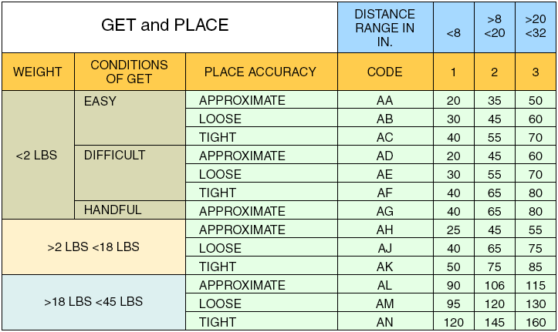
Work-force management
Some New Tools
MTM (Methods-Time Measurement) Table
Methods-Time Measurement table is a predetermined motion time system that is used primarily in industrial settings to analyze the methods used to perform any manual operation or task.

Slide 18
Work-force management
Some New Tools
MTM Table
Outcomes:
Weight - less than 2 pounds
Conditions of GET - easy
Place accuracy - approximate
Distance range - 8 to 20 inches
Element Description | Element | Time
Get tube from rack | AA2 | 35
Get stopper, place on counter | AA2 | 35
Get centrifuge tube, place at sample table | AD2 | 45
Pour (3 seconds) | PT | 83
Place tubes in rack (simo) | PC2 | 40
 | Total TMU | 238
.0006 x 238 = Total standard minutes = 0.14

Slide 19

Work-force management
Predetermined Time Stds
PTS is frequently used to set labor rates in industry by quantifying the amount of time required to perform specific tasks.
First such system is known as Methods-time measurement, released in 1948 and today existing in several variations, known as MTM-1, MTM-2, MTM-UAS, MTM-MEK and MTM-B.
Divide manual work into small basic elements that have established times
Can be done in a laboratory away from the actual production operation
Can be set before the work is actually performed
No performance ratings are necessary

Slide 20
Work-force management
Work Sampling
Estimates percent of time a worker spends on various tasks
Requires random observations to record worker activity
Determines how employees allocate their time
Can be used to set staffing levels, reassign duties, estimate costs, and set delay allowances
Advantages of work sampling
Less expensive than time study
Observers need little training
Studies can be delayed or interrupted with little impact on results
Worker has little chance to affect results
Less intrusive (disturbiance)

Slide 21
Work-force management
Work Sampling
Disadvantages of work sampling
Does not divide work elements as completely as time study
Can yield biased results if observer does not follow random pattern
Less accurate, especially when job element times are short
Steps for work sampling
Take a preliminary sample to obtain estimates of parameter values
Compute the sample size required
Prepare a schedule for random observations at appropriate times
Observe and record worker activities
Determine how workers spend their time

Slide 22
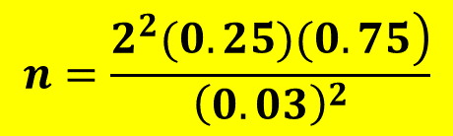
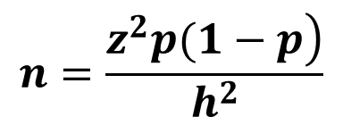
Work-force management
Work Sampling
Determination of sample size
$$n=\frac{\left.z^{2}p(1−p\right)}{h^{2}}$$
where
n = required sample size
z = standard normal deviate for desired confidence level
p = estimated value of sample proportion
h = acceptable error level in percent
Wants employees idle 25% of the time, Sample should be accurate within 3%, to have 95.45% confidence in the results
where n = required sample size
z = 2 for a 95.45% confidence level
p = estimate of idle proportion = 25% = .25
h = acceptable error of 3% = .03
$$n=\frac{\left.2^{2}(0.25)(0.75\right)}{{\left(0.03\right)}^{2}}$$
= 833 Observations

Slide 23


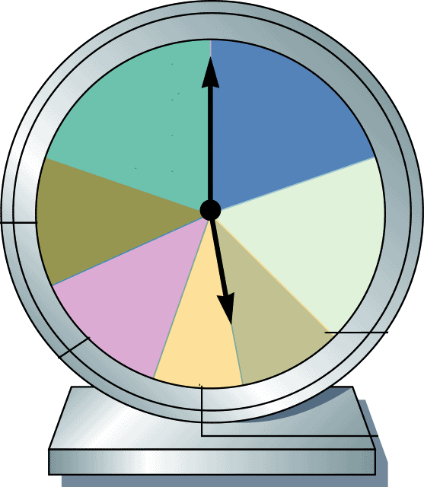
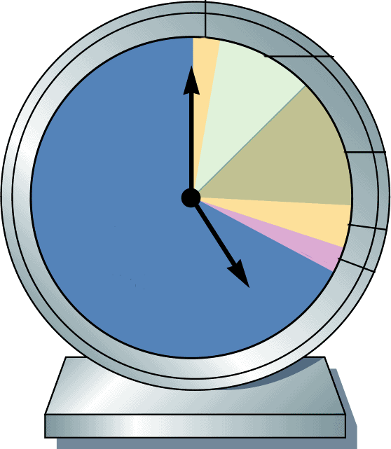
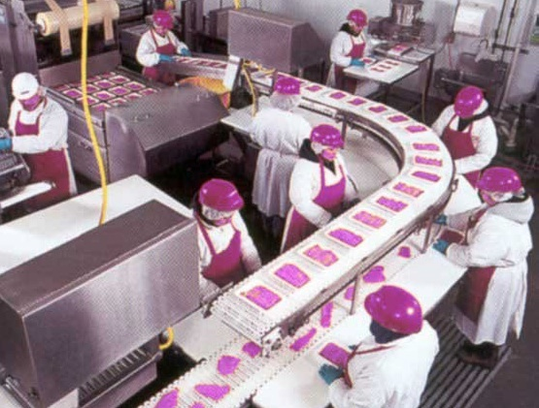
Work-force management
Work Sampling time studies
Example: Salespeople
Sales in person
20%
Travel
20%
Telephone sales
12%
Paperwork
17%
Lunch and personal
10%
Telephone within firm
13%
Meetings and other
8%
Startup/pep talk
3%
Breaks and lunch
10%
Example: Assembly line
Dead time between tasks
13%
Productive work
67%
Unscheduled tasks and downtime
4%
Cleanup
3%

Slide 24
Work-force management
Work Sampling Comparison
Advantages (over time study methods)
Less expensive as a single observer can observe several workers simultaneously
Observers do not require much training
No timing devices are needed
Observations are spread over a period of time, making results less susceptible to short term fluctuations
Worker has little chance of affecting the study’s outcome as it uses random observations over a long period
The procedure is less intrusive and thus less likely to generate objections
Studies can be interrupted without affecting the results
It is well suited for non repetitive tasks
Work of a long cycle time may be studied with fewer observer hours

Slide 25
Work-force management
Method Study Charting Techniques
Among many of traditional approaches, charting methods offer a graphic dimension to a selected problem.
These charts and diagrams are discussed below:
Operations process chart (OPC),
Flow process chart (FPC),
Flow diagram,
Man-machine chart,
Multiple activity chart,
String diagram.
OPC:
This chart is used for long time to display the operations, inspections, and their sequence for manufacture of a complete product in one figure. Operation includes all work performed by a worker or a crew at one location at one time.

Slide 26
Work-force management
Method Study Charting Techniques
Flow Process Chart (FPC):
Operations process chart pays attention only to operations, whereas FPC pays attentions on processing operations and additional components like transports or moves, delays and storages occurring during production.
It gives information regarding distance moved and time required for different items such as transportation, delays, and inspection, etc.
Storage indicates that the product come out of production’s control, and is under the control of another entity (e.g., the stockroom or warehouse).
Delay implies that the product remains under production’s direct control.
It is usually prepared for one component of an assembly at a time.

Slide 27
Work-force management
Method Study Charting Techniques
Different activities are represented by the following symbols:
Operation,
Transportation,
Inspection,
Storages,
Delay
FPC is particularly effective in tracing the distance traveled by a part in plant specially if the plant is not designed scientifically.
Three types of FPCs are :
Machine type FPC – based on machine analysis;
Man type FPC - based on man analysis;
Product type FPC - based on product analysis.

Slide 28
Work-force management
Method Study Charting Techniques
Flow Diagram
the plan view of a work to a certain scale and a line diagram which indicates the path followed by object under study.
shows the path followed by materials , man or machine.
Where more than one floor is involved, an isometric drawing can be used.
FDs are very simple and effective tools of methods study.
very useful in establishing overall sequence of operations and in determining the best layout.
presents a clear picture of a process and are very effective tools to study and improve a complex job.

Slide 29
Work-force management
Method Study Charting Techniques
Multiple Activity Chart (MAC):
It is a graphic representation of the simultaneous activities of more than one man or machine on a common time scale to show their inter-relationship.
These can be effective in analyzing situations in which at least two resources are employed within an operation.
The objective is to group or arrange the sequence of events with respect to the resources employed so that a minimum unit production time is determined.
MAC may be of the following types:
One man—one machine chart (Man-Machine Chart)
Two men—one machine chart
One men—two machine chart
Two or more men—one or more machine chart

Slide 30
Work-force management
Method Study Charting Techniques
Multiple Activity Chart (MAC):
One Man—Two Machines Chart
One man—Two machine chart can be used:
In finalizing the optimum number of machines - operator attend for minimum overall machine idleness.
Finalizing the optimum number of machines - operator can attend for his minimum overall idle period.

Slide 31
One Man—Two Machines Chart
In planning man power to attend the machines.
In scheduling the jobs for overall maximum man-machine utilization.
Example

Slide 32
Work-force management
Method Study Charting Techniques
Left Hand-Right Hand chart
When two hands of an operator are not moved simultaneously
(in general), then it can be studied by a ‘Left Hand-Right Hand chart’ as illustrated by the example:
Job Description | Time
Searching, holding and lifting work-piece to vice table by LH | 0.2 min
Opening the vice by right hand (RH) | 0.1 min
Clamping the work-piece by both hands | 0.2 min
Holding and lifting the file by RH | 0.1 min
Hand filing by both hands | 1.5 min
Bring the micro-meter by RH | 0.1 min
Checking dimension by both hands | 0.4 min
Opening the vice by RH | 0.1 min
Removing the work-piece by left hand (LH) | 0.1 min

Slide 33
Work-force management
Method Study Charting Techniques
Left Hand-Right Hand chart
Description | Syl | Time (min) | Syl | Description
Lift the work piece |  | 0.2 |  | RH idle
LH idle |  | 0.1 |  | Opening the vice
Clamping the work piece by both hands |  | 0.2 |  | Clamping the w/p
LH idle |  | 0.1 |  | Holding and lifting the file
Hand filing by both hands |  | 1.5 |  | Hand filing
LH idle |  | 0.1 |  | Bringing micrometer
Checking dim. by both hands |  | 0.4 |  | Checking dimension
LH idle |  | 0.1 |  | Opening the vice by RH
Removing the work piece |  | 0.1 |  | RH idle
Summary
Left hand idle time = 0.3 min
Right hand idle time = 0.3 min

Slide 34
Work-force management
Method Study Charting Techniques
String Diagram
A length of string is used to record the extent as well as the pattern of movement of a worker or piece of equipment within a limited area during a certain period of time.
Used to study where the journeys are irregular in distance and frequency, such as:
When a group of operators is working.
When a single operator is attending several machines.
In process, where several sub-assemblies have to be moved to other assembly.
Where processes require the operator to be moved from one work-place to another.
For checking the relative value of various layout.

Slide 35
Work-force management

Slide 36
Work-force management

Slide 37
Work-force management

Slide 38
Work-force management

Slide 39
Work-force management

Slide 40
Work-force management

