Slide 1

Operations Management
IPE 323
3.00 credits
3 Hrs/week
Production Planning and Control
Class Schedule (weekly)
Monday
Time: 9.00 – 9.50 AM
Tuesday
Time: 11.00 – 11.50 AM
Thursday
Time: 11.00 – 11.50 AM
Term Tests
Term Test # 1, at 13th Class
Term Test # 2, at 25th Class
M. Abu Hayat Mithu, PhD
Associate Professor
Dept. Industrial and Production Engineering
Shahjalal University of Science & Technology
Sylhet -3114, Bangladesh.
Ph. 821-713491, 714479, 713850, 717850, Ext. 268
Email: mithu-ipe@sust .edu ; mithuipe@gmail.com

Slide 2
Syllabus
IPE 323 OPERATIONS MANAGEMENT
3 Hrs/week, 3.0 credits
Production planning: Different types of production processes and their characteristics; Work-force management: work standards and methods of work measurement, time study. Method and Motion Study, Process planning, Value chain management, Forecasting: forecasting models and their applications; ABC analysis; Capacity Planning and Aggregate planning, concept of lumpy demand, MRP (including MPS and BOM), MRP, ERP and CRP, MRP-II, JIT and waste reduction, Characteristics of JIT (Pull-flow, Quality related issue, small lot size, set up time reduction, supplier related issue), Kanban system, Kaizen. Comparison of JIT and MRP.
Production Control: Dispatching, Routing, Scheduling and machine loading (scheduling in different situations and sequencing, scheduling techniques- 1 m/c & n jobs (EDD, FIFO, CR, SPT) and 2 m/c & n jobs Johnsons rule).
Inventory control: concept of inventory, EOQ, different types of inventory models (P and Q), Progress controlling (bar chart, curve chart, gantt chart).

Slide 3
Mission and Vision
Operations Management (OM) is concerned with planning and controlling all aspects of manufacturing, including managing materials, scheduling machines and people, and coordinating suppliers and key customers.
Therefore, we’ll learn:
What are the typical tasks performed by the operations management and how do these tasks affect company operations?
What are the key Production planning and control system components and how do they respond to a company’s needs?
How do product and process issues affect on manufacturing system (factory, organization, company etc)?
Evolution of what forces drive changes in the Manufacturing system and how do companies respond to the forces?

Slide 4
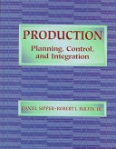
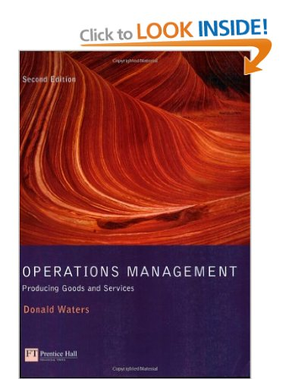
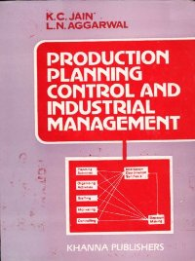




Reference Books
Production: Planning, Control and Integration
D. Sipper and R. Bulfin
Mcgraw-Hill, 1998
Operations Management: Producing Goods and Services
Donald Waters
Addison Wesley, 1996
Production Planning And Control and Industrial Management
K C jain , L. N. Agarwal
Khanna Publishers, 2002
Production Management
K C jain , L. N. Agarwal
Khanna Publishers, 2002
Operations Management
William Stevenson
McGraw-Hill, 2011
Theory and Problems in Production and Operations Management
S. N. Chary
Tata McGraw-Hill, 1995

Slide 5
Introduction
Concerned with the logistics problems in manufacturing:
Managing the details of what, when, and how many products (products and services) to produce,
Obtaining the raw materials, parts, and resources to produce them
Operations management (OM) solves these logistics problems by managing information
Currently OM is the integrator in computer integrated manufacturing
Aggregated to: Production planning & master production schedule, Material requirements planning, Capacity planning, Shop floor control, Inventory control, Extensions of MRP etc.

Slide 6
Introduction
Production Planning concerned with:
Deciding which products to make, how many of each, and when they should be completed;
Scheduling the delivery and/or production of the parts and products;
Planning manpower, equipment and other resources needed to accomplish the production plan
Main activities of PP:
Aggregate production planning – planning the production output levels for major product lines;
Master production planning – specific schedule of quantities of individual models in each major product line;
Material requirements planning (MRP) – detailed schedule of raw materials and parts production for master scheduling;
Capacity planning – planning labor and equipment resources to achieve the master schedule

Slide 7
Introduction
Production control concerned ??
Production control concerned with determining whether the necessary resources to implement the production plan have been provided
If not, it attempts to take corrective action to address the deficiencies
Major topics in production control:
Shop floor control
Manufacturing execution systems
Inventory control
Manufacturing resource planning
Enterprise resource planning

Slide 8
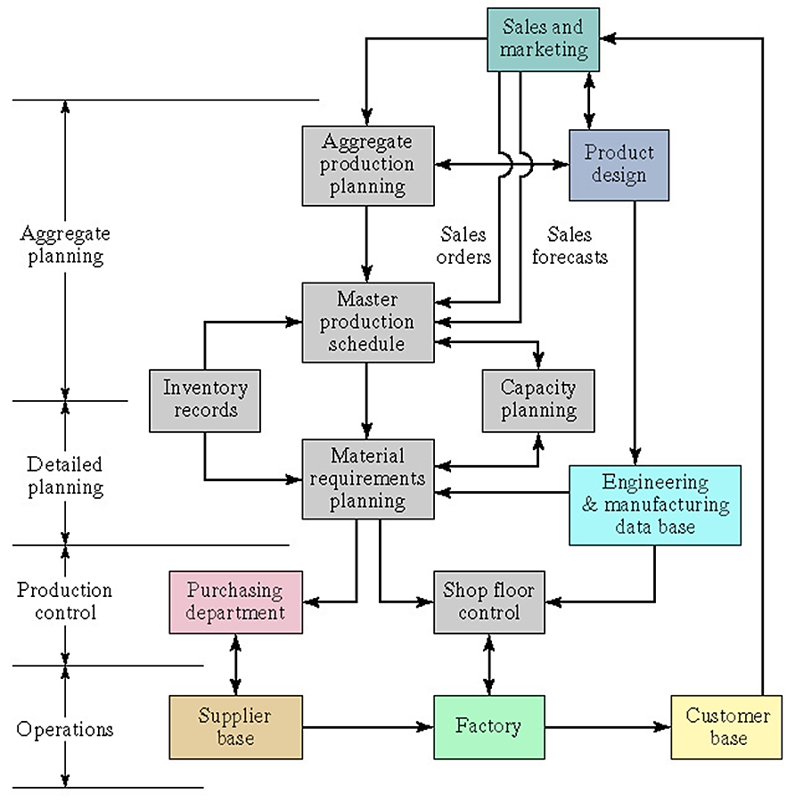
Introduction
Activities in a Production Planning and Control System

Slide 9
Introduction
Planning & Control Activities ???
How much to do?
When to do things?
Scheduling
Loading
Sequencing
Monitoring
& Control
In what order to do things?
Are activities going to plan?

Slide 10
Introduction
Production Planning and Control Activities:
Four overlapping activities are:
Loading,
Sequencing,
Scheduling, and
Monitoring and control
Valuable operating time
the best operations, can be significantly below the maximum time available.
Loading
Example: A machine on the shop floor works 168 hrs a week. It does not mean that 168 hours of work can be loaded onto that machine. For some periods the machine cannot be worked; therefore, the load put onto the machine must take this into account. If the machine breaks down, it will not be available, it must also be taken into account.
The amount of work that is allocated to a part of an operation.

Slide 11
Introduction
Sequencing
When work arrives at any part of an operation decisions must be taken on the order in which the work will be tackled, this activity is termed sequencing
The priorities given to work base on:
Customer priority
Physical constraints
Due date (DD)
Last-in first-out (LIFO)
First-in first-out (FIFO)
Longest operation time (LOT)
Shortest operation time first (SOT)
Judging sequencing rules
The activities of ordering the work based on priority

Slide 12
Introduction
Scheduling
The activity of preparing a detailed time-table showing at what time or date jobs should start and when they should end.
Example: A bus schedule shows that more buses are put on routes at more frequent intervals during rush-hour periods. The bus schedule shows the time each bus is due to arrive at each stage of the route.
The complexity of scheduling
Forward and backward scheduling
Gantt charts
Scheduling work patterns
The activity of preparing the time-table showing the date and time of job.

Slide 13
Introduction
Scheduling
All have to be scheduled based on:
Capacity matches demand,
Length of each shift,
Working at unsocial hours and off days,
Vacation and other ‘time-off ’ blocks,
Sufficient flexibility (if any)
Unusual causes, staff illness, demand
The activity of preparing the time-table showing the date and time of job.

Slide 14
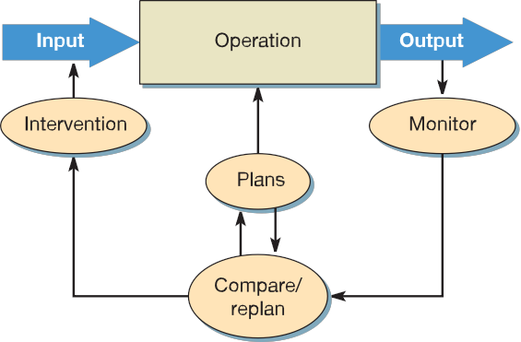
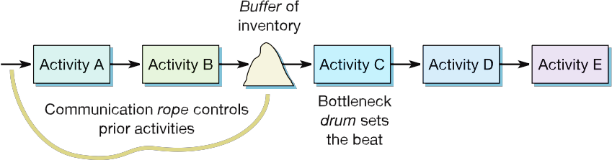
Introduction
Monitoring
The activity watching all the operations such as loading, sequencing and scheduling, each part of the operation to ensure that planned activities are indeed happening.
Push and
pull control
Drum, buffer, rope
The activity of watching all the operations such as loading, sequencing and scheduling, each part of the operation

