Slide 1
Software Project Lab-1 Basic Image Manipulation
Submitted by: Supervised:
Md. Khayrul Islam Sajib Dr. B M MainulHossain
Roll : BSSE 1552 (Professor & Director), IIT
Language used: C++
Github Link: sajib91 (Md. Khayrul Islam Sajib)

Slide 2
Project Objective
➢ Implementing the following image processing algorithms: -
▪ Edge Detection
▪ Grey Scaling
▪ Smoothing
▪ Negative
▪ Histogram
▪ Angle calculation
▪ Brightening
▪ Blurring
▪ Sharpening

Slide 3
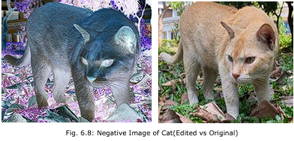
Negative Image
A negative image is a total inversion, in which light areas appear dark and vice versa. A negative color image is additionally color-reversed with red areas appearing cyan, greens appearing magenta, and blues appearing yellow, and vice versa.
Computes the negative color:
New Color = 255 - Original Color;
Example Calculation:
Original pixel: (R=50, G=100, B=200)
Negative pixel: (R=255-50 = 205, G=255-100 = 155, B=255-200 = 55)

Slide 4
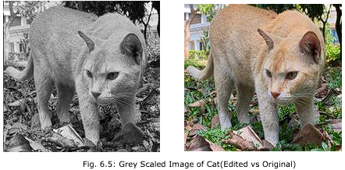

Grayscale Image
By assigning the same value (avg) to all three channels (r, g, b) for every pixel:
Grey scaling is done by making each pixel between the values 0 -255. Since our 24-bit image contains three values in pixels. I took the average of all the red, green and blue values and replace all the values in that pixel with the average value. In this way, a pixel will of a single value between 0 -255. Hence, the output image will be grey scaled properly.
• Computes the average intensity of the three color channels.
The formula used: are replaced with their grayscale equivalent.
The resulting image will have no color, only varying shades of gray.

Slide 5
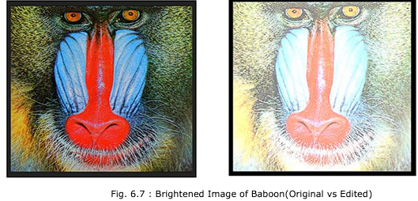
Brightening
Image brightening is a comparatively easy process in which the user inputted threshold is added to all the pixel values to brighten it to a certain level.
If the threshold + current value exceeds 255, then the algorithm sets that pixel value to 255.
Similarly, if user inputs negative value to reduce the brightness of the image and current value – threshold becomes negative, it is rounded to 0, making a darkened image.

Slide 6
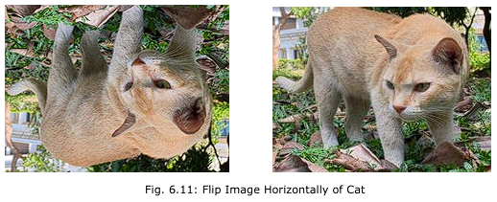
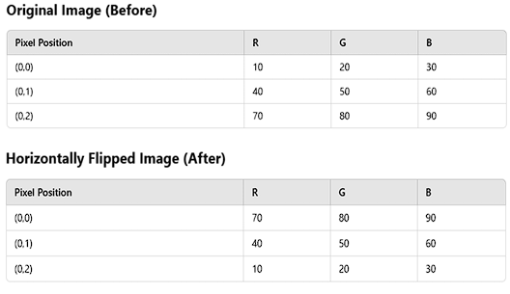
Flip
Perform the selected flip operation:
• Horizontal Flip: Swap left and right pixels.
• Vertical Flip: Swap top and bottom pixels.

Slide 7
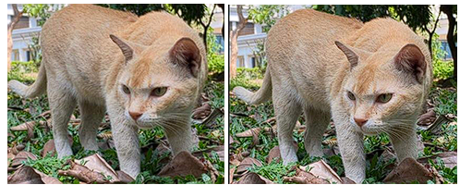
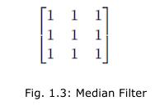
Smoothing
I have used median filtering algorithm to smoothen the image. Algorithm takes the median value of the pixel and its nearby pixels and change the value of that pixel to the median value. It requires the pixel values to be sorted to find the appropriate median. Since a pixel contains three internal values, the algorithm is applied to each of red, green and blue values of the pixel.
-> Define the 3×3 smoothing filter.
-> Iterate over each pixel (excluding the border).
-> Compute the sum of neighboring pixels.
-> Average the sum to get the new pixel value.

Slide 8
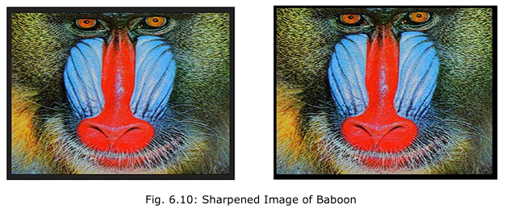
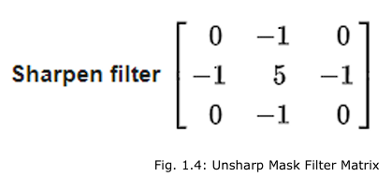
Sharpen
Image sharpening is the process of making an image less blurry or sharpening the edge pixels values to a certain point to make them look less blurry.
The unsharp masking algorithm is applied to this project. This algorithm creates a blurry image of the original image and then merges the two images to get a less blurry original image. Sharpening an image usually makes an image clearer. In this project, a 3 by 3 unsharp mask matrix is used to create a sharpened image.

Slide 9
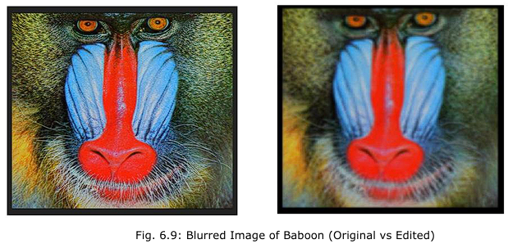
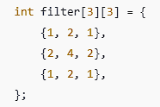
Gaussian Blur
Blurring uses an averaging algorithm where I use a 3 by 3 matrix through the pixel array of the image and set the central pixel value to the average value of that matrix. This makes all the pixels extremely smoothened with respect to the neighboring pixels. This process done three times on the three values of a pixel in our input image.
-> The Gaussian kernel is defined as a 2D matrix.
-> For each pixel in the image (except the boundary pixels),a weighted sum of its neighboring pixels is calculated using the filter.

Slide 10
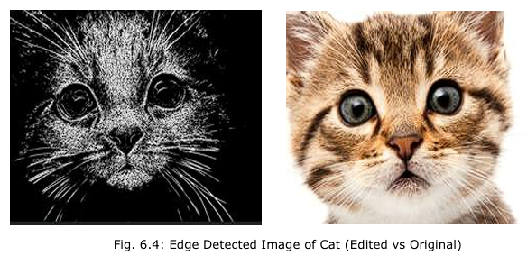
Edge Detection
I implemented the following algorithm with the help of Sobel’s operator, a 3 by 3 matrix that helps in determining the derivatives vertically and horizontally over a pixel.
Then, I calculate the resultant derivative. If the result is greater than a certain threshold then pixel value is set to 255 and if the value is below the threshold, that pixel is set to 0.
In this way, only the pixels that has gradients approximately near to the edges will only be lightened and other area of the image will be darkened.
A grey scaled image is necessary for the edge detection process, so I used the already implemented grey scaling function to grey scale a color image and then start detecting the edges.

Slide 11
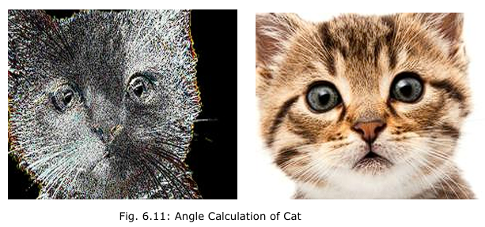
Angle Calculation
To be implementing an edge detection method using Sobel operators in the x and y directions and then computing the angle of the gradient for each pixel.
The core steps include:
Initialize Sobel Kernels (gx and gy) for edge detection.
User Input for angle threshold values.
Compute Sobel Gradient in X and Y directions for Red, Green, and Blue channels.
Calculate Gradient Angle using atan2(Ry, Rx).
Apply Threshold to determine edge pixels.

Slide 12
Challenges
Some of the challenges that I faced and solved are:
➢ Handling delicate data for pixels and headers
➢ Implementing multiple loops with exact limits
➢ Working with the matrices in programming
➢ Handling the delicate errors that were often caused by type conversion
➢ Image Learning –
▪ Bitmap Images and its header info
▪ Pixel data storage and RGB values information
▪ Gradients and intensity of the image based on the pixel values
➢ Image processing algorithms –
▪ Sobel’s edge detection algorithm
▪ Unsharp Masking
▪ Brightness Algorithm
▪ Median Filter Algorithm
▪ Gaussian Blur Algorithm

Slide 13


