Slide 1

JSON – JavaScript Object Notation
Dr. Charles Severance
www.wa4e.com
http://www.wa4e.com/code/json-01.zip
http://www.wa4e.com/code/json-02-chat.zip

Slide 2


Time
Browser
Web Server
Database Server
DOM
Send
Request
Apache
MySql
Parse
Response
PHP
ind.php
PDO
JavaScript
JQuery
http://www.wa4e.com/code/rrc/

Slide 3
Data on the Web
With the HTTP Request/Response well understood and well supported, there was a natural move toward exchanging data between programs using these protocols.
We needed to come up with an agreed way to represent data going between applications and across networks.

Slide 4

Agreeing on a “Wire Format”
PHP
Array
JavaScript
Object
{
"name" : "Chuck",
"phone" : "303-4456"
}
Python
Dictionary
Java
HashMap
a.k.a. “Wire Protocol” - What we send on the “wire”

Slide 5

JSON is a “Wire Format”
Serialize
JavaScript
Object
PHP
Array
{
"name" : "Chuck",
"phone" : "303-4456"
}
De-Serialize

Slide 6
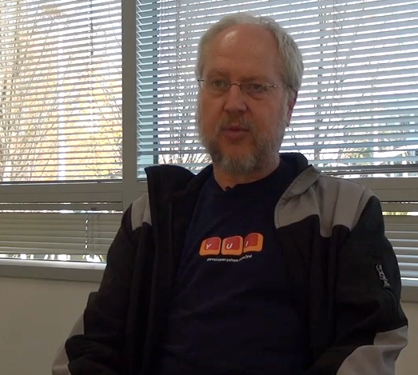
JavaScript Object Notation
Douglas Crockford – “Discovered” JSON
Object literal notation in JavaScript
https://www.youtube.com/watch?v=kc8BAR7SHJI

Slide 7
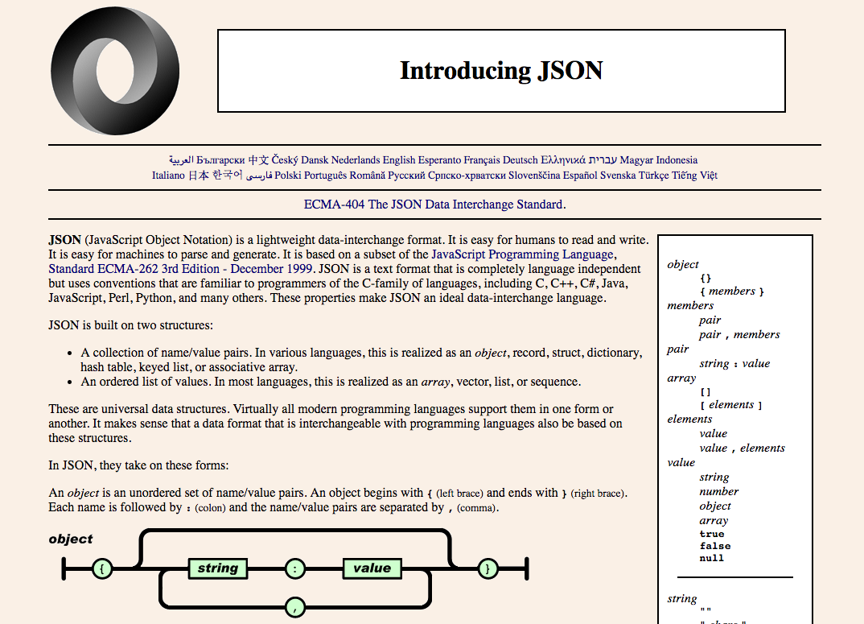
www.json.org
Derived from the JavaScript “constant” syntax
Similar to Python Dictionary syntax

Slide 8
JSON and jQuery

Slide 9
Associative Arrays Objects
JavaScript Associative Arrays are actually objects with member variables.
They can be accessed with either associative array syntax or object syntax.

Slide 10
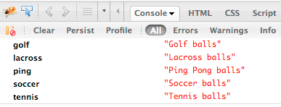
balls = {"golf": "Golf balls",
"tennis": "Tennis balls",
"ping": "Ping Pong balls"};
balls.soccer = "Soccer balls";
balls['lacross'] = "Lacross balls";
console.dir(balls);

Slide 11
JSON Syntax
who = {
"name": 'Chuck',
"age": 29,
"college" : true,
"offices" : [ '3350DMC', '3437NQ' ],
"skills" : { "fortran": 10,
"C": 10,
"C++": 5,
"python" : '7'
}
};
String
Integer
Boolean
List/Array
Object

Slide 12
json-01/syntax.php
<html><head/><body>
<script type="text/javascript">
who = {
"name": 'Chuck',
"age": 29,
"college": true,
"offices" : [ '3350DMC', '3437NQ' ],
"skills" : { 'fortran': 10, 'C': 10,
'C++': 5, 'python' : '7' }
};
window.console && console.log(who);
</script>
<p>Check out the console.log to see the cool object</p>
<pre>
....
Constant

Slide 13
<?php
sleep(2);
header('Content-Type: application/json; charset=utf-8');
$stuff = array('first' => 'first thing',
'second' => 'second thing');
echo(json_encode($stuff));
json-01/json.php
{
"first" : "first thing",
"second" : "second thing"
}
...
$(document).ready( function () {
$.getJSON('json.php', function(data) {
$("#back").html(data.first);
window.console && console.log(data);
})
}
);
...
json-01/index.php

Slide 14
JSON Chat

Slide 15
<?php
session_start();
if ( isset($_POST['reset']) ) {
$_SESSION['chats'] = Array();
header("Location: index.php");
return;
}
if ( isset($_POST['message']) ) {
if ( !isset ($_SESSION['chats']) ) $_SESSION['chats'] = Array();
$_SESSION['chats'] [] = array($_POST['message'], date(DATE_RFC2822));
header("Location: index.php");
return;
}
?>
<html>
<head>
<script type="text/javascript" src="jquery.min.js">
</script>
</head>
json-02-chat/index.php

Slide 16
<body>
<h1>Chat</h1>
<form method="post" action="index.php">
<p>
<input type="text" name="message" size="60"/>
<input type="submit" value="Chat"/>
<input type="submit" name="reset" value="Reset"/>
</p>
</form>
<div id="chatcontent">
<img src="spinner.gif" alt="Loading..."/>
</div>
<script type="text/javascript" src="jquery.min.js">
</script>
<script type="text/javascript">
....
json-02-chat/index.php

Slide 17
function updateMsg() {
window.console && console.log('Requesting JSON');
$.getJSON('chatlist.php', function(rowz){
window.console && console.log('JSON Received');
window.console && console.log(rowz);
$('#chatcontent').empty();
for (var i = 0; i < rowz.length; i++) {
entry = rowz[i];
$('#chatcontent').append('<p>'+entry[0] +
'<br/>&nbsp;&nbsp;'+entry[1]+"</p>\n");
}
setTimeout('updateMsg()', 4000);
});
}
// Make sure JSON requests are not cached
$(document).ready(function() {
$.ajaxSetup({ cache: false });
updateMsg();
});
json-02-chat/index.php

Slide 18
json-02-chat/chatlist.php
<?php
session_start();
sleep(5);
header('Content-Type: application/json; charset=utf-8');
if ( !isset($_SESSION['chats']) ) $_SESSION['chats'] = array();
echo(json_encode($_SESSION['chats']));
[
["Hello","Fri, 01 Apr 2016 00:47:38 +0200"],
["Lunch?","Fri, 01 Apr 2016 00:47:53 +0200"]
]

Slide 19
json-03-crud
http://www.wa4e.com/code/json-03-crud.zip

Slide 20
Summary
JSON is very simple and powerful.
It is well supported and performance in many languages.
JavaScript and PHP have excellent support.

Slide 21
Acknowledgements / Contributions
These slides are Copyright 2010- Charles R. Severance (www.dr-chuck.com) as part of www.wa4e.com and made available under a Creative Commons Attribution 4.0 License. Please maintain this last slide in all copies of the document to comply with the attribution requirements of the license. If you make a change, feel free to add your name and organization to the list of contributors on this page as you republish the materials.
Initial Development: Charles Severance, University of Michigan School of Information
Insert new Contributors and Translators here including names and dates
Continue new Contributors and Translators here

Slide 22
Additional Source Information
Image of Douglas Crockford is Copyright Charles R. Severance and licensed as CC-BY

