Slide 1
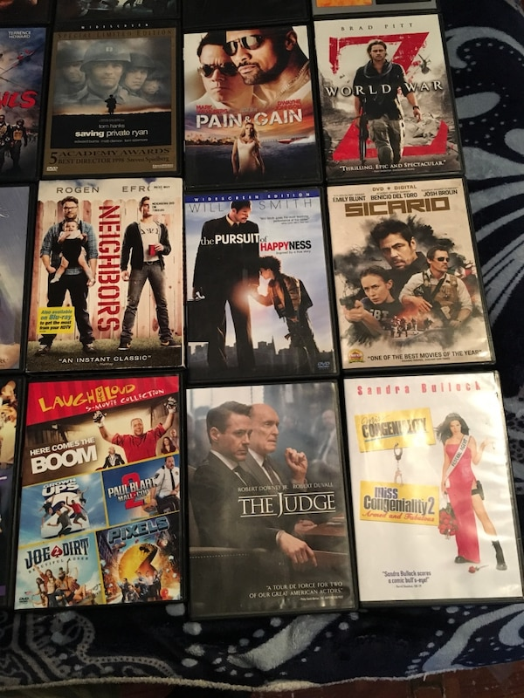
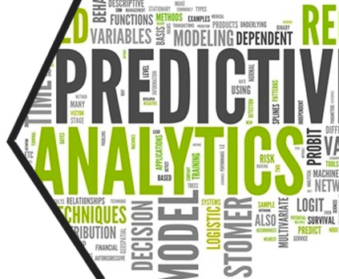
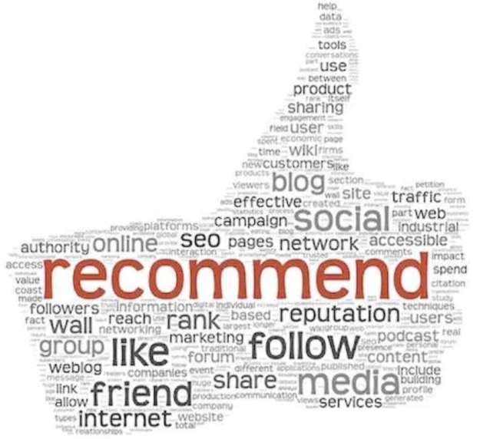
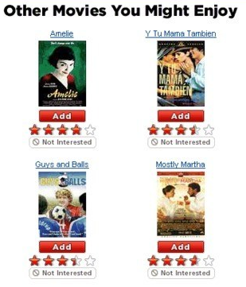


Data Science & Machine Learning
Capstone Project (13th Oct – 9th Nov 2019)
“Propensity to watch a video in the next 2 days”
> By
SAJIB HALDER
COHORT(9TH FEB-2019, DSMP-DL)

Slide 2
DS & ML – Capstone Project “Audience segmentation of a content app, based on its user’s propensity to watch a video in the next 2 days.”
INDEX
Problem Statement & Data Description
Dataset Features
Solution Overview
Data Exploration, EDA, Features Engineering & Selection
Model Building , Segmentation & Actionable Insight
Prediction Results & Recommendation Engine
Conclusion & CEO Pitch

Slide 3
Capstone Project : Problem Statement
Problem Statement>> Video watching Predication and Recommendation : Segment the audience of a content app based on its user’s propensity to watch a video in the next 2 days and recommend the users to watch the videos as per his / her taste.
Data Information: The data is related to the various event details for a Video Content app. As the user engages with the app, some of his actions are recorded in detail.
For eg. as soon as the user launches the app, an "AppLaunched" event is recorded which contains details such as timestamp, OS, device, country, userId etc.
When the user registers itself for the app, a "Registered" event is raised. Similarly when he views the details of a video or an episode, a "VideoDetails" event is recorded.
Also, when he starts watching a video, a "VideoStarted" event is raised.
App owners also engage with the customers via Push Notifications, SMS, emails etc. When a user clicks on any such campaign, a UTM Visited campaign is recorded.
Goal:- The goal is to classify the audience of a content app based on its user’s propensity to watch a video in the next 2 days and recommend the users to watch the videos as per his / her taste and previous history.

Slide 4
Dataset Features
AppLaunched.csv
Shape : (2716093, 8)
UserId object
Date int64
Minute_Of_Day int64
Second int64
State Int64
Country Int64
Device int64
OS int64
AppUninstalled.csv
Shape : (326684, 8)
UserId object
Date int64
Minute_Of_Day int64
Second int64
State int64
Country int64
Device int64
OS int64
Registration.csv
Shape : (329579, 9)
UserId object
Date int64
Minute_Of_Day int64
Second int64
State int64
Country int64
Device int64
OS int64
UTMVisited.csv
Shape : (495850, 8)
UserId object
Date int64
Minute_Of_Day int64
Second int64
State int64
Country int64
Device int64
OS int64
VideoDetails.csv1 VideoStarted.csv
Shape : (3695451, 12) Shape : (1796525, 12)
UserId object
Date int64
Minute_Of_Day int64
Second int64
State int64
Genre object
Category object
ProgramType object
Country int64
Device int64
OS int64
VideoId object

Slide 5
Dataset Features(Details):
Every event (Dataset) contains the following :
UserId: Every app user is assigned a unique identity
Date: The date on which this event was raised
Minute_Of_Day: The minute of that day on which the event was raised
Second: The second of the minute on which the event was raised. Date, Minute_of_Day and Second provides the exact timestamp of the event
Country: The country Id in which the user was present while doing the event.
State: The state Id of that country. For e.g. India will have State Ids in the range [1,29].
OS: The OS of the device from which event was raised. They are coded as : 0: Others, 1: Android, 2: iOS, 3: Windows, 4: Mac, 5: BlackBerry, 6: Linux
Device: The type of device. They are coded as : a. 0: Desktop, 1: Mobile, 2: Tablet, 3: TV
Some custom properties of specific events:
VideoStarted and VideoDetails
a) Genre : The genre of the video
b) ProgramType : Records the type - TVShow or Movie etc.
c) Category : Records the category - Video on demand("vod") or not
d) VideoId : The video name
Registered : a) Status: The status of the registration

Slide 6
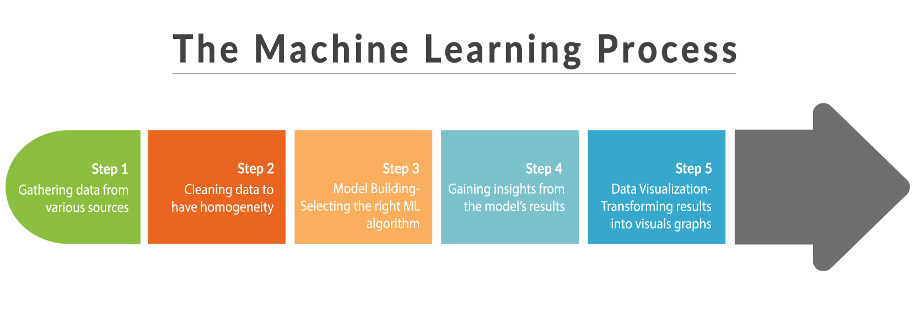
Solution Overview:
To build and deploy a recommendation engine that can segment the users on the basis of their propensity to watch a video in the next 2 days, follow the steps below :
Setting the approaches based on the desired goal
Retrieving Data
Data Exploration & Visualization
Building the recommendation engine

Slide 7
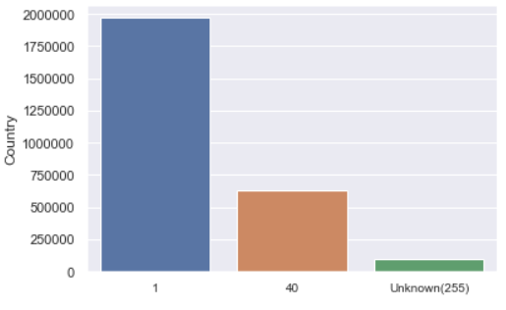
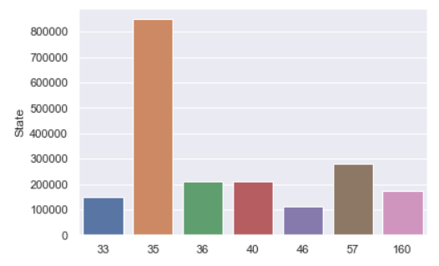
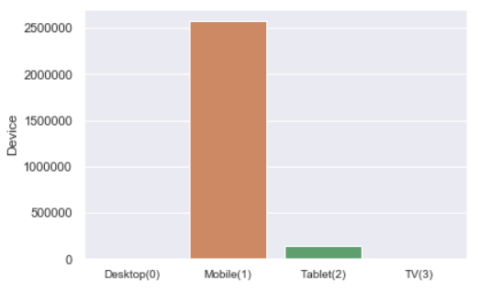
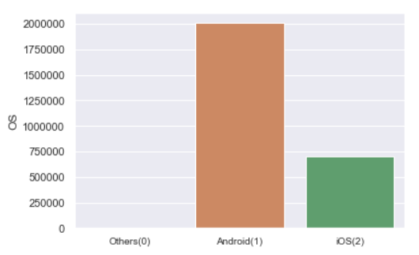
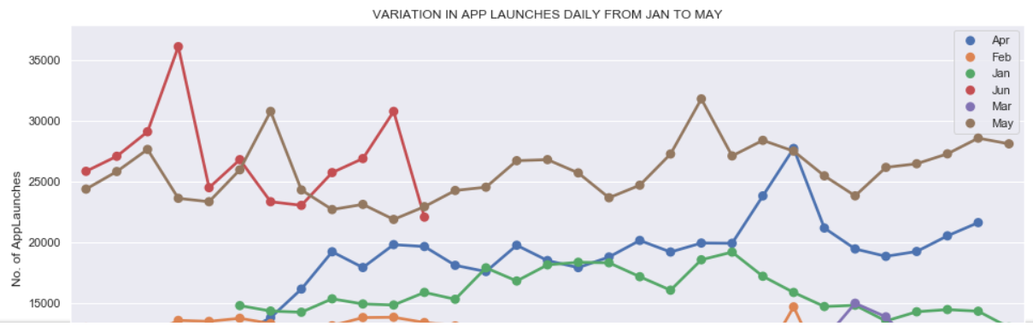
Data Exploration:
AppLaunched (Distribution Graphs)
Selecting only those country which have high counts of users launching the application
stacked line chart

Slide 8
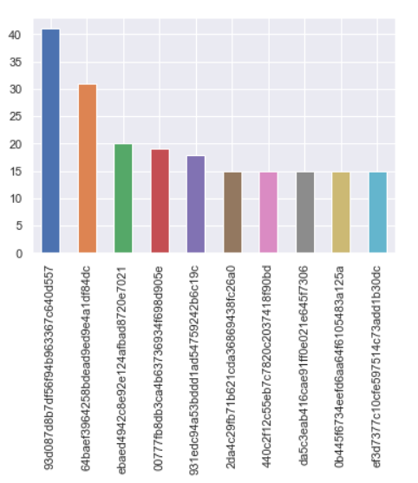
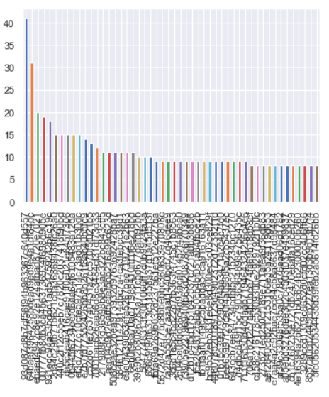
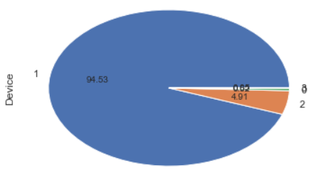
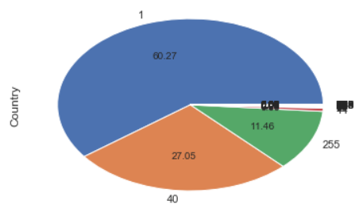
Data Exploration
AppUninstalled (Distribution Graphs)
Top 10 users

Slide 9
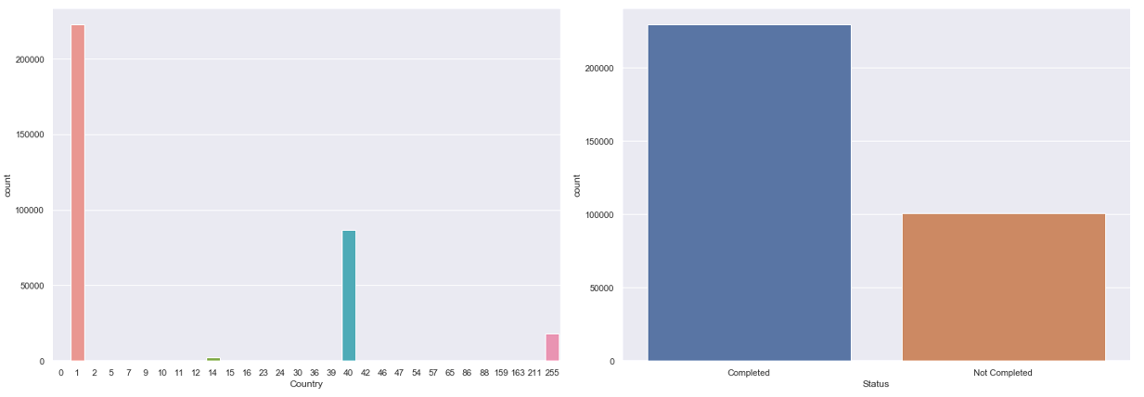
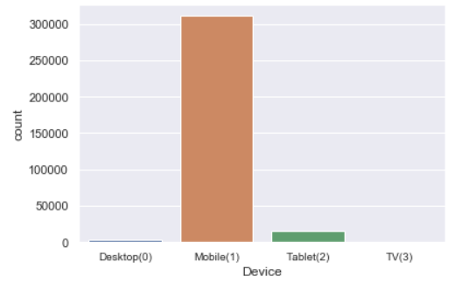
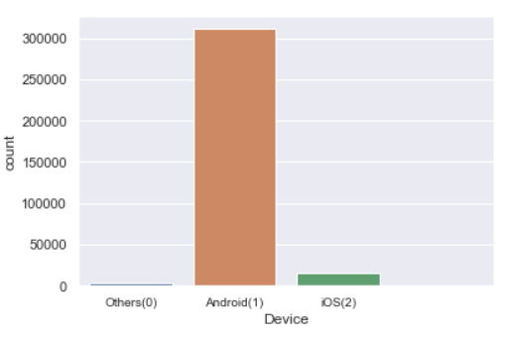
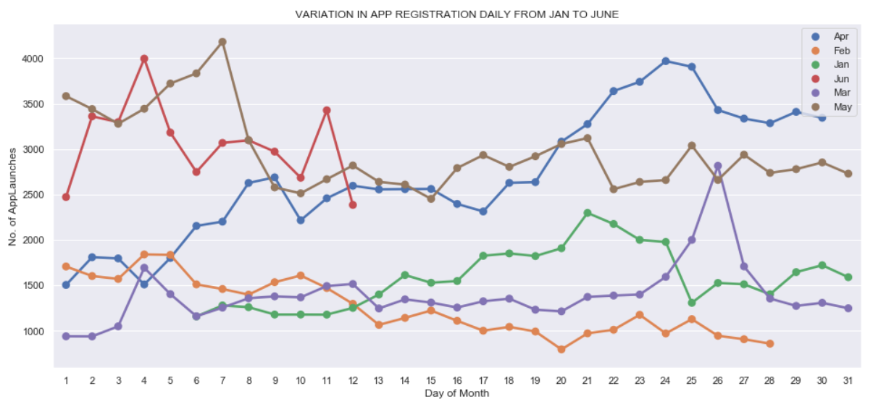
Data Exploration
Registration (Distribution Graphs)

Slide 10
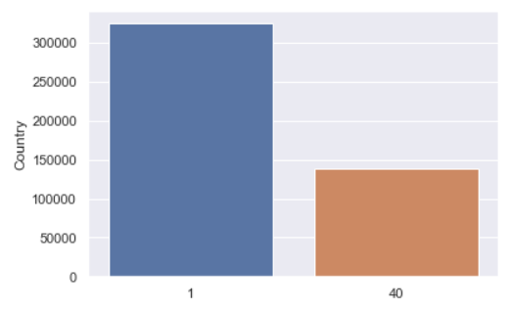
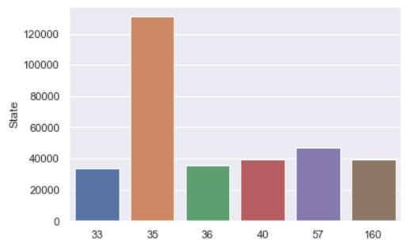
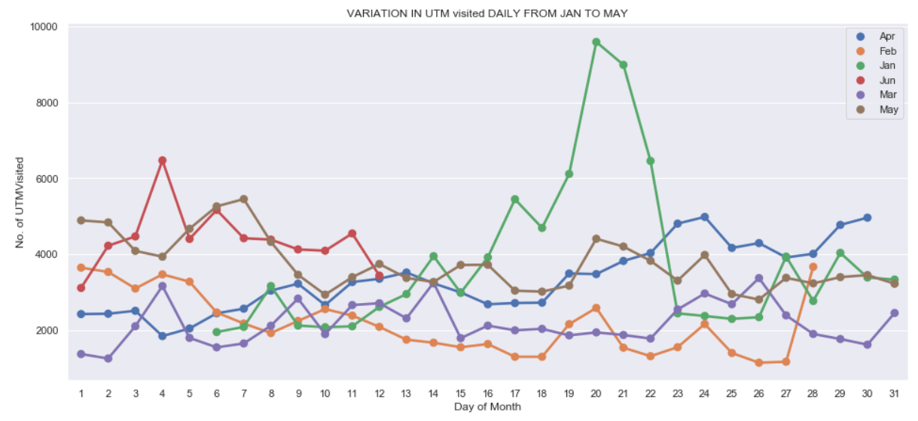
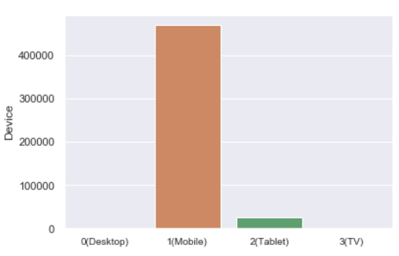
Data Exploration
UTMVisited (Distribution Graphs)

Slide 11
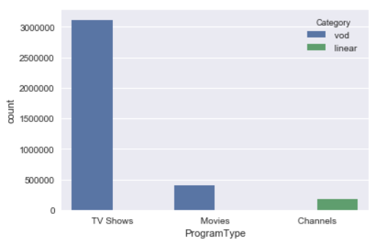
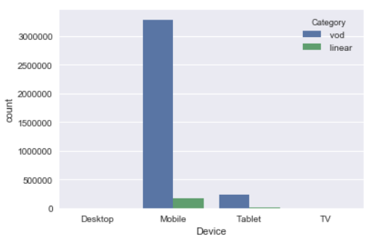
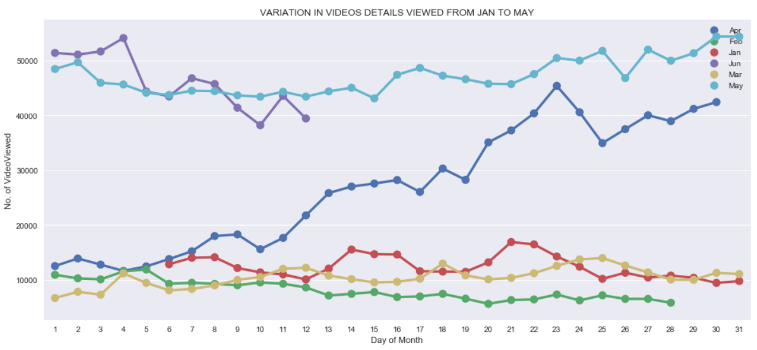
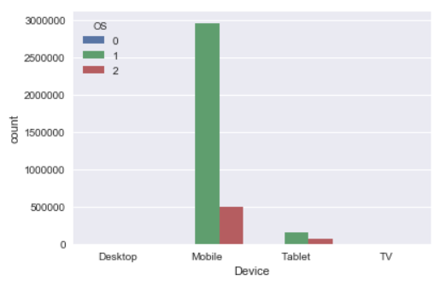
Data Exploration
VideoDetails (Distribution Graphs)

Slide 12
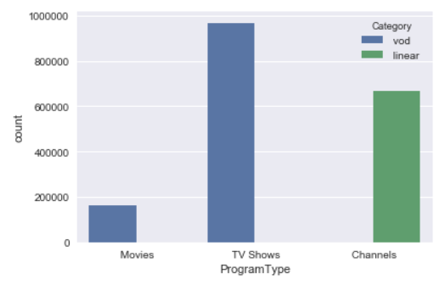
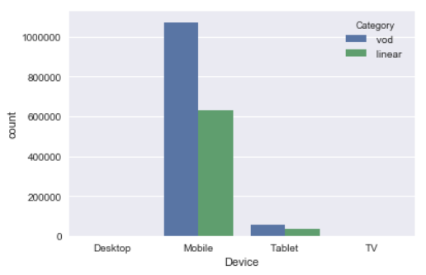
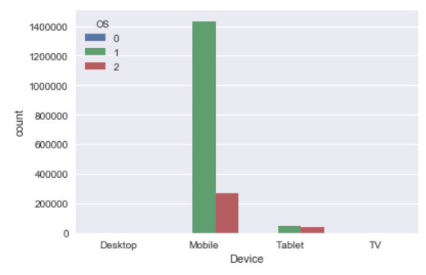
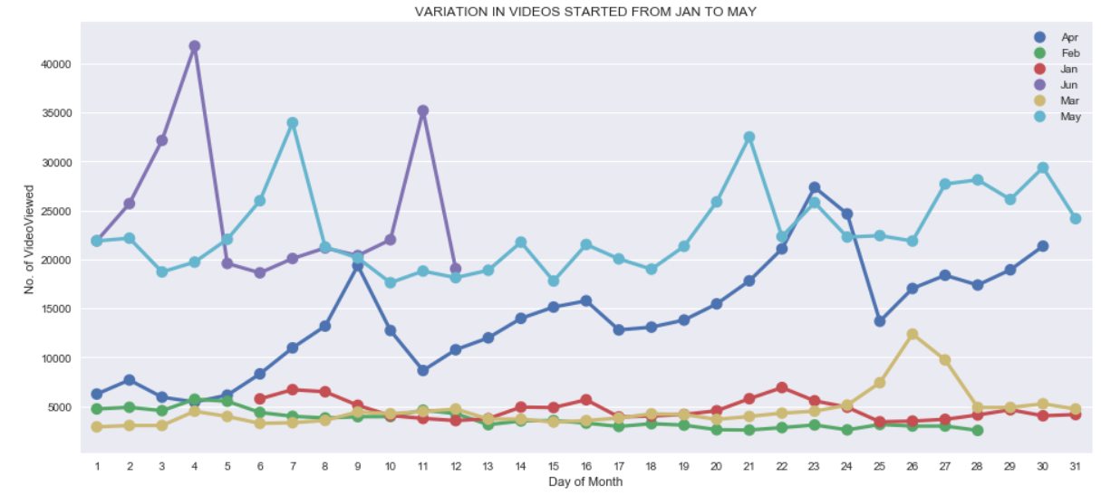
Data Exploration
VideoStarted (Distribution Graphs)

Slide 13
Simple Machine Learning Model:
1. Logistic regression
2. Linear SVC
3. Gaussian Naive Bayes
4. Decision Tree
5. KNN Classifier
Step1. Datasets used (provided by CleverTap & Greyatom)
Step 2. High level data pipeline
Steps performed in data Cleaning & pre processing
Feature engineering and Feature selection(PCA , t-SNE, etc)
Step 3. Changing Time Stamp to Epoch values
Step 4. Tuning the model & observe Evaluation Metrics
High Level Approaches: Recency-Frequency
Approach To Segment Users(RFM Model)
Step 1. Define a column “epoch” as Timestamp (One Epoch is when an ENTIRE dataset is passed forward or backward through the neural network only ONCE.)
Step 2. Sort Data Frame in ascending order of epoch and Split the dataset into train & test
Step 3. For train-data, calculate frequency value & score
Step 4. For train-data, calculate Recency value & score
Step 5. Define Segments and Calculate count of users for segments
Step 6. Define threshold for calculating f1 score
Step 7. Get Classification Reports

Slide 14
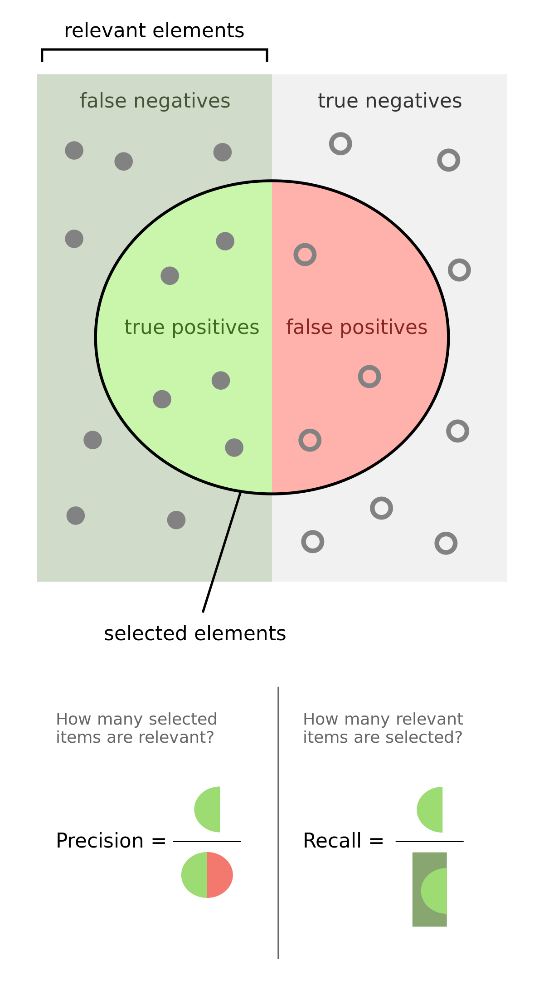
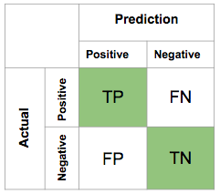
Useful Terms To Understand:
RFM analysis is one such popular customer segmentation technique that can help retailers maximize the return on their marketing investments.
Recency: Recency is the most important predictor of who is more likely to respond to an offer. Customers who have purchased recently from you are more likely to purchase again from you compared to those who did not purchase recently.
Frequency: The second most important factor is how frequently these customers purchase from you. The higher the frequency, the higher is the chances of them responding to your offers.
Monetary: The third factor is the amount of money these customers have spent on purchases. Customers who have spent higher are more likely to purchase based on the offer compared to those who have spent less.
User Based Collaborative Filtering uses that logic and recommends items by finding similar users to the target user (to whom we are trying to recommend videos). A specific application of this is the user-based Nearest Neighbor algorithm. This algorithm needs two tasks:
Find the K-nearest neighbors (KNN) to the user.
Recommend the videos that the neighbours of the target user have watched but the target user has not watched.
Evaluation Metrics:
Precision: Measures what proportion of predicted positive label is actually positive.
Recall: Measures what proportion of actual positive label is correctly predicted as positive.
F1 Score: When we are trying to get the best precision and recall at the same time? F1-Score is the solution.

Slide 15
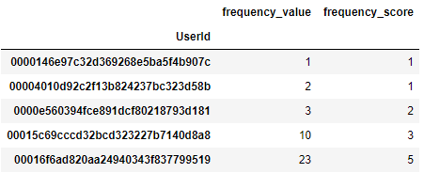
Step 3: For train-data, calculate frequency value & score
How did we do Step 3
Frequency Score | Frequency Value Range
5 | > 22
4 | 10 - 22
3 | 4 – 10
2 | 2 - 4
1 | 1 or 2

Slide 16
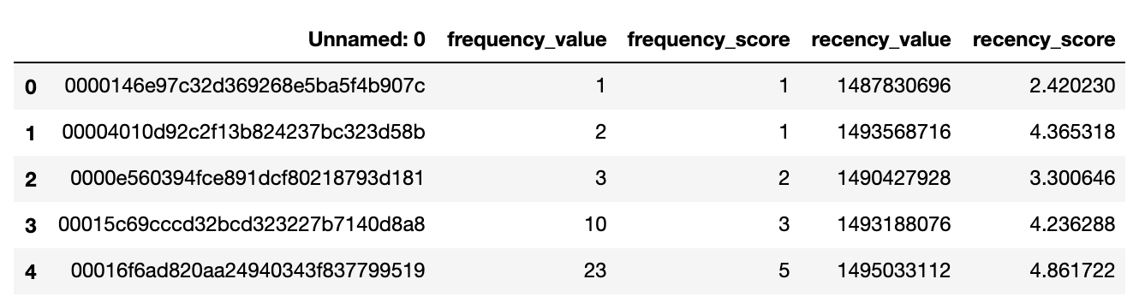
Step 4: For train-data, calculate Recency value & score
Step 5 : Define Segments
Segment | Recency Score Range | Frequency Score Range
Champions | 4-5 | 4-5
Loyal Customers | 3-4 | 4-5
Potential Loyalists | 4-5 | 2-3
Promising | 3-4 | 1-2
Can't Lose Them | 1-2 | 4-5
At Risk | 1-2 | 3-4
Hibernating | 1-2 | 1-2
New Customers | 4-5 | 1-2

Slide 17
Calculate count of users for segments:
Segment | Count in Training Set
At Risk | 4578
Can't Lose Them | 2593
Champions | 18892
Hibernating | 16760
Loyal Customers | 4458
New Customers | 20775
Potential Loyalists | 22843
Promising | 18358
Step 6: Define threshold for calculating f1 score
Category | Score Range
Recency Score | >= 3.89
Frequency Score | >= 4

Slide 18
Step 7: Final Outcome / Get Classification Reports:
Metric | Value
Precision | 0.74
Recall | 0.90
F1-score | 0.81
Recency-Frequency Analysis:
Possible Improvements:
Video’s Genre-wise Frequency calculation.
Defining thresholds using Learning Algorithms.

Slide 19
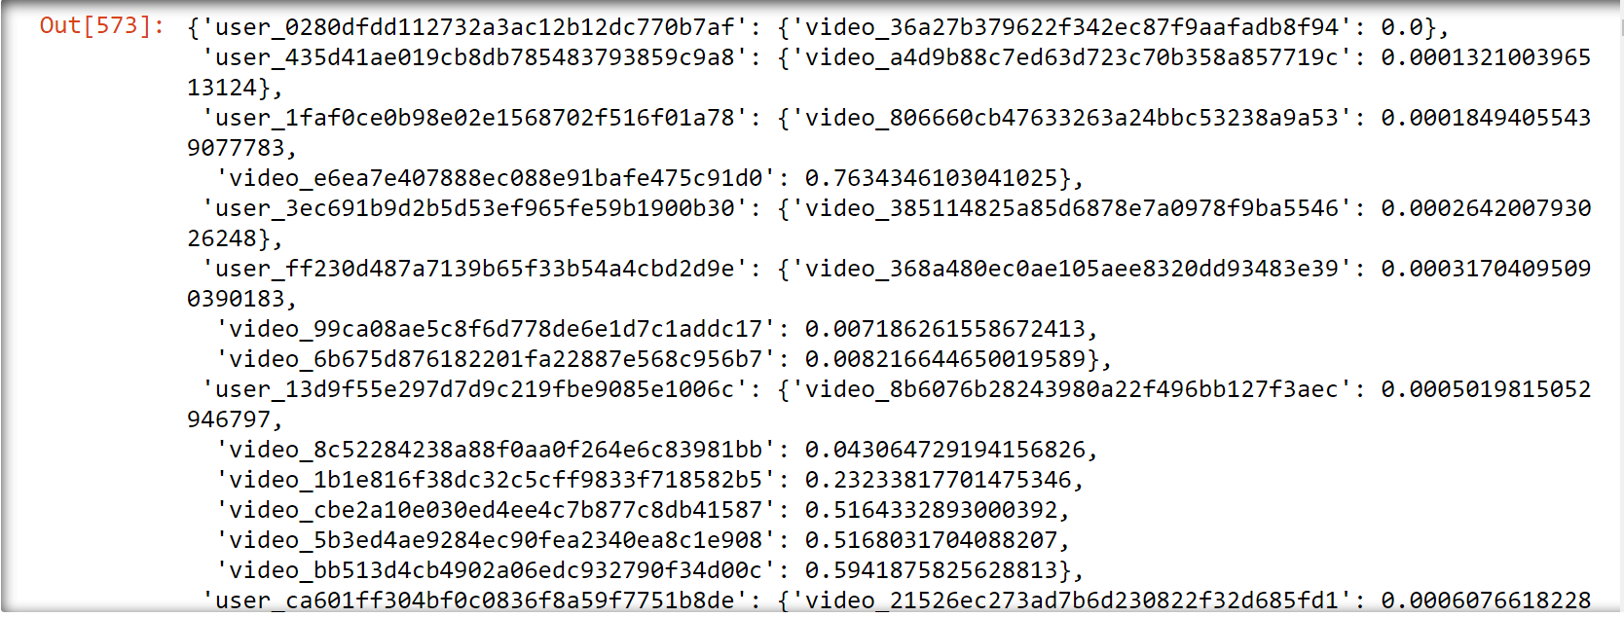
Recommendation Engine
Data Manipulation :
Created a Timestamp for the time a video was watched.
Converted it to epoch time.
Created a dictionary of unique users and the videos they have watched along with the epoch time when they watched the video.

Slide 20
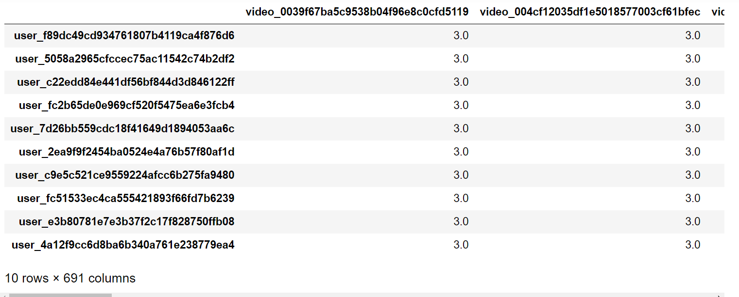
Recommendation Engine
Vectorize the Data
If a user has watched a video we use the scaled value of epoch time as the value, else if a user has not watched a video assign a integer greater than 2. (we have used 3)

Slide 21
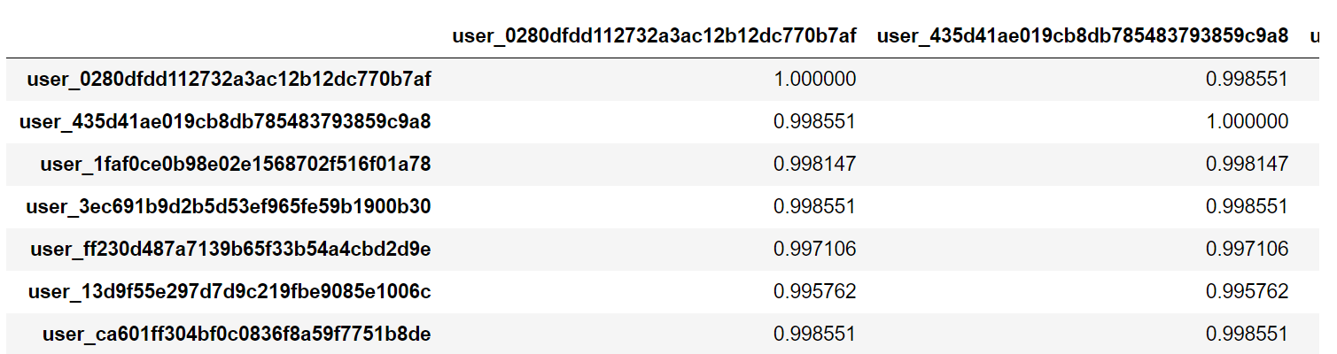
Recommendation Engine
User Based Collaborative Filtering
Finding the similarity between users using cosine similarity.

Slide 22
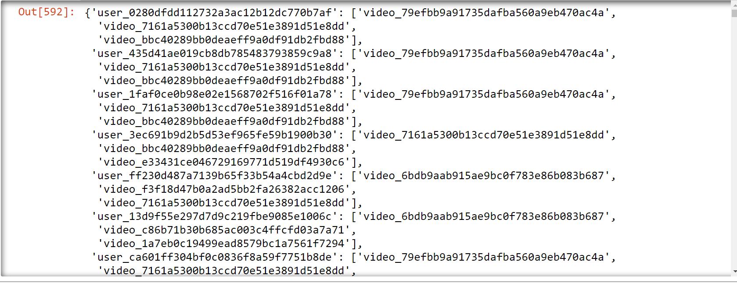
Recommendation Engine
Find the top 10 nearest neighbors and recommend 3 videos that the target user has not watched but the neighbors have watched in the given time frame.

Slide 23
Recommendation Engine
Possible Improvements:
Use item based collaborative filtering for faster predictions.
Use the RF- score calculated earlier to rank the recommendations according to the users they are coming from.
Value delivered to business/ CEO PITCH:
Digital marketers today constantly strive to understand their users better. To send highly contextual and relevant communication to your users means having a good segmentation strategy. Without segmentation, you are hitting your entire user base with a one-size-fits-all campaign that will fail due to irrelevance. so
First know who you’re selling to. This is by far the most important building block of a financial model.
Do some push Notifications, SMS, emails etc before a live-stream videos or new TV Shows launches etc
Identify Top most watched user and recommend others who are connected with them
Segment the Customers properly.

Slide 24
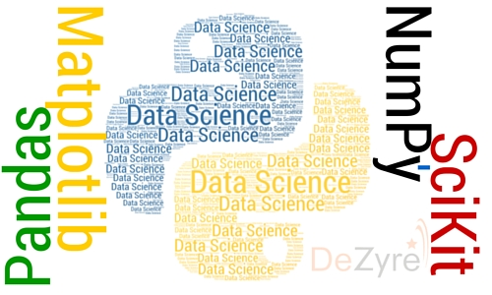
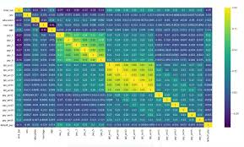
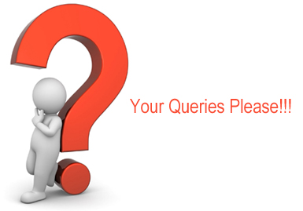
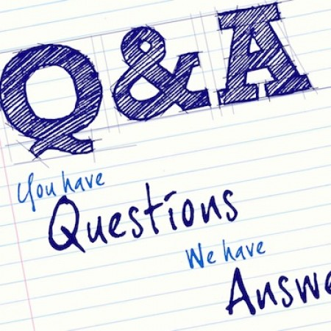
DS & ML – Capstone Project

Slide 25


Capstone Project : By SAJIB HALDER (09/11/2019)

