Slide 1
Printing floats with specific precision
float a = 3.1415987666;
printf(“%f”, a); 3.141599 Default precision = 6
printf(“%.1f”, a); 3.1
printf(“%.2f”, a); 3.14

Slide 2
Compound Assignment Operator
a = a + b;
a += b;
Compound Assignment operator

Slide 3
Compound Assignment Operator
a = b + c;
a = b + c;

Slide 4
Compound Assignment Operator
a = a – b; a -= b;
a = a * b; a *= b;
a = a / b; a /= b;
a = a % b; a %= b;

Slide 5
Increment Operator
a++; ++a;
post-increment pre-increment (post-fix) (pre-fix)

Slide 6
Decrement Operator
a--; --a;
post-decrement pre-decrement (post-fix) (pre-fix)

Slide 7
Type Casting
Converting an expression of a given data type into another data type

Slide 8
Type Casting: Implicit
int i = 3;
float p;
p = i;
printf(“%f”, p);
Output = 3.000000

Slide 9
Type Casting: Explicit
(data type) expression
int i = 3, j = 5;
float p;
p = (float) j / i;
printf(“%f”, p);
Output = 1.6667

Slide 10
Logical Expression
Produces 0(false) /1(true)

Slide 11
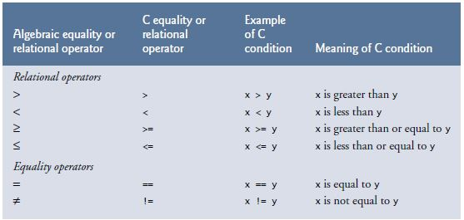
Relational Operators

Slide 12
Logical Operator
Operator | Name
! | Logical not
&& | Logical and
|| | Logical or

Slide 13
Logical Operator
p | !p
0 | 1
1(Non zero) | 0
Truth table of logical not
p | q | P && q
0 | 0 | 0
0 | 1(Non zero) | 0
1(Non zero) | 0 | 0
1(Non zero) | 1(Non zero) | 1
Truth table of logical and

Slide 14
Logical Operator
p | q | P || q
0 | 0 | 0
0 | 1(Non zero) | 1
1(Non zero) | 0 | 1
1(Non zero) | 1(Non zero) | 1
Truth table of logical or

Slide 15
Swap: 2 Variables
10
20
a
b

Slide 16
Swap: 2 Variables
10
20
c
a
b

Slide 17
Swap: 2 Variables
10
10
20
c
1
a
b
c = a;

Slide 18
Swap: 2 Variables
10
20
20
2
c
a
b
a = b;

Slide 19
Swap: 2 Variables
3
10
20
10
c
a
b
b = c;

Slide 20
Swap: Left Cyclic Shift
3
1
2
c
a
b

Slide 21
Swap: 2 Variables
10
20
a
b
c

Slide 22
Swap: Right Cyclic Shift
3
a
2
b
1
c

Slide 23
Statements: Review
Return Statements:
return 0
Expression Statements:
b = 3;
a = a + b;
b++ ;
b > 0;
b > 0 && b < 10;

Slide 24
Selection Statements

Slide 25
If statements
if(Expression){
statements
}

Slide 26
If statements: Good Practice
if(Logical Expression){
statements
}

Slide 27
If else statements
if(Expression){
statements
}
else{
statements
}

