Slide 1
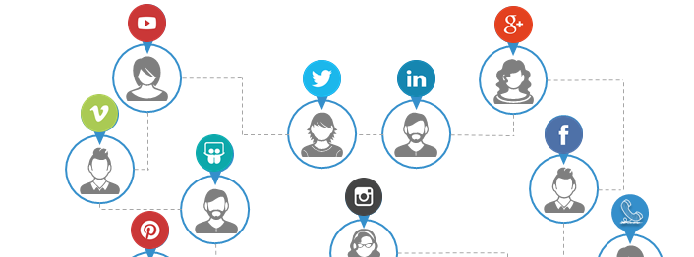
THE CASE
BlueTelco is a Telco- Digital Company operating in Bangladesh. In the past 2 years, it has released 3 new apps in the sports, entertainment and information categories.
For BlueTelco , monetization of apps is a major challenge. In spite of making large investments, due to nature of lack of spending from users in the Asia-Pacific Continent, it is becoming difficult for BlueTelco to generate a healthy ROI to remain as a sustainable business.
In face of this challenge, how can BlueTelco remain profitable in the market?

Slide 2
Imagine that you are pitching to be appointed as a Business Development Consultant for BlueTelco. You are required to follow the next steps to be shortlisted for an Interview.
Instructions :
To qualify to the second round of assessments, you need to send your proposal presentation within 7 PM September 21, 2018 . Below are the guidelines for your proposal submission and design. Failure to follow the guidelines will result in automatic disqualification.
Share your Proposal in the next slide. Your solution should be within the 1 slide template. DO NOT modify the slides or add new ones. Font must be Arial and no less than size 9.
Name the PowerPoint with your ‘Name_University Name’ e.g : Abdullah al Mahmood_DU
Make sure your mail size does not exceed 1 MB.
Wait for the results to be published on end of September . Best of Luck !
Incomplete submissions will be automatically rejected

Slide 3
What is the problem of BlueTelco that you are trying to solve? Mention in 1 sentence.
What do you propose a your BIG IDEA to solve the above problem?
There are 100s of applications of qualified potential applicants . Tell us why we should choose you.
What are the 3 biggest drivers of in-app revenue globally?
1.
2.
3.
4.
5.

